Slide 1
NLAP
Products Brochure 2025
https://aecenar.com/index.php/companies/nlap
Waste Management & Energy
Tripoli/Lebanon
Marketing & Project Management
Waste Management (Separation, Recycling), Environmental Friendly Waste Incineration and Electricity Generation, Organic Waste Handling with Anaerobic Digestion & Biogas Production
NLAP-WEDC (Waste to Energy Demonstration Cycle)
R&D, System Testing
Address
Harba Building, next to Hospital Albert Haykal, Ras Masqa, (1 km from Tripoli), Lebanon
Contact
Dr. Eng. Samir Mourad, CEO Mobile +49 178 72 855 78 (WhatsApp) / +961 76 341 526 Email: samir.mourad@temo-group.com

Slide 2
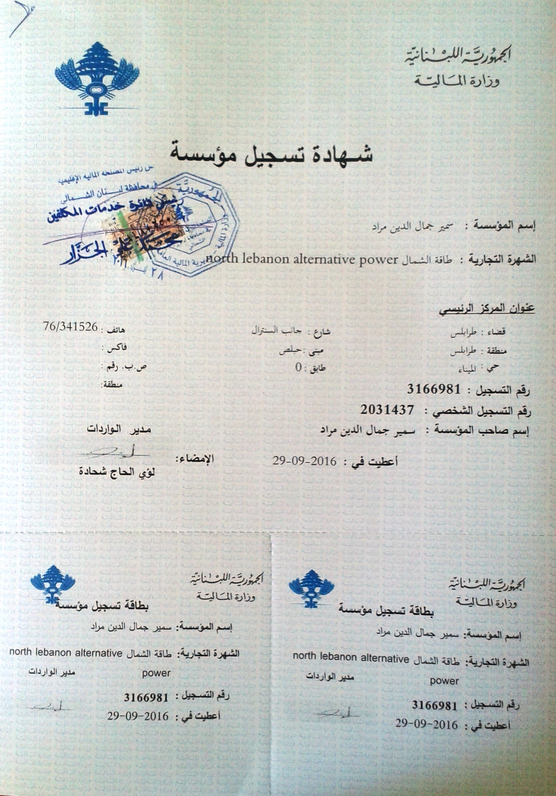
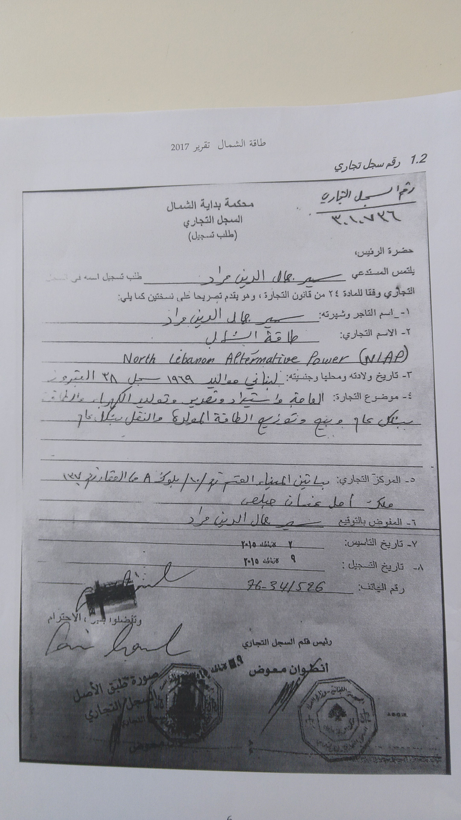
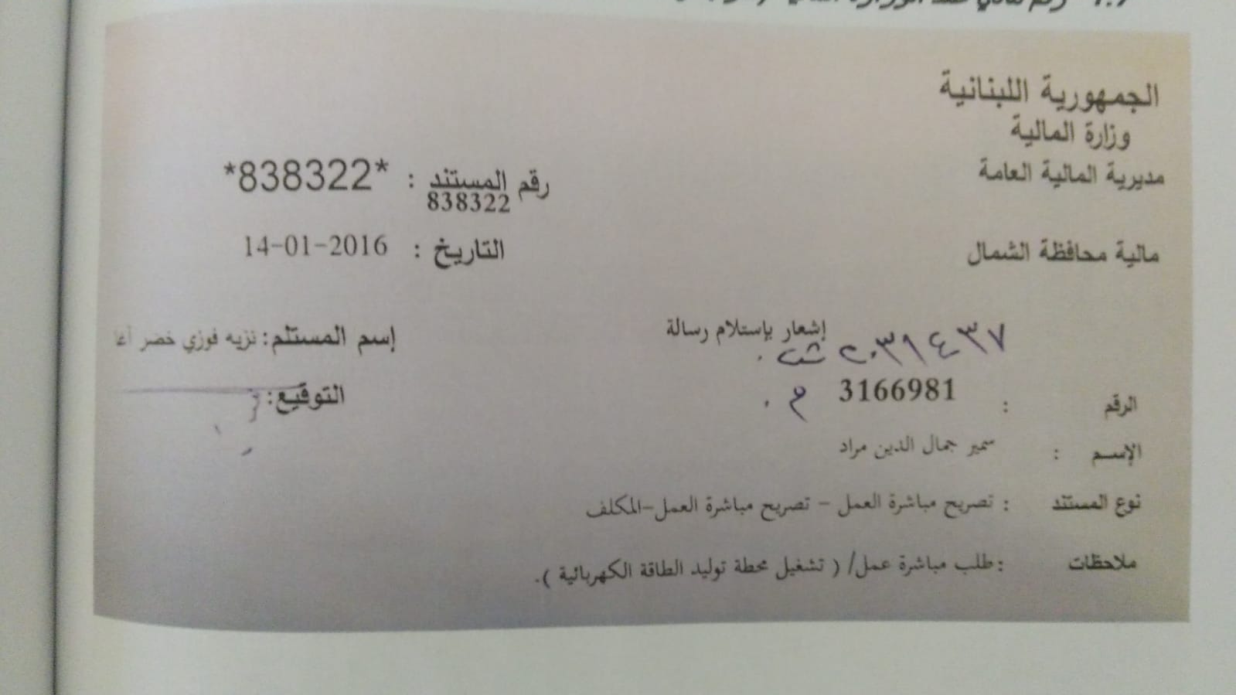
NLAP Official Papers
Registered in Tripoli/Lebanon
Tax Number 3166981

Slide 3
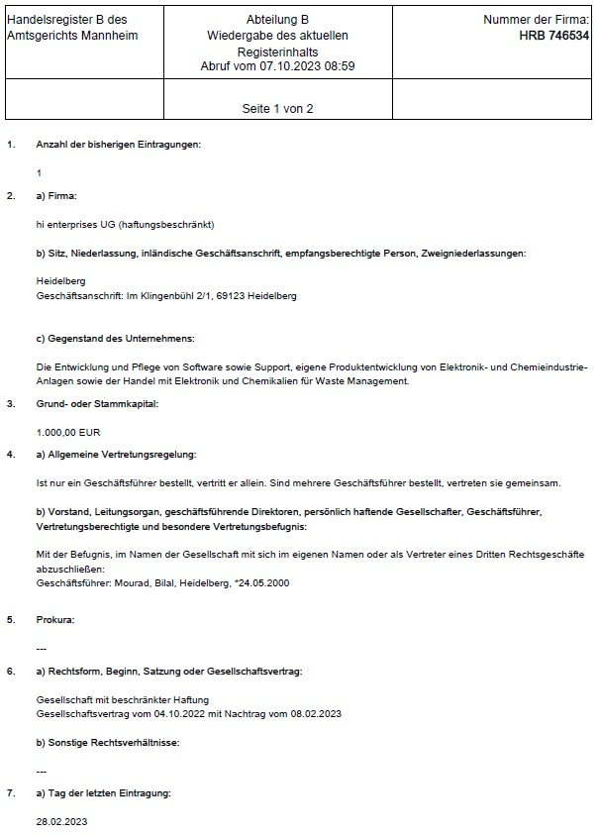
hi enterprises Official Papers
Registered in Mannheim/Germany

Slide 4
3 parts integrated waste solution for 100,000 citizens
Municipal Waste Separation, Recycling
Installation Cost | Land Use | Operation Cost | Return of Invest (ROI) | Municipal waste handling
200,000 $ | 20m x 50m = 1,000 qm | 6 workers 1 Technicians/ Engineers 10,000$/month | 20$x25tons/dayx360days=180,000$/year | 100 t/d 100,000 citizens
Anaerobic Digestion of Organic Waste
Installation Cost | Land Use | Oper-ation Cost | Return of Invest (ROI) | Organic waste handling
Civil Eng. 15,000$ Digester 1x25,000$ = 40,000$ | 60mx55m = 3300qm | 6 workers 2 Techn./ Eng 10,000$/month | Dunger سماد (0,1$/kg), 80% of organic waste is water : -> 0,25 Mio.$/y; + Biogas 25 kg/day -> 9,000 $ / year | 100t/d (50% of 200 t/d)
Refused Waste Incinerator (without el. Power Generation)
Installation Cost | Land Use | Operation Cost | Return of Invest (ROI) | Refused waste handling
25t/d 400,000$ | 25m x 20m = 500 qm | 3 shifts x (2 workers + 1 Technician/Eng) 10,000$/month |  | 25/d (25% of 100 t/d)
Total
Installation Cost | Land Use | Operation Cost (incl. Maintenantece) | Return of Invest (ROI) – Operation Cost | Municipal waste handling
640,000 $ | 5000 qm | 12x30,000$ /year=360,000$/year | 439,000$/year (amortized in 1,8 years) | 100t/d

Slide 5
3 parts integrated waste solution for 200,000 citizens
Municipal Waste Separation, Recycling
Installation Cost | Land Use | Operation Cost | Return of Invest (ROI) | Municipal waste handling
400,000 $ | 20m x 100m = 2,000 qm | 12 workers 2 Technicians/ Engineers 20,000$/month | 40 tons / day Plastic, metals, carton (25% of 200t/d, 20$/ton) -> 250,000$/year | 200 t/d 200,000 citizens
Anaerobic Digestion of Organic Waste
Installation Cost | Land Use | Operation Cost | Return of Invest (ROI) | Organic waste handling
Civil Eng. 30,000$ Digester 1x50,000$ = 80,000$ | 120mx55m = 6600qm | 12 workers 2 Technicians/ Engineers 20,000$/month | Dunger سماد (0,1$/kg), 80% of organic waste is water : -> 0,5 Mio.$/y; Biogas 50 kg/day -> 18,000 $ / year | 100t/d (50% of 200 t/d)
Refused Waste Incinerator Power Plant
Installation Cost | Land Use | Operation Cost | Return of Invest (ROI) | Refused waste handling
50t/d, 2 MWel max.: 4 Mio$ | 25m x 20m = 500 qm | 5 workers 2 Technicians/ Engineers 10,000$/month | 40 000 kWh/day 4,000 $/day 1,2 Mio.$ / year | 50t/d (25% of 200 t/d)
Total
Installation Cost | Land Use | Operation Cost (incl. Maintenantece) | Return of Invest (ROI) – Operation Cost | Municipal waste handling
4,480,000 $ | 9,100 qm | 0,6 Mio.$ /year | 1,1 Mio.$ / year (amortization time: 4 years) | 200t/d

Slide 6
3 parts integrated solution for 1 Mio. citizens
Separation, Recycling
Installation Cost | Land Use | Operation Cost | Return of Invest (ROI) | Municipal waste handling
1,9 Mio.$ | 100m x 100m = 10,000 qm | 40 worker 3 Technicians/ Engineers 25,000$/month | 200 tons / day Plastic, metals, carton (25% of 1000t/d, 20$/ton) -> 1,5 Mio. $/year | 1000 t/d 1 Mio. citizens
Anaerobic Digestion
Installation Cost | Land Use | Operation Cost | Return of Invest (ROI) | Organic waste handling
Civil Eng. 100,000$ 5x50,000$ = 350,000$ | 120mx280m=33,600 qm |  | Biogas 250 kg/day | 500t/d (50% of 1000 t/d)
Refused Waste Incinerator Power Plant
Installation Cost | Land Use | Operation Cost | Return of Invest (ROI) | Refused waste handling
5x50t/d, 5x2 MWel 19 Mio$ | 5x25m x 20m = 2500 qm |  | 200 000 kWh/day 20,000 $/day 6 Mio.$ / year | 250t/d (25% of 1000 t/d)
Total
Installation Cost | Land Use | Operation Cost (incl. Maintenantece) | Return of Invest (ROI) – Operation Cost | Municipal waste handling
21,250,000 $ | 45,500 qm | 0,6 Mio.$ /year | 7,5 Mio.$ / year (amortization time: 4 years) | 1000t/d

Slide 7
Municipal Waste Separation, Recycling
Installation Cost | Land Use | Operation Cost | Return of Invest (ROI) | Municipal Waste Handling / Citizens
1,9 Mio.$ | 100m x 100m = 10,000 qm | 40 worker 3 Technicians/ Engineers 25,000$/month | 200 tons / day Plastic, metals, carton | 1000 t/d 1,000,000 citizens
400,000 $ | 20m x 100m = 2,000 qm | 12 workers 2 Technicians/ Engineers 20,000$/month | 40 tons / day Plastic, metals, carton (25% of 200t/d, 20$/ton) -> 250,000$/year | 200 t/d 200,000 citizens

Slide 8
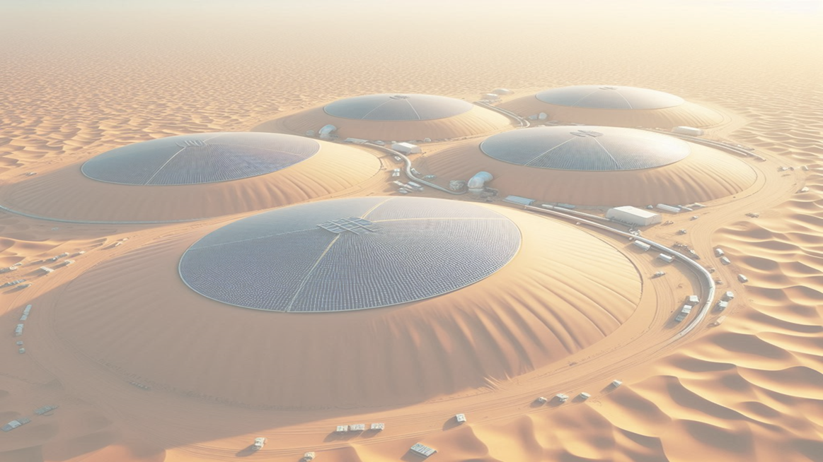
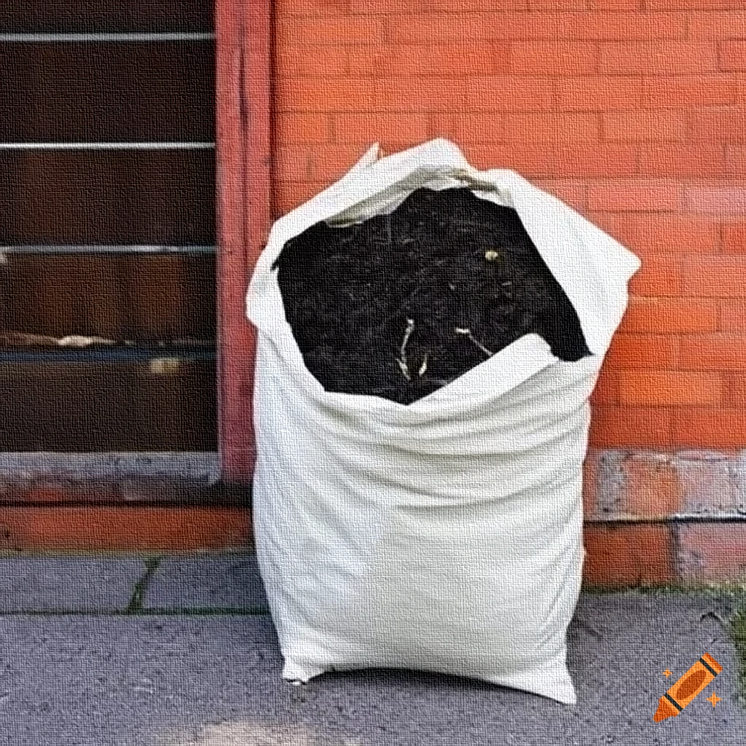
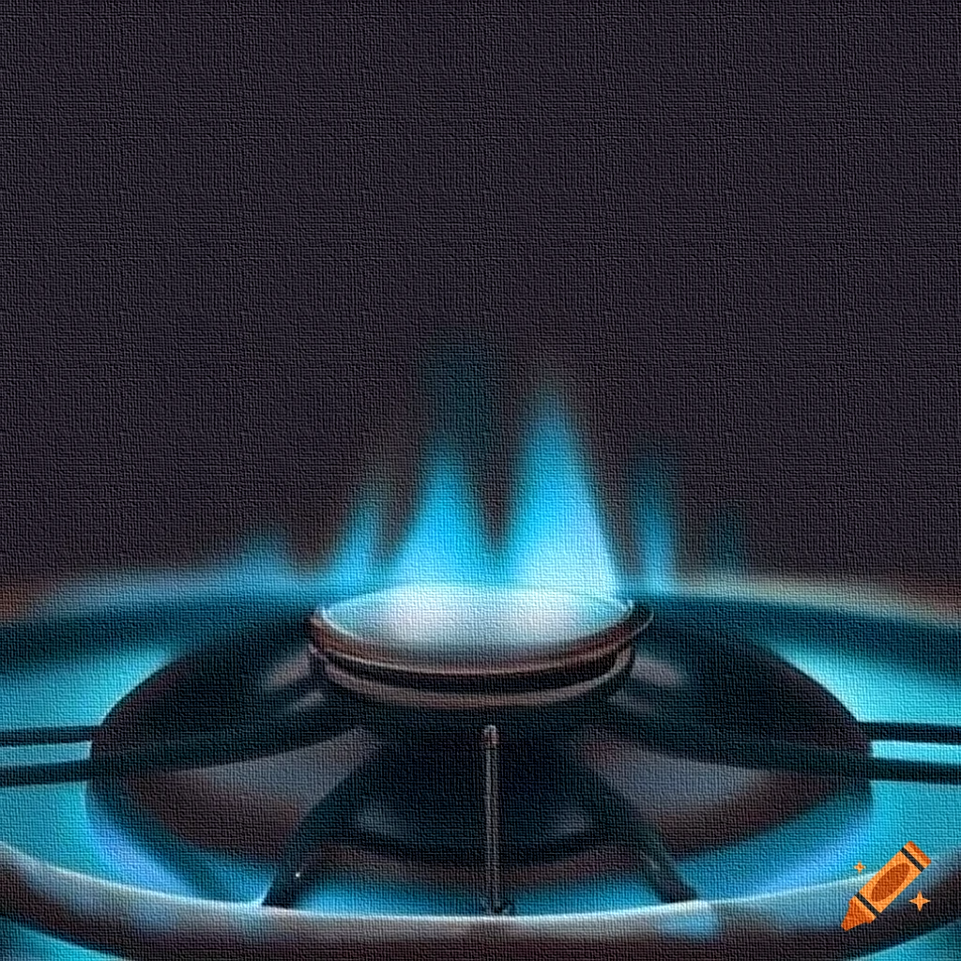
Anaerobic digestion of organic waste تمهيض بدون هواء للنفايات العضوية (بقايا الاكل)
Natural fertilizer
سماد طبيعي
Methan gas
غاز الميثان
The percentage of organic waste in municipal solid waste can vary by region and the type of waste, but a common average figure is around 40-50%.
Then how many anaerobic digesters and how much is the radius and height of each one to digest 500 tons of organic waste?

Slide 9
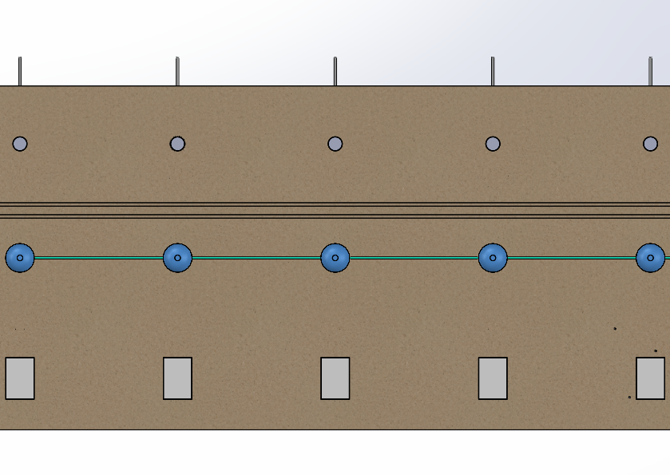
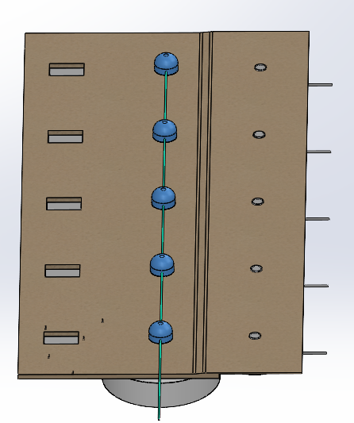
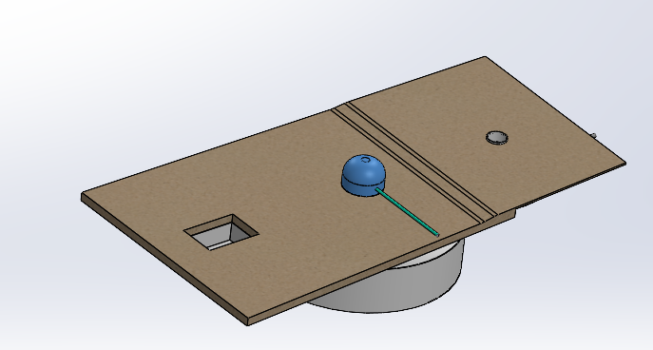
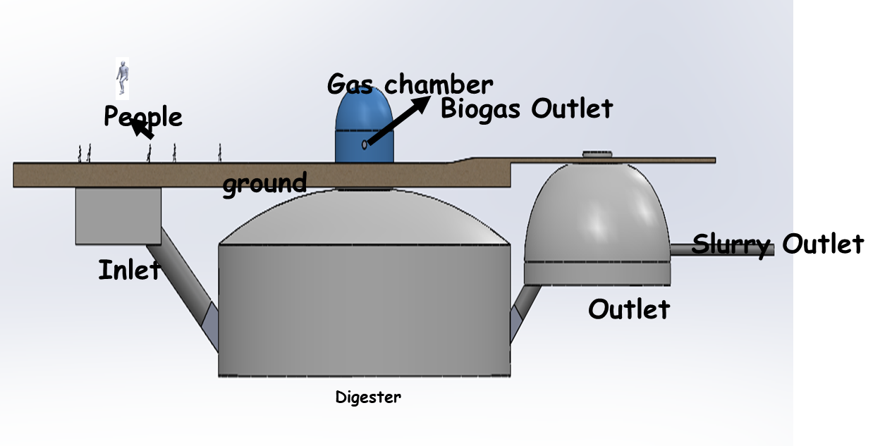
Anaerobic Digestion Plant for 500t/d
Outlet 1
Outlet 2
Outlet 3
Outlet 4
Outlet 5
To process 500 tons of organic waste per day, we would need:
5 anaerobic digesters.
Each with a diameter of 25 meters and a height of 12 meters.
A land of 120,000 x 280,000-meter square for the 5-digester system.
Biogas pipe
Biogas pipe
Biogas pipe
120,000-meter
Biogas pipe
Digester 1
Digester 2
Digester 3
Digester 4
Digester 5
Inlet 1
Inlet 2
Inlet 3
Inlet 4
Inlet 5
280,000-meter

Slide 10
Products Overview - Incinerator

Slide 11
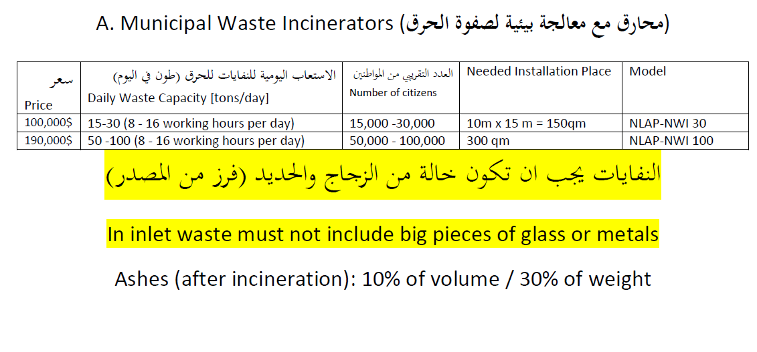
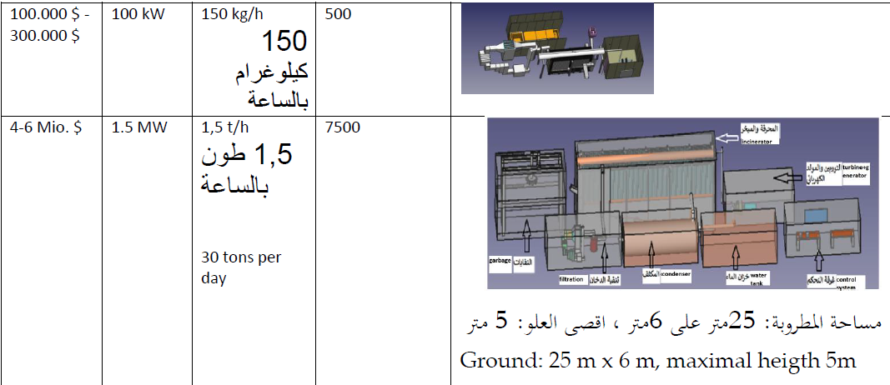
Products Overview - Incinerator

Slide 12
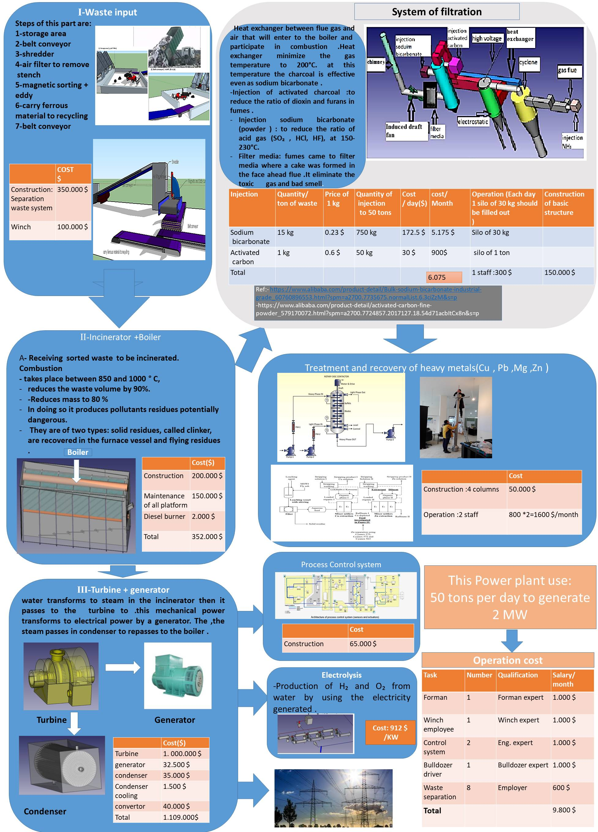
Marketing & Project Management
2 MWel from 50tons/day Municipal Waste Incineration
50t/2MWel Platform 2019

Slide 13
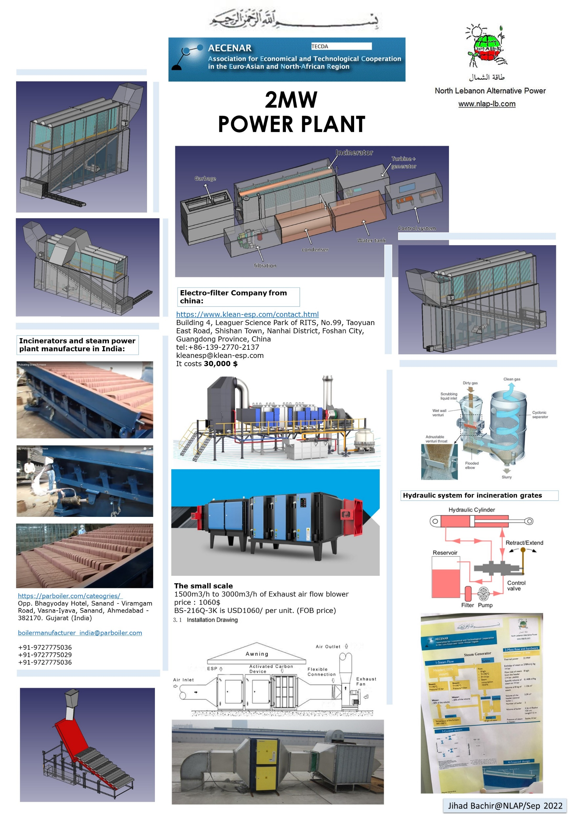
Marketing & Project Management
2 MWel from 50tons/day Municipal Waste Incineration

Slide 14
Marketing & Project Management
Organic Waste Handling with Anaerobic Digestion & Biogas Production Assoun 2023/2024

Slide 15
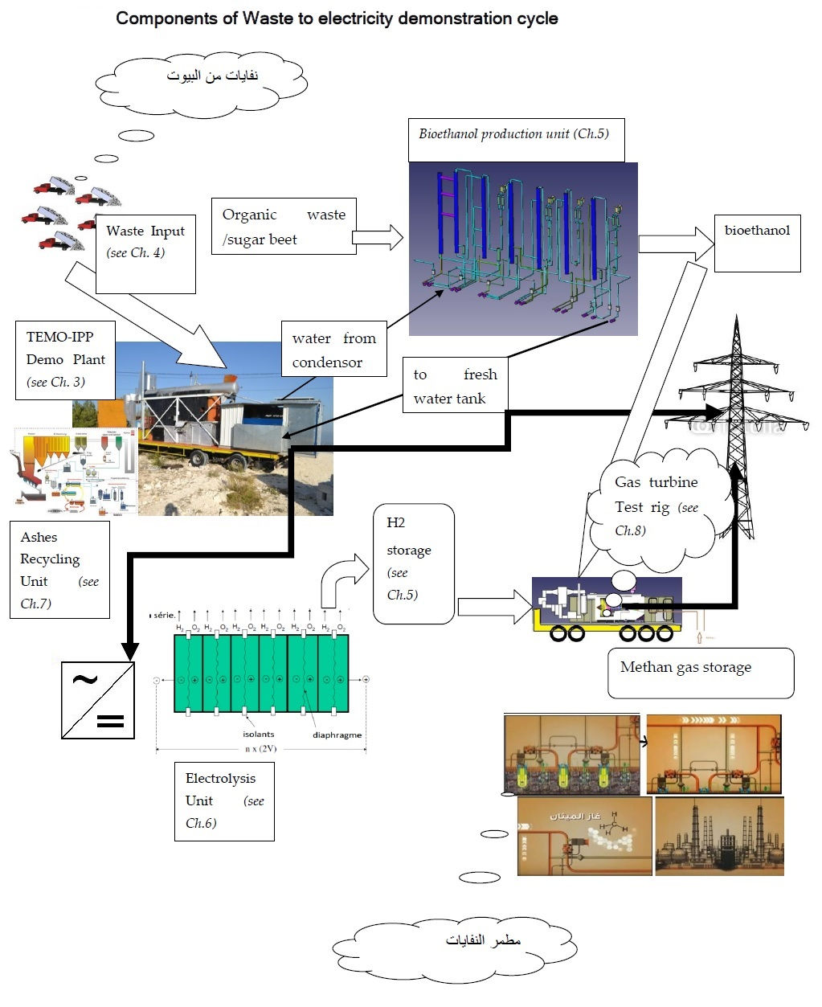
NLAP-WEDC (Waste to Energy Demonstration Cycle)

Slide 16
Marketing & Project Management
Waste Management Pilot Project in Ras Maska Nov 2023

Slide 17
NLAP-WEDC in Ras Maska 2023

Slide 18
NLAP-WEDC - Waste Separation System

Slide 19
NLAP-WEDC – Inciniration Power Plant (IPP)

Slide 20
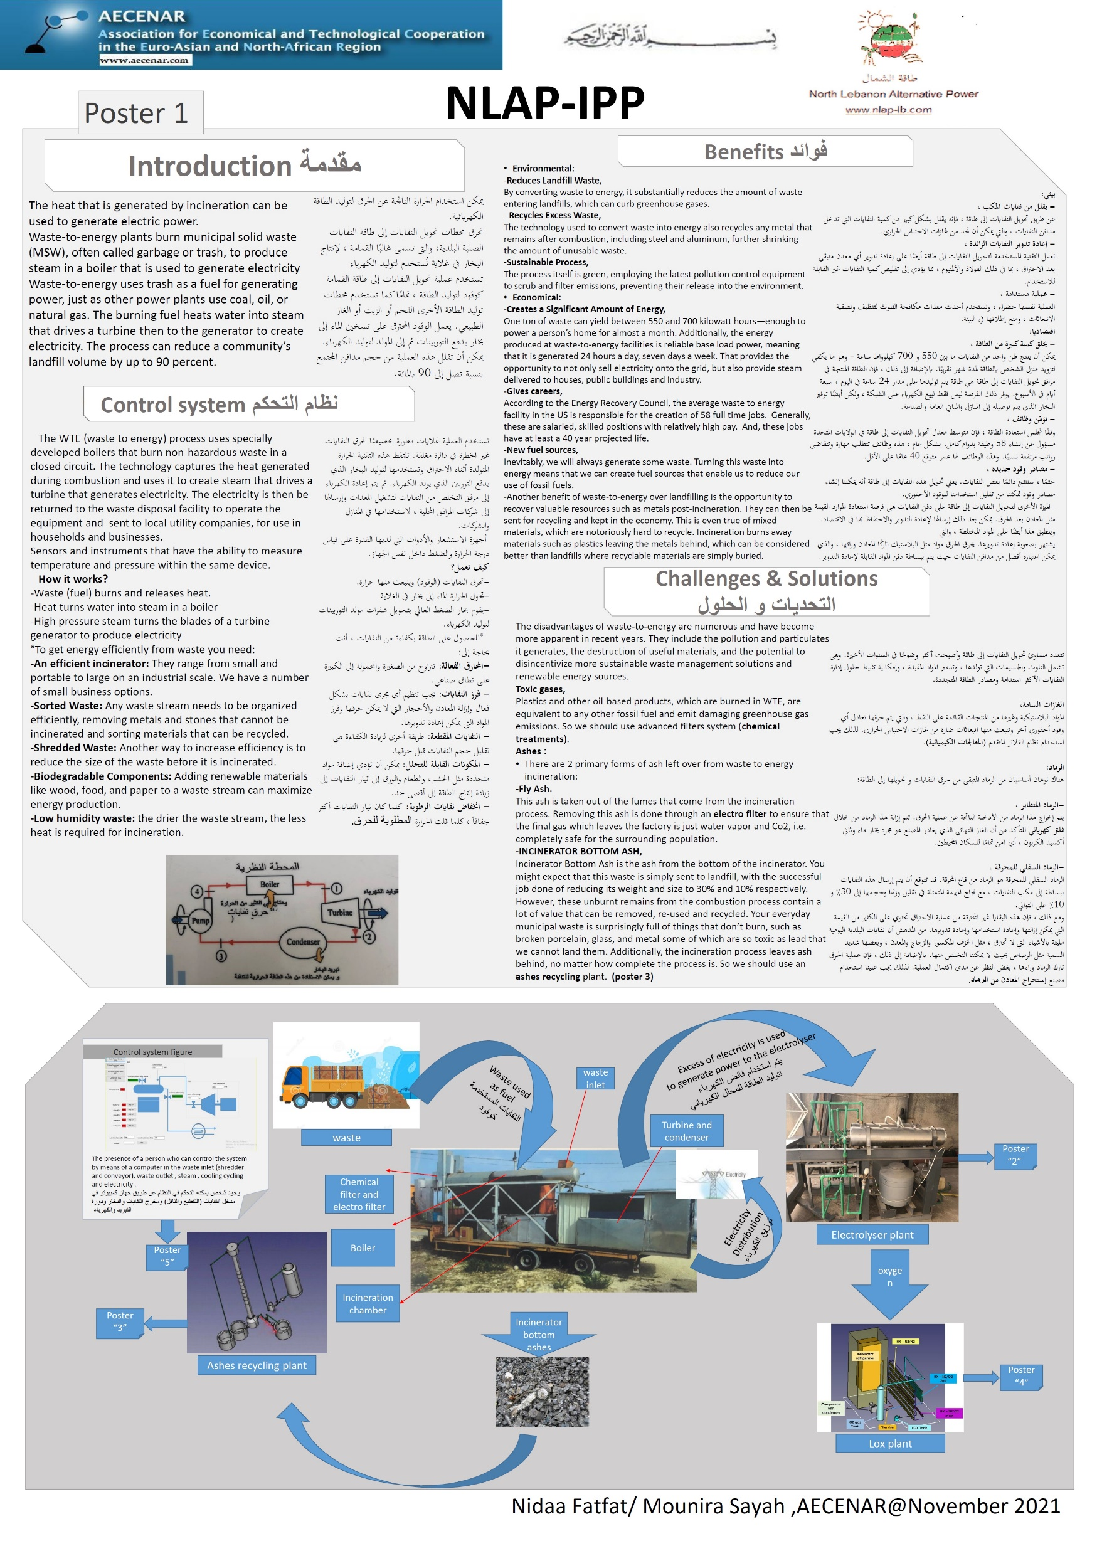
NLAP-WEDC – Inciniration Power Plant (IPP)

Slide 21
NLAP-WEDC – Inciniration Power Plant (IPP)

Slide 22
NLAP-WEDC Environment Friendly Treatment
Ashes Recycling

Slide 23
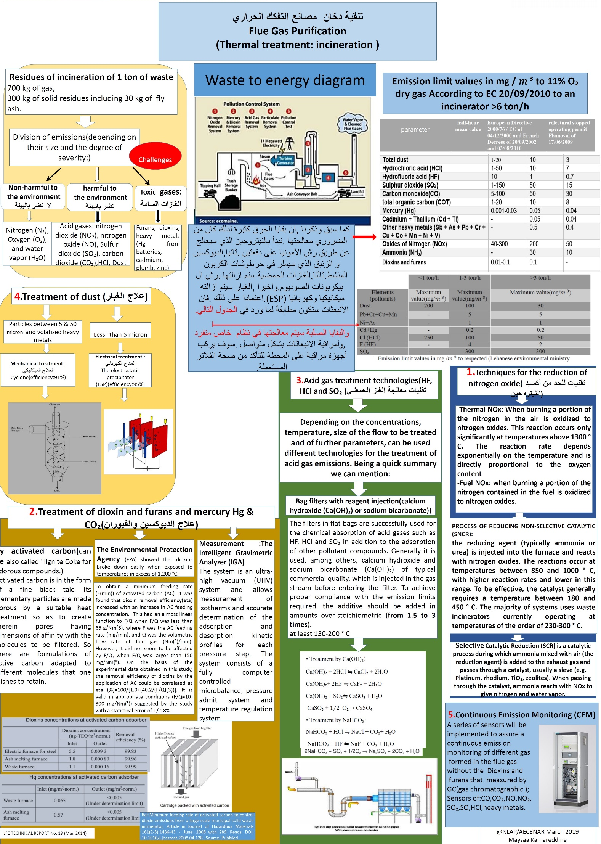
NLAP-WEDC Environment Friendly Treatment
Filter System

Slide 24
NLAP-WEDC Environment Friendly Treatment
Filter System Improvement 2023

Slide 25
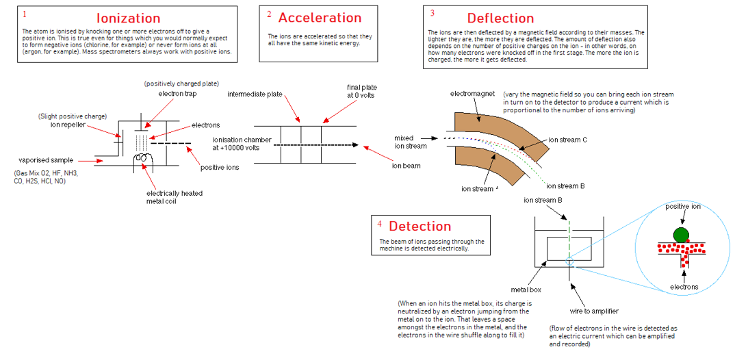
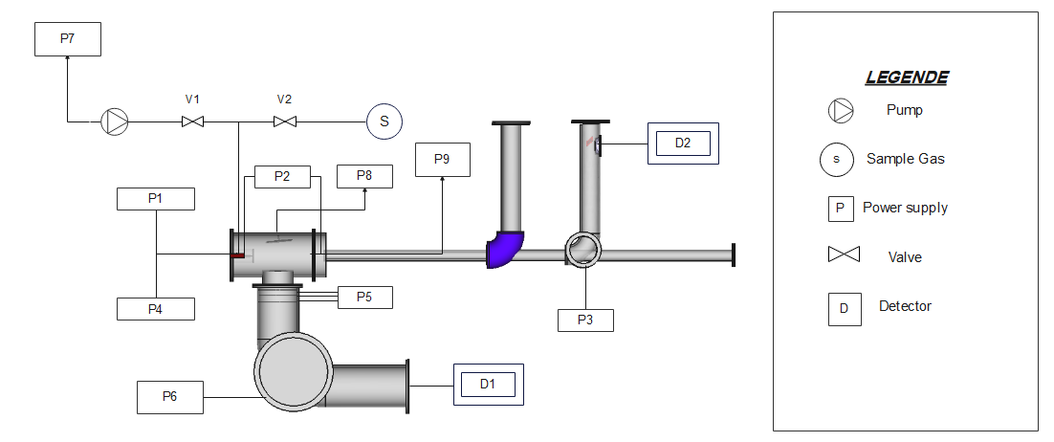
NLAP-WEDC Environment Friendly Treatment
Flue Gas Continous Measurement with Mass Spectrometry
Concept and Automation
Flue Gas Analysis with Mass Spectrometry

Slide 26
NLAP-WEDC Environment Friendly Treatment
Flue Gas Continous Measurement with Mass Spectrometry

Slide 27
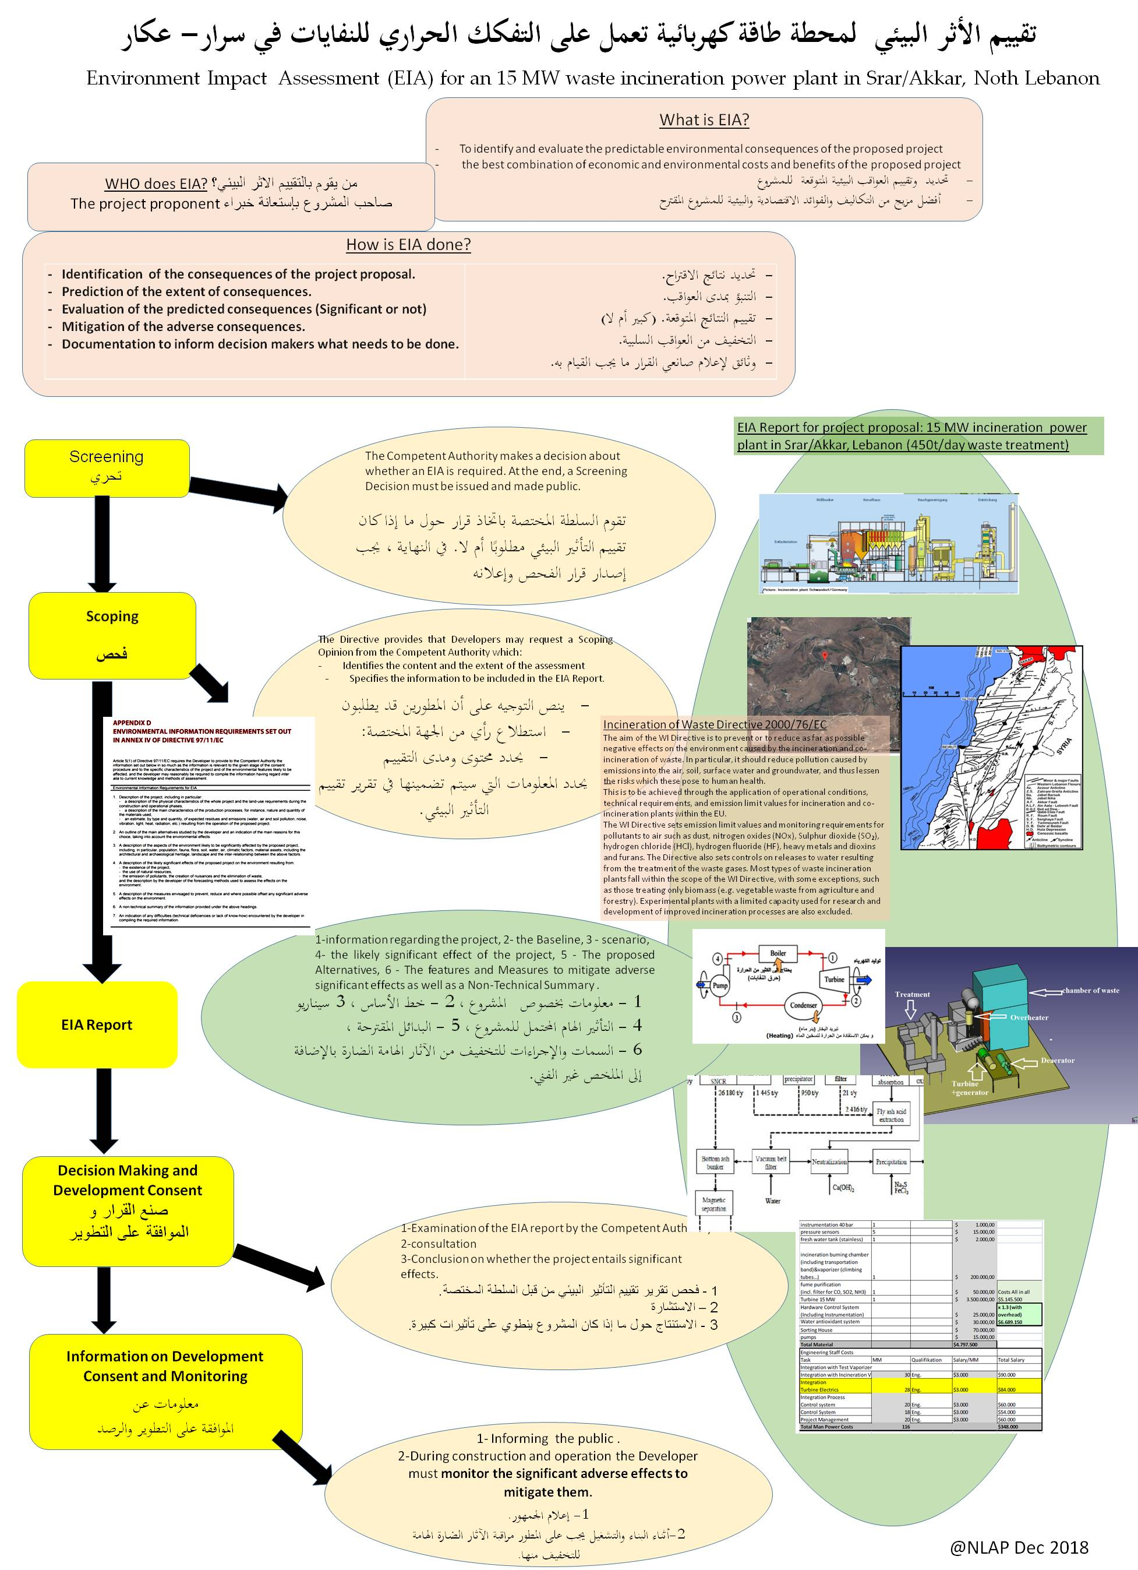
Legal matters - المسائل القانونية
Environmental Impact Assessment (تقييم اثر البيئي)

Slide 28
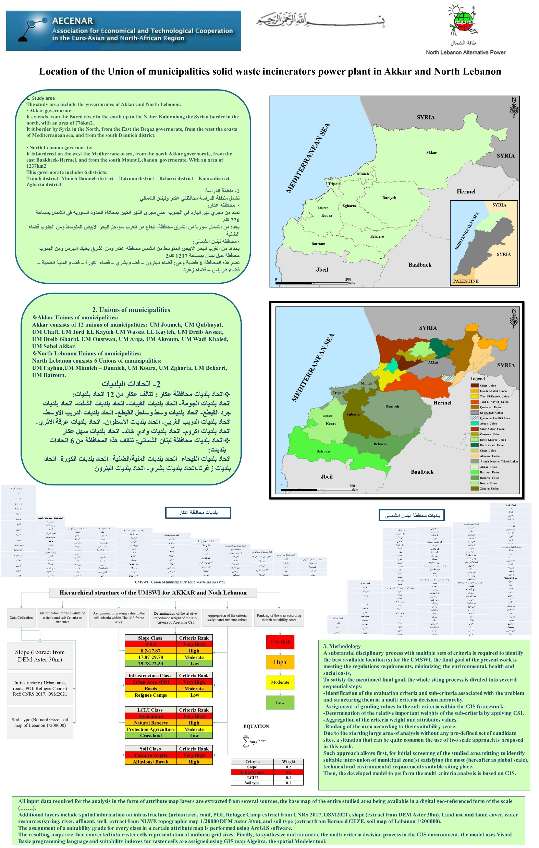
إدارة ملف انفايات في شمال لبنان

Slide 29
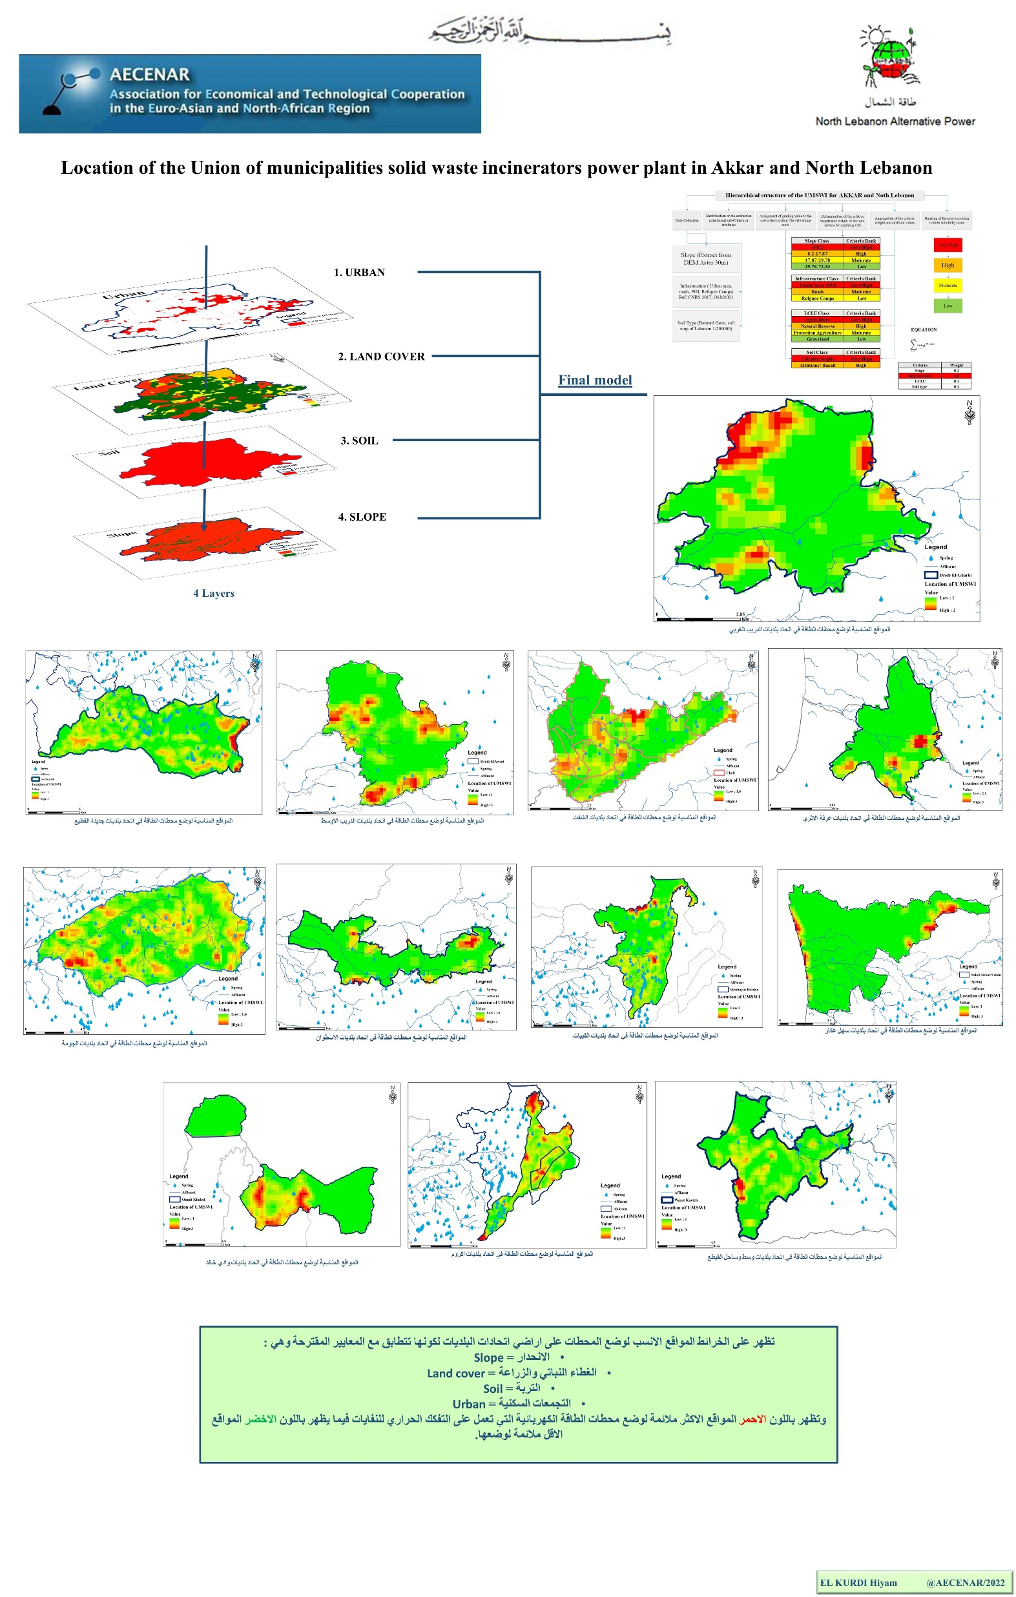
إدارة ملف انفايات في شمال لبنان

