Slide 1
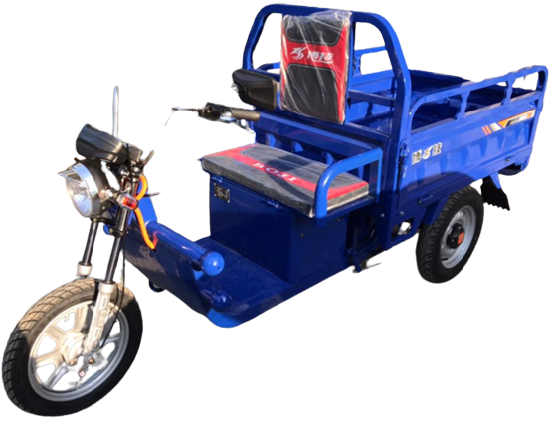
Agriculture Multi purposing
E-tuktuk
Project Plan

Slide 2
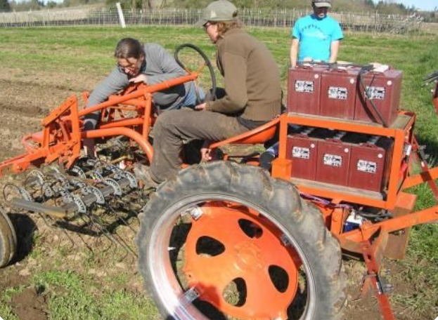
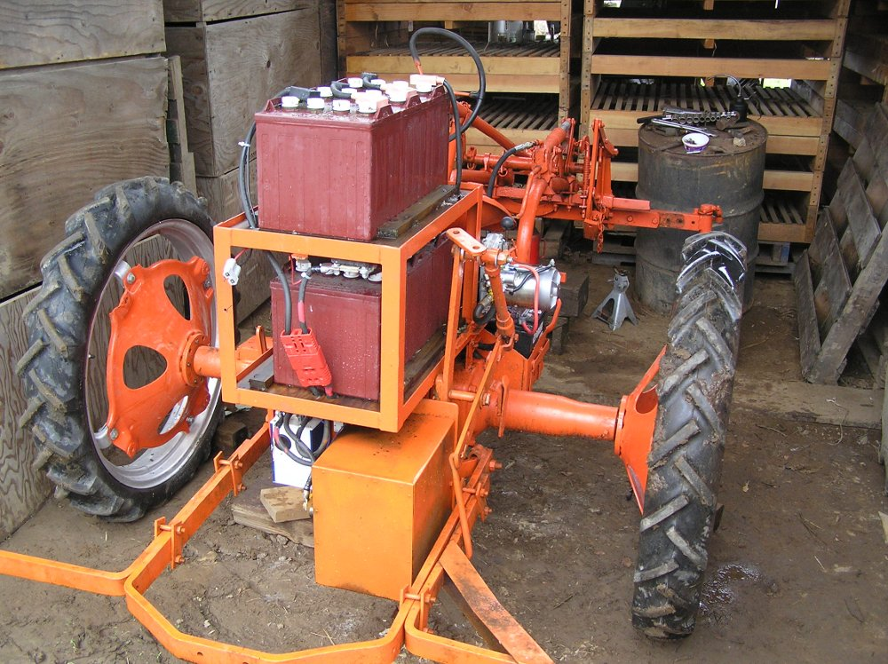
Agriculture Electric Real Size Tractors in market
Advantages:
Great tractor for cultivating
Fully functional, easy-to-maintain, quiet, no-emissions tractor
G’s electric tractor works great for cultivating and seeding
https://farmhack.org/wiki/electric-tractor-conversion

Slide 3
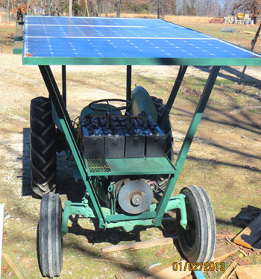
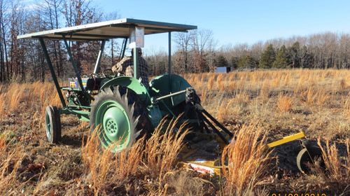
Solar-Powered Tractor
- It will run for nearly two hours with the eight batteries
- For small farm applications the solar tractor is perfect,
- Top speed is approximately 20 mph
https://www.motherearthnews.com/sustainable-living/green-transportation/our-solar-powered-tractor-zbcz1307/

Slide 4
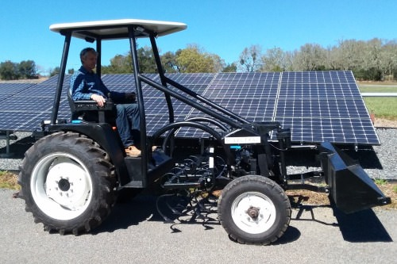
Solectrac Electric Tractors
eFarmer has a front hitch for loader or reaper
Has a mid hitch for bed preparation and cultivation with total visibility
Has a rear hitch and 540rpm PTO for any Category
18" of ground clearance to allow cultivation without damaging crops.
The front and rear wheel tract is adjustable from 40" to 72" to work on the different width planting beds
https://solarimpulse.com/solutions-explorer/solectrac-electric-tractors

Slide 5
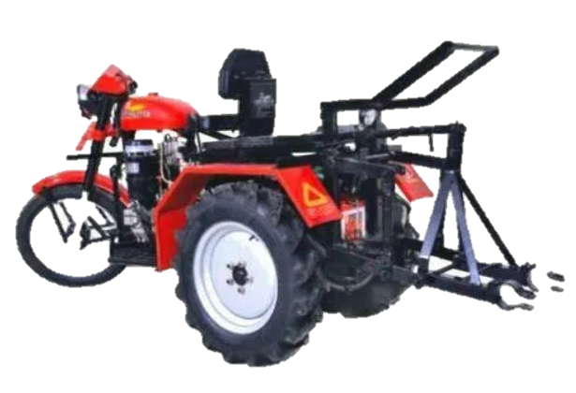
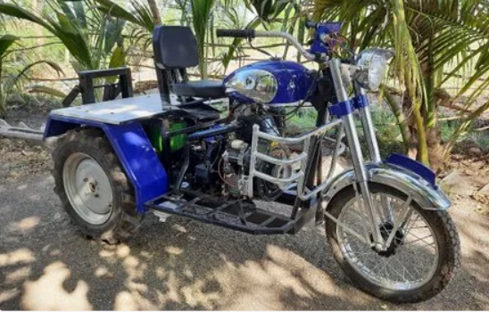
Mini agriculture TukTuk products
Low cost mini tractor based on a 2 wheels motorcycle
Small size for small gardens
low fuel consumtion
https://www.indiamart.com/proddetail/shakti-three-wheels-mini-tractor-16757725962.html

Slide 6
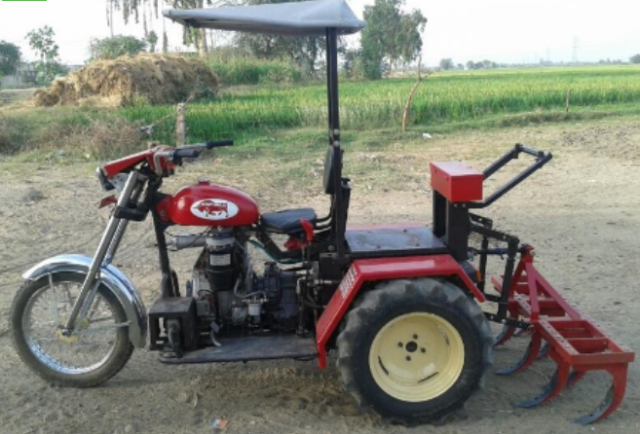
Mini agriculture TukTuk products
10hp engine
High speed mini tractor
Can handle several agriculture machines
https://kishankart.com/product/mini-tractor-tractbull/

Slide 7
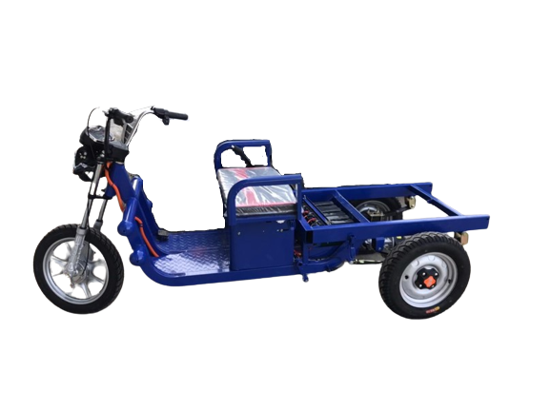
Objectives
Converting an electric transportation tuktuk to an agriculture one.
Boosting the E-tuktuk batteries
AGRI E-TukTuk to replace the tractor.
Used in several agricultural terrain.

Slide 8
Current E-TukTuk specification
Vehicle Weight: 415 kg
Load Weight: 600 kg (normal), 900kg (Gear)
Dimension: 3020*1175*1330mm
Engine power: 1000 W,
Supply battery: 5 Acid batteries of total 64V, 52Ah
Made in china
3 speed (low medium high)
Brake sensor
Soft start
5 hours of working
20 degree of climbing
70 km per charge

Slide 9
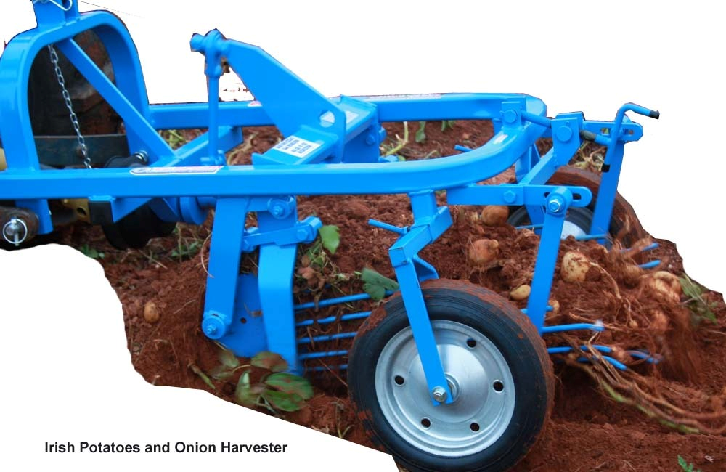
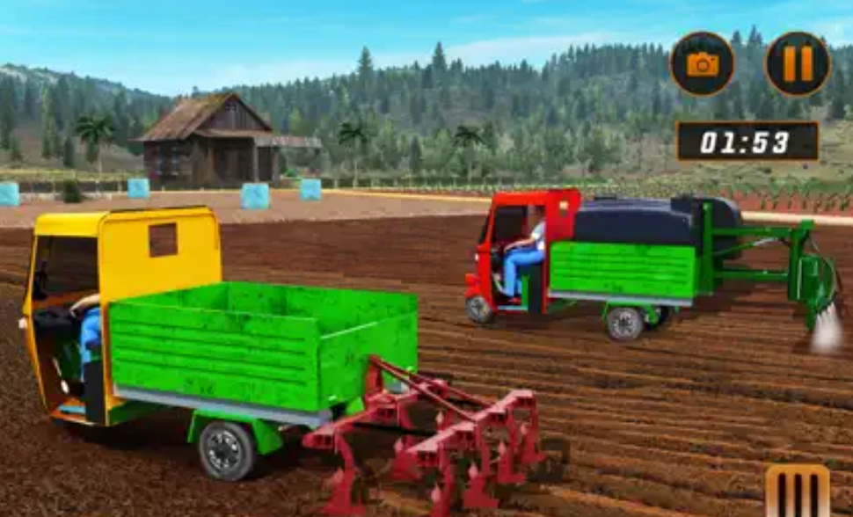
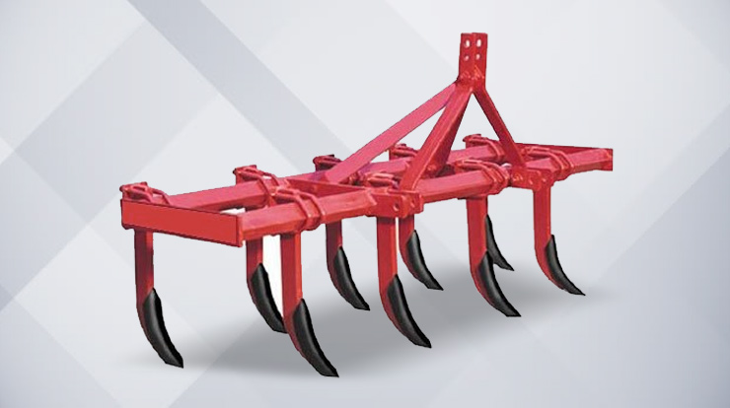
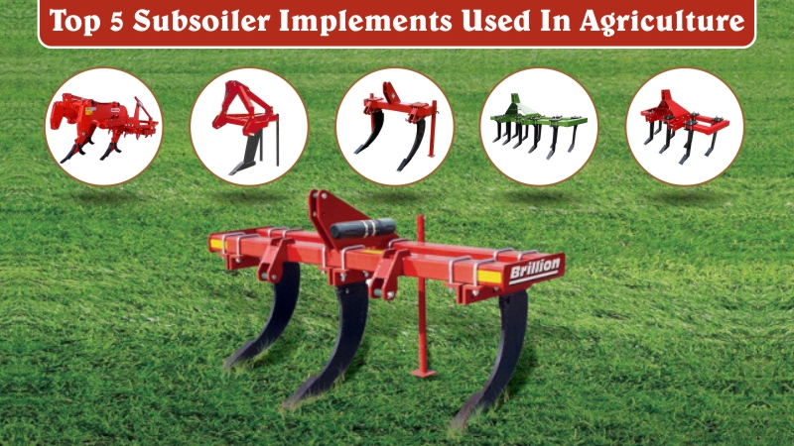
MAKE IT AGRICULTURAL

Slide 10
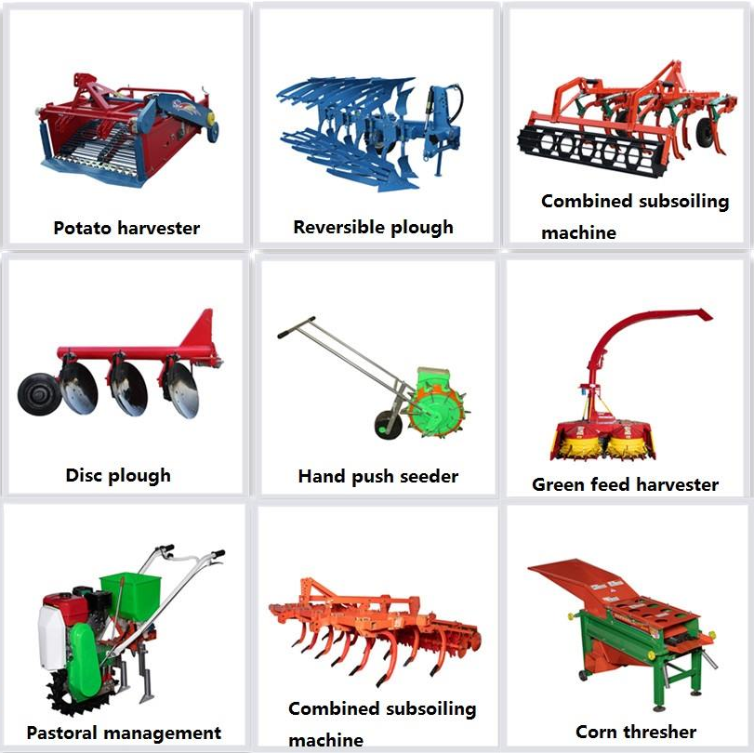
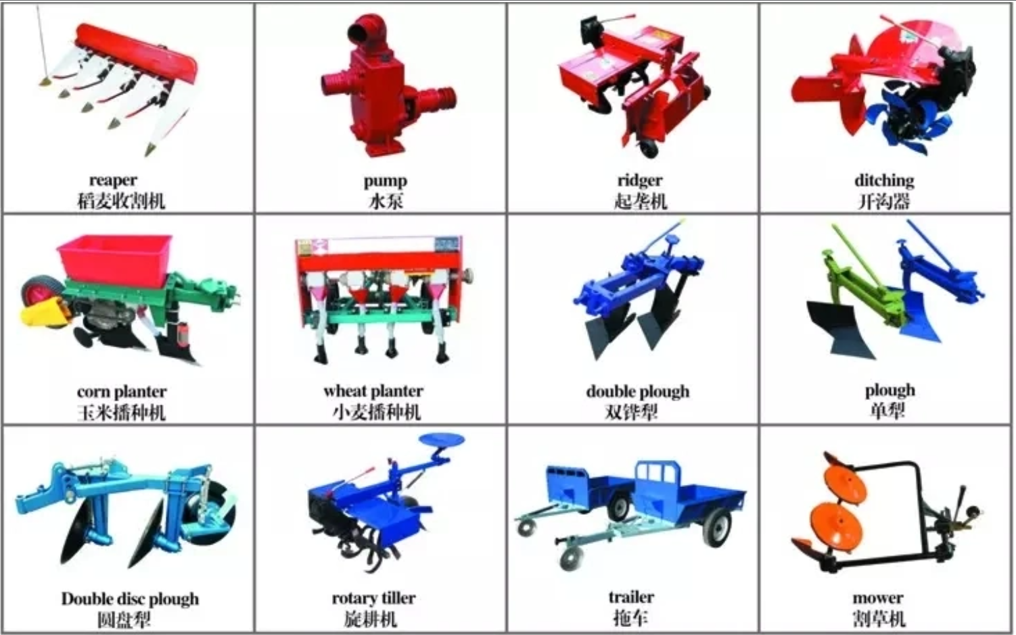
MAKE IT AGRICULTURAL Agricultural Machines

Slide 11
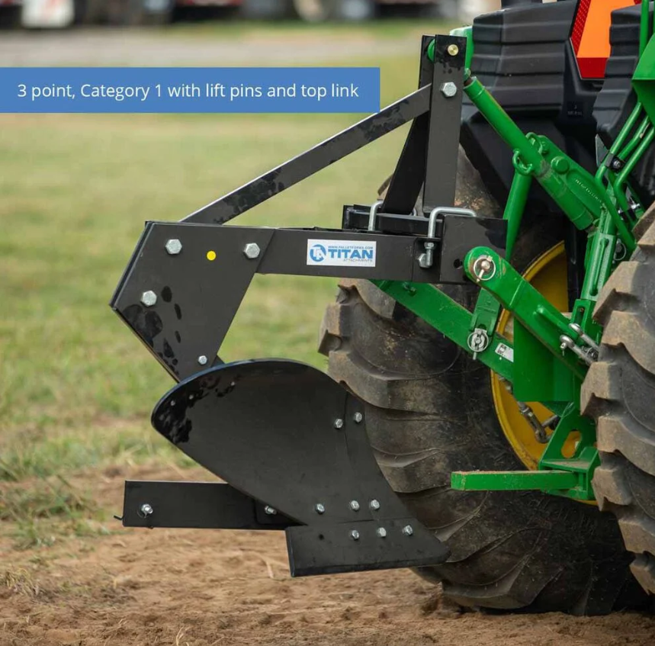
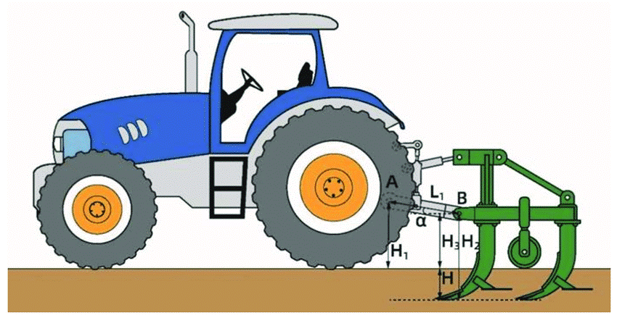
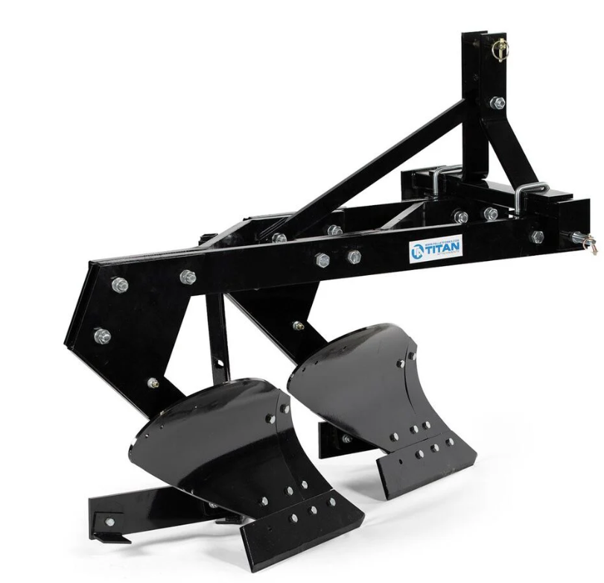
MAKE IT AGRICULTURAL Machines Mounting
- 3 points hitch mounted to the back and attached to the chassis and the axle
Simple design to attach an agriculture machine
It can be manual or motorized hitch

Slide 12
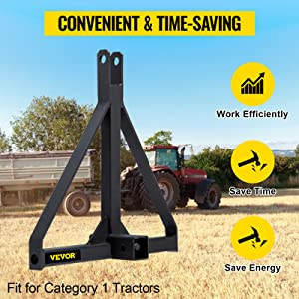
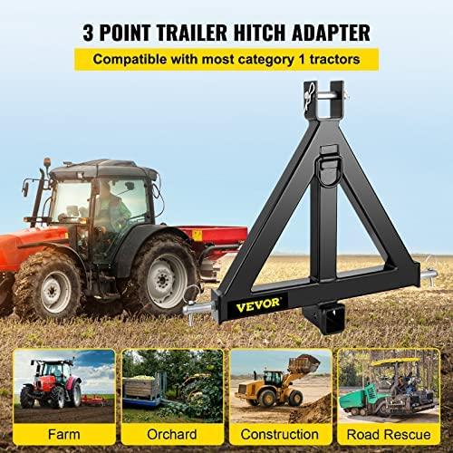
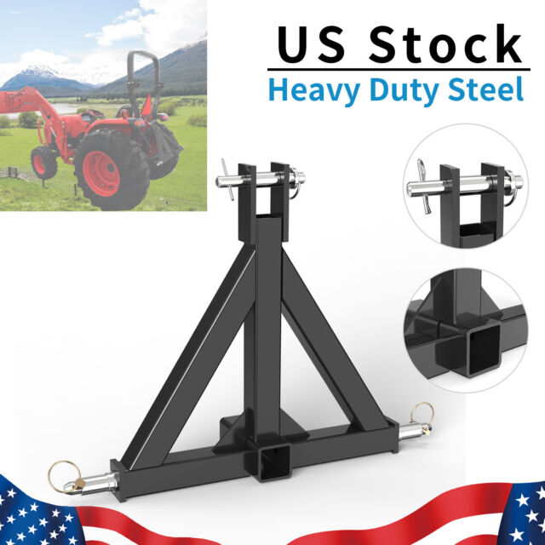
MAKE IT AGRICULTURAL Hitch design
Buy a hitch from market
Design a simple 3 points design
Can handle several useful Agri machines

Slide 13
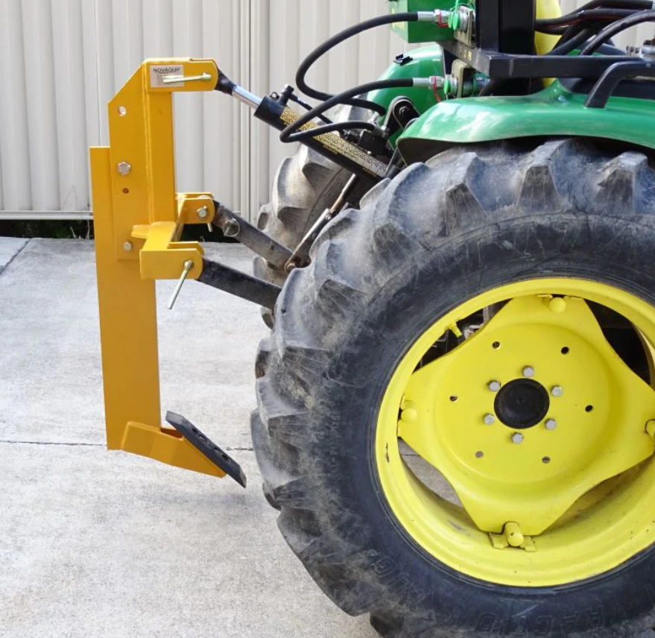
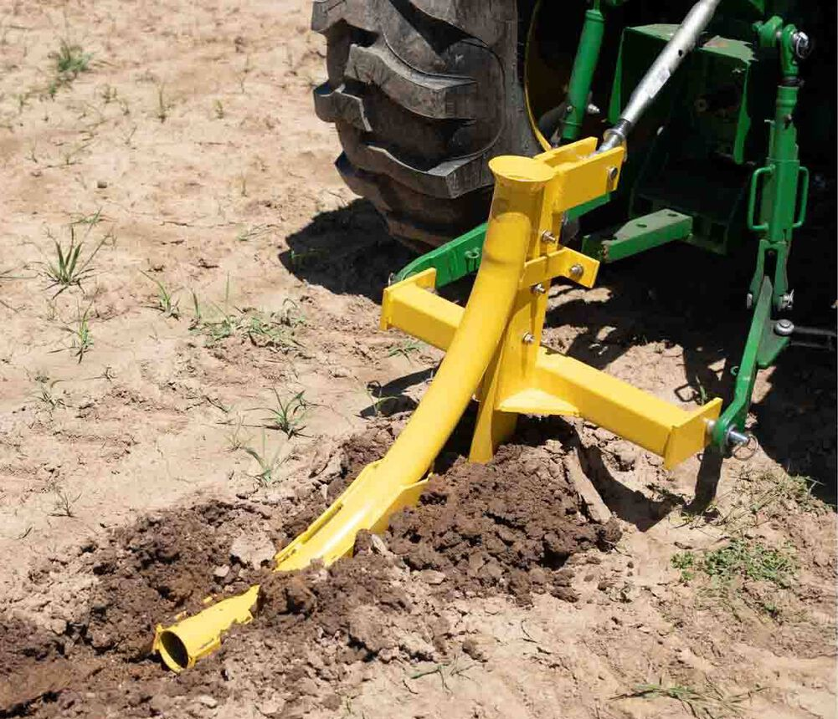
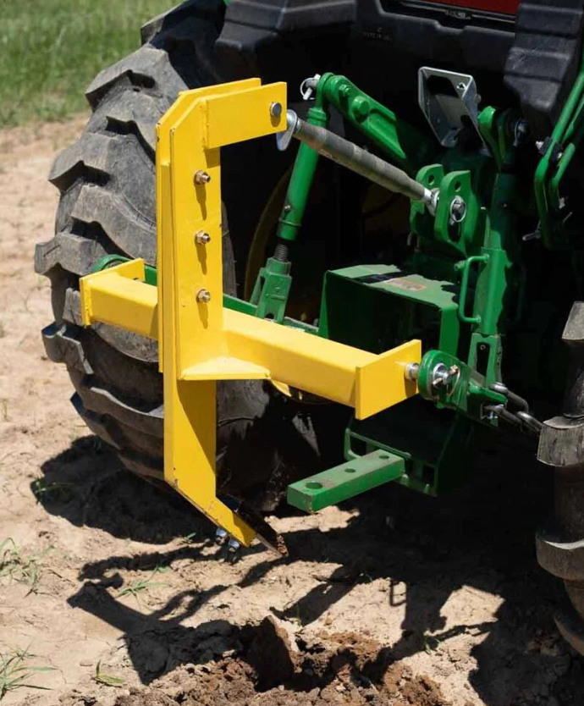
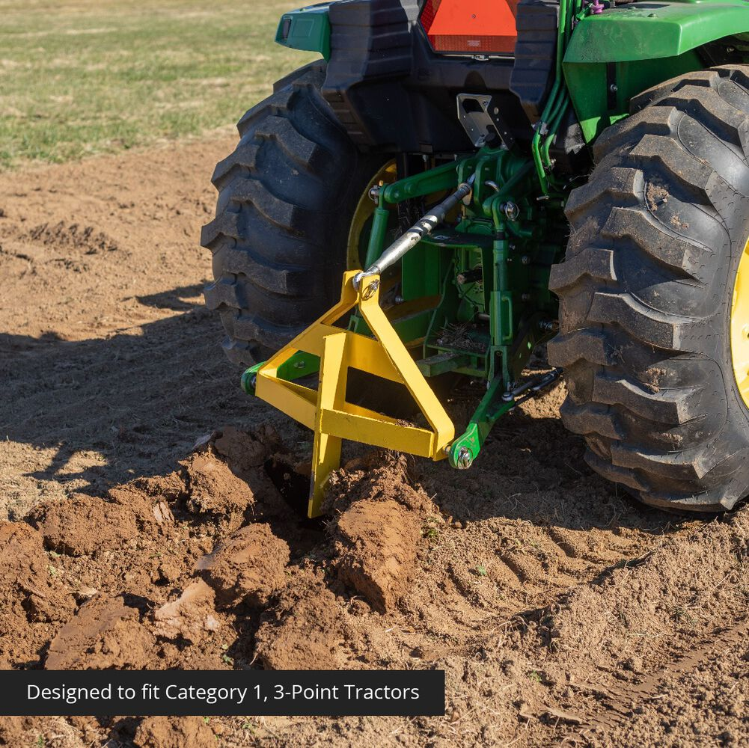
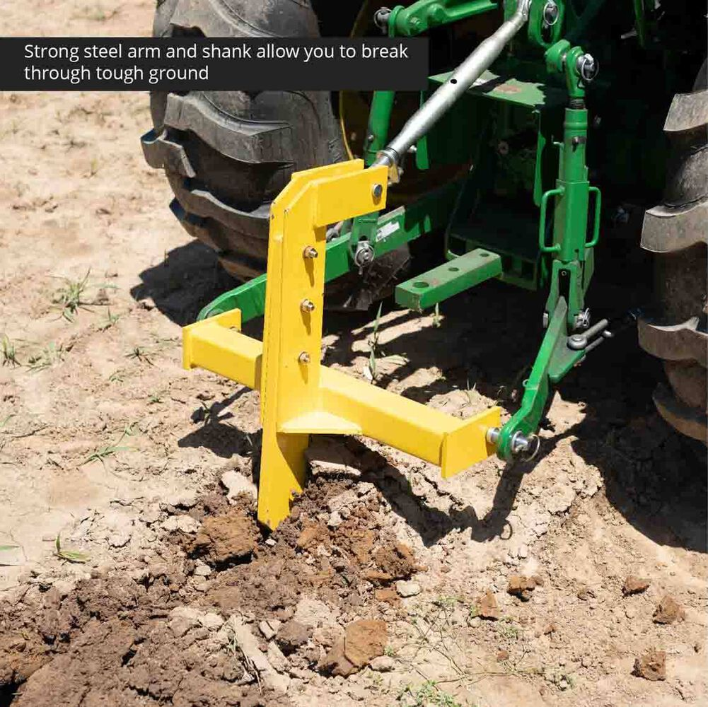
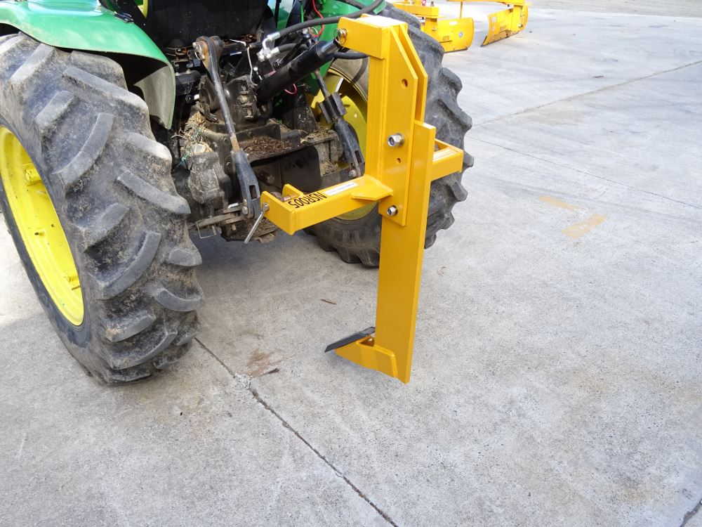
MAKE IT AGRICULTURAL Hitch design

Slide 14
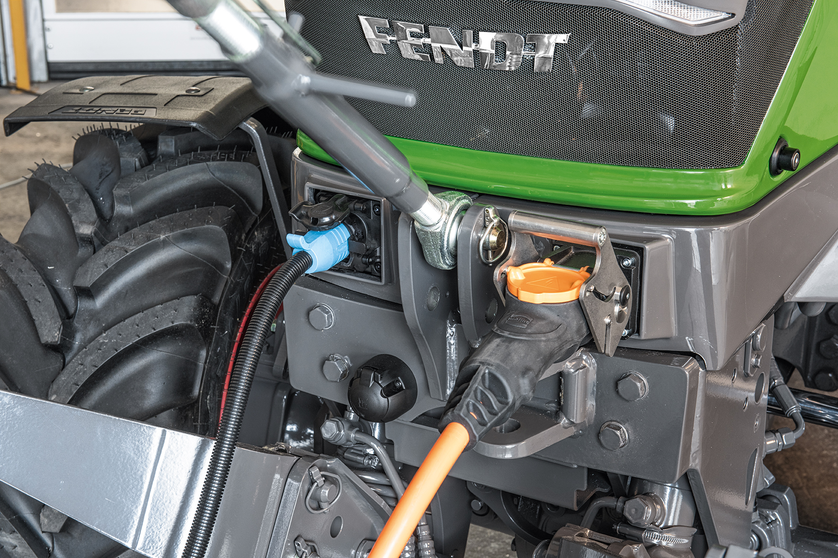
MAKE IT AGRICULTURAL Electric sockets for external Agri machines
Some agriculture machines needs electricity to work like:
Sprayer
Cutter
So there should be an electric
sockets with many voltage ranges

Slide 15
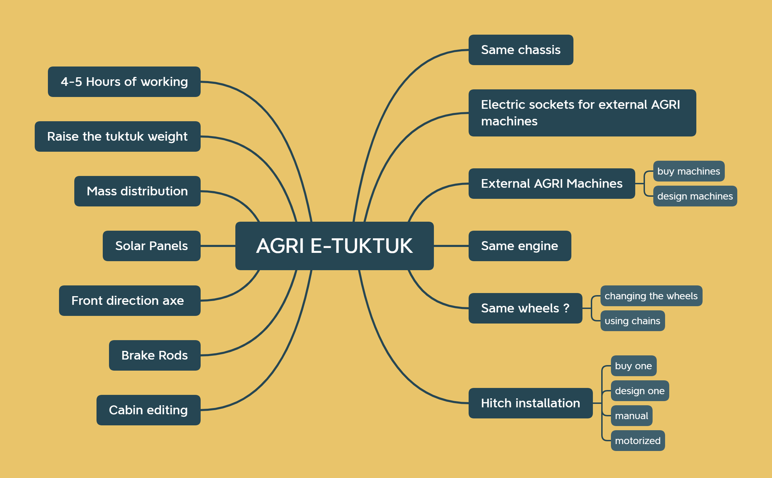
Main Jobs & Requirements

Slide 16
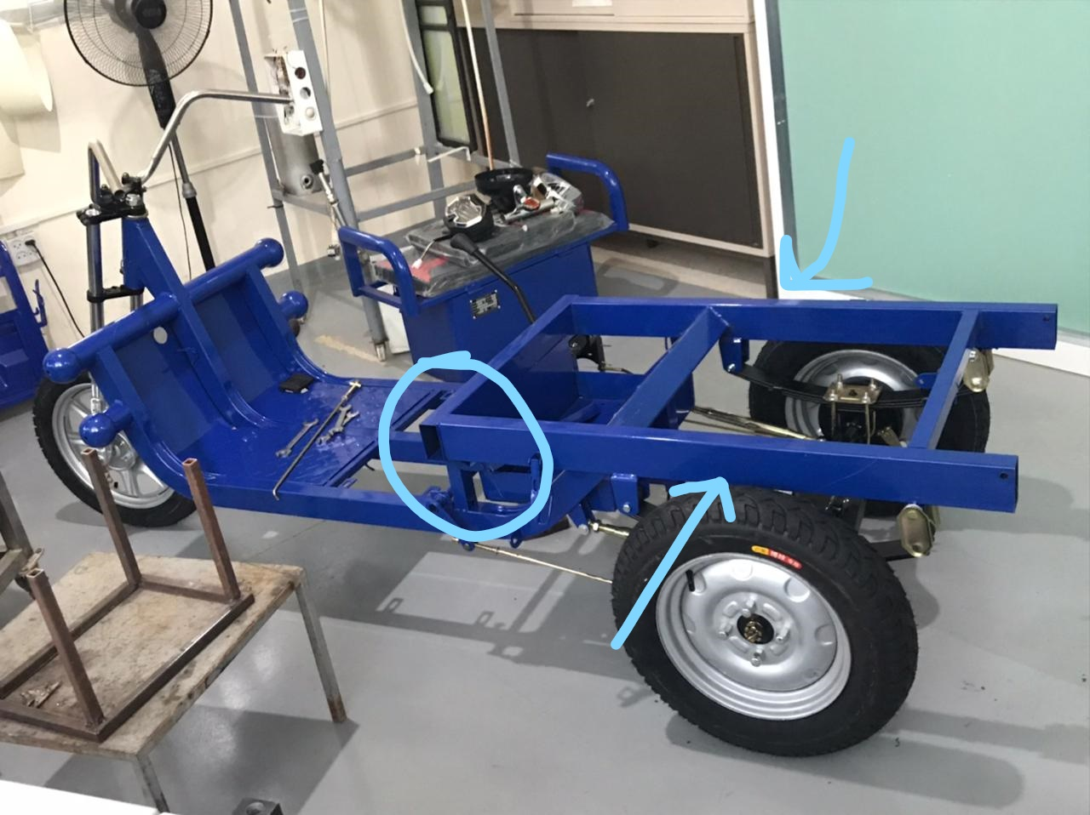
IMPROVE EQUIPMENTS Chassis
There are some weak points on the current chassis which should be improved, so:
We can strengthening the weak points
Redesign the same size chassis with better material

Slide 17
IMPROVE EQUIPMENTS Weight
The weight of the tuktuk used is 415 kg with the cabin
With extra parts weight the AGRI tuktuk will have a 500 kg of weight
With mass distribution we can shift more weight to the back to insure a good tire gripe

Slide 18
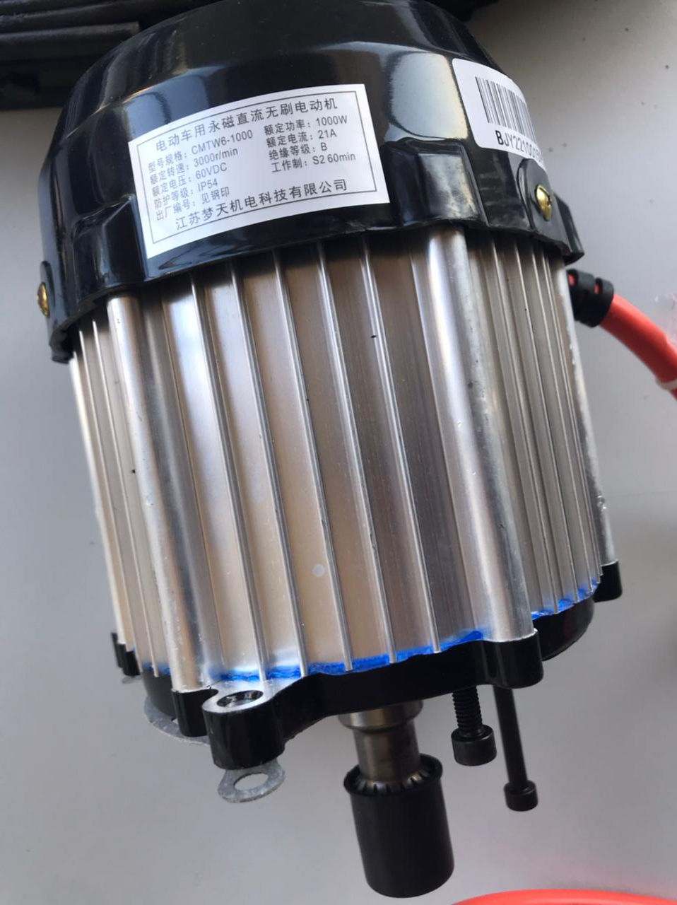
IMPROVE EQUIPMENTS Motor
Current motor power is 1000w
It can be easily replaced with one with bigger power without the need to any mounting or mechanical change
We can shift to 1200w, 1500w and up to 4500w motor available in Tripoli market.

Slide 19
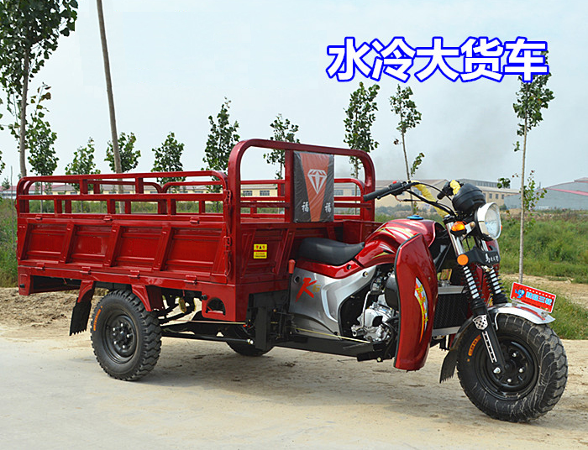
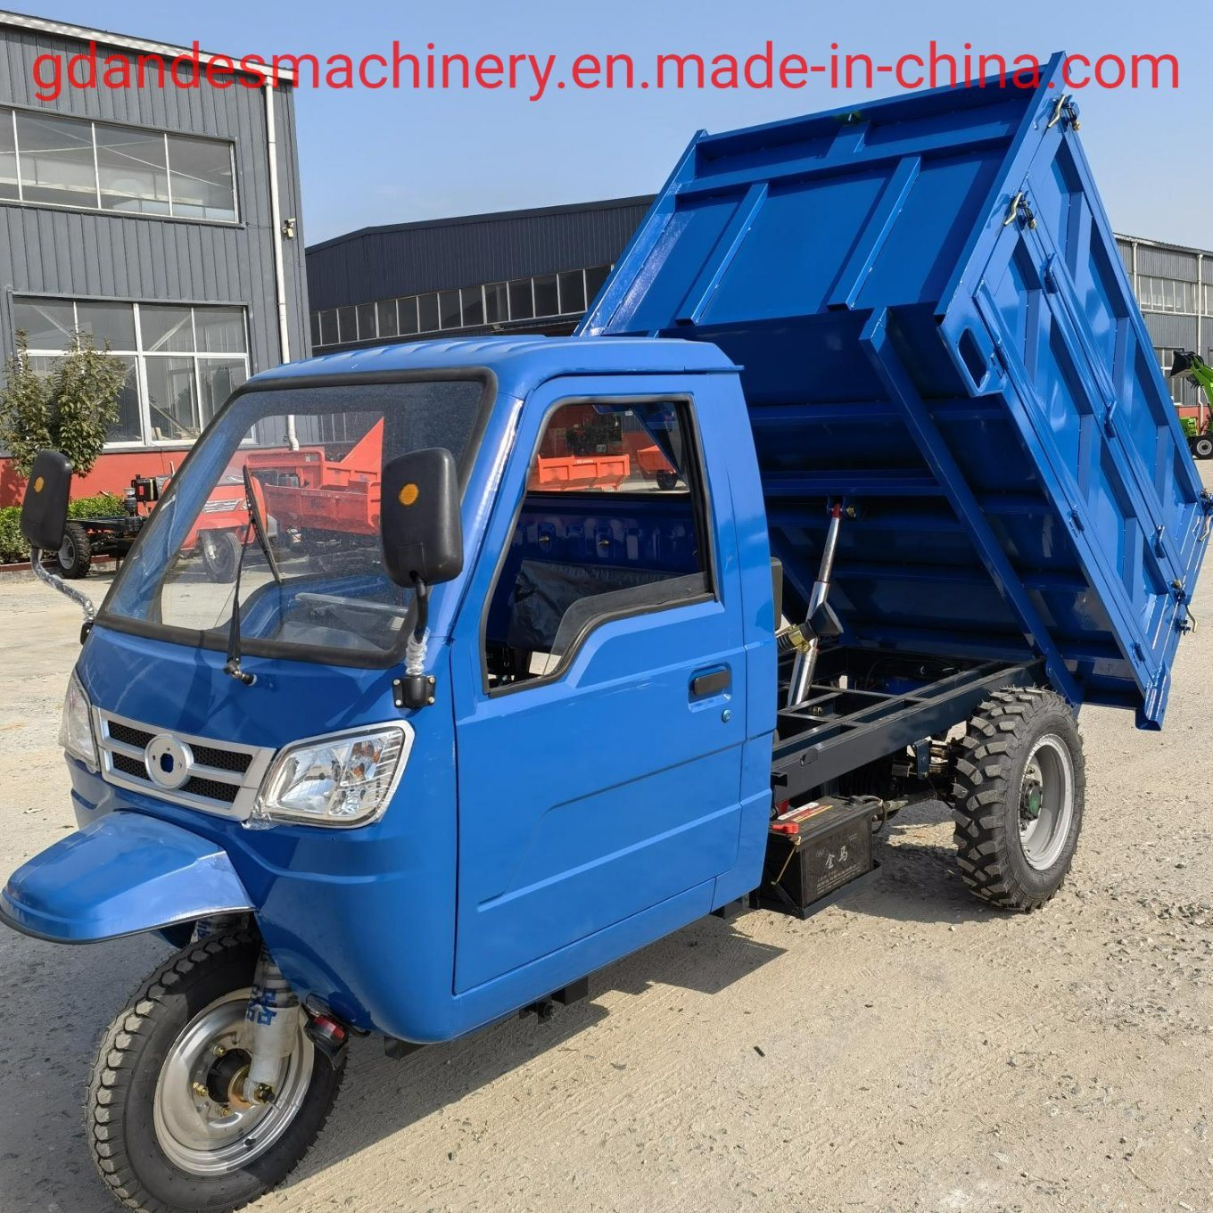
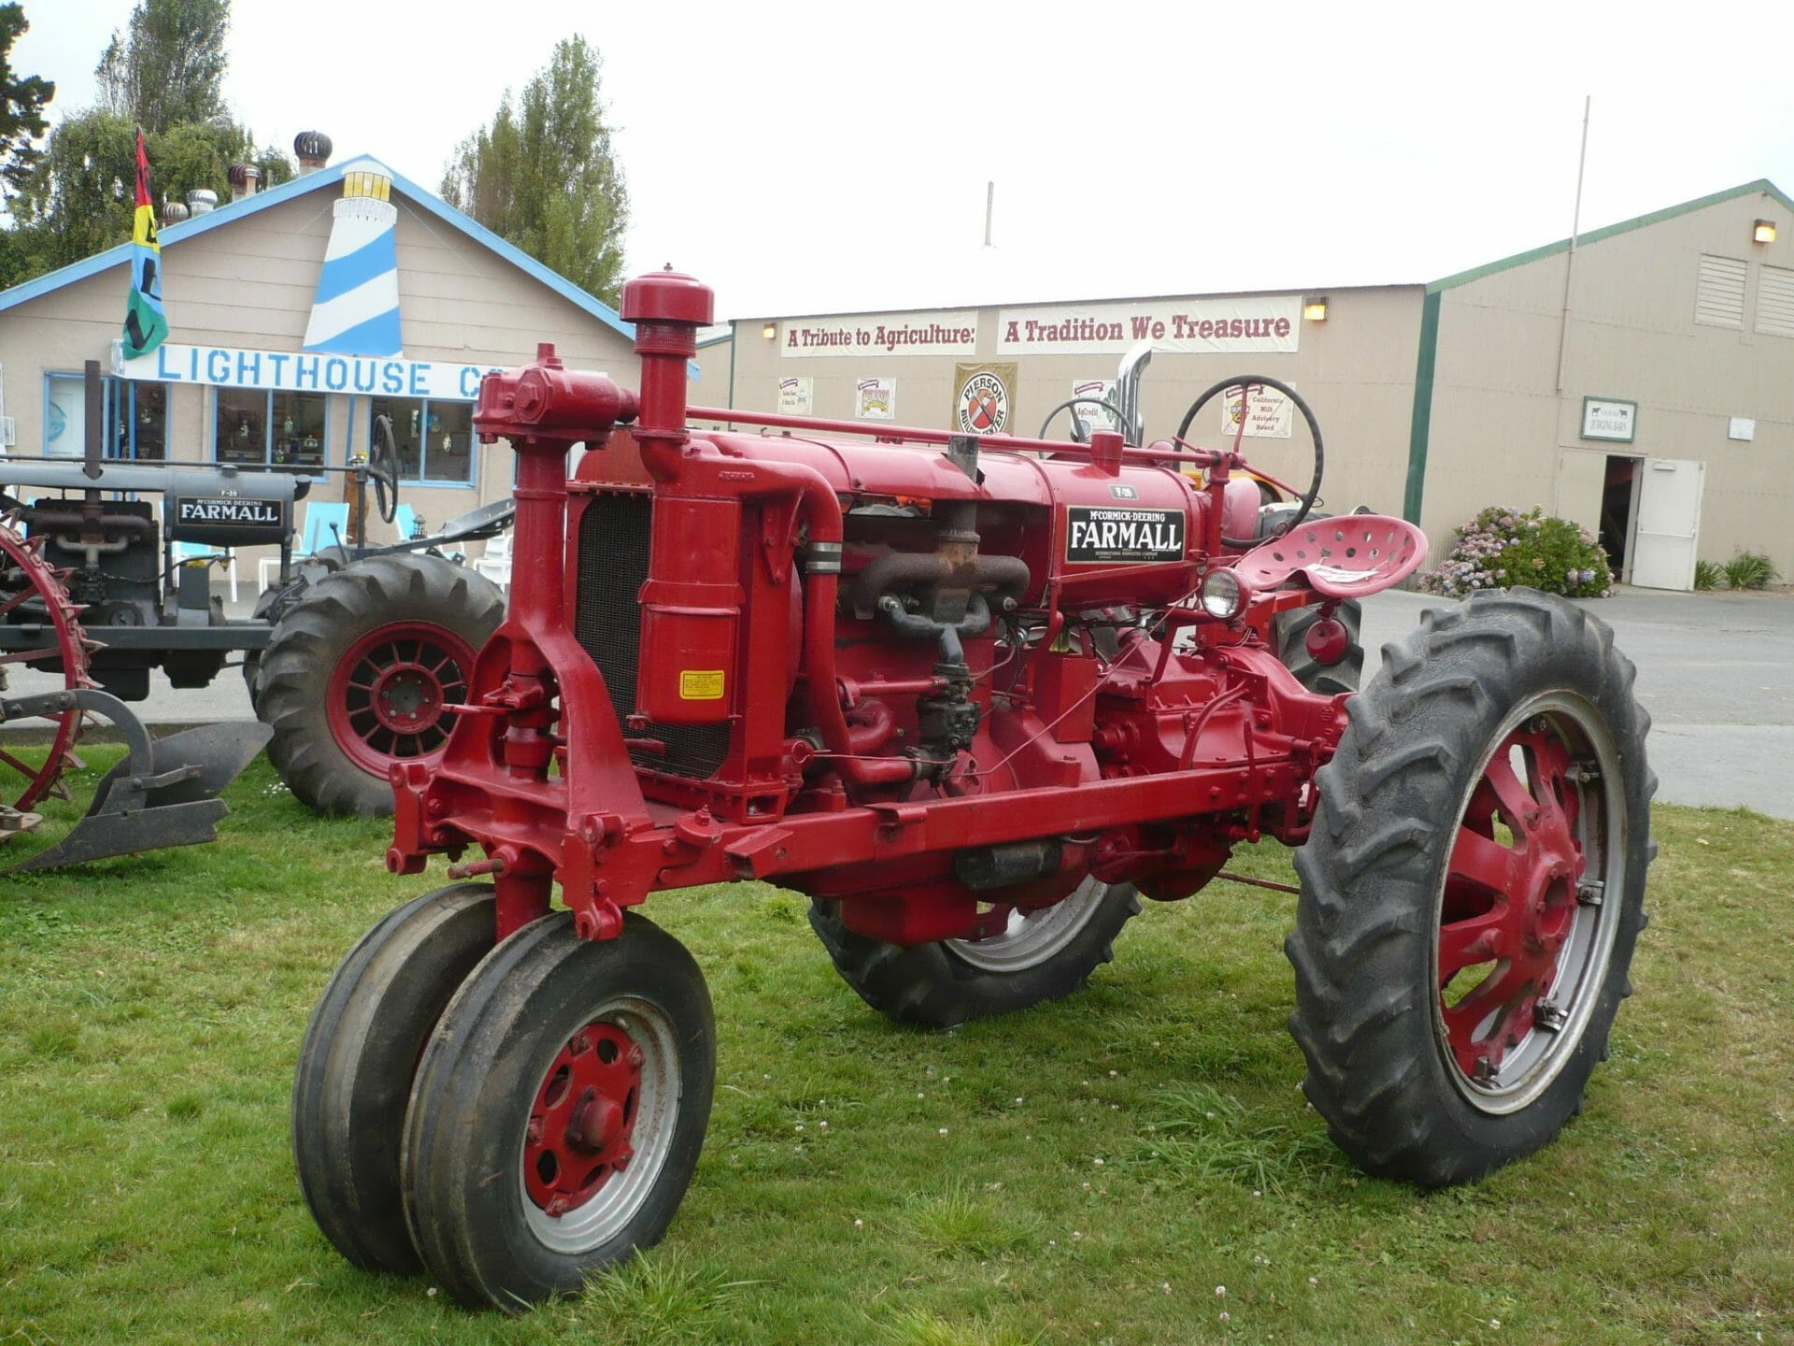
IMPROVE EQUIPMENTS Wheels
Front and rear wheels can be replaced by such type and size of tires

Slide 20
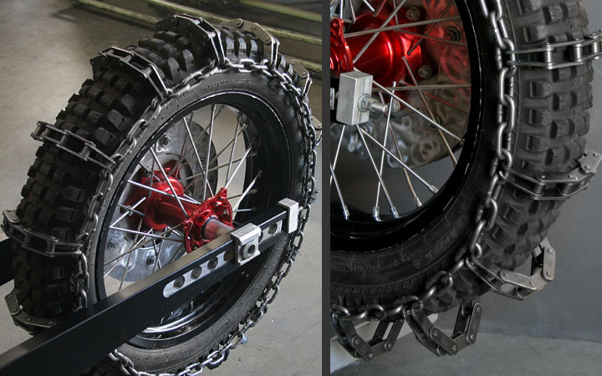
The rear wheels should fit the wheel cover space and drum width - Wheel chains for dirt roads can be used - or use bigger Off-Road wheels (cabin may need to left up)
WHEELS Rear Wheels

Slide 21
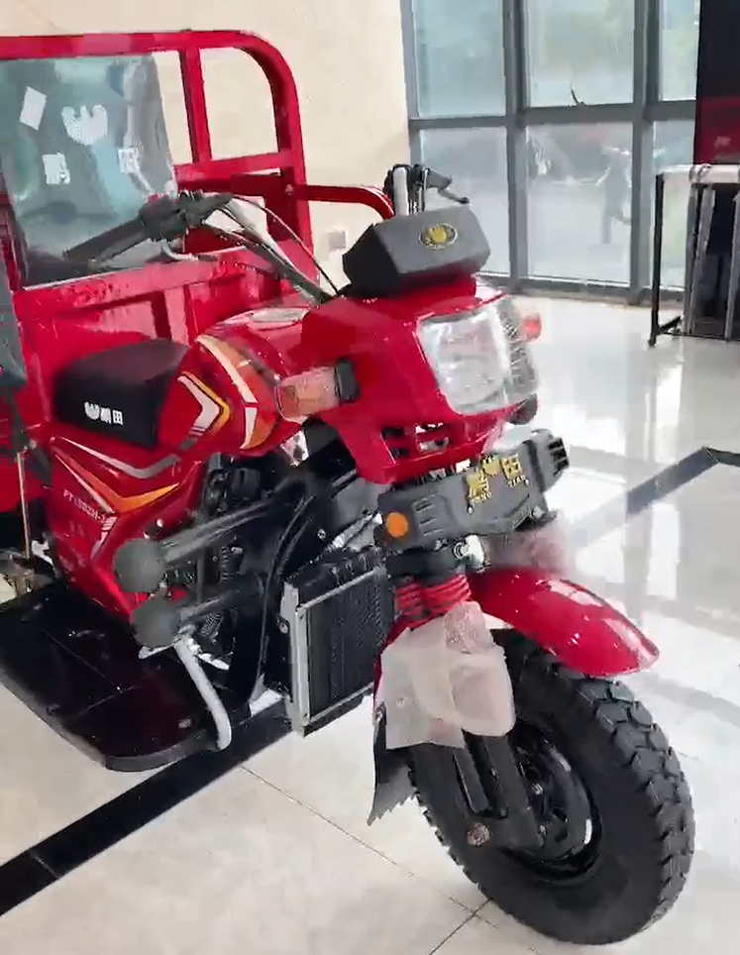
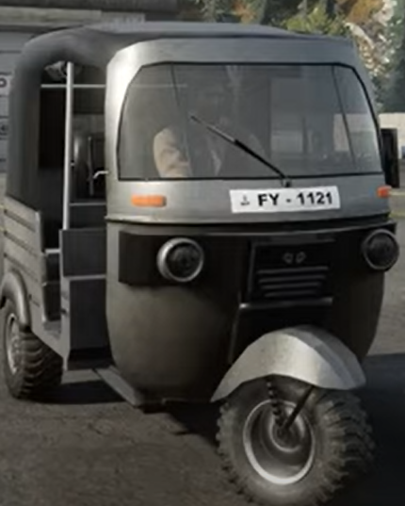
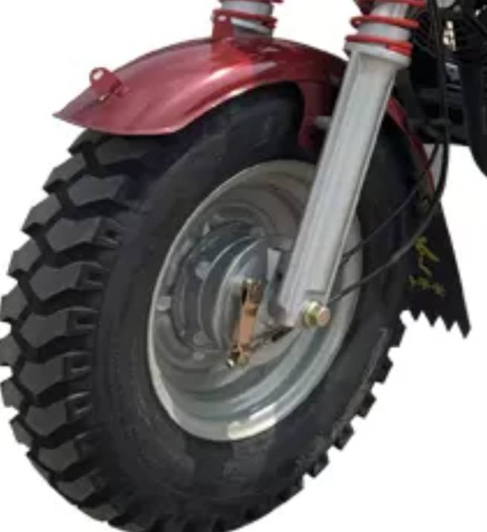
WHEELS Front Wheel

Slide 22
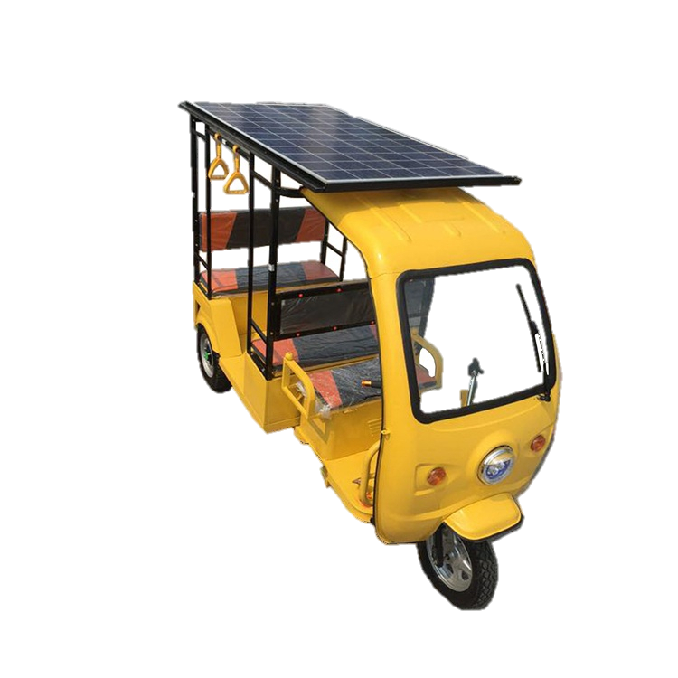
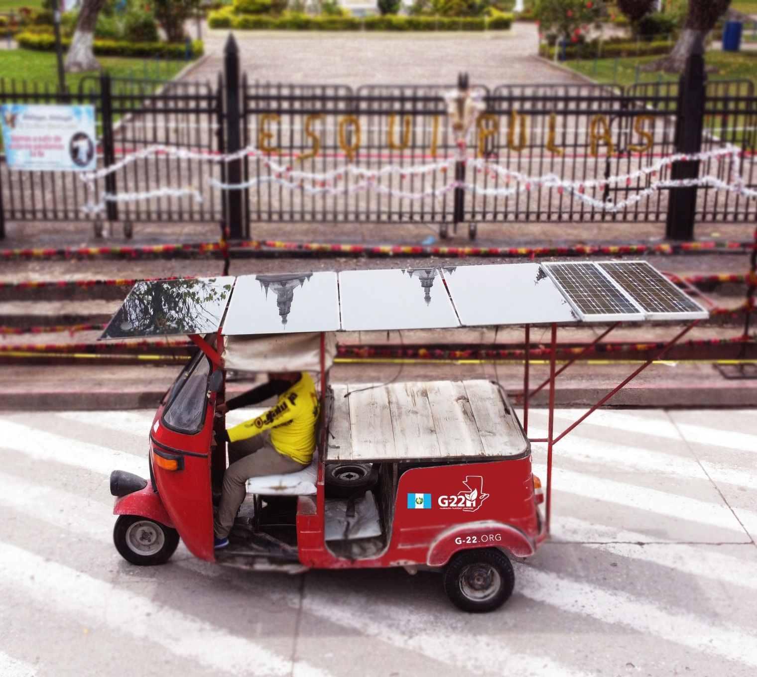
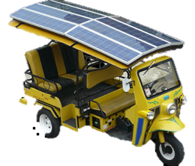
RUNNING HOURS Improve The Running Hours
The product should give a 4 to 5 of working hours
If we use maximum speed and power without stopping, the batteries will discharge after approx. 2 hours 30 min.
The solar panels will boost the working hours with 1 hour and 30 min extra (50%)
Lead-acid batteries must be charged in stages over a longer time, and they perform inefficiently during high discharge periods, making them less versatile than their lithium counterparts. So using lithium batteries is an advantage but it is expensive:
Fast charging minimizes downtime
lithium's high rate of discharge is perfect for a burst of power

Slide 23
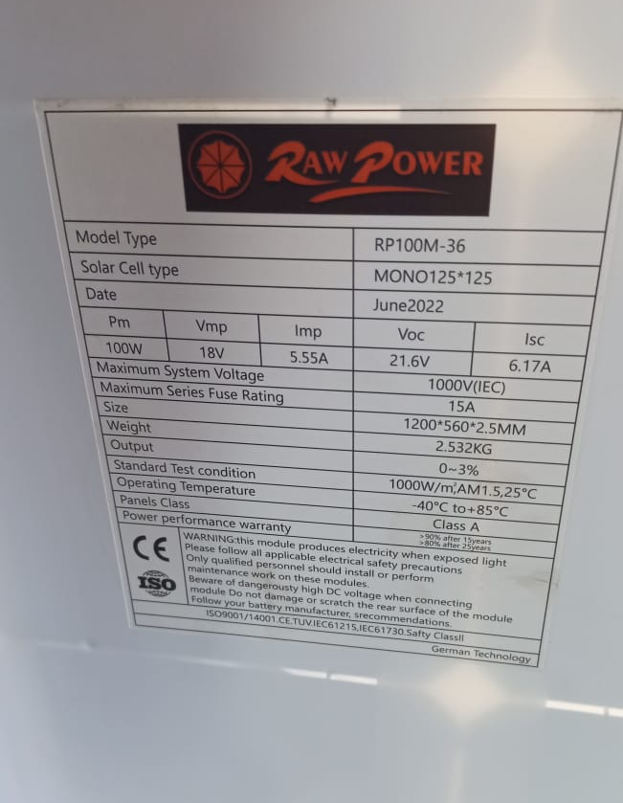
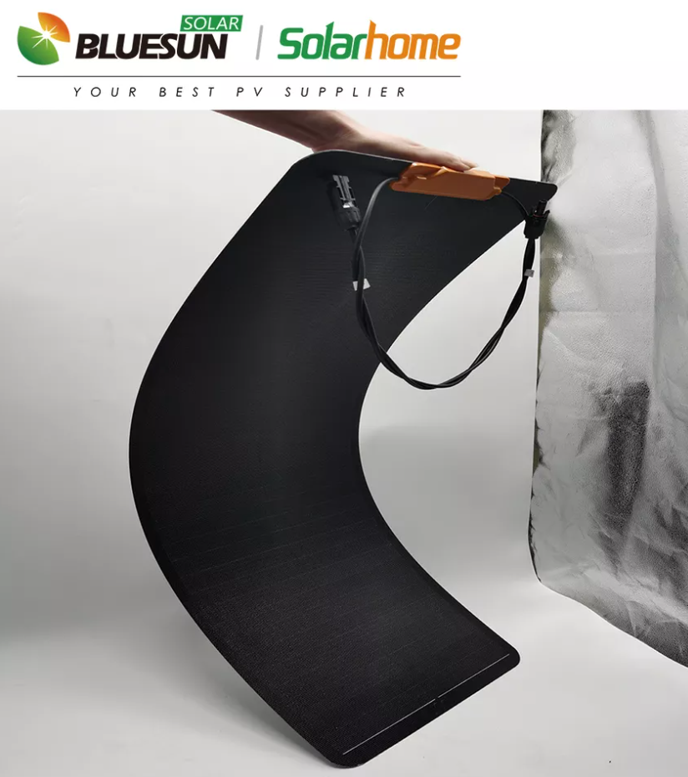
RUNNING HOURS On Market flexible solar panel
100w solar panel in Tripoli for 70$
160w solar panel online for 70$

Slide 24
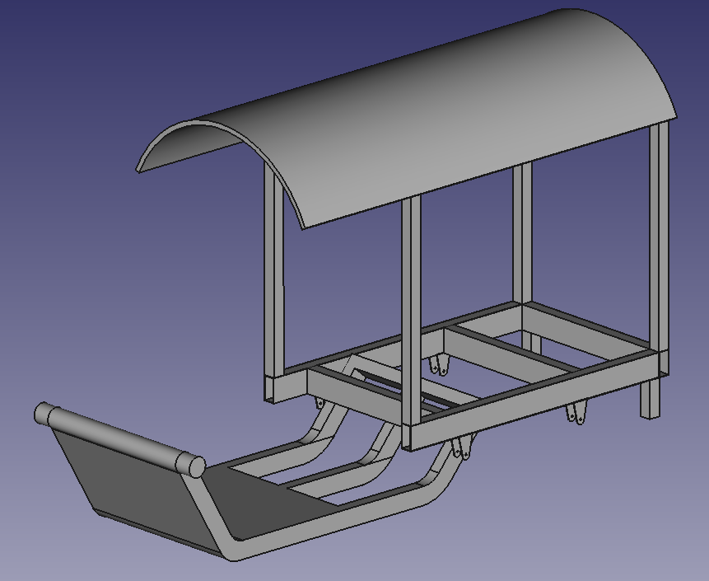
RUNNING HOURS Solar panel Mounting

Slide 25
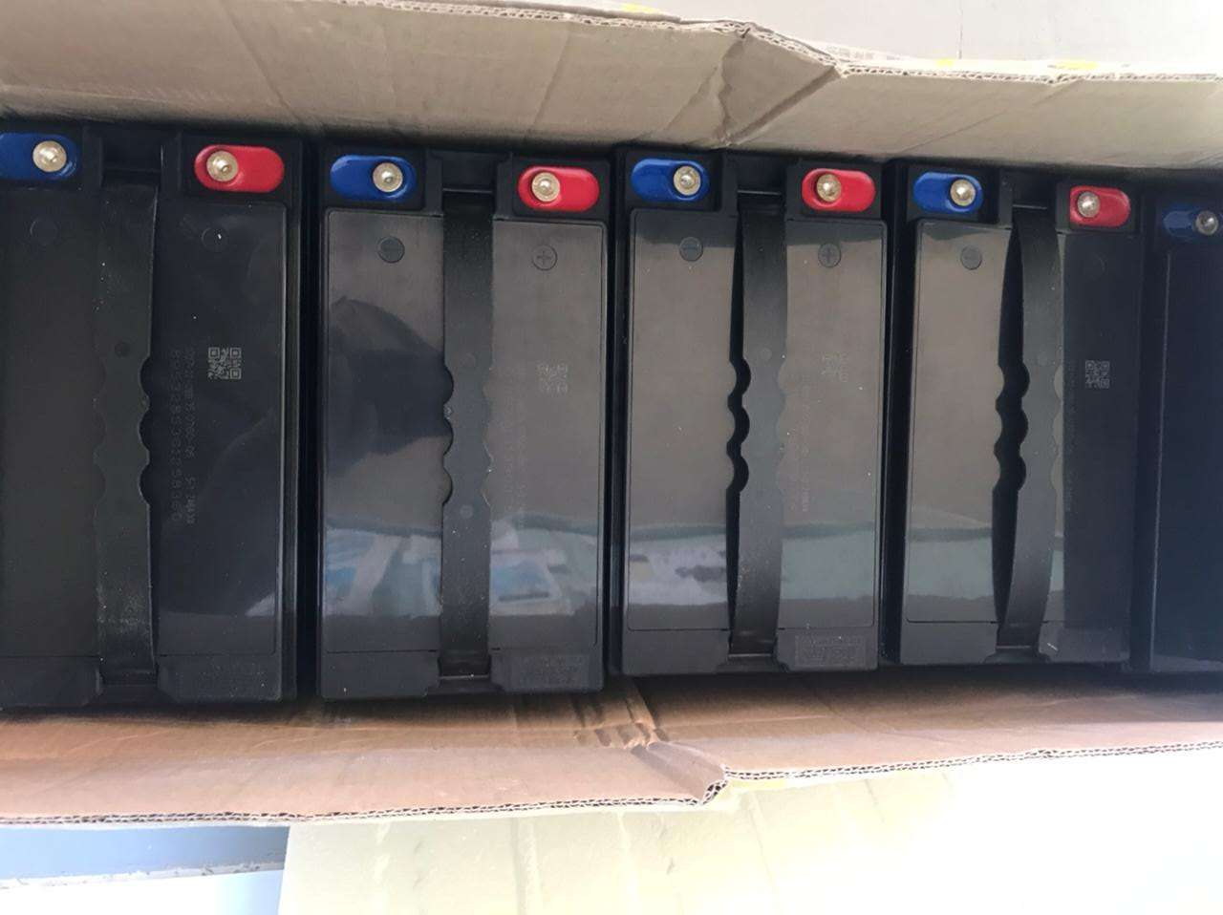
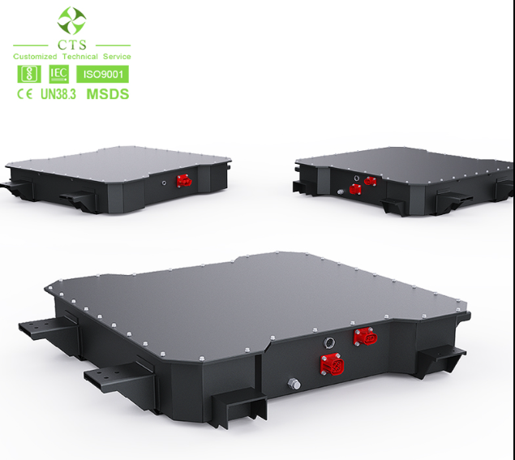
RUNNING HOURS Lithium Batteries
10 times longer life than lead-acid batteries
provide 80% of rated capacity after 2,000 cycles
lithium-ion batteries last five years or more, The average lead-acid battery lasts just two years.
lithium's high rate of discharge is perfect for a burst of power
good high-temperature performance
high power-to-weight ratio, high energy efficiency
high energy per unit mass relative to other electrical energy storage systems.

Slide 26
Cost Estimation
The E-tuktuk used costs 1380$
The cost of the agriculture E-tuktuk depends on the features and the modifications added
The estimated cost of all terrain agriculture E-tuktuk should not exceed 2500$ with the cost of:
solar panels: 300$ (70$ x 4)
Wheels: 200$
Hitch: 120$
Accessories and modifying costs: 400$

Slide 27
Test Needed
Test the torque and drag force that the engine can produce with attaching a subsoiling machine to the tuktuk
Test the brake rods level
Test the rear wheels gripe (no slipping)
Test the gear in agri roads
Hitch design
Batteries capacity
Wheels:
Use dirt wheel
Large wheel
Big rims

