Slide 1
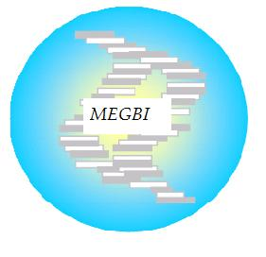
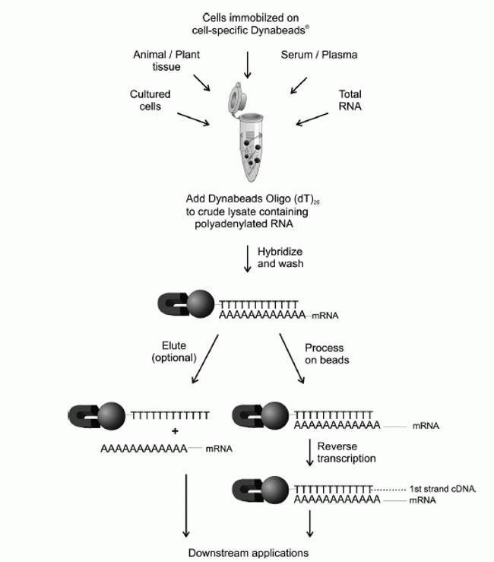
LIPID NANOPARTICLE (LNP) RNA VACCINE PRODUCTION (LAB SCALE)
Protocol (LNP) method
Overview As the world continues to fight the COVID-19 pandemic and prepare for the global distribution of vaccines. The global need for vaccine and the wide geographic diversity of the pandemic require more than one effective vaccine approach. the mRNA vaccine has become deservedly popular as the technology to ensure stable mRNA developed, along with superior delivery methods to get the vaccine into the host cell. In this study we have chosen SLN which are nanoparticles composed of lipids as mRNA delivery vehicles.
Available protocols for RNA vaccine production:
1. Reverse Transcription Reaction (First-Strand cDNA Synthesis)
2. Transcription protocol
3. RNA purification
is a laboratory technique combining reverse transcription of RNA into DNA (in this context called complementary DNA or cDNA)
This will lead for more RNA copies
Total RNA purification involves the extraction and purification of total RNA from your sample
>
Materials
mRNA
Lipids
DMG-PEG2000
SM-102
DSPC
Cholesterol
The liquid part of the vaccine
Sucrose (sugar)
Water
Tris buffer
Sodium acetate
Sugar: Sucrose
Water
4. LNP formulation (Encapsulation by microfluidic mixing)
This method employs a herringbone micromixer to facilitate the mixing of lipid components dissolved in ethanol and RNA in aqueous buffer. The flow of the two streams of fluid is controlled using a dual syringe pump. The herringbone micromixer exponentially increases the surface area between the two streams of fluid, resulting in rapid mixing on a millisecond timescale. Residual ethanol is removed by dialysis and the pH of the solution is raised to 7.0. This method results in over 90% siRNA encapsulation efficiencies. Particle size is adjustable from 20 to 50 nm by varying the PEG-lipid content from 5% to 1%.
Preparation of Solid-Lipid Nanoparticles.
Dissolve lipids in ethanol
mRna in tris buffer
Microfluidic mixing using herringbone micromixer
Amin Etro @MEGBI/AECENAR Dec 2020

