Slide 1



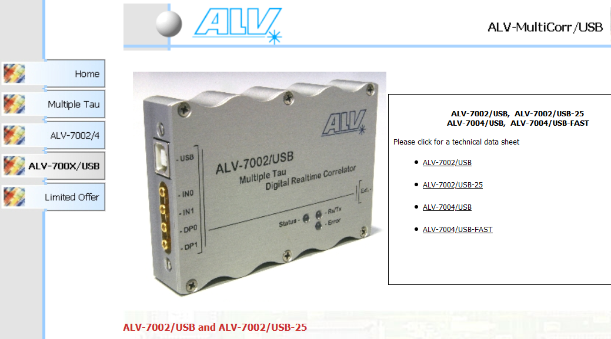
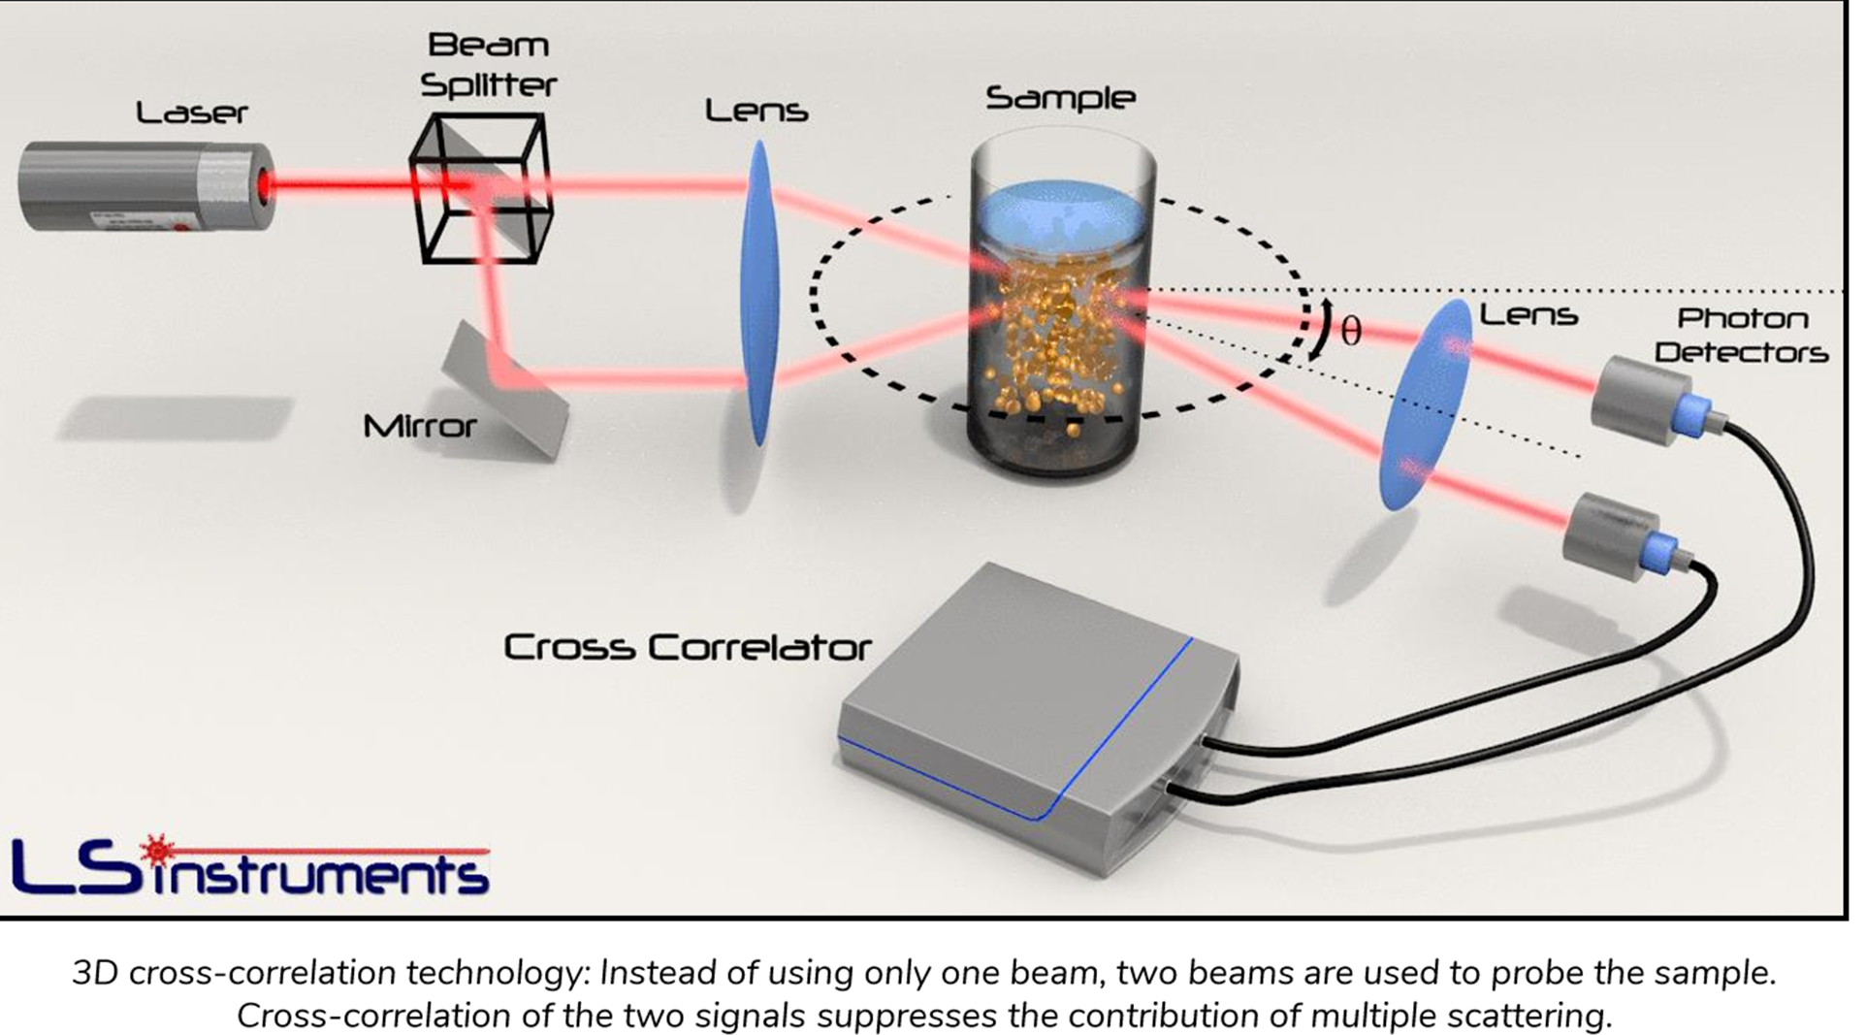
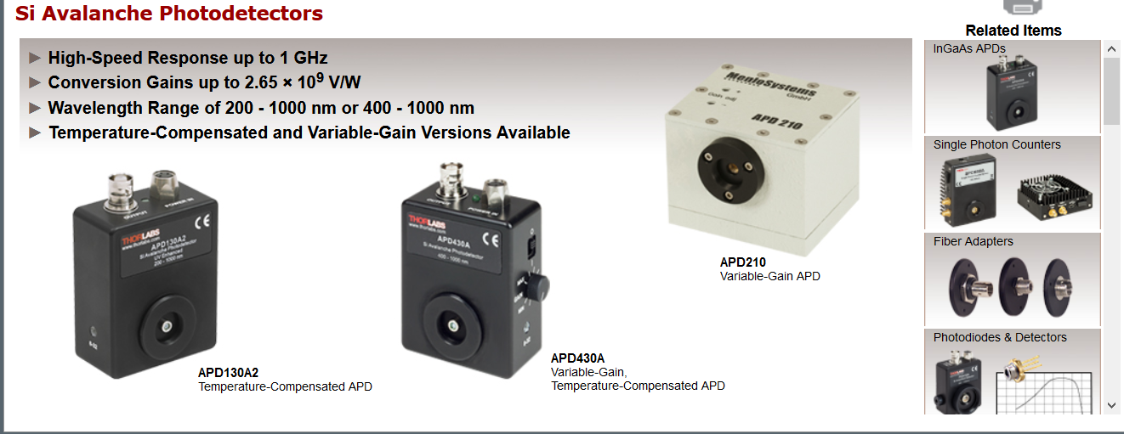
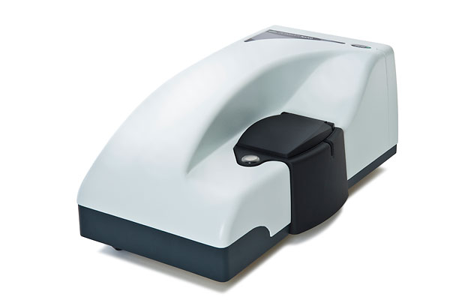
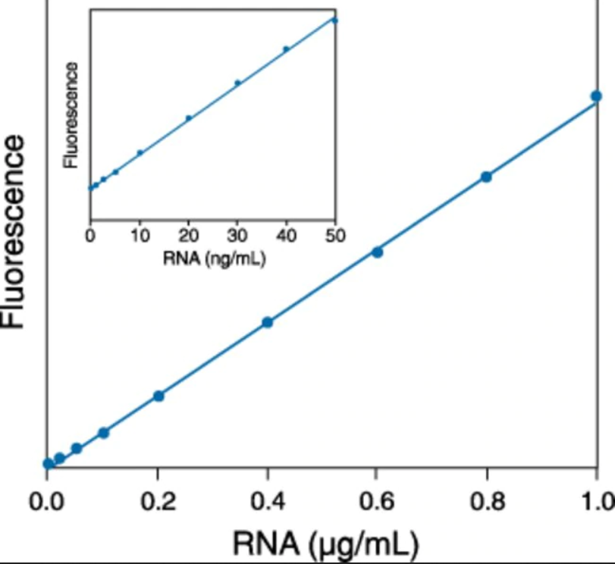
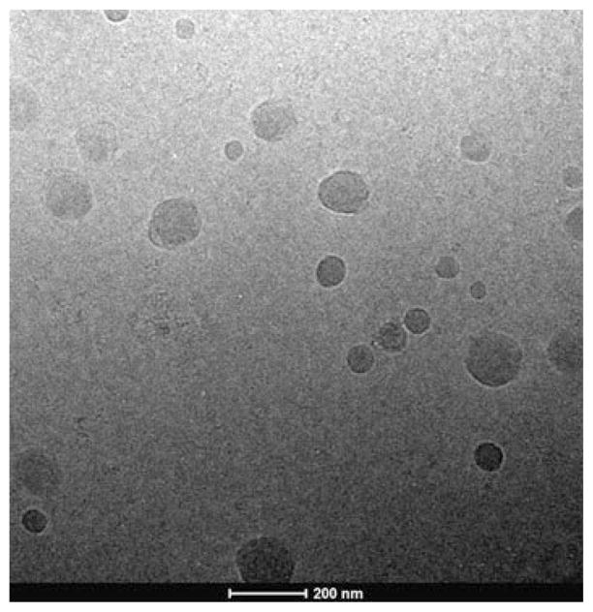
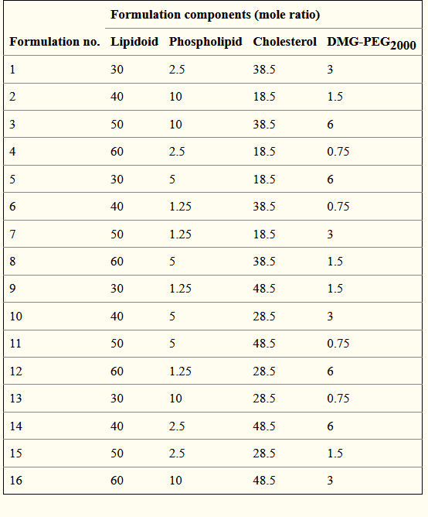
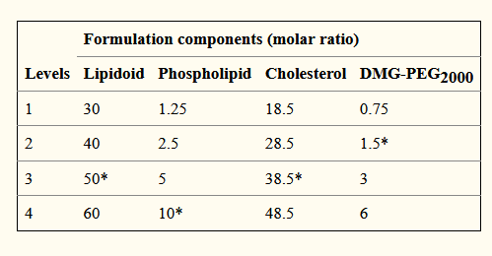
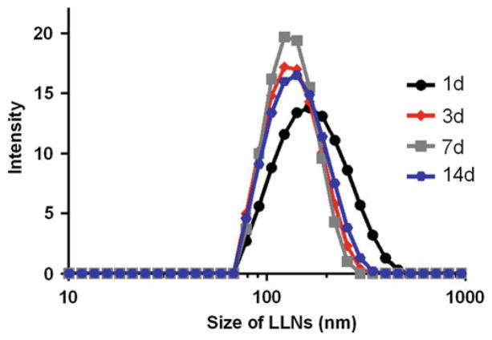
Lipid Nanoparticle (LNP) characterization
Introduction
To ensure safe and efficacious vaccines, it is essential to use robust and reliable characterization tools across discovery, development, production and quality control.
Measuring particle size and zeta potential
The zeta potential (ZP) can be used to evaluate the charge stability of a disperse system, such as liposomes; it is used to quantify the magnitude of the electrical charge of the lipid bilayer. A measurement is taken by applying an electric charge across the sample in a folded capillary flow cell.
disperse 0.3/ y μL of LLNs into milli-Q water to a final volume of 1 mL in disposable cuvette to make a 300 ng/mL working solution
Determine the particle size and zeta potential of LLNs using a NanoZS Zetasizer after mixing well.
2. Measurement of mRNA entrapment efficiency (How much RNA is present in LNPs)
  6. Determination of the Optimal Formulation Parameters
Prepare a 500 ng/mL working solution in TE buffer
. Add 50 μL of working solution (use TE buffer as blank) to each well of 96-well plate in triplicate, followed by adding 50 μL of TE buffer or 1% Triton X-100 (v/v, in TE buffer)
To this solution, add 100 μL of 200-fold diluted Quant-iT RiboGreen RNA reagent (diluted in TE buffer).
Incubate for 15 min at 37 °C in the dark.
. Measure the fluorescence on a SpectraMax M5 plate reader (Molecular Devices) with an excitation wavelength of 480 nm and emission wavelength of 520 nm. The entrapment efficiency is determined as [1 − ( A TE − A blank)/( A 1% Triton − A blank)] × 100.
Identification of lead lipid-like compound: prepare LLNs as mentioned above using newly synthesized lipid-like compounds.
2. Conduct LLNs-mediated cell transfection assay to select the lead lipid-like compound.
3. Optimization of formulation components ratio: choose a proper orthogonal array table based on the number of formulation components (factors) and assigned molar ratios (levels) ( see Note 12).
4. Prepare formulation according to the orthogonal table with assigned factors and levels.
5. Conduct LLN-mediated cell transfection assays.
6. Predict the best ratio by analyzing the average luminescence intensity ( K n) of each factor ( see Note 13).
7. Readjust the intervals according to the impact trend of each component and carry out the second or even more rounds of orthogonal optimization until selecting the optimal formulation ( see Note 14).
8. Optimization of the ratio for pegylation: regulate the pegylation extent of the above predicted formulation while keeping the other component ratios constant.
9. Measure LLNs-mediated luciferase expression
Examine the particle size of LLNs twice weekly (Fig. 3) to identify stable and potent formulation (see Note 15)
Notes are available in the report.
3. Cryo-TEM (transmission electron microscope)
>
Add approximate 3 μL of LLNs to a specimen grid.
Remove any excess solution.
Plunge the grid into liquid ethane using a verification device.
Transfer under liquid nitrogen to a cryotransfer holder that is loaded to an electron microscope.
Record Cryo-TEM images on a postcolumn 1k × 1k CCD camera at a magnification of 18,500×
A representative Cryo-TEM image of optimized LLNs. Scale bar: 200 nm (reproduced from ref. 25 with permission from (2015) American Chemical Society)
Four levels assigned to each formulation component (lipidoid, phospholipid, cholesterol, and DMG-PEG₂₀₀₀). Asterisk indicates the original molar ratio 50:10:38.5:1.5
  4. Evaluation of Cytotoxicity of Lipid-Like Nanoparticles (LLN)
  5. Evaluation of LLNs-Mediated Transfection
Hep 3B cells are maintained in Eagle’s Minimum Essential Medium (EMEM) supplemented with 10% heat-inactivated FBS.
Detach cells with 0.05% trypsin when they reach approximately 70% confluence.
Seed cells into 96-well plates (150 μL/well) at a density of 20,000 cells per well ( see Note 10).
Treat cells with 20 μL of freshly formulated LLNs per well for 6 h after overnight culture.
Add 17 μL of MTT per well for 4 h.
Carefully remove the whole medium.
Add 150 μL of DMSO.
Dissolve MTT by shaking the plate for about 15 min.
Measure the absorbance using a plate reader at 570 nm.
Notes are available in the report.
Seed and treat Hep3B cells as described above except that 96-well opaque white plates are used.
Six hours after treatment, carefully remove the medium containing the formulation.
Add 100 μL of a mixture consisting of 50 μL of serum-free EMEM and 50 μL of Bright-Glo ( see Note 11).
Cover the plate with aluminum foil.
Wait at least 5 min to allow complete cell lysis.
Measure the luminescence values using a plate reader
Orthogonal array table L₁₆ (4⁴) used for optimization of formulation components ratio
The particle stability of LLNs after incorporation of DMG-PEG₂₀₀₀ (reproduced with permission from (2015) American Chemical Society)
Amin Etro @MEGBI/AECENAR Dec 2020

