Slide 1
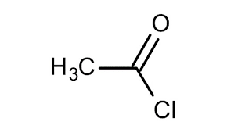
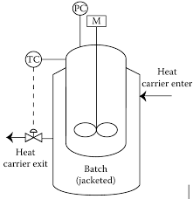
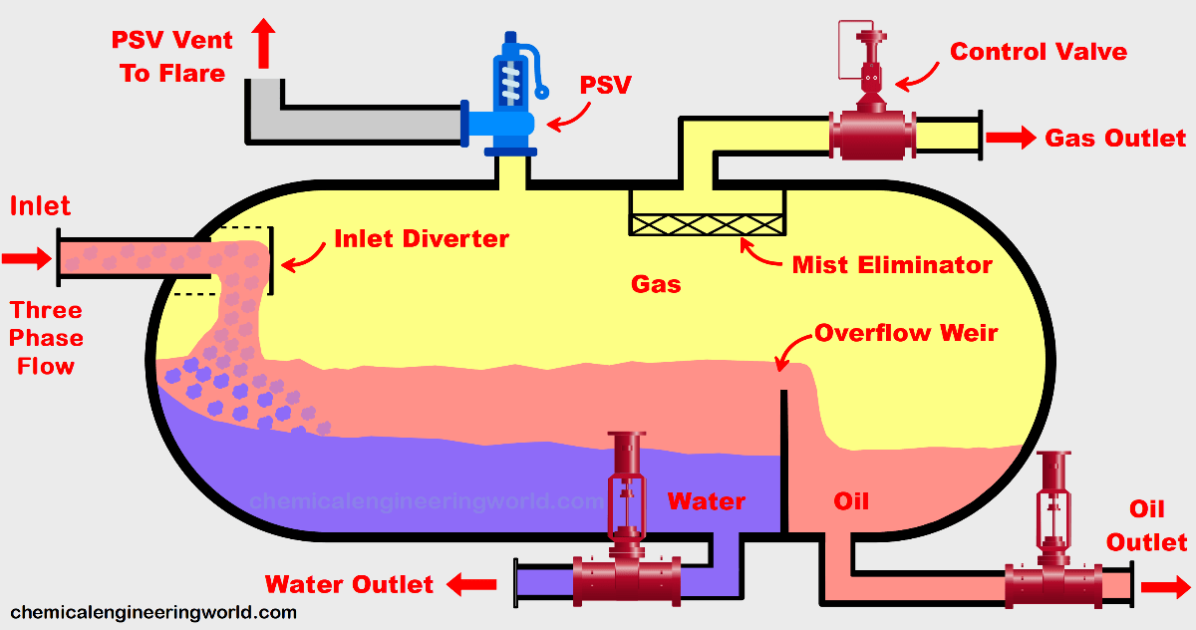
﷽
Acetyl chloride production scale
Introduction: Acetyl chloride (CH₃COCl) is an acyl chloride used in various organic synthesis reactions, particularly for introducing acetyl groups. One common method of synthesis is by reacting acetic acid with phosphorus pentachloride (PCl₅), a strong chlorinating agent.
Alternate Name:
Acetic acid chloride
Ethanoyl Chloride
Acyl Chloride
Objective: This poster explores the chemical synthesis process of acetyl chloride and the reaction conditions necessary for optimal production
Chemical structure
Chemical reaction:
CH₃COOH+PCl₅→CH₃COCl+POCl₃+HCl
In this reaction, phosphorus pentachloride replaces the hydroxyl group (-OH) in acetic acid with a chlorine atom, forming acetyl chloride. The by-products are phosphorus oxychloride
(POCl₃) and hydrogen chloride (HCl)
Unit operation needed:
Reactor : Since this is a relatively simple, exothermic reaction, a batch reactor may be appropriate for small-scale synthesis, allowing for careful control of reactant addition
3_phase separator :
3-phase separator in acetyl chloride synthesis separates hydrogen chloride gas (HCl), acetyl chloride (light liquid), and phosphorus oxychloride (heavy liquid). HCl gas is vented to a scrubber, while acetyl chloride and phosphorus oxychloride are separated based on density. This ensures efficient separation and safe handling of corrosive by-products.
.
Parameter | condition | Explanation
Time | 1to 2 hours
Reaction type | Exothermic | Heat is released during the reaction, which needs to be controlled.
Temperature | 20–40°C (room temperature to slightly elevated) | Optimal for the reaction, prevents decomposition of acetyl chloride.
Pressure | Optimal for the reaction, prevents decomposition of acetyl chloride. | No pressure requirements
Rawan Abdelmajid @ AECENAR_Green chemistry /September 2024

