Slide 1
PAA production
Comparison Methods :
-cost
-yield
-safety

Slide 2

1.Mandelic Acid (A)
(safe production)
Method 2 - Mandelic Acid (A)
Reagent | Quantity per experiment | Quantity ordered | Price | Reference
Mandelic acid | 15 g | 250 g | $84.20 | Sigma
Potassium iodide | 2.07 g | 100 g | $46.47 | Sigma
Red phosphorous | 6 g | 250 g | $60.61 | Sigma
Phosphoric acid | 70 mL | 500 mL | $77.16 | Sigma
Ether | As needed | 1 L | $67.16 | Sigma
Dilute NaHSO3 | As needed | 1 L | $52.56 | Sigma
Na2SO4 | As needed | 500 g | $36.28 | Sigma
 |  |  | $424.44
The yield is 12.5 grams (90%) of phenylacetic acid .
Apparatus | Pieces | Price | Reference
Vacuum distillation set |  | $80.00 | Amazon
reflux | -
seperatory funnel | -

Slide 3
A variety of methods are illustrated by this patent. Though they use p-hydroxymandelic acid hydrate in their examples, they state that mandelic acid is a suitable starting reagent, albeit the substituted derivatives are especially preferred. With highest yield and simplest method
2.Mandelic Acid (B) Expensive
The patent listed in method 3 refers to this method as expensive due to the use of KI
Reagent | Quantity per experiment | Quantity ordered | Price | Reference
Mandelic acid | 20 g | 250 g | $84.20 | Sigma
Pd/BaSO4 | 0.5 g | 10g | $108.00 | Sigma
Hydrogen gas | As needed
 |  |  | $192.20
Apparatus | Price | References
high pressure hydrogenation autoclave with magnetic stirrer | $2,250.00 | Ollital tech | Ali baba
Total yield 13.6 g or 85% of the theoretical.

Slide 4

3.Acetophenone
(safe production)
Reagent | Quantity per experiment | Quantity ordered | Price | Reference
Acetophenone | 4.56 g | 100 mL ≈ 100 g | $23.92 | Sigma
Methanol | 10 mL | 1 L | $48.95 | Sigma
Boron trifluoride etherate | 22 g | 100 mL ≈ 115 g | $44.39 | Sigma
Lead tetraacetate | 17.7 g | 100 g | $61.26 | VWR
Benzene | 700 mL | 1 L | $127.25 | Sigma
Sodium bicarbonate | 150 mL | - | - | -
Sodium chloride | 200 mL | - | - | -
Sodium sulfate | As needed | 500 g | $36.28 | Sigma
Sodium hydroxide (2M) | 10 mL | 1 L | $36.03 | Sigma
 |  |  | $378.08
Yield 86% methyl phenylacetate
92% PAA
80% overall
Note:
If we can order Methyl phenylacetate (intermediate product),this will reduce the process of PAA production ,saving money and time.
methyl phenylacetate
Sigma
Apparatus | Price | Reference
Magnetic stirrer | -
Vacuum distillation set | $80.00 | Amazon
Reflux | -
Separatory funnel | -

Slide 5
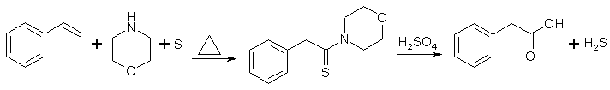
4.Styrene
(Toxic byproduct)
Reagent | Quantity per experiment | Quantity ordered | Price | Reference
Styrene | 104 g | 250g | $101.64 | Biosynth
Sulfur | 80 g | 1Kg | $38.50 | Sigma
Morpholine | 174 g | 500 mL | $35.90 | Sigma
Chloroform | As needed | 500 mL | $80.32 | Sigma
Dilute hydrochloric acid | As needed | - | - | -
Sulfuric acid (50% by weight) | 1200 mL | - | - | -
Ether | 1500 mL | 2.5 L | $147.09 | Sigma
12% caustic soda (NaOH) | 100 mL | - | - | -
 |  |  | $403.45
Apparatus | Pieces | Quantity ordered | Price | Reference
Vacuum distillation
Reflux | - | - | - | -
Separatory funnel | - | - | - | -
 |  |  | $0.00
Total
Note: One of the byproducts H₂S is extremely flammable and highly toxic, so necessary precautions must be taken to ensure it does not escape as a gas.
Such precautions include utilizing a fume hood.
59% yield of phenylacetic acid,

Slide 6
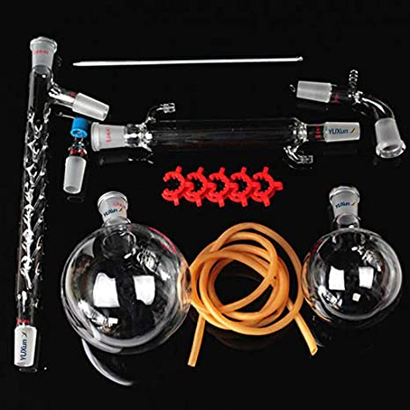
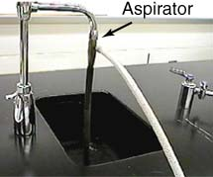
Vacuum Distillation
Vacuum distillation apparatus
Two faucets
  One for the condenser
  One to add a water aspirator to introduce the vacuum
Two stands
Boiling chips
Note: To prevent bumping
during vacuum distillation,
utilize a magnetic stirrer
instead of boiling chips.
Boiling chips are needed
for reflux.

Slide 7
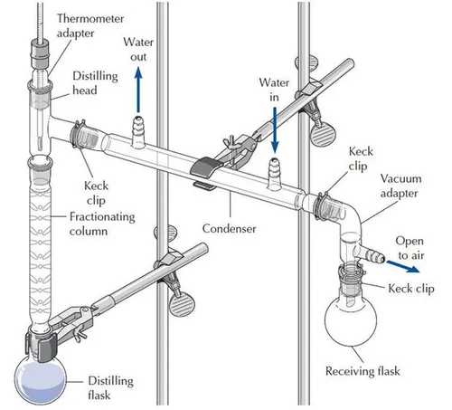

Slide 8
Minimum safety equipment
Safety glasses (2)
Fire extinguisher
Would be helpful to have
Fume hood
Eye wash station

