Slide 1
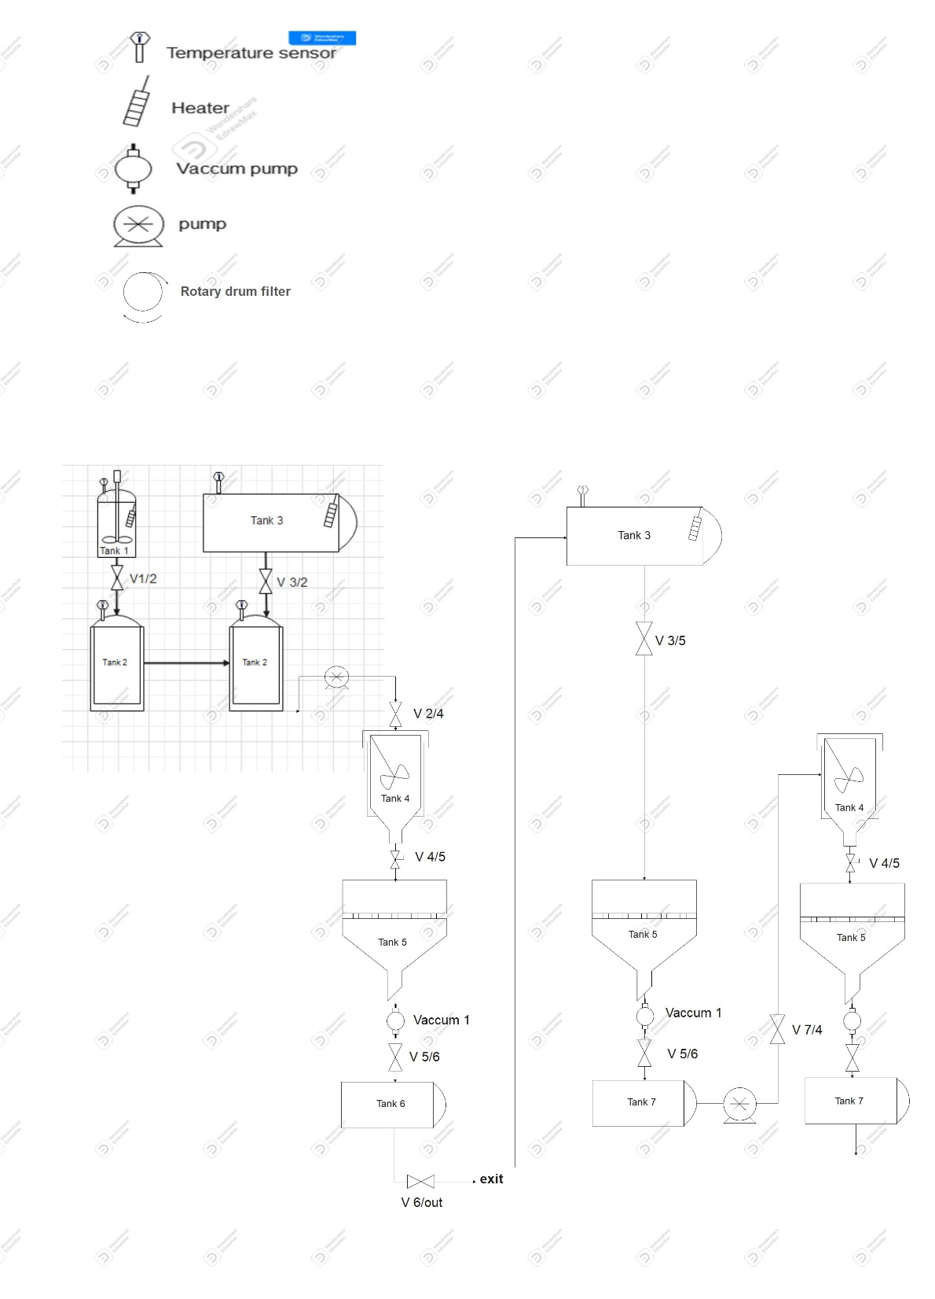
MEGBI - Middle East Genetics and Biotechnology Institute
مركز أبحاث للجينات والتقنية البيولوجية
12- Sterilization system:
Close all the presented valves
Open valve V1/2 (T=120 P=1.5 bar)
Close valve V1/2
Open valve V3/2 (T=120 P=1.5 bar)
Close valve V3/2
Open valve V3/2 (T=120 P=1.5 bar) for second time
Close valve V3/2
Open valve V2/4 (T=120 P=1.5 bar)
Close valve V2/4
Open valve V7/4 (T=120 P=1.5 bar)
Close valve V7/4
3- Tank 3 to tank 2 :
Open Valve V3/2
Add 5L warm water .
1- Tank 1 :
Place 1013.5g of salicylic acid
Add 2.5L acetic anhydride
Add 125ml concentrated H2SO4
Mix and heat to 85º for at least 10min .
4- Tank 2 to tank 4
Open valve V2/4
Cool the mix about 20min in an ice bath with mixing .
Crystals are formed now.
7- Tank 5:
Open valve V3/5
The obtained aspirin crystals are re-dissolved with 30L warm water for about 20 min.
Open valve V5 and valve V5/7
2- Tank
Open valve V1/2
Cool down the mix to between 25- 28º.
9-Tank 4:
Re-cool the mix about 20 min in the ice bath with mixing.
Open valve V4/5 for the final vacuum filtration.
5- Tank 4 to tank 5:
Open valve V4/5, V5 and V5/6
let the vacuum filtration begin.
Aspirin crystals are now in tank 5.
10- Tank 6 :
Open valve V5/6 and V 6/out
Crude Aspirin crystals are harvested from tank 5 and ready to be dry, tested and compressed for the market
V 5
V 5/7
Vaccum 1
V 5/6
6- filtrate discarding
Open valve V6/out
The filtrate is discarded from the tank 6 out of the system.
Close valve V5, V6/out, V4/5, and V5/6
Tank 6
V 6/out
8- Tank 7 to 4
Open valve V7/4
The solution is pumped now from tank 7 to tank 4 for the second crystallization
exit
Figure 1 : Dynamic view of pilot plant aspirin production system

