Slide 1



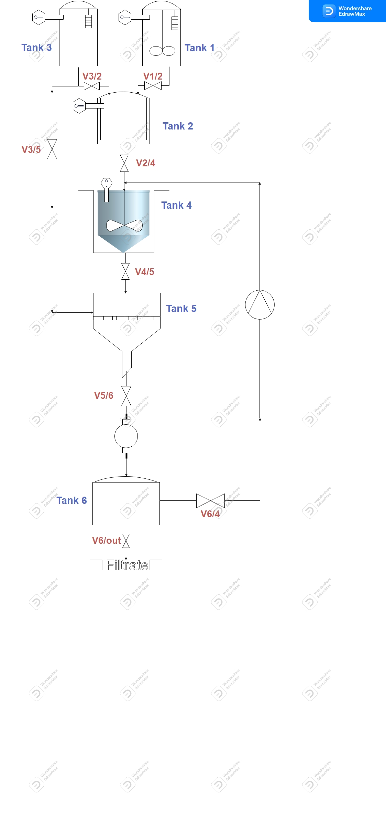
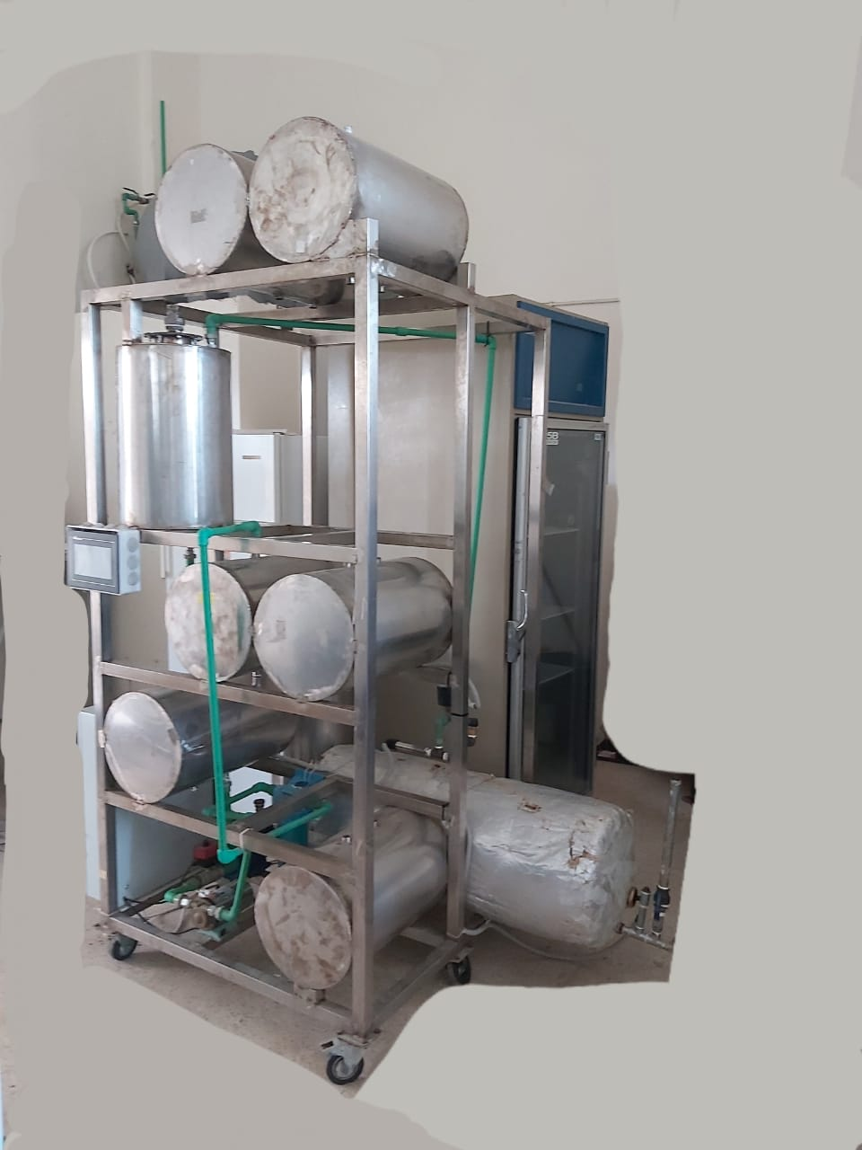

www.aecenar.com
Pilot Plant Scale for Aspirin Production
Introduction: Aspirin or Acetylsalicylic acid (ASA) is one of the first drugs to come into common usage, still widely used around the world with approximately 40,000 tonnes produced globally each year. Aspirin is an ingredient in many proprietary analgesic and cold/flu preparations. It is also used for the prevention of cardiovascular disease and there is growing work on its role in the prevention and management of cancer. Aspirin ( C₉H₈O₄) remains on the World Health Organization’s Model List of Essential Medicine (21st List 2019) both for its use in pain control and anti-platelet effects. Here we have to present a static and a dynamic view for the pretended aspirin bioreactor
Tank3
Tank1
Tank2
Sterilizer
Tank6
Figure 1 : An approximative view of aspirin system production
Figure 2 : The real Aspirin production system
1- Tank 1 :
Place 1013.5g of salicylic acid
Add 2.5L acetic anhydride
Add 125ml concentrated H2SO4
Mix and heat to 85º for at least 10min .
2- Tank 2 :
Open valve V1/2
Cool down the mix to between 25- 28º.
3- Tank 3 to tank 2 :
Open Valve V3/2
Add 5L warm water .
4- Tank 2 to tank 4
Open valve V2/4
Cool the mix about 20min in an ice bath with mixing .
Crystals are formed now.
5- Tank 4 to tank 5:
Open valve V4/5 and V5/6
let the vacuum filtration begin.
Aspirin crystals are now into the filter paper in tank 5.
Open valve V6/out
The filtrate is discarded out of the tank 6 .
Close valve V5/6, V4/5 and V6/out
6- Tank 5:
Open valve V3/5
The obtained aspirin crystals are re-dissolved with 30L warm water for about 20 min.
Open valve V5/6
7- Tank 6 :
Here is the dissolved aspirin .
Open valve V6/4
8- Tank 6 to 4
The solution is pumped now from tank 6 to tank 4 for the second crystallization.
9-Tank 4:
Re-cool the mix about 20 min in the ice bath with mixing.
Open valve V4/5 for the final vacuum filtration.
10-Tank 5 :
Open valve V5/6
The filtrate is discarded into tank 6 and then out of the system by opening valve V6/out.
Crude Aspirin crystals are harvested from filter paper and ready to be dry, tested and compressed for market delivery.
11- Sterilization:
Close all the valves
The whole system must be sterilized by using sterilizer system
The valves are successively re-opened as mentioned as above.
Rayane Dergham, Hind Abd El Hamid @ MEGBI/ AECENAR November 2022

