Slide 1



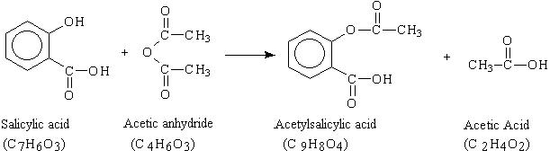
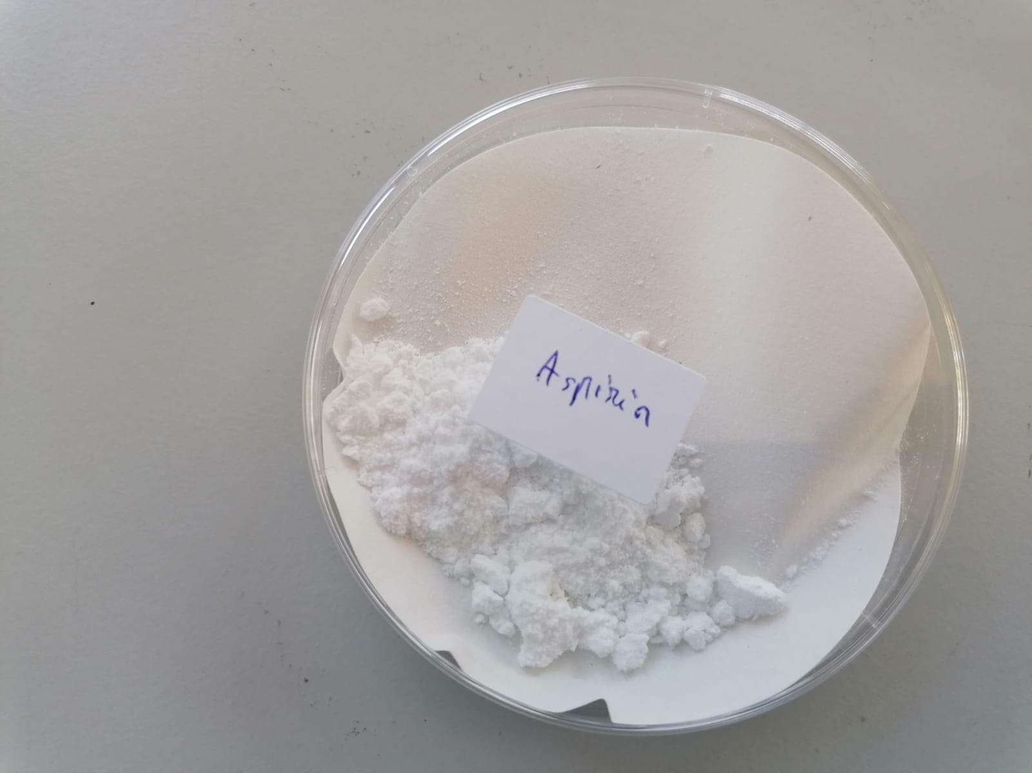
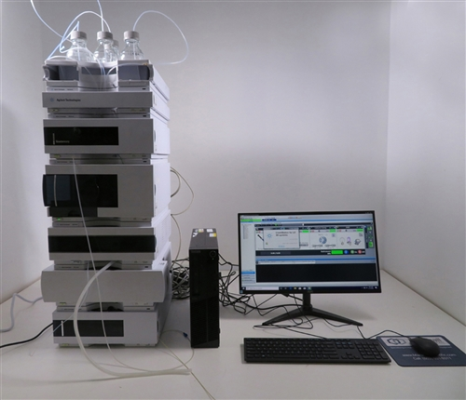
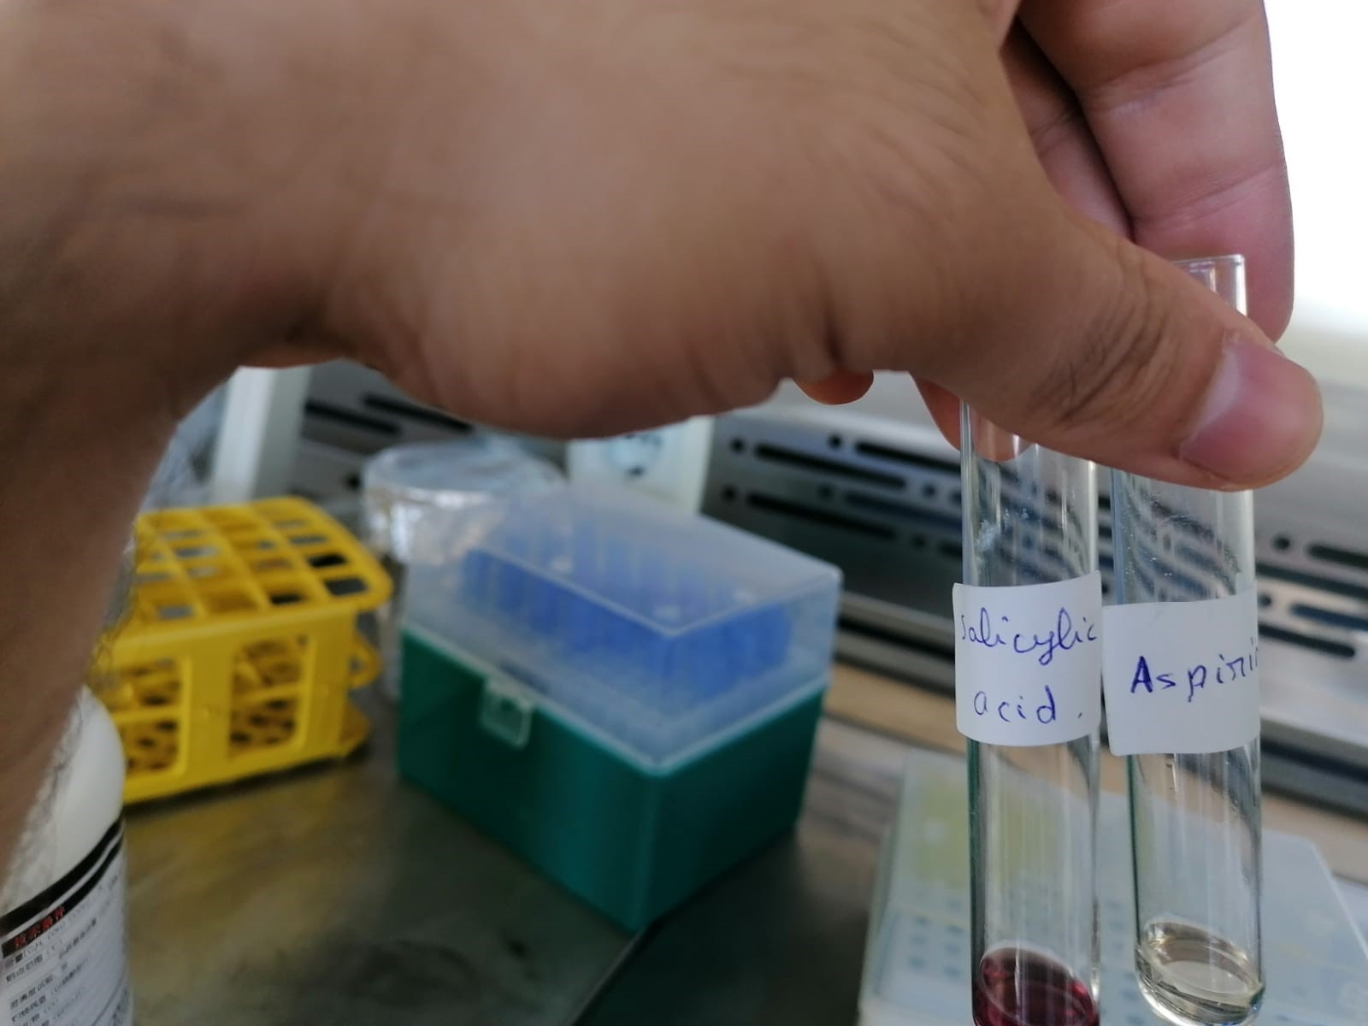
www.aecenar.com
Aspirin Production and quantification
Introduction: Aspirin or Acetylsalicylic acid (ASA) is one of the first drugs to come into common usage, still widely used around the world with approximately 40,000 tonnes produced globally each year. Aspirin is an ingredient in many proprietary analgesic and cold/flu preparations. It is also used for the prevention of cardiovascular disease and there is growing work on its role in the prevention and management of cancer. Aspirin ( C₉H₈O₄) remains on the World Health Organization’s Model List of Essential Medicine (21st List 2019) both for its use in pain control and anti-platelet effects.
Lab scale for Aspirin Production:
ASPIRIN
Aspirin synthesis:
Place 2.027g (0.015 mole) of salicylic acid in a volumetric flask.
Add 5 mL (0.05 mole) of acetic anhydride, followed by 5 drops of conc. H₂SO₄ (use a dropper, H₂SO₄ is highly corrosive)
Swirl the flask gently until the salicylic acid dissolves.
Heat the flask gently on the steam bath for at least 10 minutes.
Allow the flask to cool at room temperature.
Add 10 mL of warm water and cool the mixture for about 10 min in an ice bath so aspirin can start precipitating.
Filtrate the aspirin using filter paper (add small amount of cold water on the filter paper before adding the solution).
Pour the crystals into a beaker.
Dissolve them again by adding 60 ml of warm water.
Put the beaker in ice to recrystallize.
Filter the product again.
Results 1.54 g of crystal aspirin
Aspirin qualitative test using ferric chloride:
The test is done with the crude product, pure product, and the salicylic acid:
Take a very small amounts of the 3 products and put them in test tubes.
Add 1 mL of ethanol 95% to each test tube.
Add 1 drop of FeCl3 Solution (2.5%).
Shake the test tubes and see the colors.
Formation of an ironphenol complex with Fe(lll) gives a definite colour ranging from red to violet, depending upon the particular phenol present.
Note: Iron (III) ion reacts with phenols to form a purple complex. Salicylic acid contains a phenol group, but acetylsalicylic acid does not.
Results of qualitative test of FeCl3 with salicylic
acid (purple) and aspirin (transparent)
Aspirin Quantification :
The quantification of the produced aspirin is done with HPLC wish is an analytical chemistry technique used to separate, identify, and quantify each component in the mixture.
First you run pure standard with known concentration and note down retention time and peak area.
Then run sample and note down the chromatographic area of peak appear at same retention time as that of standard.
Calculate concentration= sample Area of sample divided by area of standard multiply by conc. of standard.
Rayane Dergham, Ihab Wehbe, Muhammad Kalawoon
@ MEGBI/ AECENAR 2022

