Slide 1



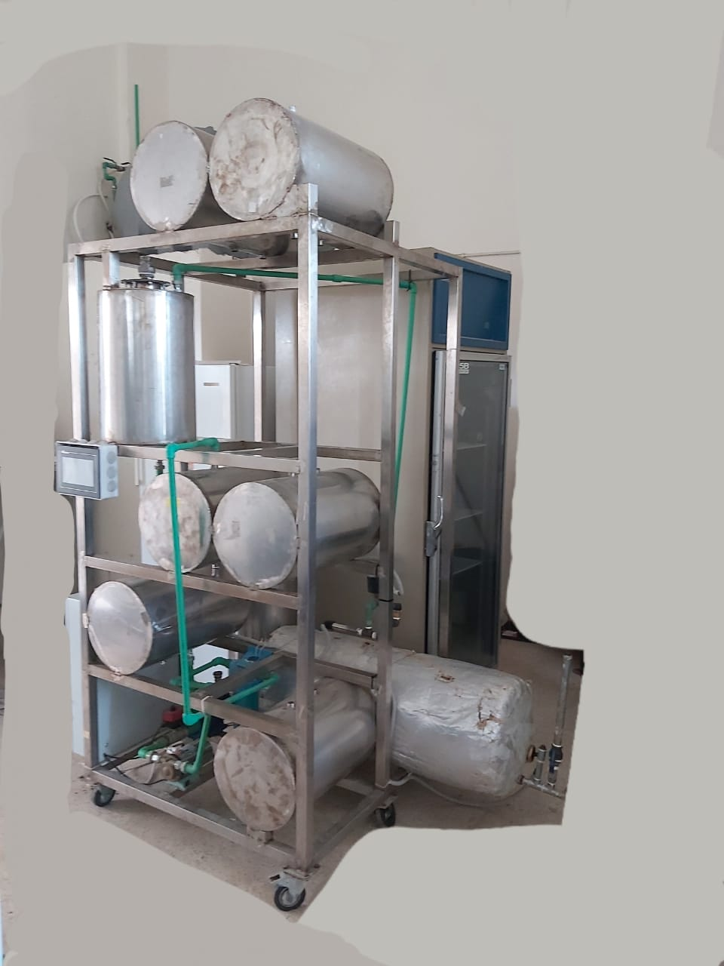
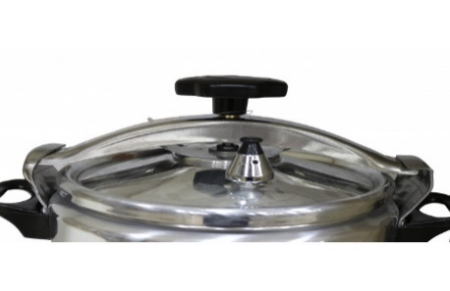





www.aecenar.com
Pilot Plant Scale for Aspirin Production
Introduction: Aspirin or Acetylsalicylic acid (ASA) is one of the first drugs to come into common usage, still widely used around the world with approximately 40,000 tonnes produced globally each year. Aspirin is an ingredient in many proprietary analgesic and cold/flu preparations. It is also used for the prevention of cardiovascular disease and there is growing work on its role in the prevention and management of cancer. Aspirin ( C₉H₈O₄) remains on the World Health Organization’s Model List of Essential Medicine (21st List 2019) both for its use in pain control and anti-platelet effects. Here we have to present a static and a dynamic view for the pretended aspirin bioreactor
Tank3
Tank1
T1=85º
Tank 4 with ice bath
Tank3
T3=60º
Warm water
Tank1
∞
V3/4
V3/2
V1/2
T2=25º
V2/4
Tank2
V4
V5
Tank 5
Tank2 with water bath
Pump to fulfill a vaccum filtration
Tank5
V6
Figure 1 : An approximative view of the desired Aspirin production system
Figure 2 : The real Aspirin production system
1- Tank 1 :
Place 1013.5g of salicylic acid
Add 2.5L acetic anhydride
Add 125ml concentrated H2SO4
Mix and heat to 85º(T1) for at least 10min .
2- Tank 2 :
Open valve V1/2
Cool down the mix to between 28- 25º (T2).
3- Tank 3 to tank 2 :
Open Valve V3/2
Add 5L warm water .
4- Tank 2 to tank 4
Open valve V2/4
Cool the mix about 10min in an ice bath .
5- Tank 4 to tank 5:
Open valve V4
let the filtration begin.
Aspirin crystals are now into the filter paper in tank 4.
Close valve V4
6- Tank 3 to tank 4 : (but here without ice)
Open valve 5 (to get rid of ice)
Open valve V3/4 (washing)
The obtained aspirin crystals are re-dissolved with 30L warm water for about 15 min
7- Tank 4:
Close valve V5
The ice is re-added to the jacketed tank for the second crystallization
Re-cool the mix about 10 min in the ice bath
Open valve V4 for the final filtration.
Crude Aspirin crystals are harvested from filter paper and ready to be dry, tested and compressed for market delivery
8- Tank 5:
Open valve V6
The filtrate is than discarded out of the system
9- Sterilization:
Close all the valves
The whole system must be sterilized by using sterilizer system
The valves are successively re-opened
Rayane Dergham, Hind Abd El Hamid @ MEGBI/ AECENAR November 2022

