Slide 1



محطة لمعالجة النفايات ولتوليد الطاقة الكهربائية
NLAP-WEDC Waste to Electricity Demonstration Cycle
(Actual Status December 2020, TODOs for 2021, Timeline, Costs)

Slide 2
Actual Status at AECENAR Research Center in Ras Maska
الوضع الحالي للمحطة المتواجدة عند مركز أبحاث AECENAR في راسمسقا - طرابلس
المحرقة جاهزة
تم اجراء تجارب للحرق عليها
إمكانية للتحكم عن بعد
Test at 1 Oct 2019 and 27 Dec 2019

Slide 3
Measurement of CO in flue gas (September 2020)
قد اثبت ان الانبعاثات بعد الفلترات ضمن المتطلبات وزارة البيئة

Slide 4
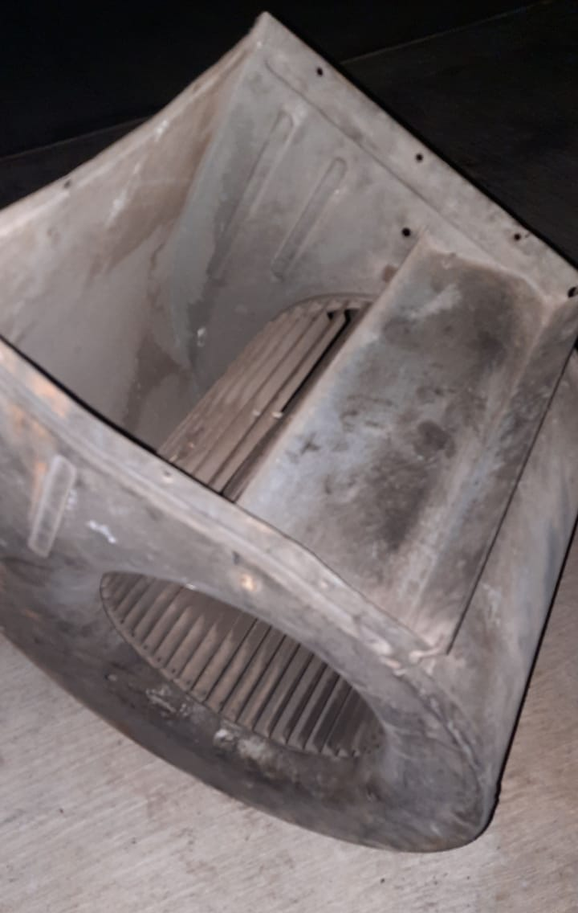
TODOs 2021
Adding a fan immediatly after flue gas outlet before of filters
Electrofilter Test and Improvement (actual 40 kV)
Incineration of all of the waste next to the plant (1-2 days)
Renting of a ground suitable for commisioning of incinerator (must be away from housings)
Commisioning of incinerator and operation for at least 2 months (costs: moving 200 USD + about 1800 USD per months including workers)
Commisioning of power plant.
  open tasks: turbine govering valve automation, isolation and covering of incinerator and especially pressure drum (for safety in case of accident), stabilization of outcoming electricity (costs: about 3000 USD)
Installation planned on 16 Dec 2020
(responsible: Eng. Mahmud)

