Slide 1
NLAP
Waste Management & Energy
Tripoli/Lebanon
Marketing & Project Management
Waste Management (Separation, Recycling), Environmental Friendly Waste Incineration and Electricity Generation, Organic Waste Handling with Anaerobic Digestion & Biogas Production
NLAP-WEDC (Waste to Energy Demonstration Cycle)
R&D, System Testing
Address
Harba Building, next to Hospital Albert Haykal, Ras Masqa, (1 km from Tripoli), Lebanon
Contact
Dr. Eng. Samir Mourad, CEO Mobile +49 178 72 855 78 (WhatsApp) / +961 76 341 526 Email: samir.mourad@temo-group.com
Staff
1 System Engineer (AZ), 1 Autom. Eng.(AQ), 2 Electronics Engineers, 2 Software Engineers, 1 Electric Engineer

Slide 2
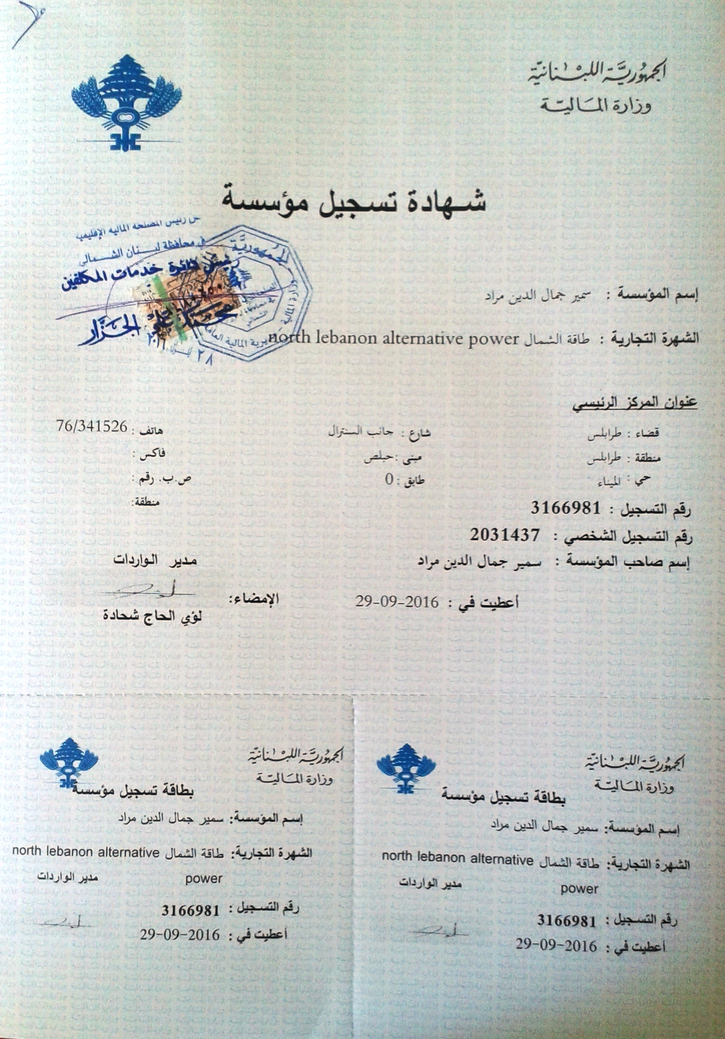
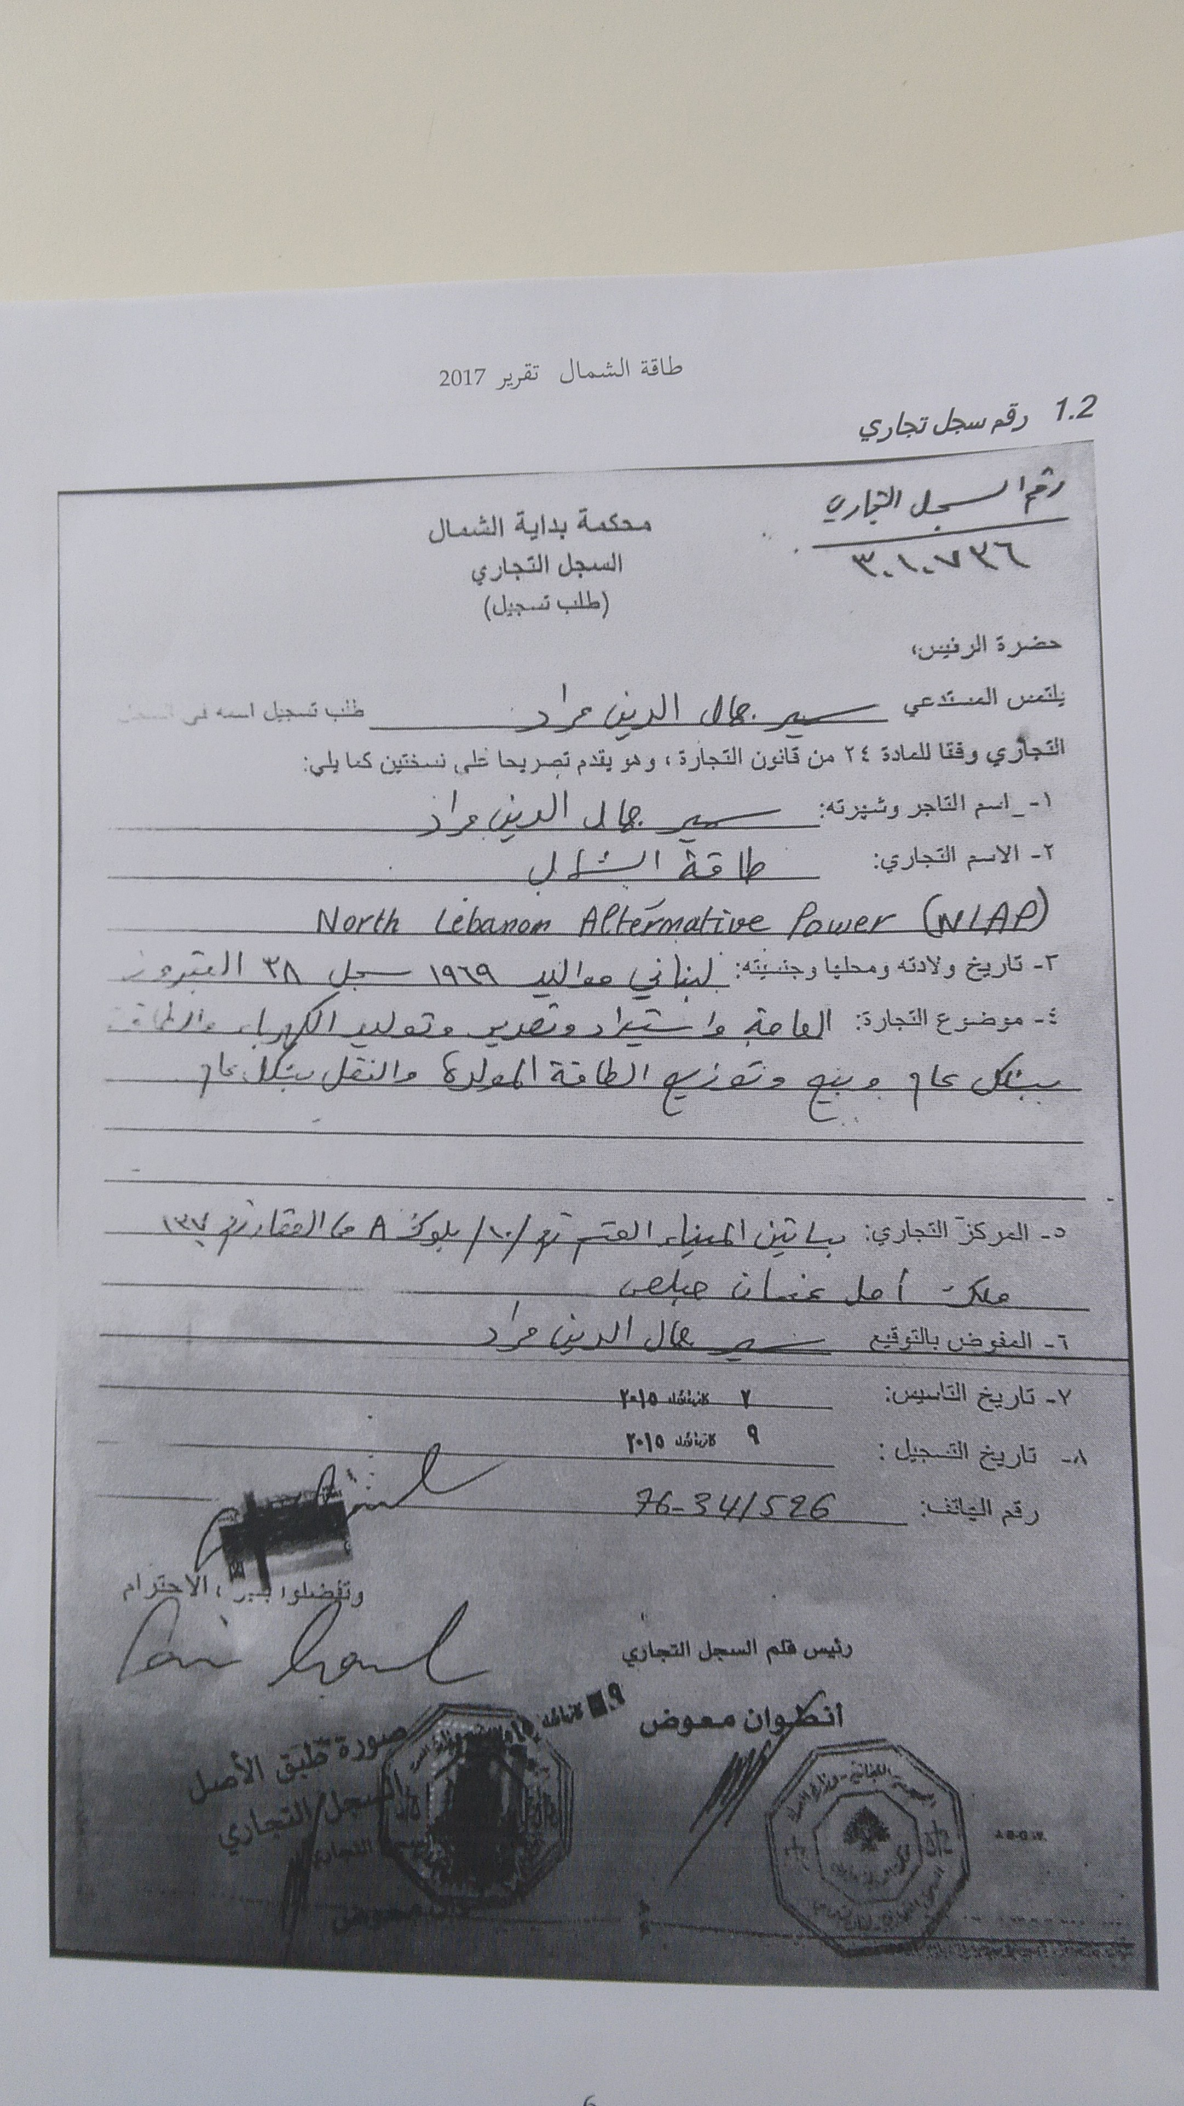
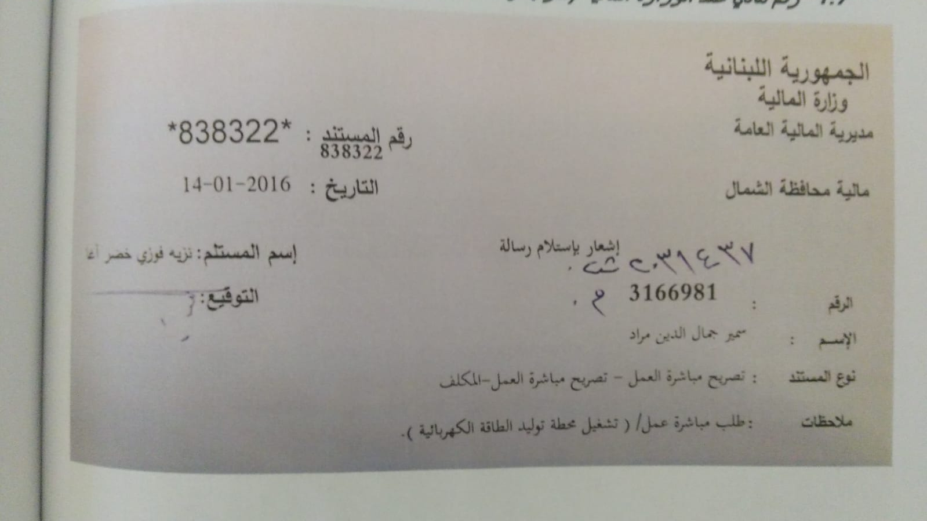
NLAP Official Papers
Registered in Tripoli/Lebanon
Tax Number 3166981

Slide 3
Marketing & Project Management
Waste Management (Separation, Recycling)

Slide 4
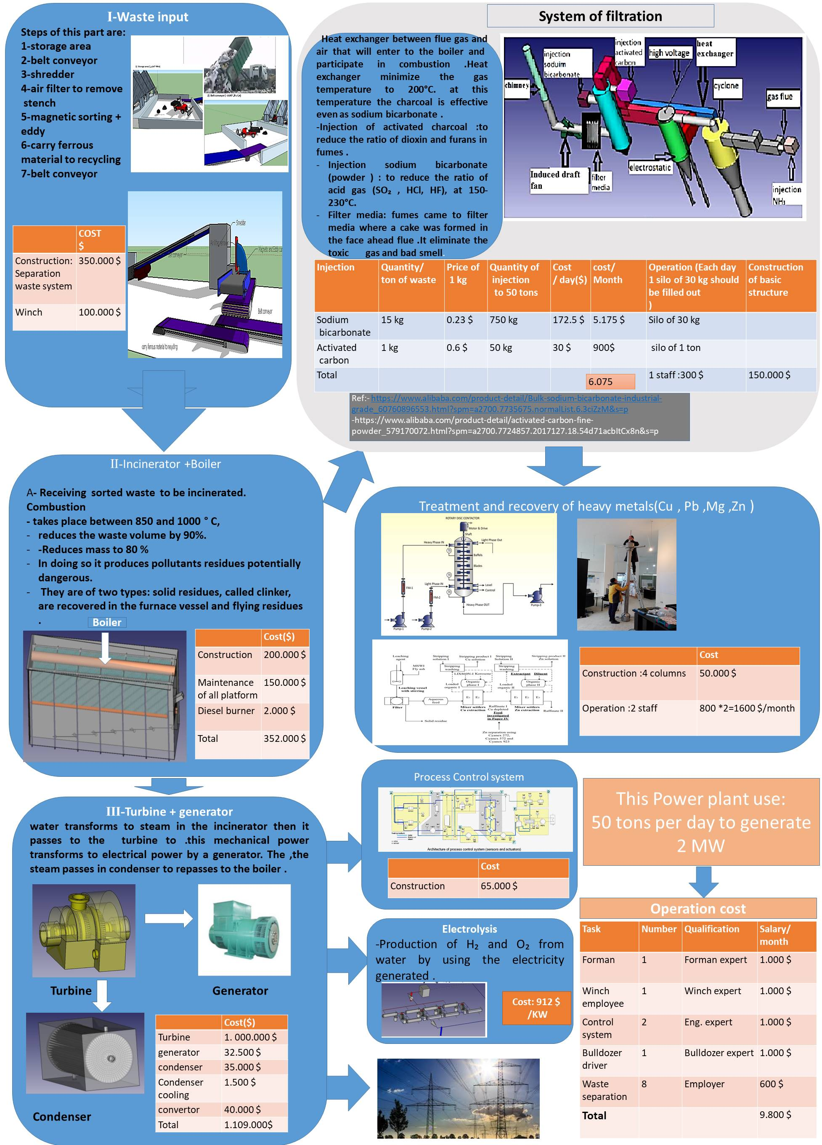
Marketing & Project Management
2 MWel from 50tons/day Municipal Waste Incineration
50t/2MWel Platform 2019

Slide 5
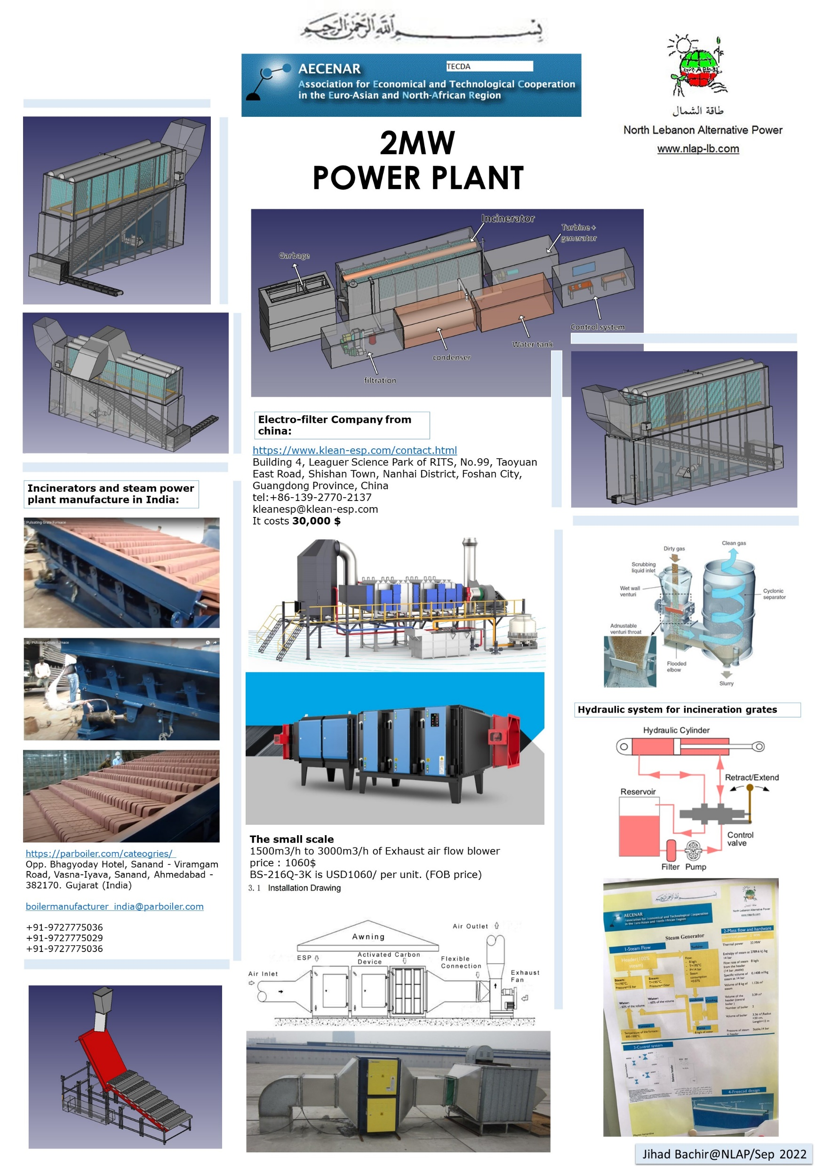
Marketing & Project Management
2 MWel from 50tons/day Municipal Waste Incineration

Slide 6
Marketing & Project Management
Waste Management Pilot Project in Ras Maska Nov 2023

Slide 7
Marketing & Project Management
Organic Waste Handling with Anaerobic Digestion & Biogas Production Assoun 2023/2024

Slide 8
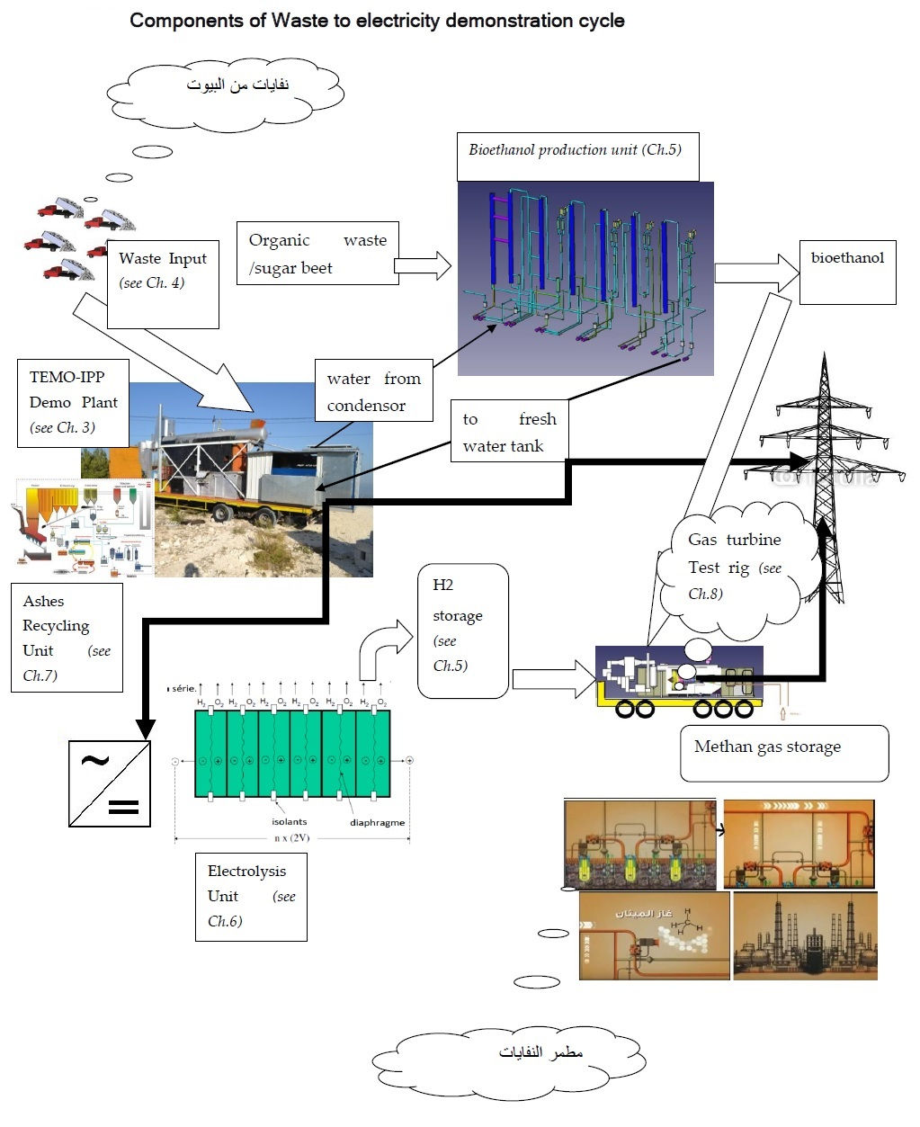
NLAP-WEDC (Waste to Energy Demonstration Cycle)

Slide 9
NLAP-WEDC in Ras Maska 2023

Slide 10
NLAP-WEDC – Inciniration Power Plant (IPP)

Slide 11
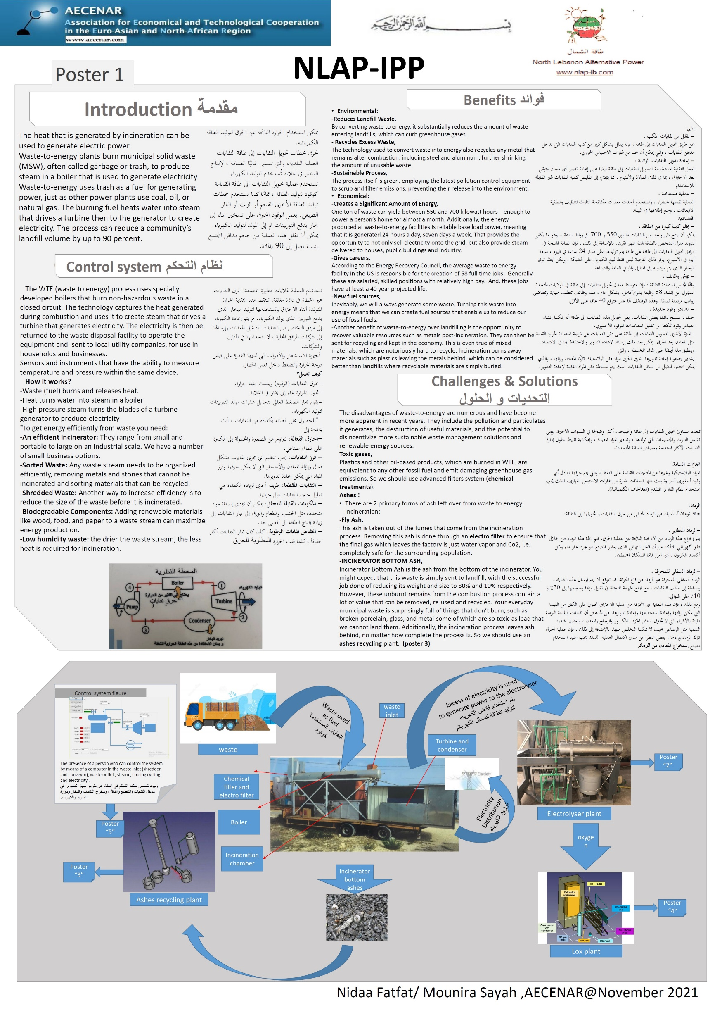
NLAP-WEDC – Inciniration Power Plant (IPP)

Slide 12
NLAP-WEDC – Inciniration Power Plant (IPP)

Slide 13
NLAP-WEDC - Waste Separation System

Slide 14
NLAP-WEDC Environment Friendly Treatment
Ashes Recycling

Slide 15
NLAP-WEDC – Energy Storage: Electrolyzer

Slide 16
NLAP-WEDC – Energy Storage: Electrolyzer

Slide 17
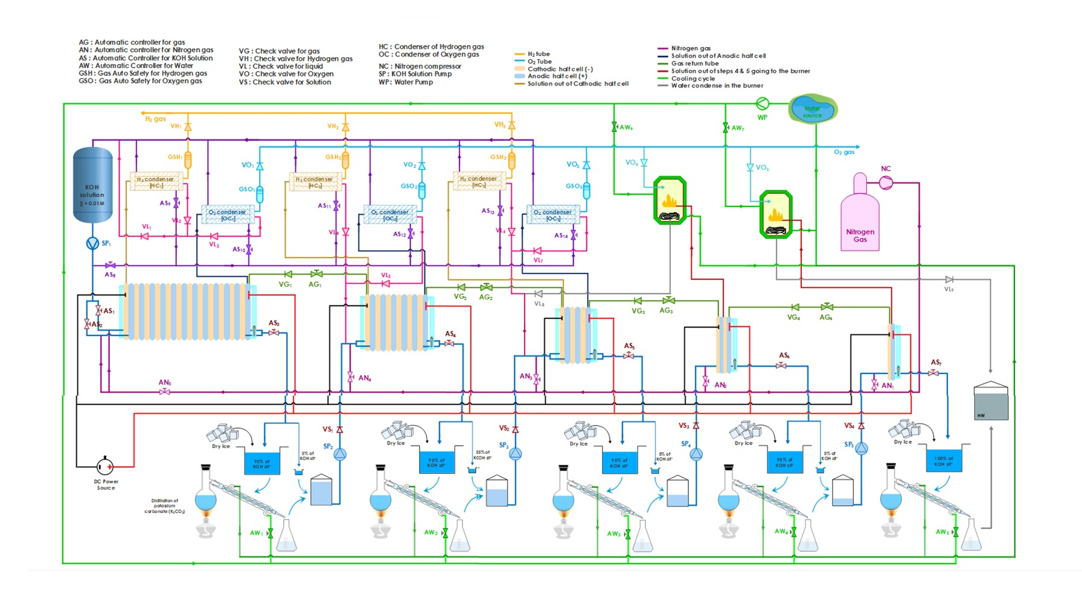
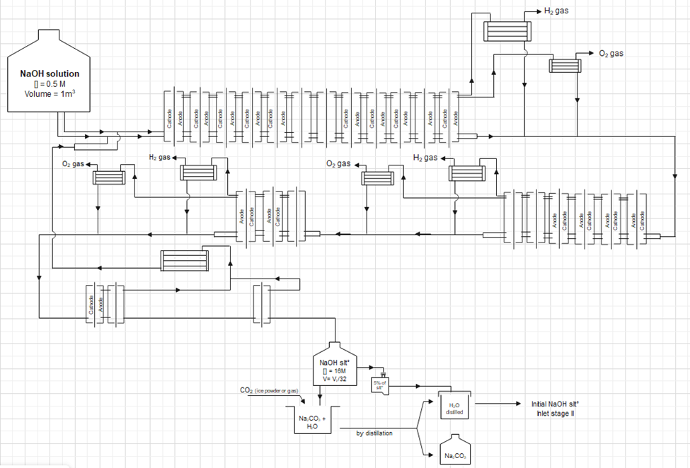
NLAP-WEDC – Energy Storage: Multistage Electrolyzer
Multistage GUI Design

Slide 18
NLAP-WEDC – Energy Storage Electricity: Fuel Cell

Slide 19
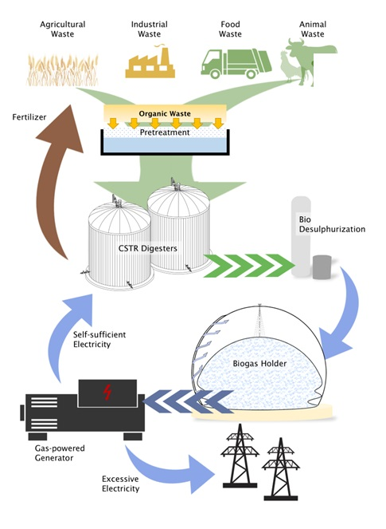
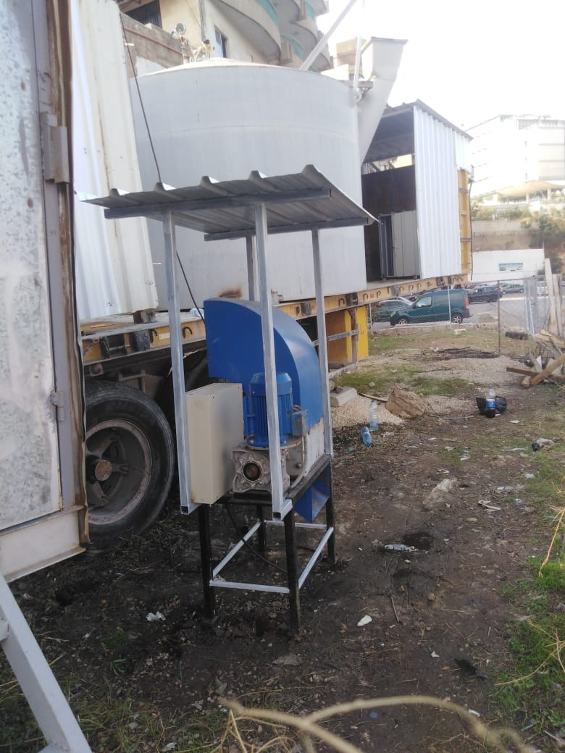
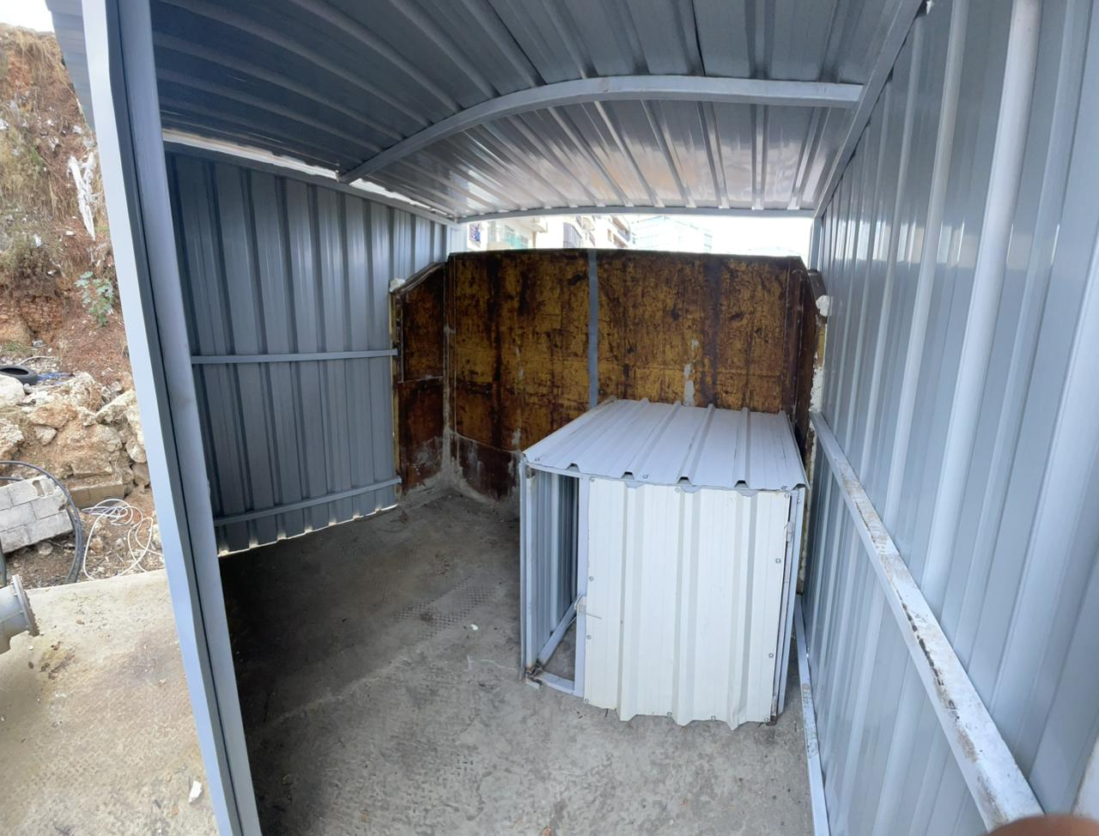
NLAP-WEDC
Mobile Biogas Generation and Gas Turbine Testrig

Slide 20
NLAP-WEDC
Mobile Biogas Generation and Gas Turbine Testrig

Slide 21
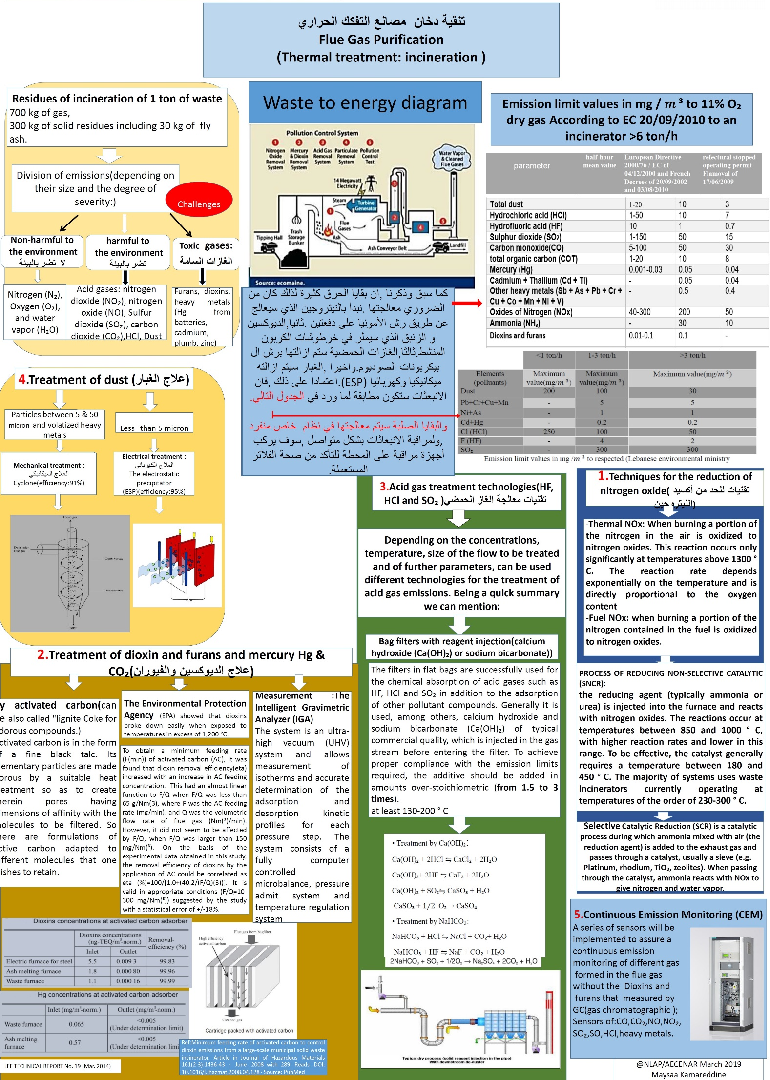
NLAP-WEDC Environment Friendly Treatment
Filter System

Slide 22
NLAP-WEDC Environment Friendly Treatment
Filter System Improvement 2023

Slide 23
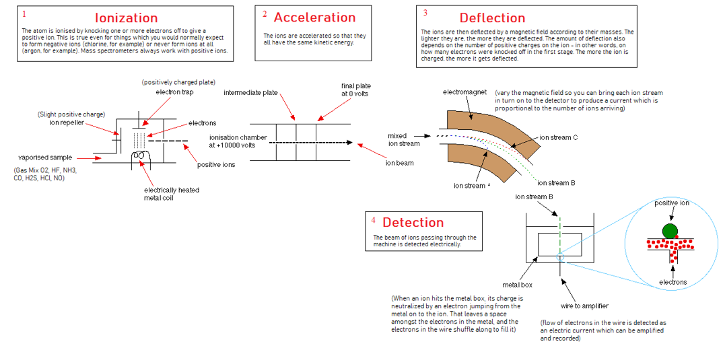
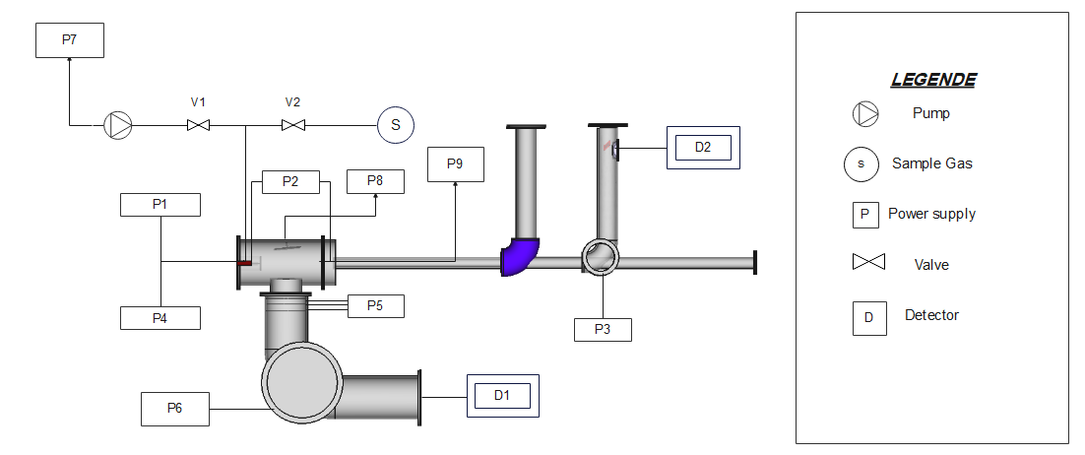
NLAP-WEDC Environment Friendly Treatment
Flue Gas Continous Measurement with Mass Spectrometry
Concept and Automation
Flue Gas Analysis with Mass Spectrometry

Slide 24
NLAP-WEDC Environment Friendly Treatment
Flue Gas Measurement with Laser

Slide 25
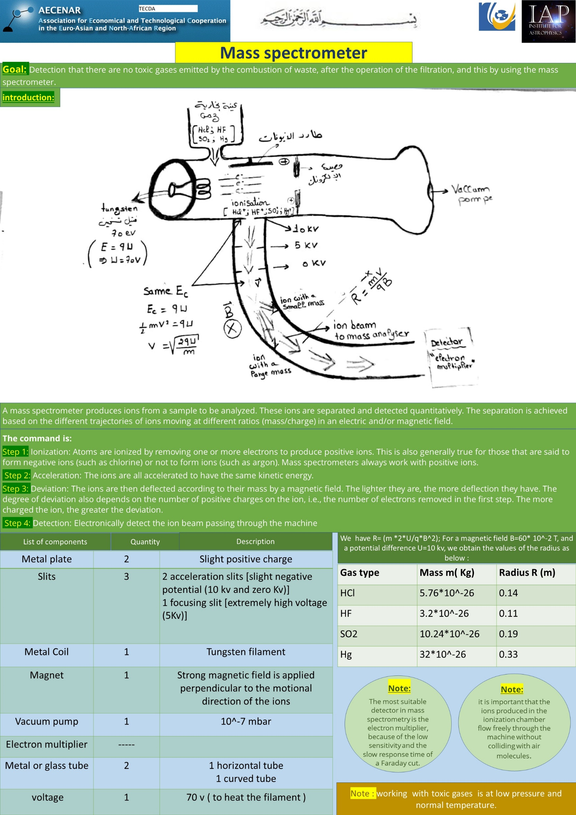
NLAP-WEDC Environment Friendly Treatment
Flue Gas Continous Measurement with Mass Spectrometry

Slide 26
NLAP-WEDC Environment Friendly Treatment
Flue Gas Continous Measurement with Mass Spectrometry

Slide 27
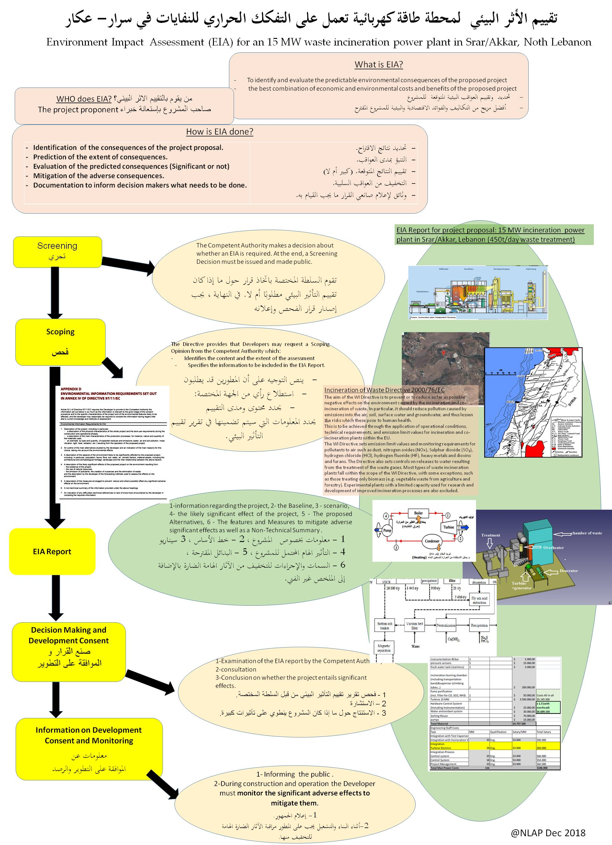
Legal matters - المسائل القانونية
Environmental Impact Assessment (تقييم اثر البيئي)

Slide 28
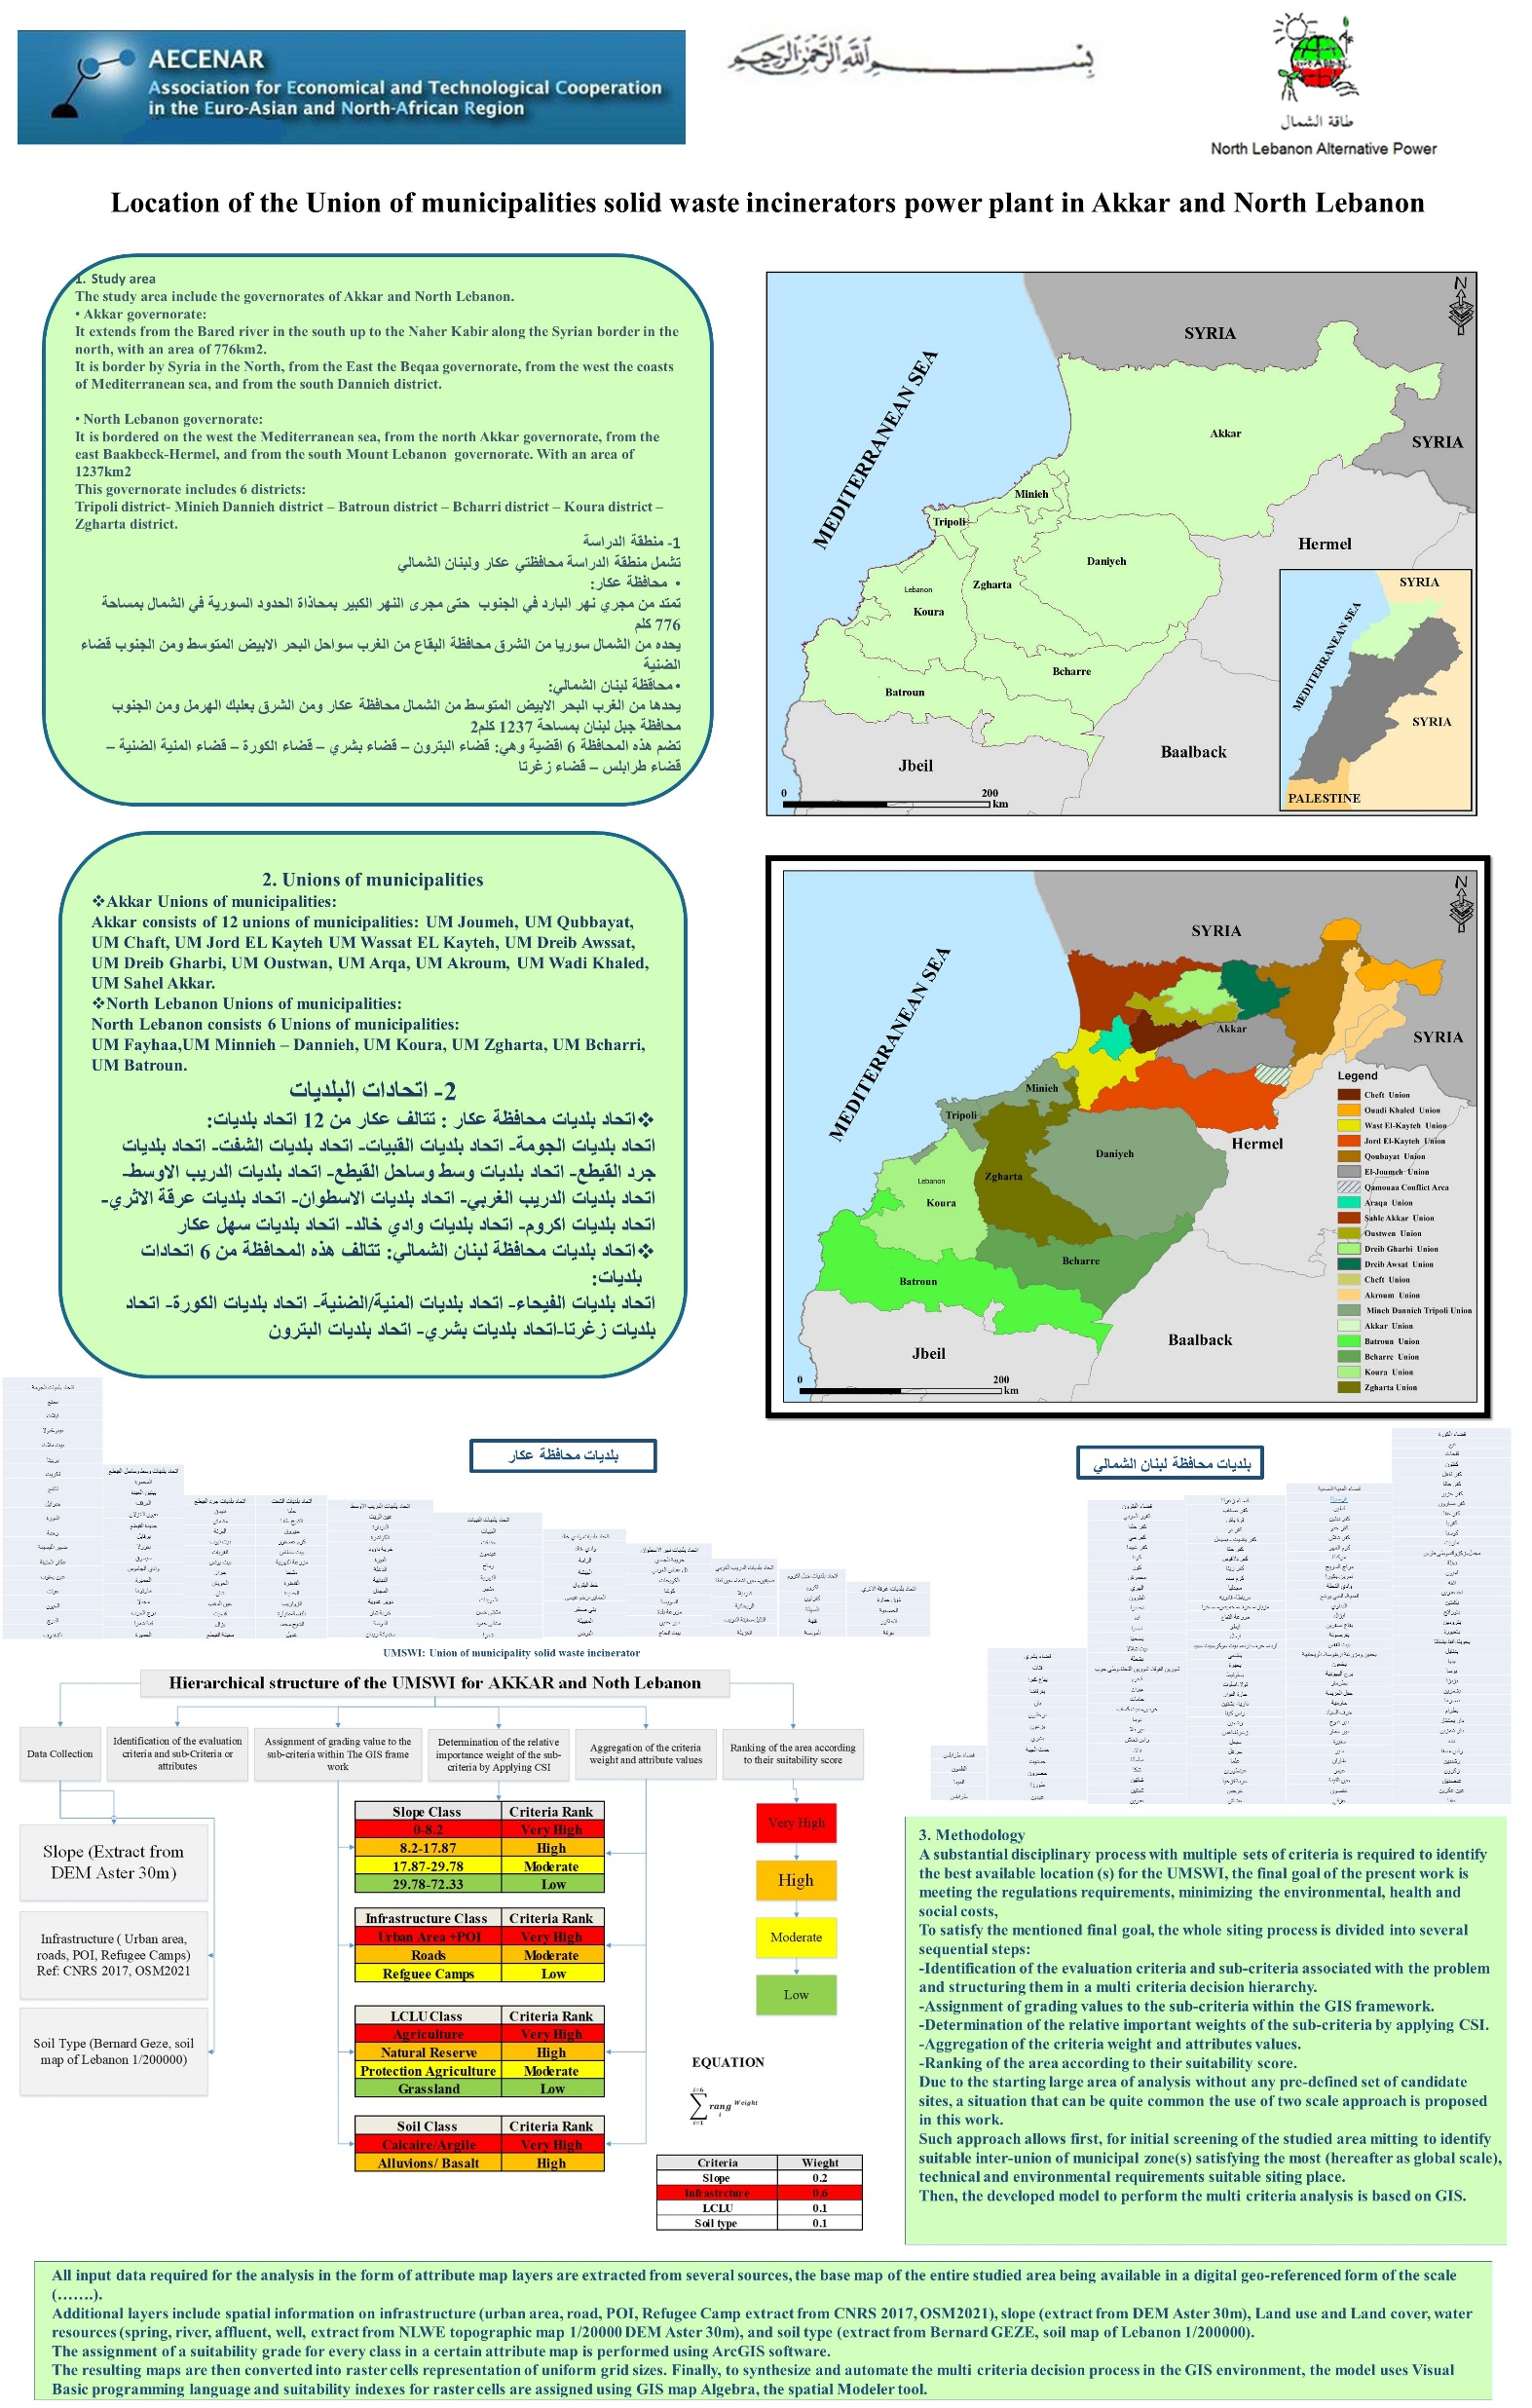
إدارة ملف انفايات في شمال لبنان

Slide 29
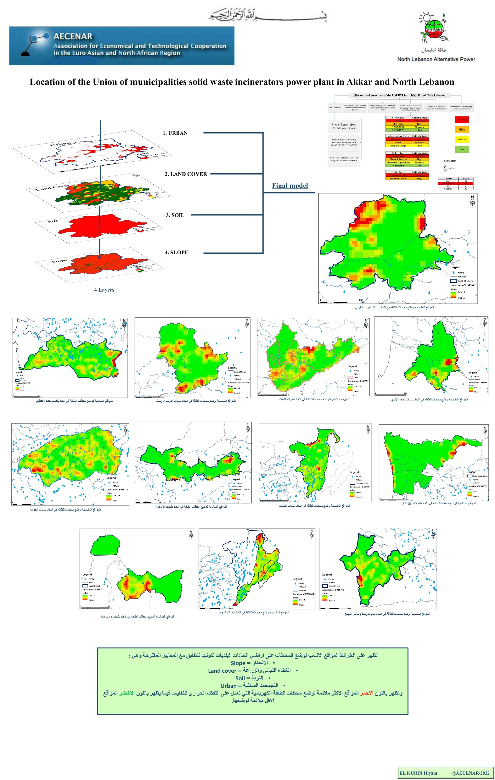
إدارة ملف انفايات في شمال لبنان

