Slide 1



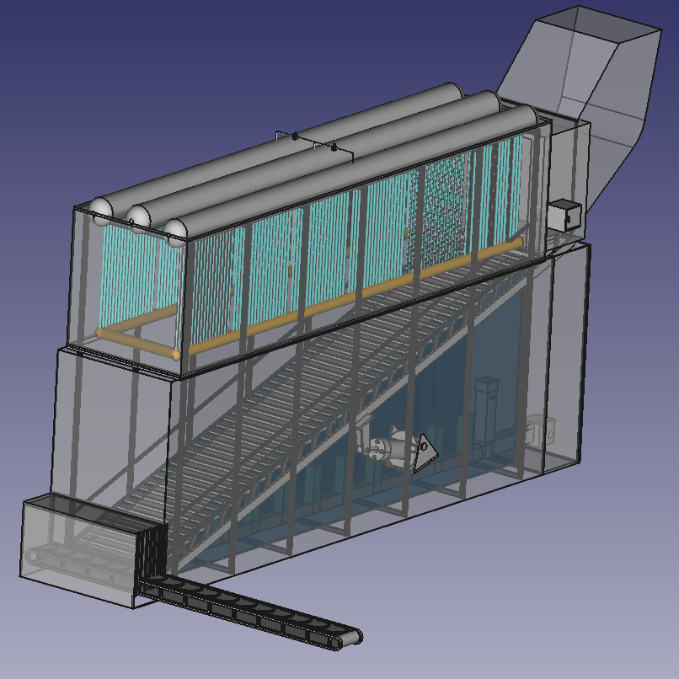
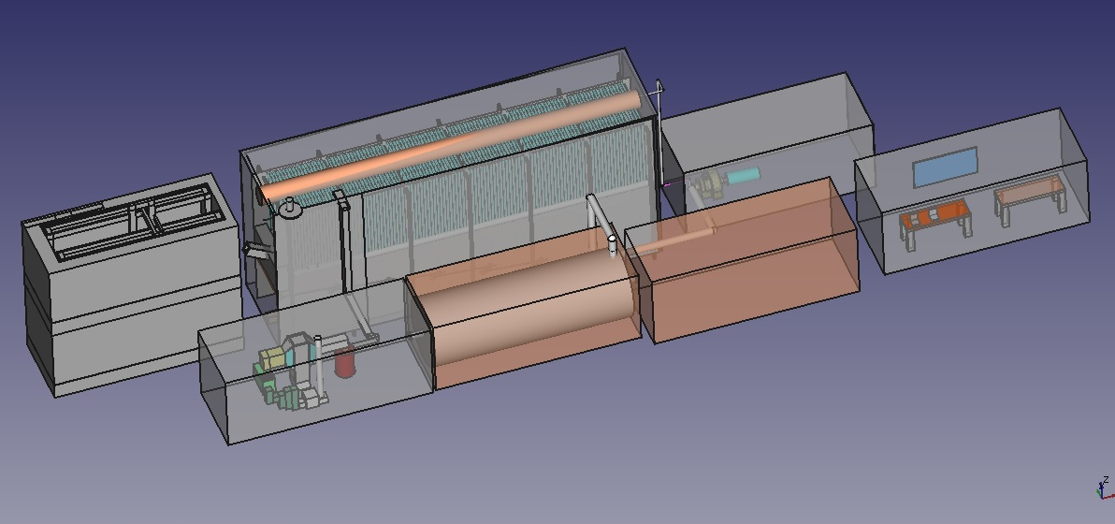
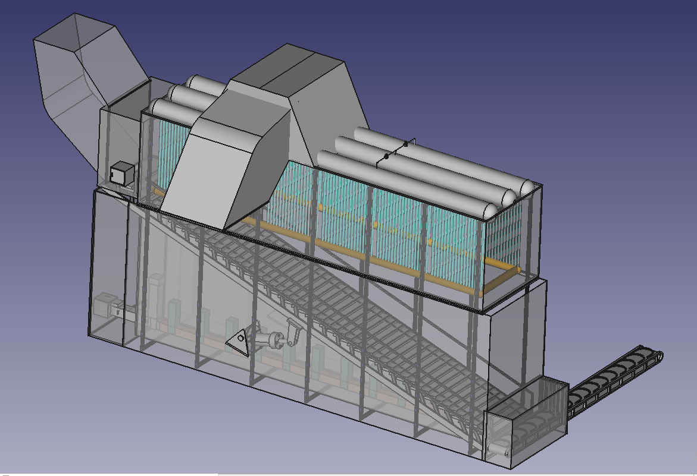
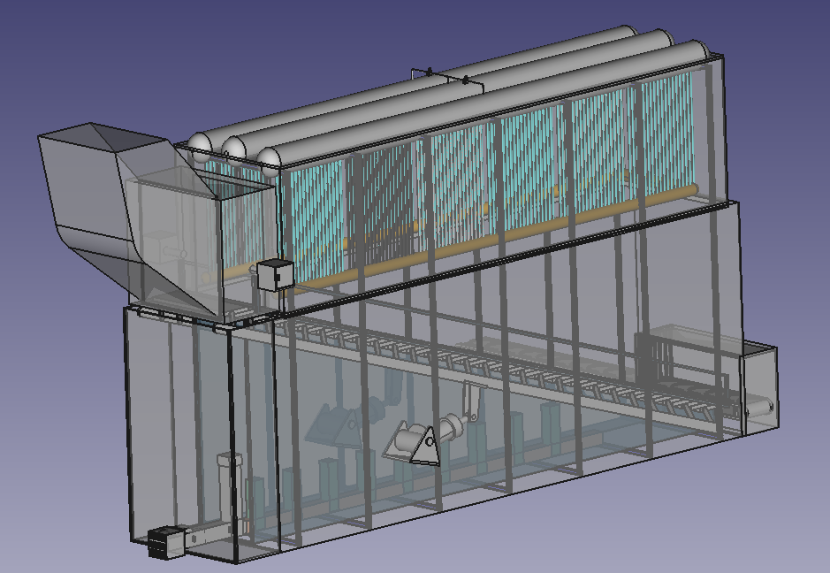
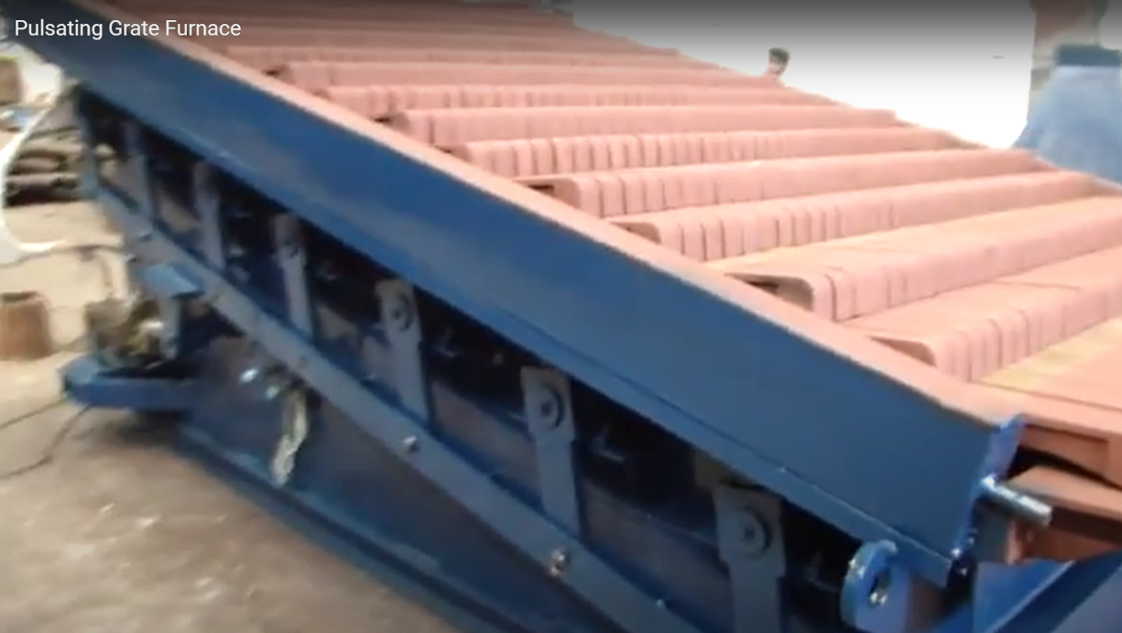
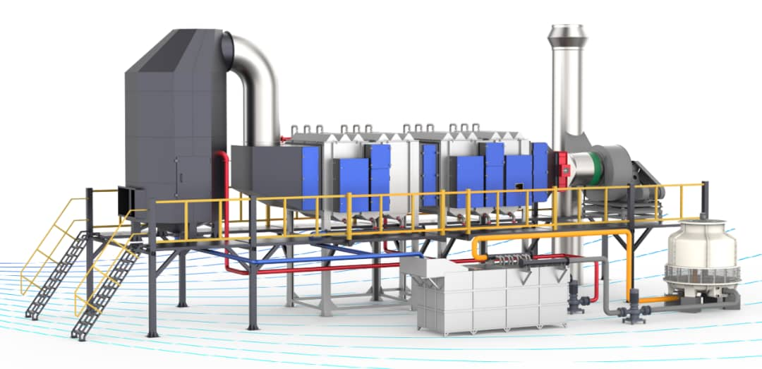
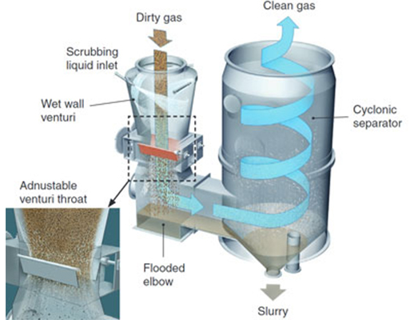
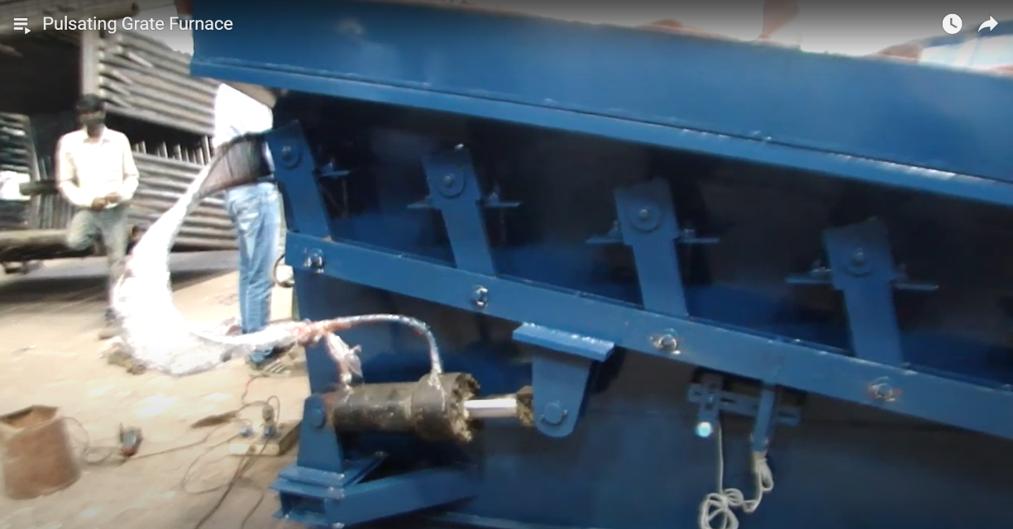
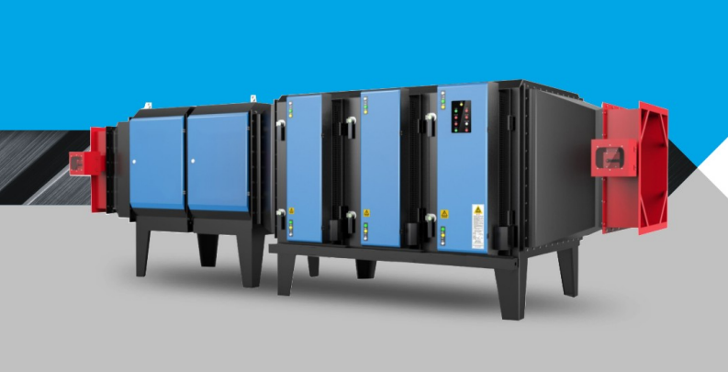
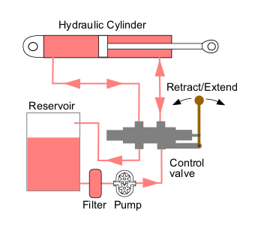
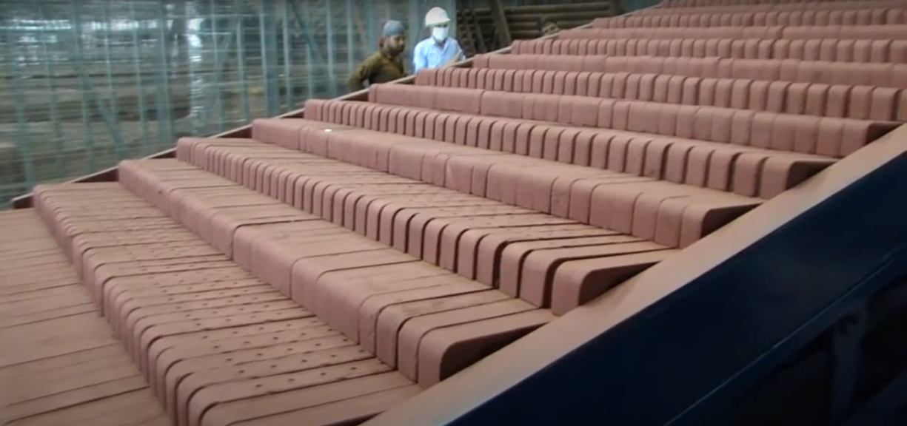
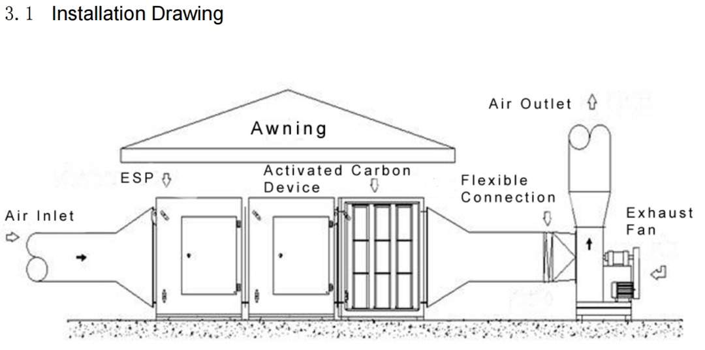
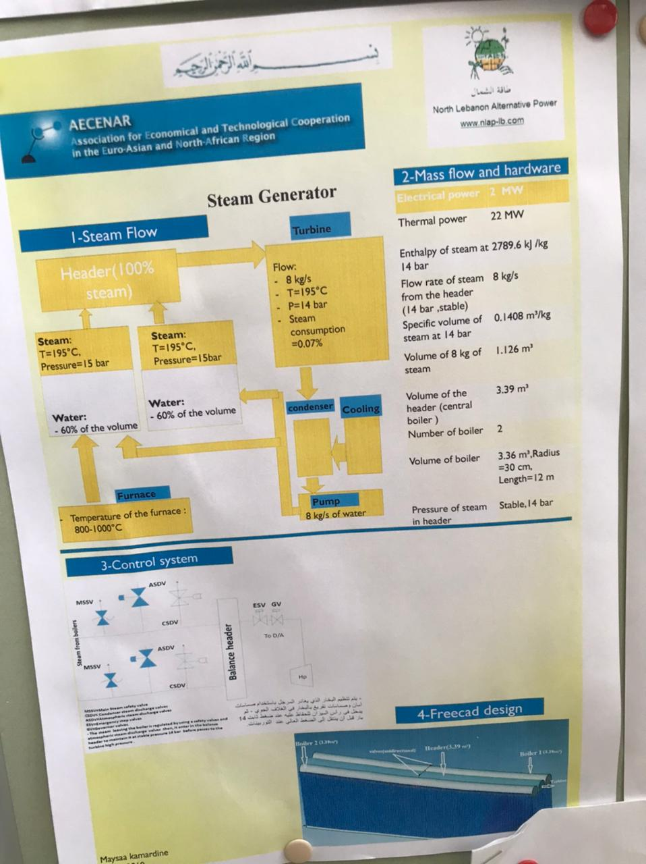
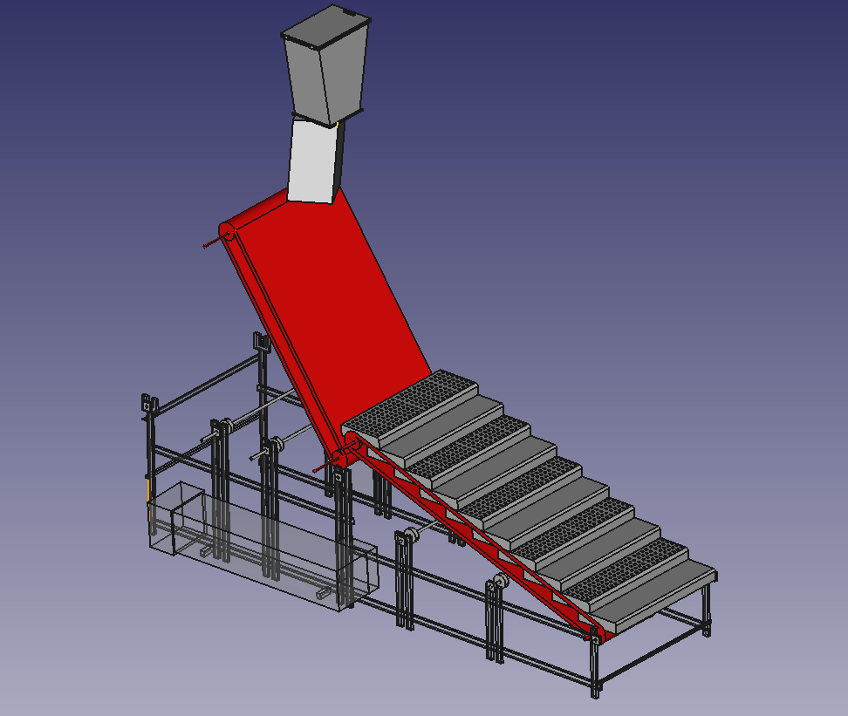
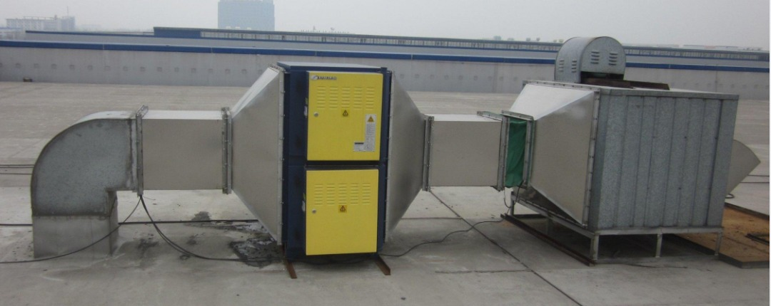
2MW
POWER PLANT
Incinerator
Turbine + generator
Garbage
Water tank
Control system
filtration
condenser
Electro-filter Company from china:
https://www.klean-esp.com/contact.html
Building 4, Leaguer Science Park of RITS, No.99, Taoyuan East Road, Shishan Town, Nanhai District, Foshan City, Guangdong Province, China
tel:+86-139-2770-2137
kleanesp@klean-esp.com
It costs 30,000 $
Incinerators and steam power
plant manufacture in India:
Hydraulic system for incineration grates
https://parboiler.com/cateogries/
Opp. Bhagyoday Hotel, Sanand - Viramgam Road, Vasna-Iyava, Sanand, Ahmedabad - 382170. Gujarat (India)
boilermanufacturer_india@parboiler.com
+91-9727775036
+91-9727775029
+91-9727775036
The small scale
1500m3/h to 3000m3/h of Exhaust air flow blower
price : 1060$
BS-216Q-3K is USD1060/ per unit. (FOB price)
Jihad Bachir@NLAP/Sep 2022

