Slide 1
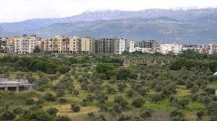
Municipality of
MEJDLAYA

Slide 2
1- من نحن
2- لماذا نظام تفاعل حراري
3- لمحة عامة عن المشروع
4- معايير سلامة البيئة
5- نظام التحكم في العمليات
6- استراتيجية وزارة البيئة
7- القيمة المضافة
8- الخطة الحالية

Slide 3
1- من نحن
&

Slide 4
1- من نحن
OBJECTIVE AND PURPOSE OF THE ASSOCIATION:
committed to the promotion of international cooperation in the economic
and scientific fields in order to achieve the idea of international understanding
and a closer relationship between institutions of the Middle East,
in Europe and its neighbors.
Banking account data:
AECENAR e.V.,IBAN: DE04 67250020 0009192433,SWIFT-BIC:SOLADES1HDB,Bank Name: Sparkasse Heidelberg, Germany

Slide 5
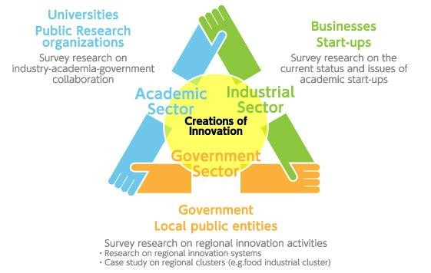
1- من نحن
OBJECTIVE AND PURPOSE OF THE ASSOCIATION:

Slide 6
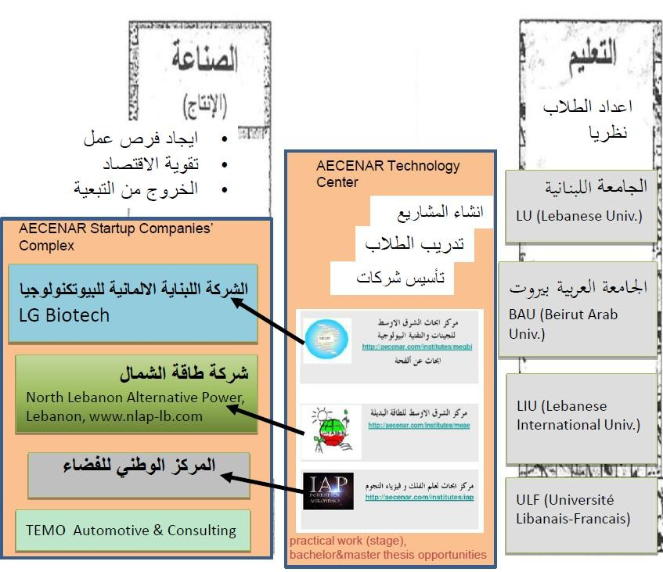
1- من نحن
OBJECTIVE AND PURPOSE OF THE ASSOCIATION:

Slide 7
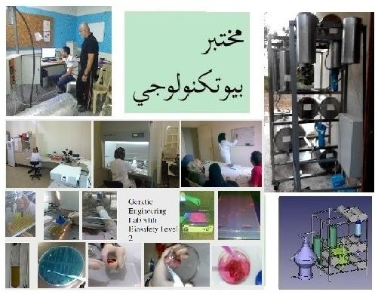
1- من نحن
OBJECTIVE AND PURPOSE OF THE ASSOCIATION: Exemple

Slide 8
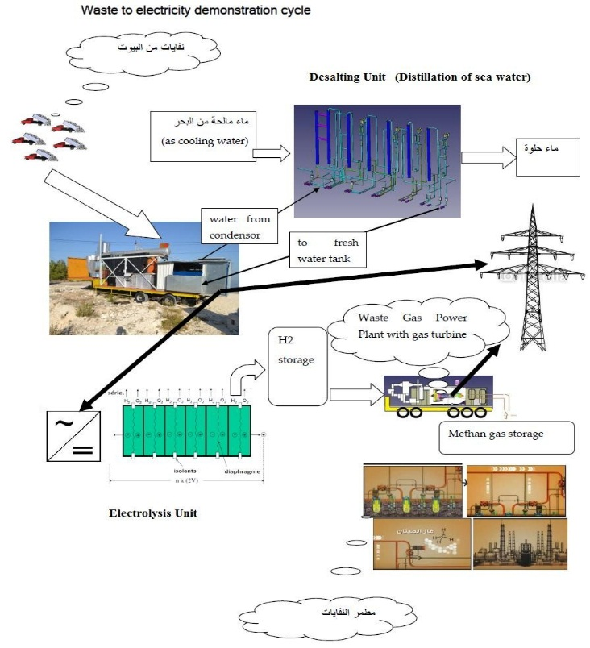
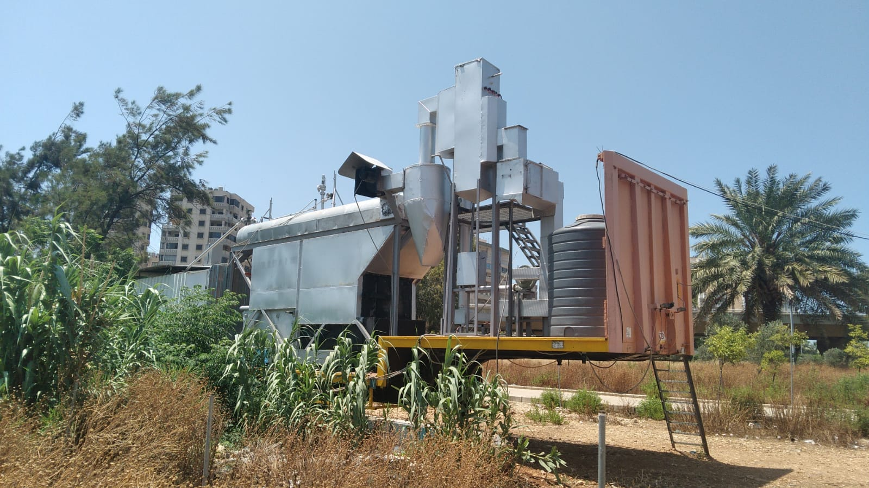
1- من نحن
OBJECTIVE AND PURPOSE OF THE ASSOCIATION:
Electrical Power Plant Technology

Slide 9
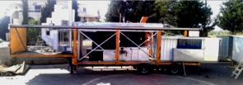
2- لمحة عامة عن المشروع
2005
2016
2022

Slide 10
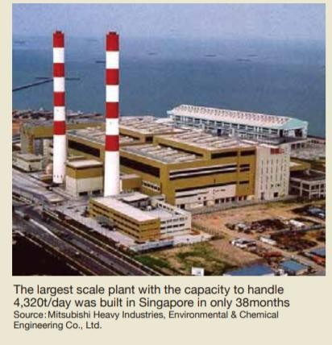
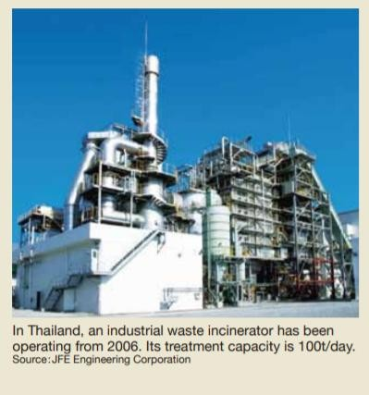
2- لمحة عامة عن المشروع
Incinerator in world

Slide 11
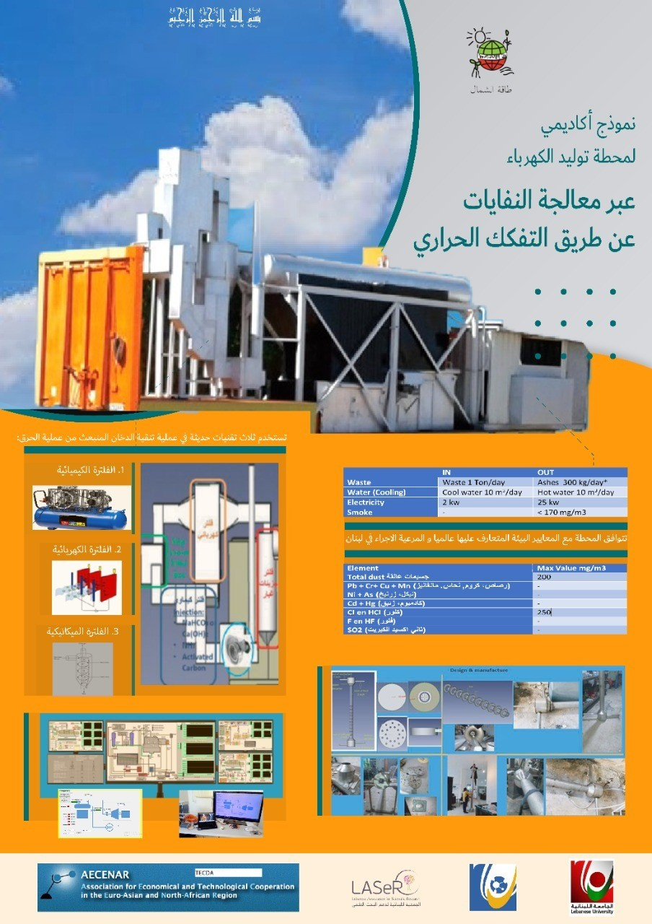
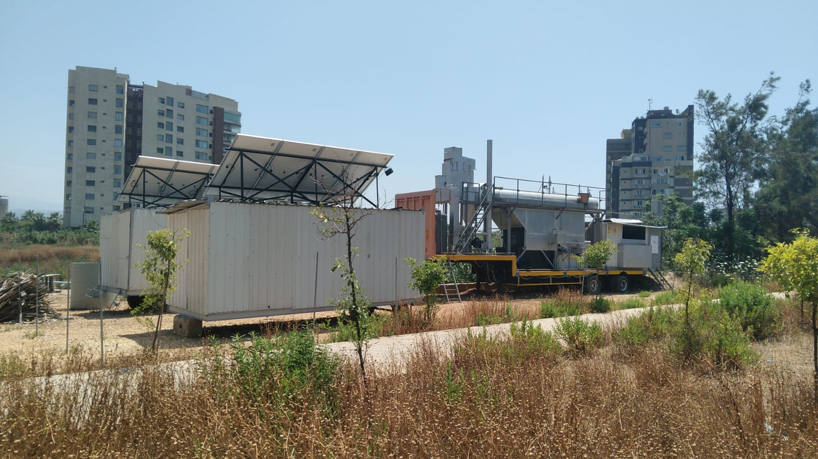
2- لمحة عامة عن المشروع

Slide 12
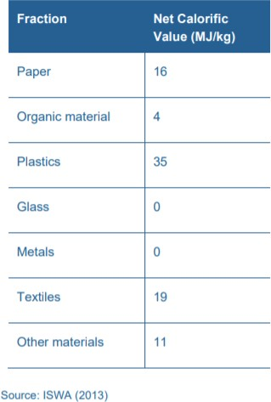
2- لماذا نظام التفكك الحراري

Slide 13
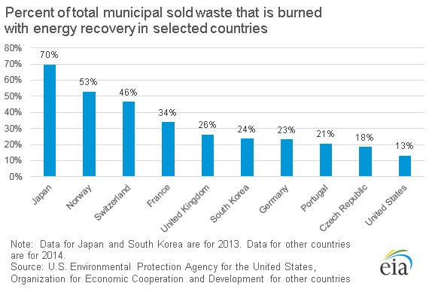
3- لماذا نظام التفكك الحراري

Slide 14
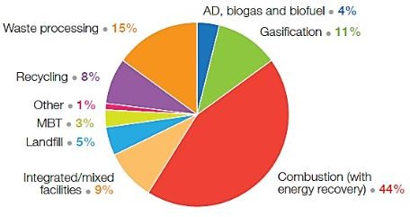
3- لماذا نظام التفكك الحراري
Utility Scale Plants existing according to the technology used
(Data from 93 countries in 2013­2014
(total of 2723 facilities))
*(Mechanical Biological Treat MBT)

Slide 15
4- معايير سلامة البيئة
Residues of incineration of 1 ton of waste
700 kg of gas,
300 kg of solid residues including 30 kg of fly ash.
Division of emissions(depending on their size and the degree of severity:)
harmful to the environment
Non­harmful to
the environment
Toxic gases
Nitrogen (N₂), Oxygen (O₂), and water vapor (H₂O)
Acid gases: nitrogen dioxide (NO₂), nitrogen oxide (NO), Sulfur dioxide (SO₂), carbon dioxide (CO₂),HCl, Dust
Furans, dioxins, heavy metals (Hg from batteries, cadmium, plumb, zinc)

Slide 16
4- معايير سلامة البيئة
1.Techniques for the reduction of nitrogen oxide
­Thermal NOx: When burning a portion of the nitrogen in the air is oxidized to nitrogen oxides. This reaction occurs only significantly at temperatures above 1300 ° C. The reaction rate depends exponentially on the temperature and is directly proportional to the oxygen content
­Fuel NOx: when burning a portion of the nitrogen contained in the fuel is oxidized to nitrogen oxides.
PROCESS OF REDUCING NON­SELECTIVE CATALYTIC (SNCR):
the reducing agent (typically ammonia or urea) is injected into the furnace and reacts with nitrogen oxides. The reactions occur at temperatures between 850 and 1000 ° C, with higher reaction rates and lower in this range. To be effective, the catalyst generally requires a temperature between 180 and 450 ° C. The majority of systems uses waste incinerators currently operating at temperatures of the order of 230­300 ° C.
Selective Catalytic Reduction (SCR) is a catalytic process during which ammonia mixed with air (the reduction agent) is added to the exhaust gas and passes through a catalyst, usually a sieve (e.g. Platinum, rhodium, TiO₂, zeolites). When passing through the catalyst, ammonia reacts with NOx to give nitrogen and water vapor.

Slide 17
4- معايير السلامة البيئية
2.Treatment of dioxin and furans and mercury Hg & CO₂
By activated carbon(can be also called "lignite Coke for odorous compounds.) Activated carbon is in the form of a fine black talc. Its elementary particles are made porous by a suitable heat treatment so as to create therein pores having dimensions of affinity with the molecules to be filtered. So there are formulations of active carbon adapted to different molecules that one wishes to retain.
 | To obtain a minimum feeding rate (F(min)) of activated carbon (AC), It was found that dioxin removal efficiency(eta) increased with an increase in AC feeding concentration. This had an almost linear function to F/Q when F/Q was less than 65 g/Nm(3), where F was the AC feeding rate (mg/min), and Q was the volumetric flow rate of flue gas (Nm(³)/min). However, it did not seem to be affected by F/Q, when F/Q was larger than 150 mg/Nm(³). On the basis of the experimental data obtained in this study, the removal efficiency of dioxins by the application of AC could be correlated as eta (%)=100/[1.0+(40.2/(F/Q)(3))]. It is valid in appropriate conditions (F/Q=10­300 mg/Nm(³)) suggested by the study with a statistical error of +/­18%.
Measurement :The Intelligent Gravimetric Analyzer (IGA)
The system is an ultra­high vacuum (UHV) system and allows measurement of isotherms and accurate determination of the adsorption and desorption kinetic profiles for each pressure step.
The system consists of a fully computer controlled microbalance, pressure admit system and temperature regulation system

Slide 18
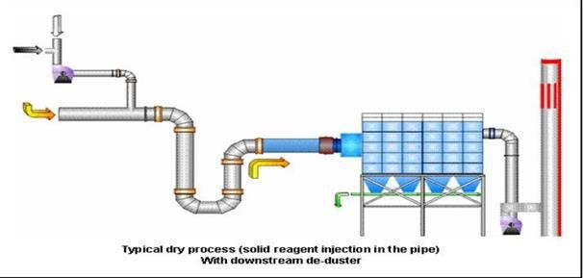
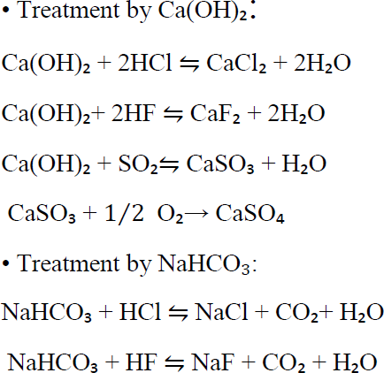
4- معايير سلامة البيئة
3.Acid gas treatment technologies(HF, HCl and SO₂ )
Depending on the concentrations, temperature, size of the flow to be treated and of further parameters, can be used different technologies for the treatment of acid gas emissions. Being a quick summary we can mention:
Bag filters with reagent injection(calcium hydroxide (Ca(OH)₂) or sodium bicarbonate))
The filters in flat bags are successfully used for the chemical absorption of acid gases such as HF, HCl and SO₂ in addition to the adsorption of other pollutant compounds.
Generally it is used, among others, calcium hydroxide and sodium bicarbonate (Ca(OH)₂) of typical commercial quality, which is injected in the gas stream before entering the filter. To achieve proper compliance with the emission limits required, the additive should be added in amounts over­stoichiometric (from 1.5 to 3 times).
at least 130­200 ° C

Slide 19
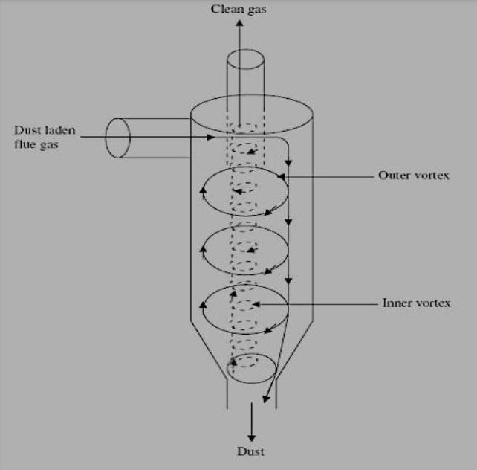
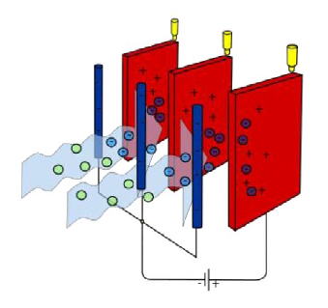
4- معايير سلامة البيئة
4.Treatment of dust
g
Particles between 5 & 50 micron and volatized heavy metals
Less than 5 micron
Mechanical treatment :
العلاج الميكانيكي
Cyclone(efficiency:91%)
Mechanical treatment :
العلاج الميكانيكي
Cyclone(efficiency:91%)

Slide 20
4- معايير سلامة البيئة
Bottom & flying ashes: heavy metals recovery

Slide 21
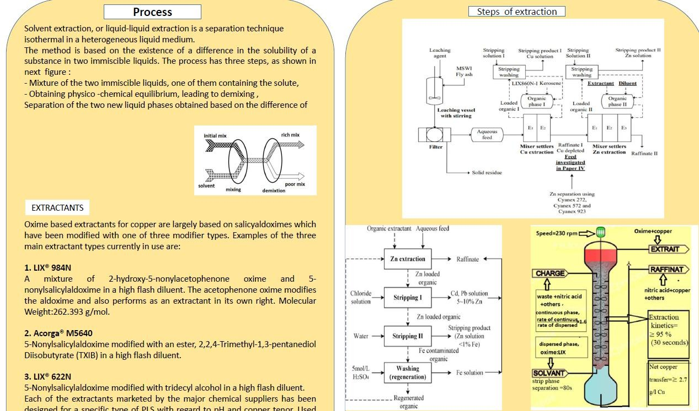
4- معايير سلامة البيئة
Bottom & flying ashes: heavy metals recovery

Slide 22
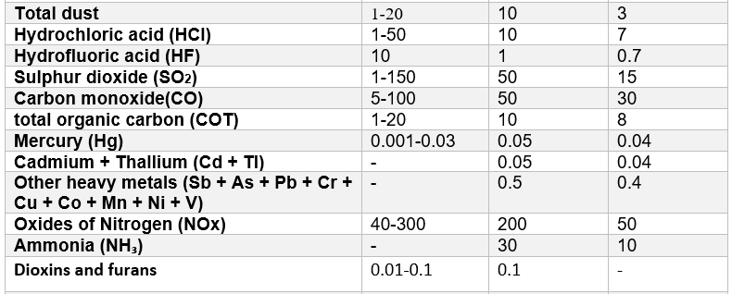
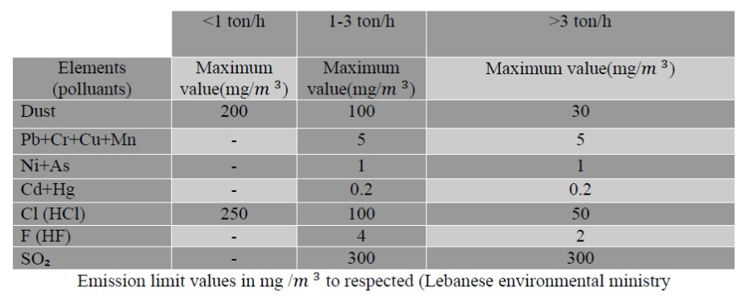
4- معايير سلامة البيئة

Slide 23
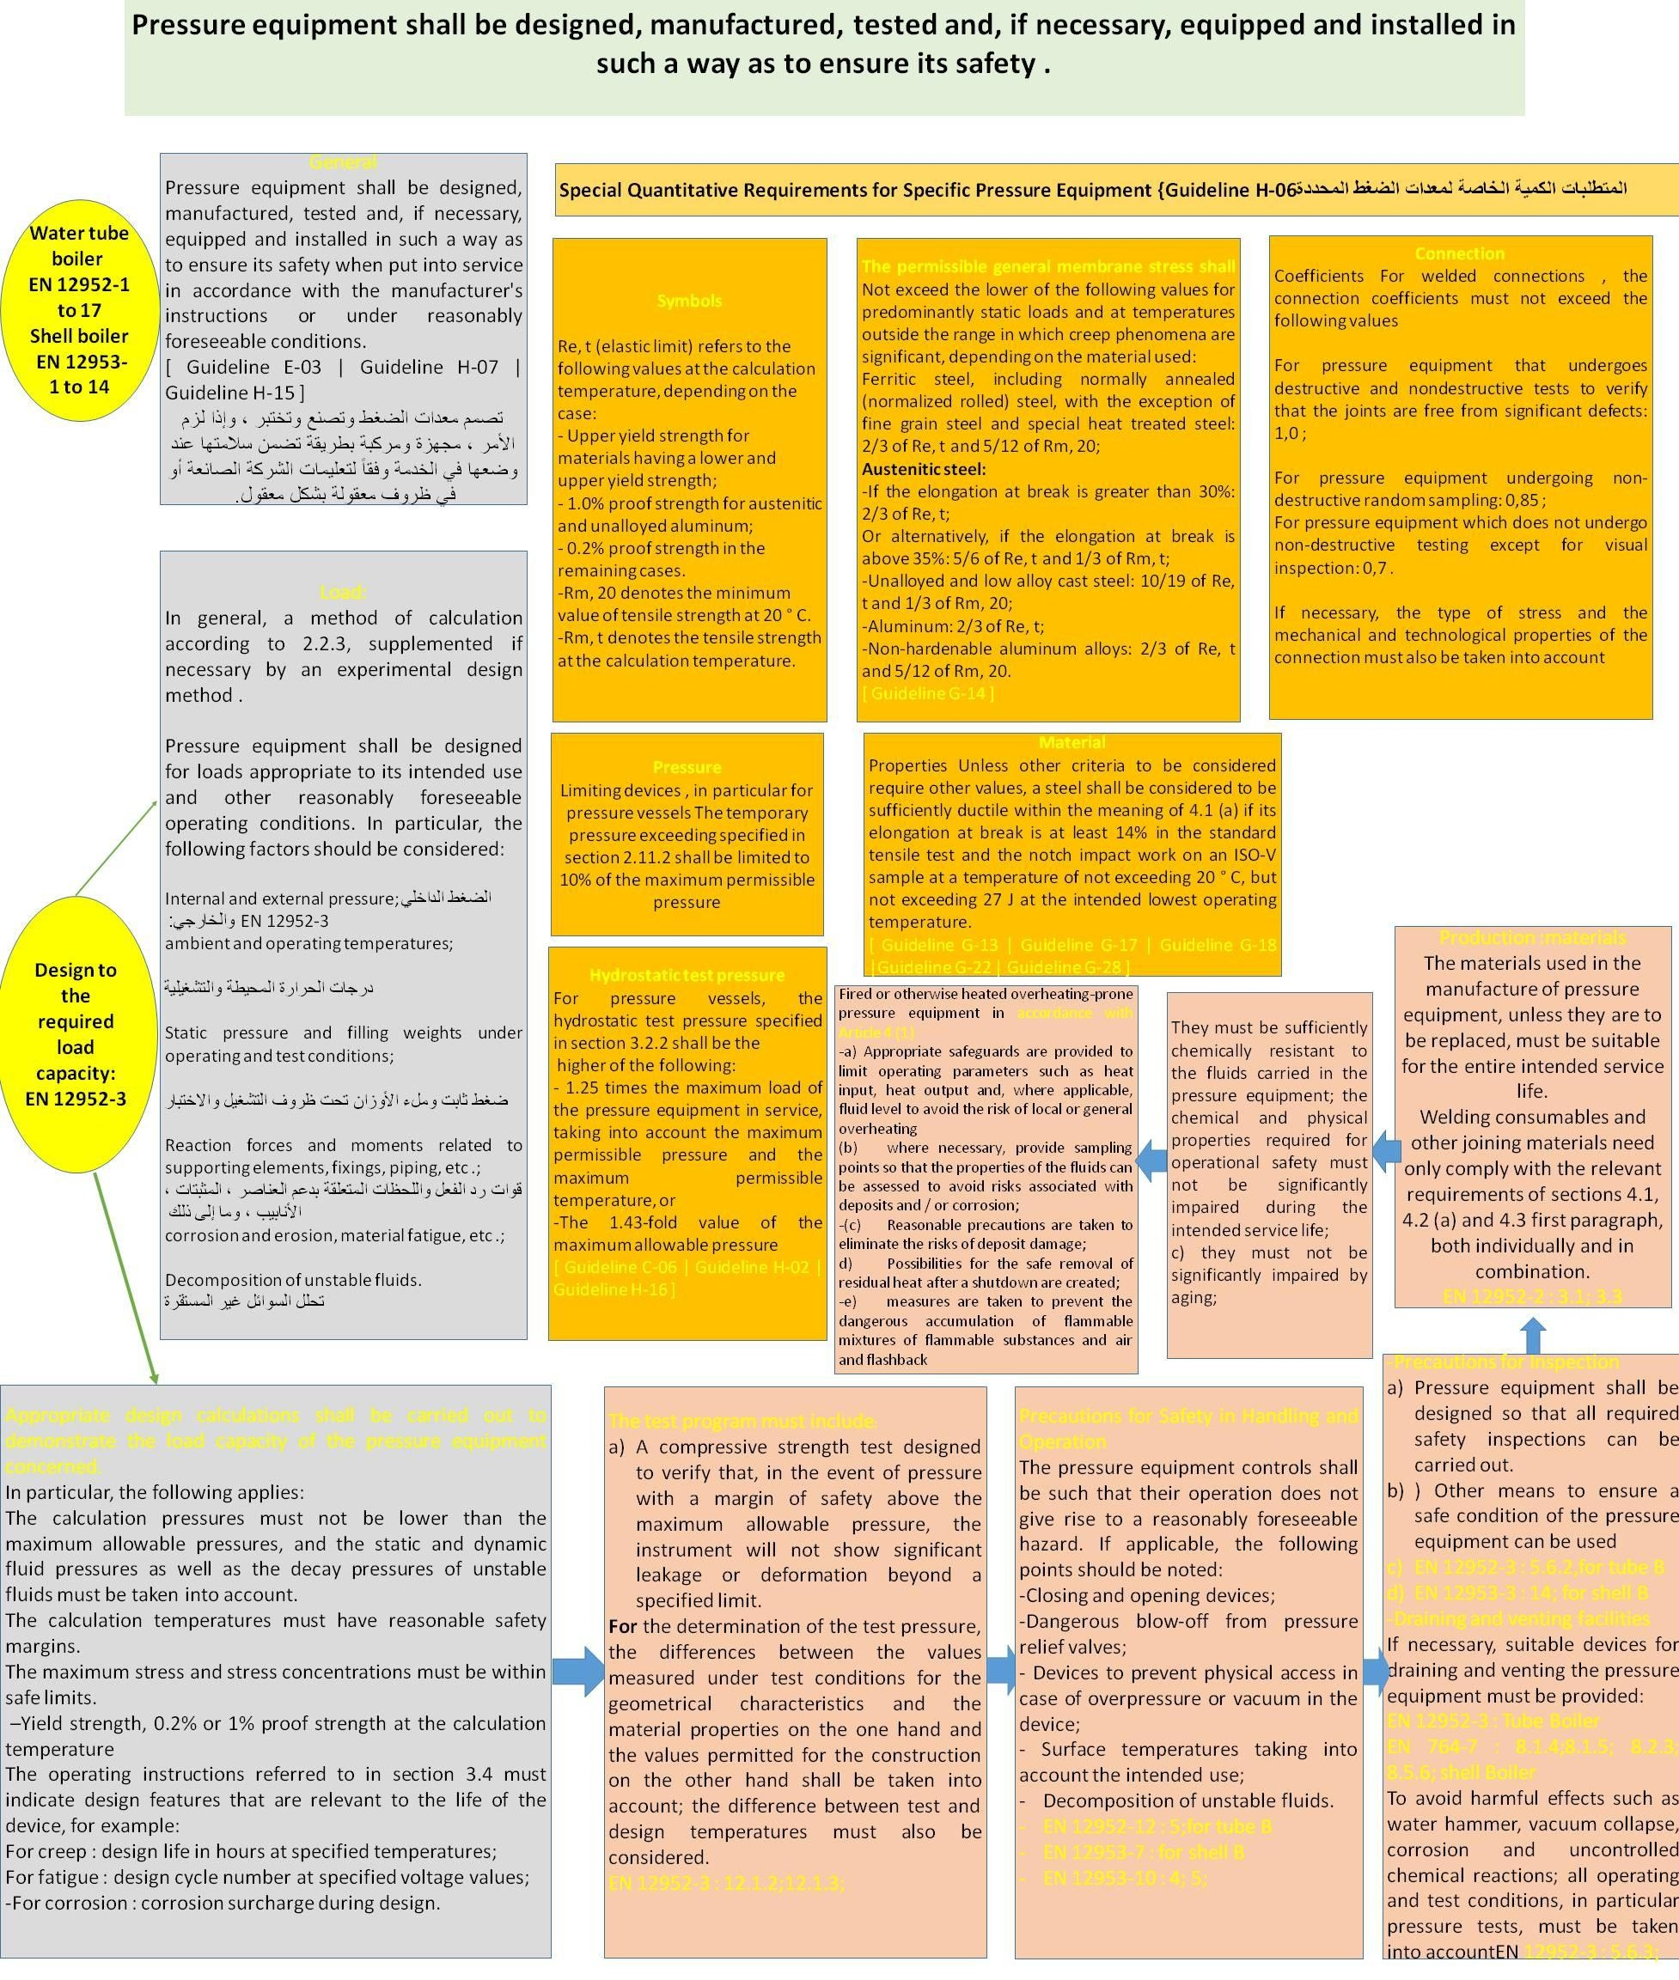
4- معايير سلامة البيئة

Slide 24
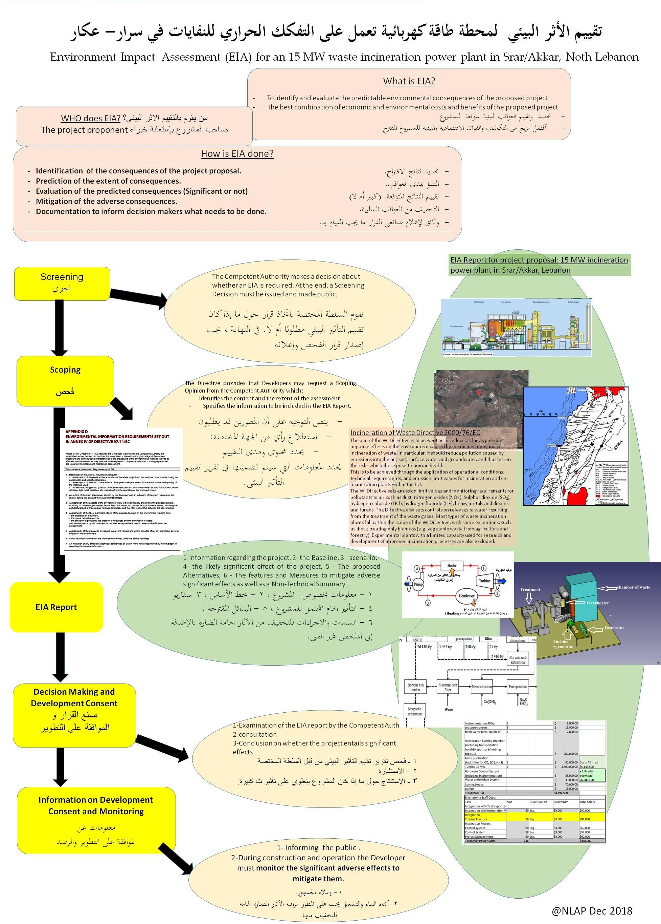
4- معايير سلامة البيئة

Slide 25
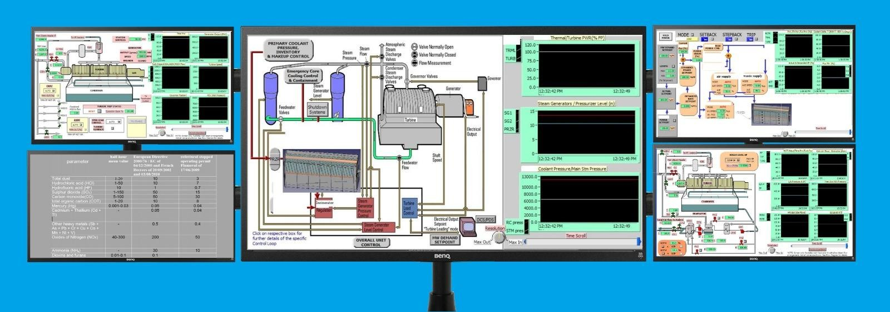
5- نظام التحكم في العمليات

Slide 26
5- نظام التحكم في العمليات

Slide 27
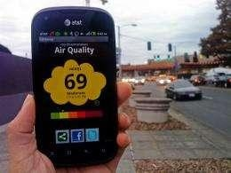
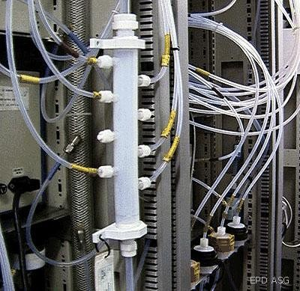
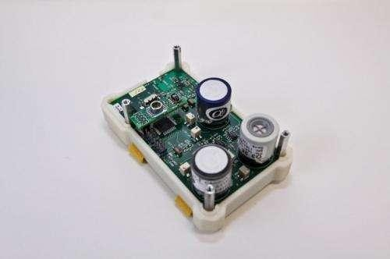
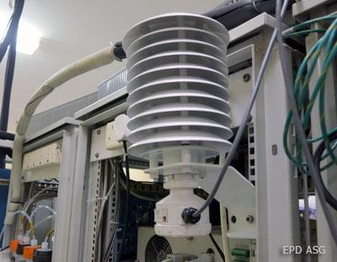
5- نظام التحكم في العمليات
نظام مراقبة تلوث الهواء على الانتزنت

Slide 28
6- استراتيجية وزارة البيئة
وزراة البيئة تشجع معالجة النفايات لاسترداد الطاقة

Slide 29
7- القيمة المضافة
1- تامين فرص عمل
2- صناعة محلية لكامل المصنع تكون اوفر
3- معالجة لمشكلة النفايات المزمنة في الحال (جبل النفايات – النفايات اليومية)
4- تقليل العجز في الكهرباء
5- الاستفادة من بقايا الحرق لصيانة وتعبيد الطرقات
6-اعادة تدوير المعادن

Slide 30
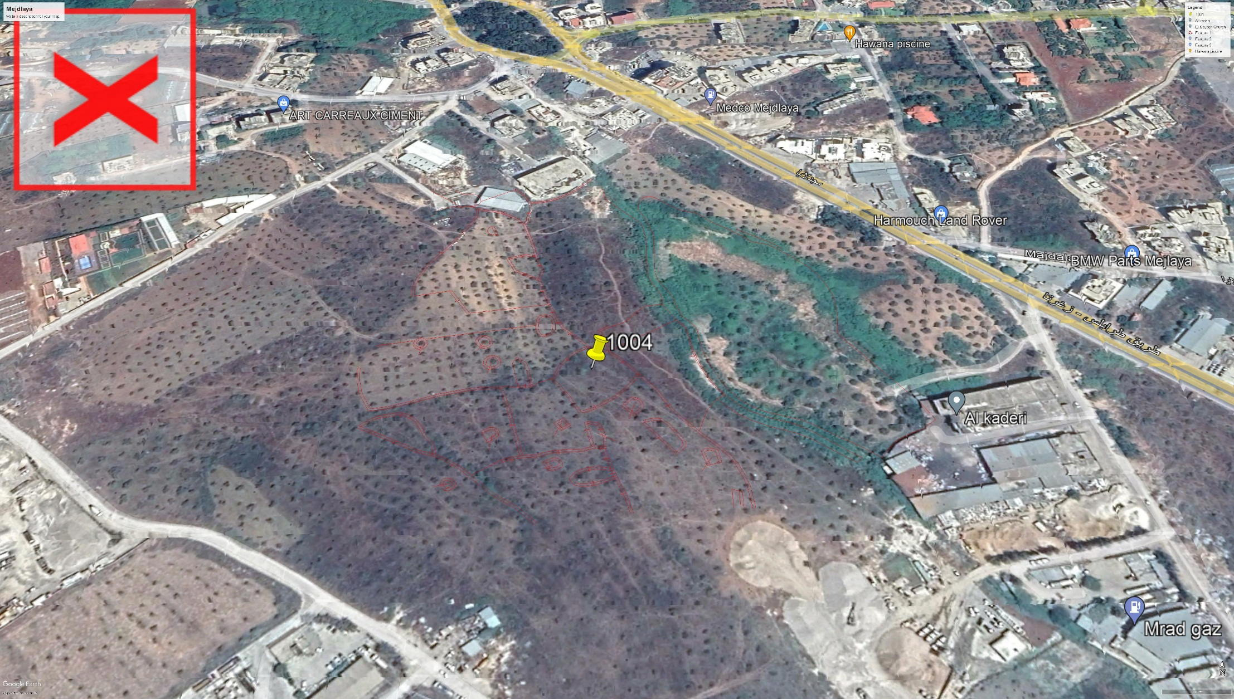
8- الخطة الحالية

Slide 31
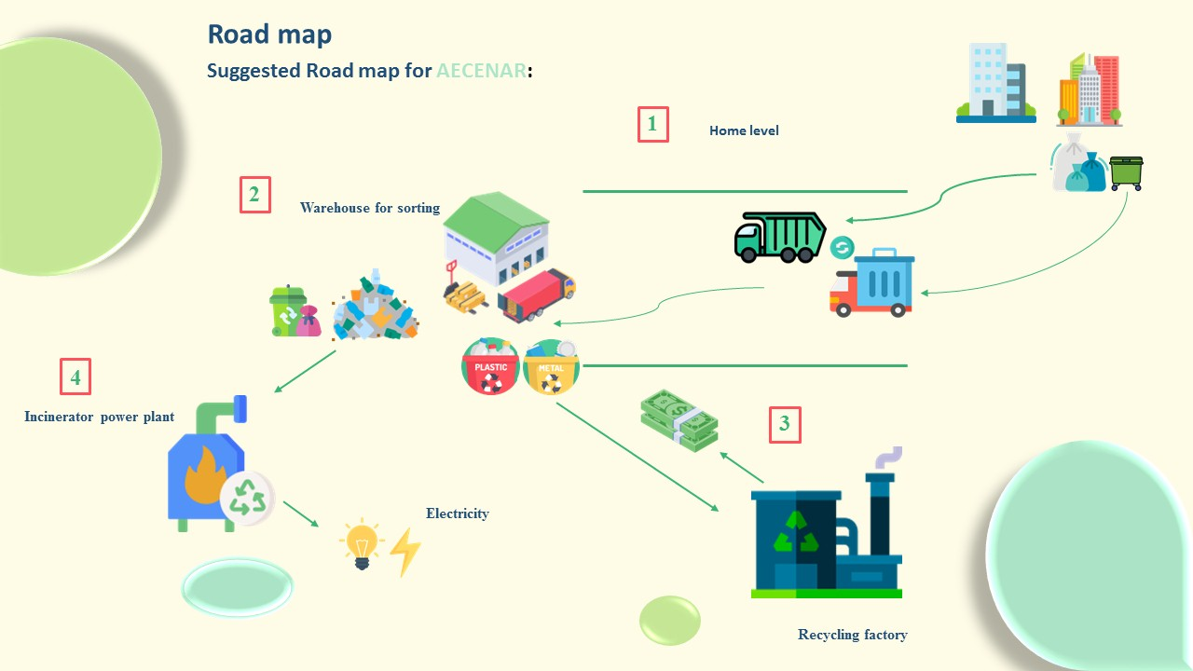
8- الخطة الحالية

Slide 32
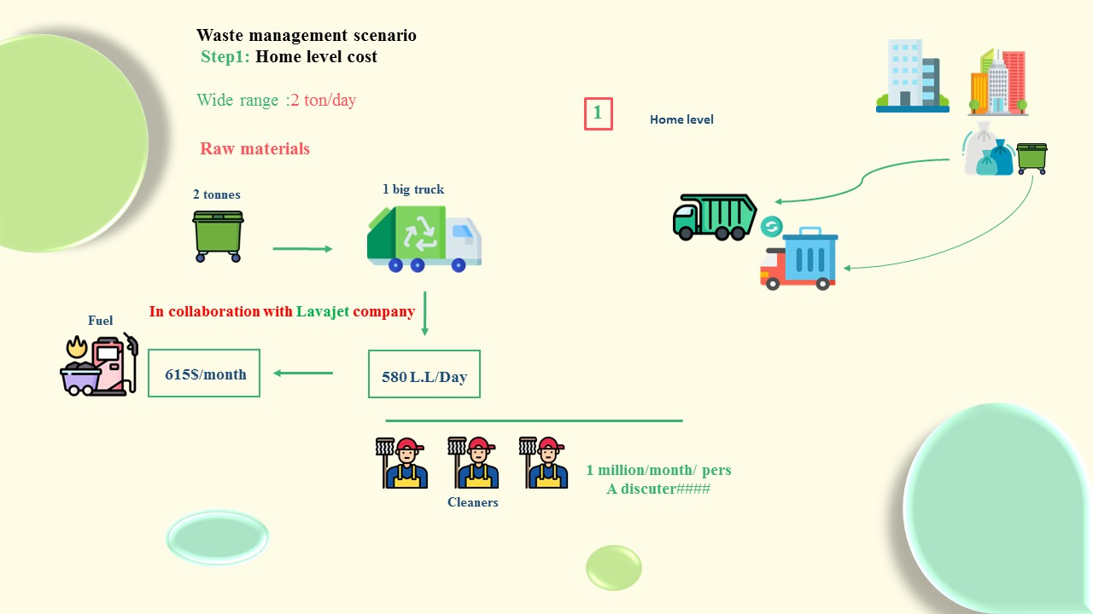
9- الخطة الحالية

Slide 33
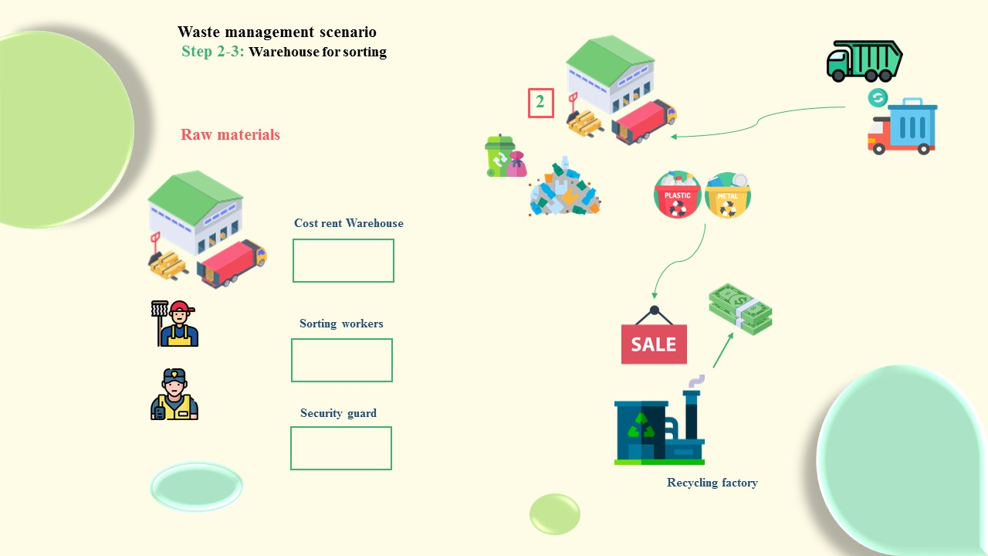
8- الخطة الحالية

Slide 34
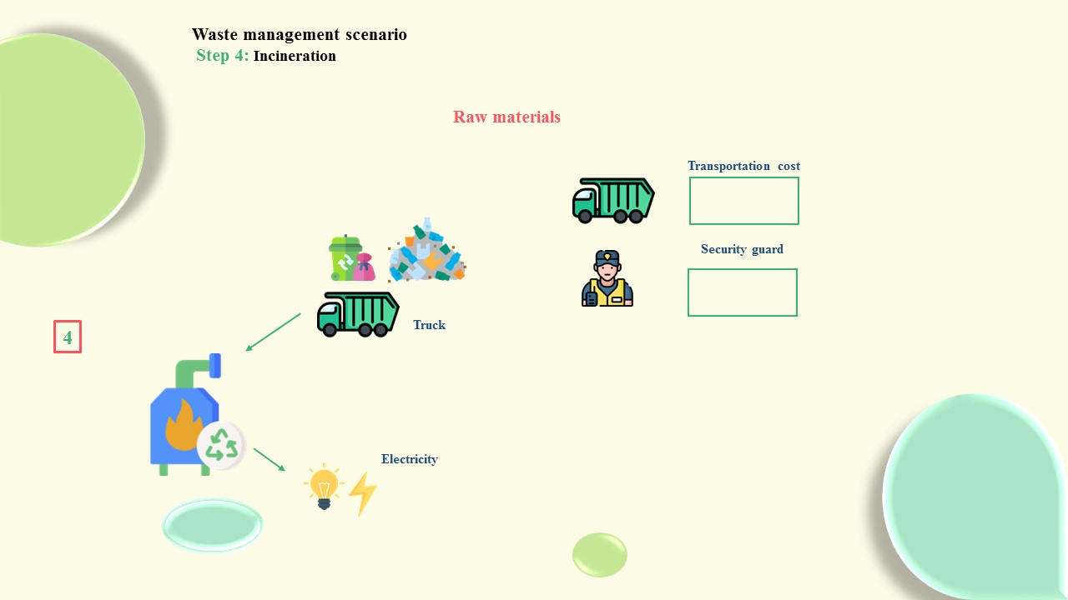
8- الخطة الحالية

Slide 35
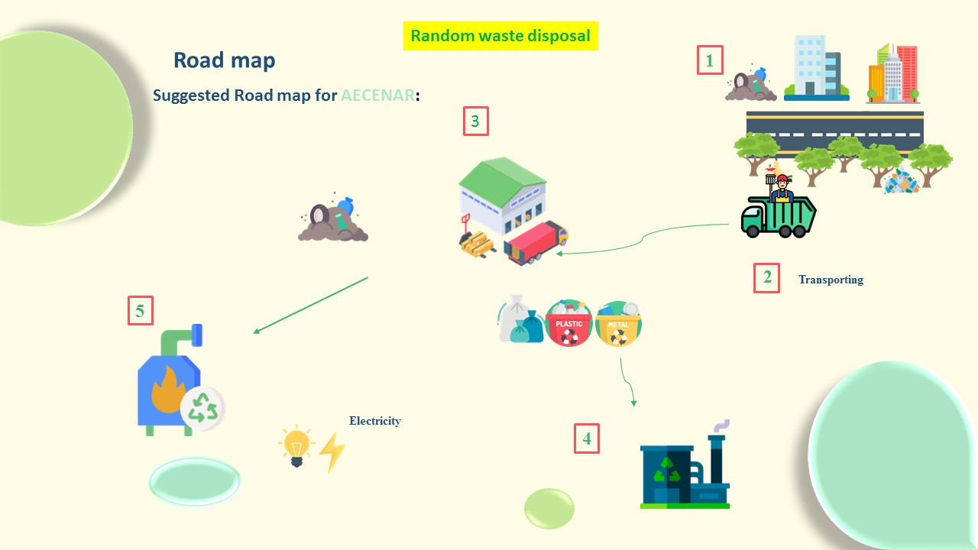
9- الخطة الحالية

