Slide 1


Environmental Impact Assessment for an academic mobile municipal waste incinerator
Abdullah Mourad, B.Sc in Chemistry

Slide 2
Content
Waste to Energy
The cycle of a thermal power plant
Our mobile waste to energy power plant
What is an enviromental impact assesment (EIA)
The enviromental reqquirements
What needs to be considered in our case
The maximum allowed concentrations
The removal of the NOx gazes
The treatment of the furane and the dioxine
Acid gases treatment
Treatment of dust
Measurement
The ashes recycling
The mobile power plant
Additional condition in lebanese law
Overview of all suitable places for waste incinerators in North Lebanon
The different locations in which the power plant was
With contribution of

Slide 3
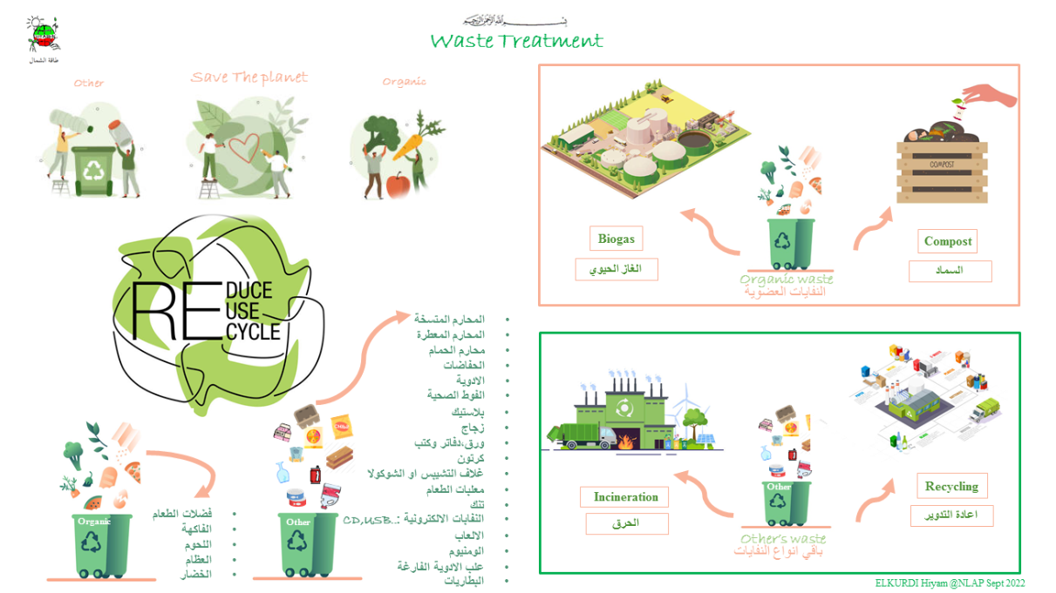

Slide 4
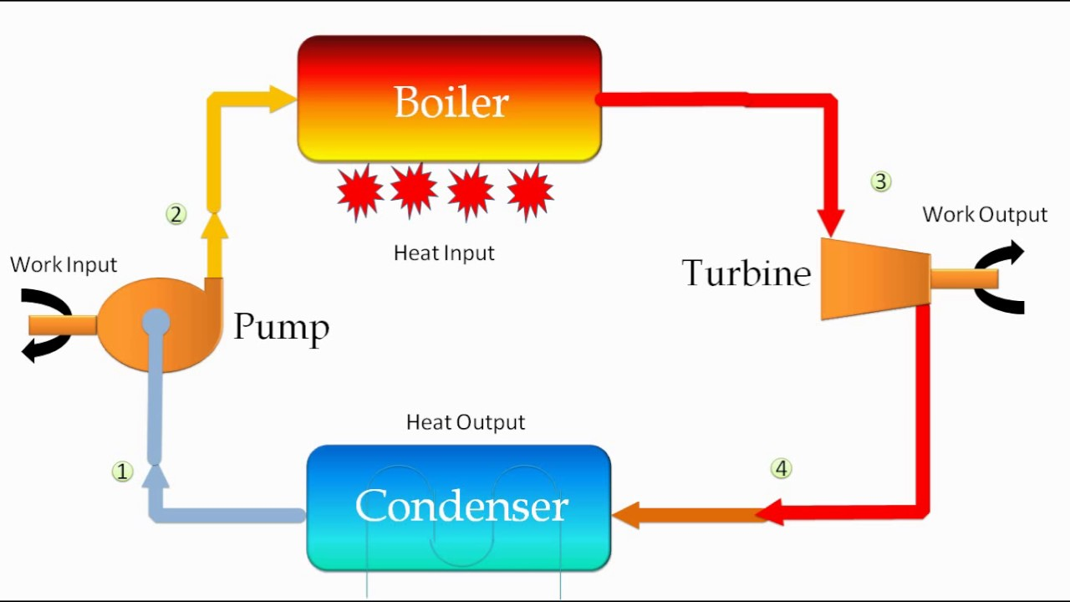
The cycle in a thermal power plant

Slide 5
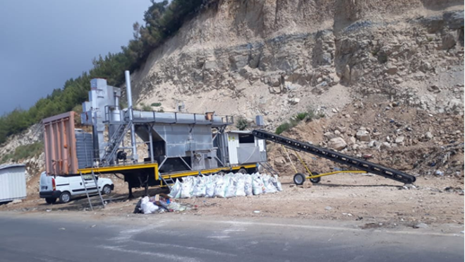
Our mobile waste to energy power plant

Slide 6
a big challenge is the enviroment impact assessment and that is why this is the main topic of the presentation.

Slide 7
What is an enviromental impact assesment
Environmental Impact Assessment (EIA) is a process of evaluating the likely environmental impacts of a proposed project or development, taking into account inter-related socio-economic, cultural and human-health impacts, both beneficial and adverse.

Slide 8
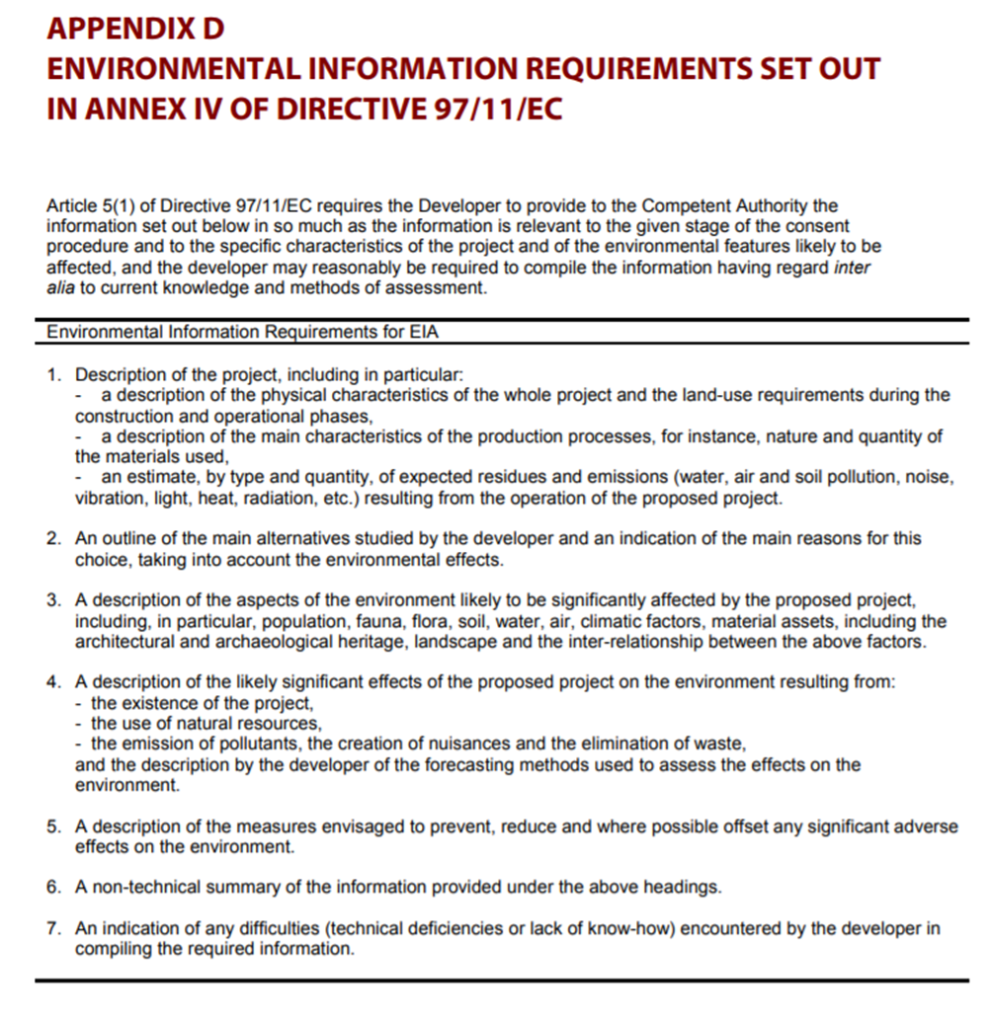

Slide 9
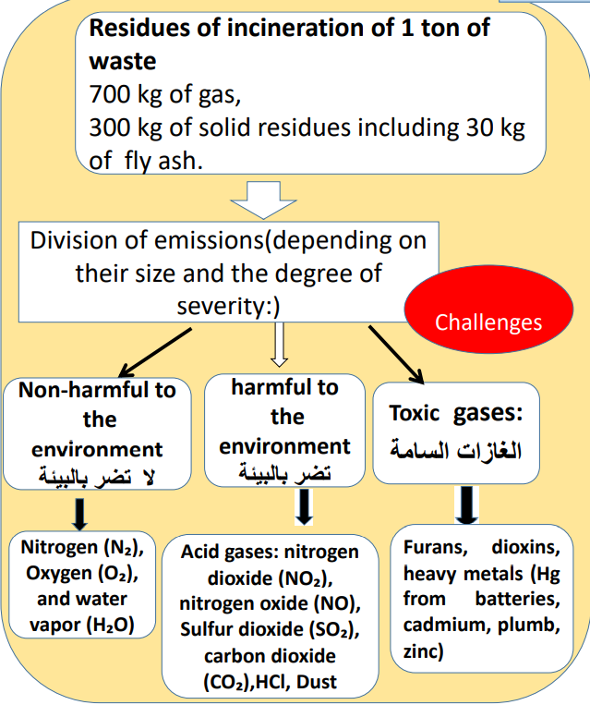
What needs to be considered in our case

Slide 10
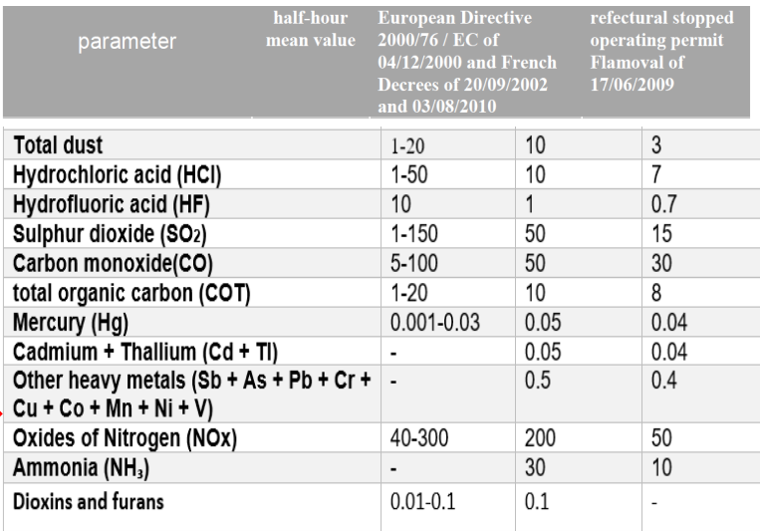
The maximum allowed concentrations

Slide 11
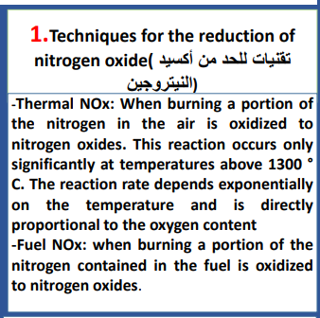
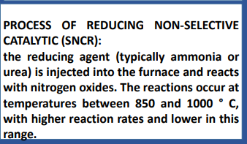
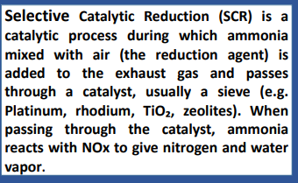
The removal of the NOx gazes

Slide 12
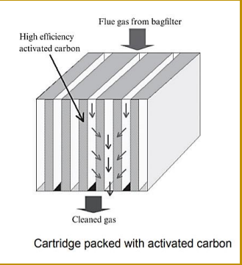
The treatment of the furan and dioxine

Slide 13

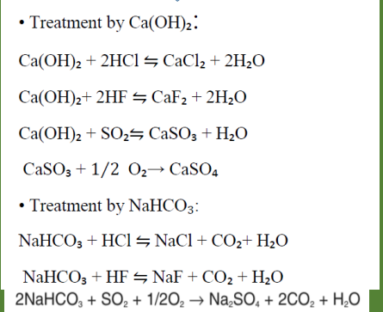
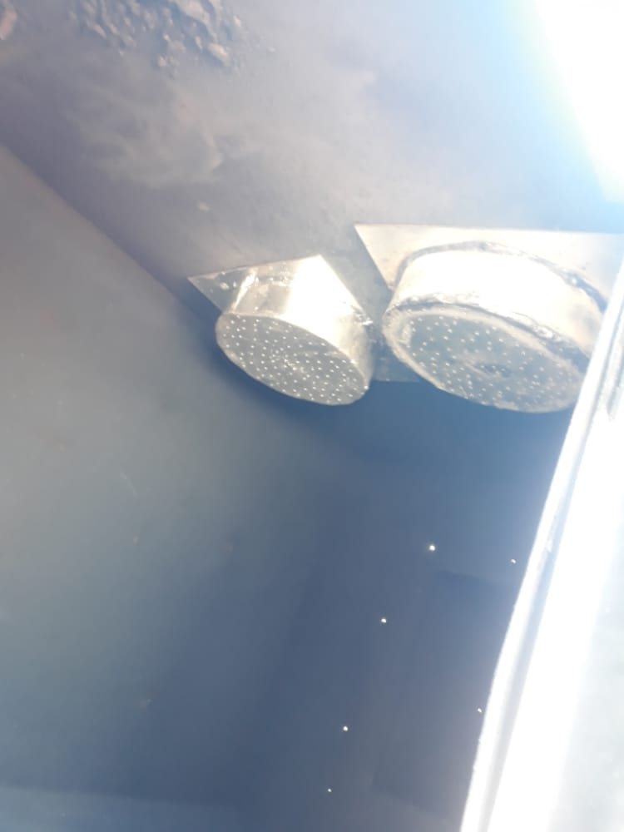
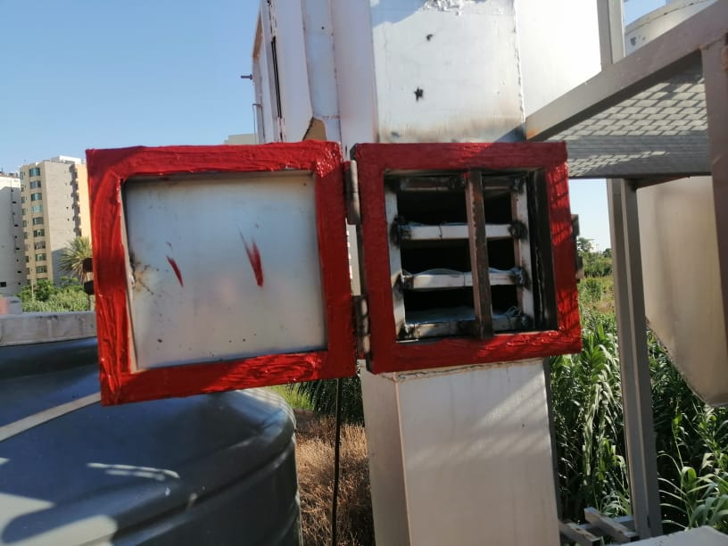
On-site realization

Slide 14
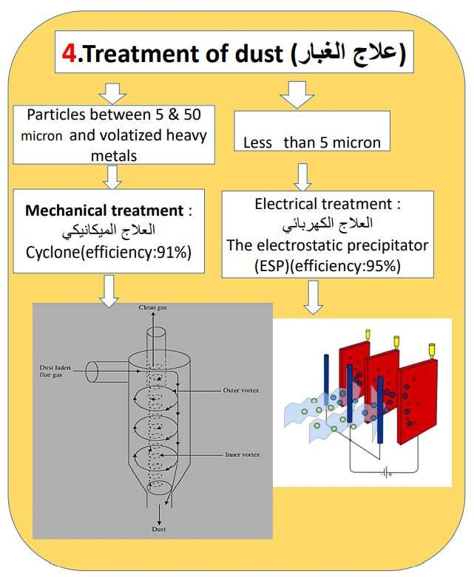
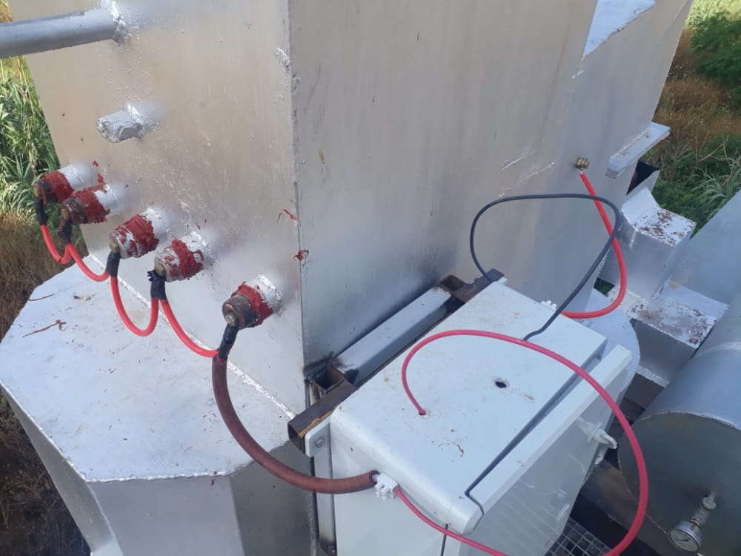
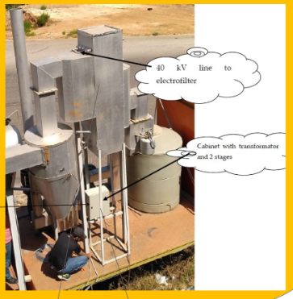
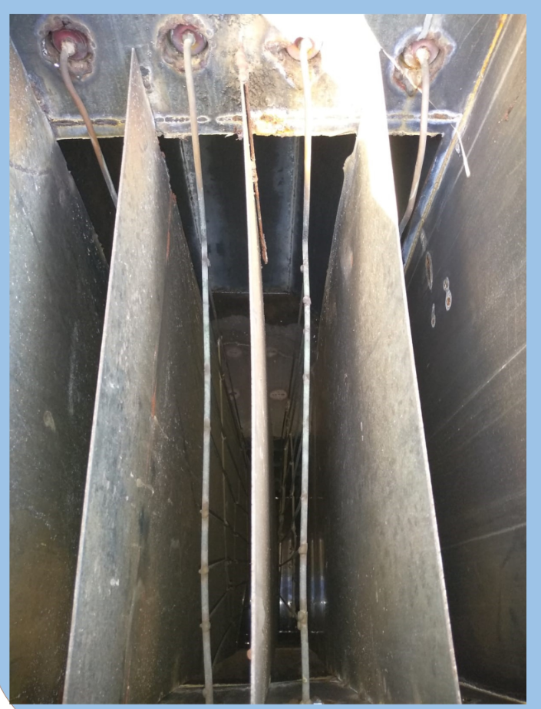
On-site realization
Cyclone I Electrofilter

Slide 15
Mesurement
to make sure that the allowed concentrations are not exceeded, measurement techniques have to be applied:
laser absorption and
the filter weight measurement

Slide 16
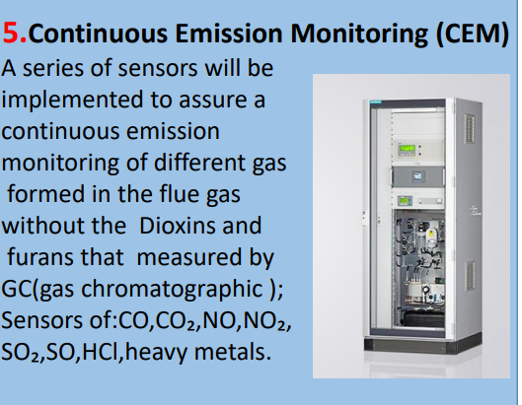
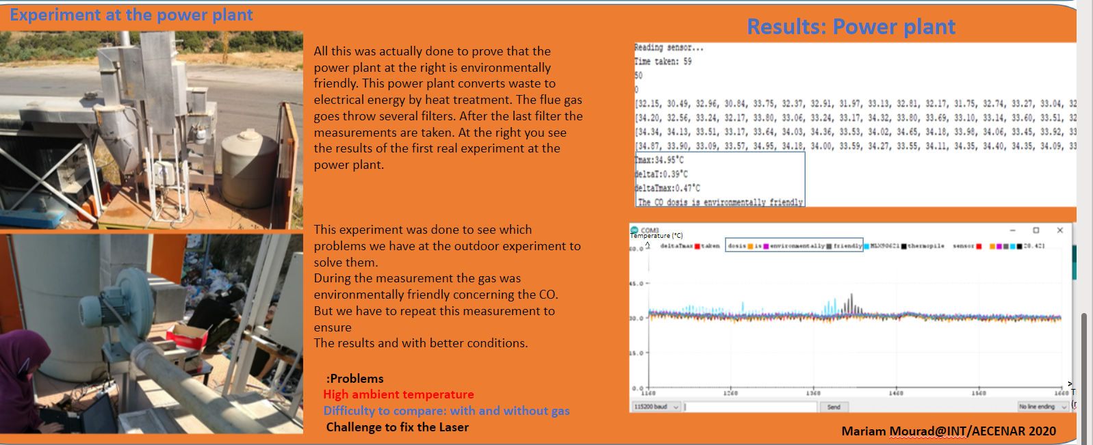
On-site realization
laser absorption

Slide 17
The filter weight measurement
Mass of filter before treatment =1300 g
mass after treatment =1364 the total mass of particulate =1364-1300=64 g
375 m³/h correspond to 64 g
Thus 170 mg / m³ <200 mg/ m³ confirm to Lebanese standard (annex D) positive results

Slide 18
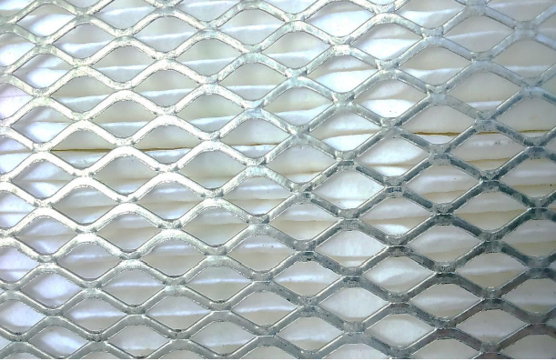
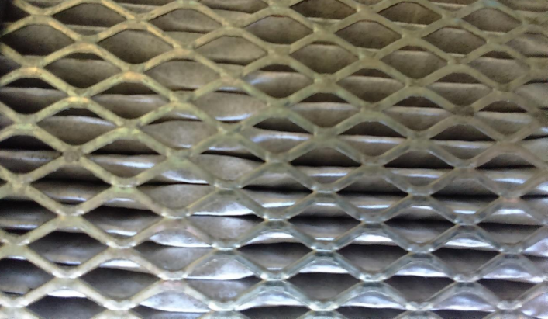
Color of media before treatment
Filter media after treatment

Slide 19
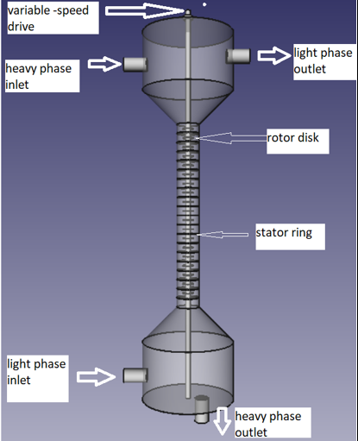
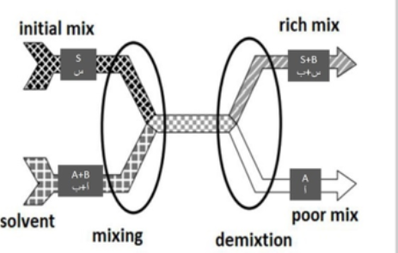
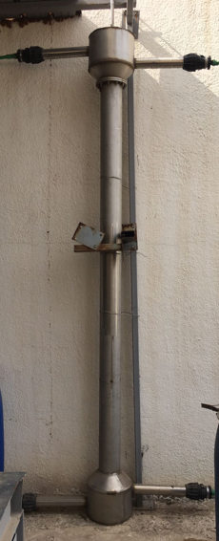
The ashes recycling
Realization

Slide 20
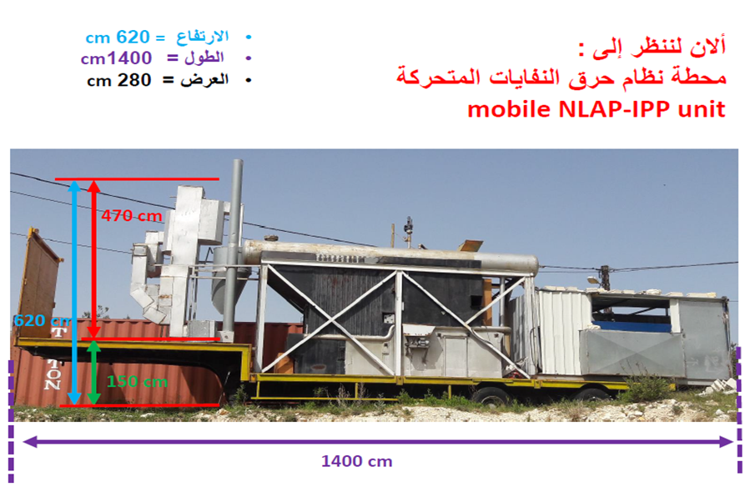
The mobile powerplant

Slide 21
Additional condition in lebanese law
Constrain is according to lebanes law that the incenerator has to be at least 1 km distance to any public building or private house .

Slide 22
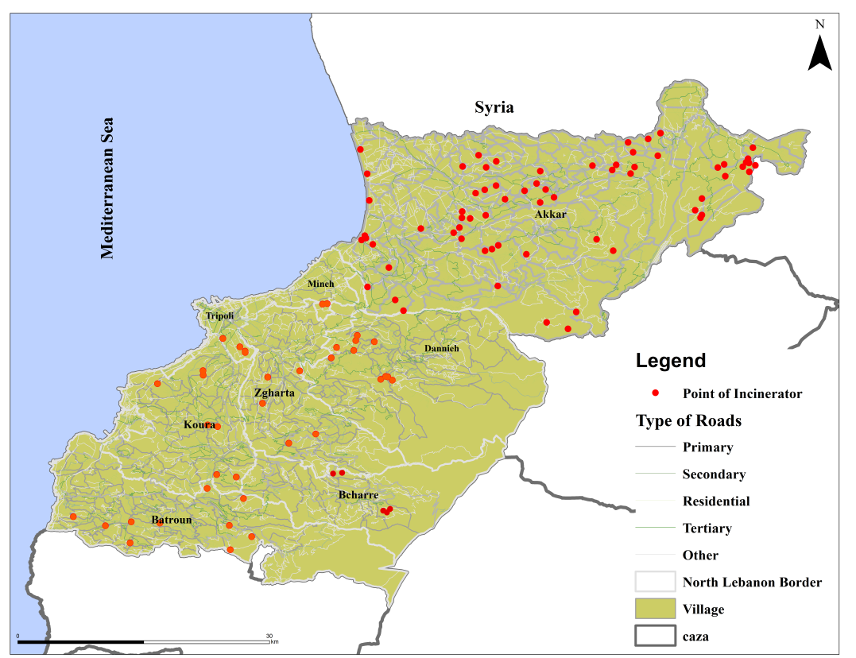
Overview of all suitable places for waste incinerators in North Lebanon

Slide 23
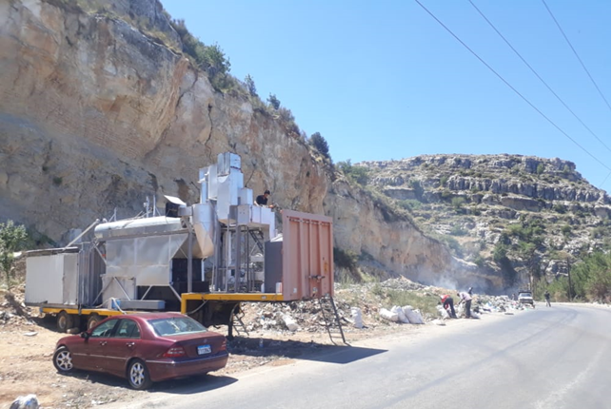
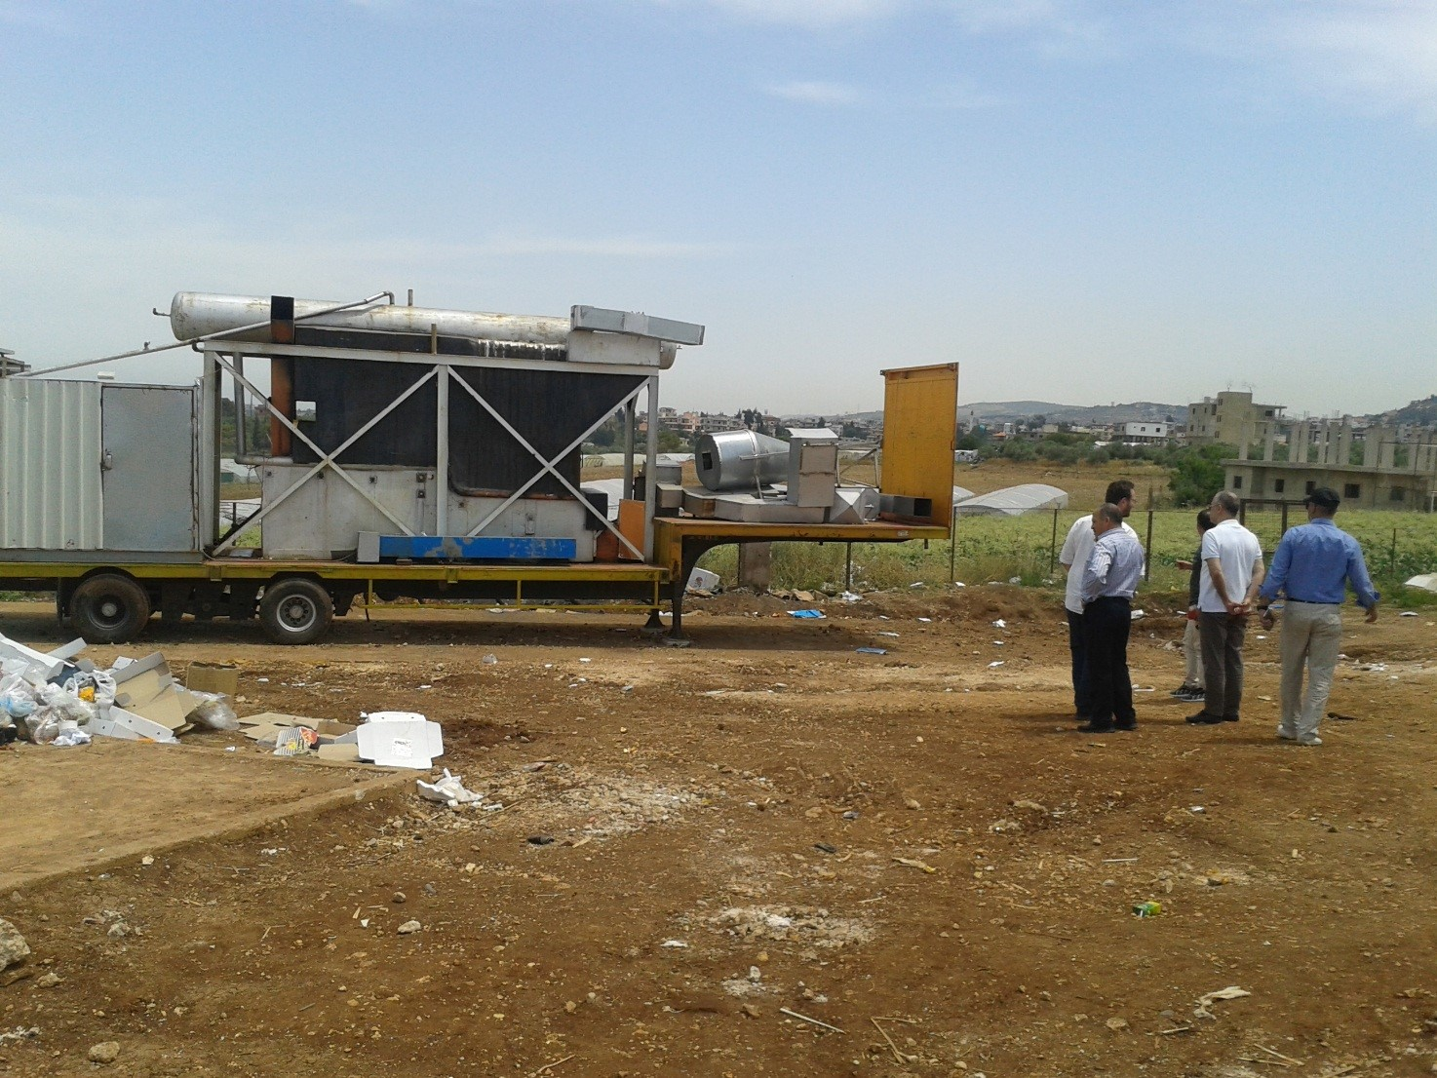
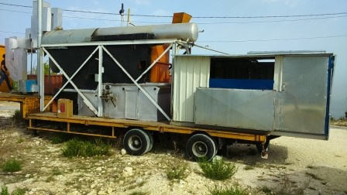
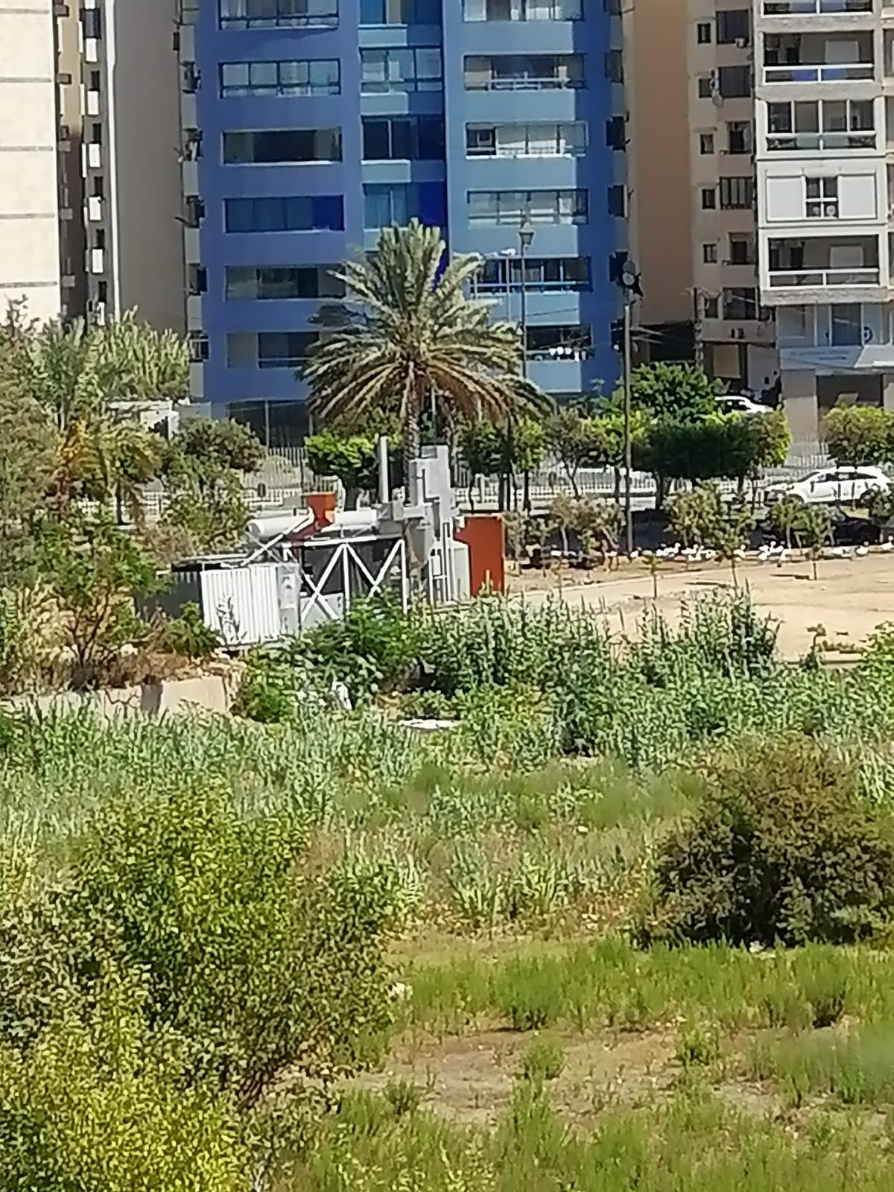
The different locations in which the mobile power plant was
Rasn hach
Rayhaniye Camp
Beqaa Sefrin
Masjid El Salam – El Mina

Slide 24
With contribution of :
Hiyam Elkurdi (cand. M.Sc. Environmental Science and Spatial Planing
the suitable places for waste incinerators in North Lebanon
Abdullah Kassem (M.Sc in Electrical Physics )
The rocess control system
Jihad Bachir (Mechanical engineer )
Test engineer and designer
Maysaa Kamareddine (M.Sc in physique energetique)
the filter systeme
Mariam Mourad (M.Sc in fundamental physics)
the laser absorbtion mesurement of the polluent gases
Ali Dib (B.Sc in physics)
On-site director

