Slide 1
Nozzle of turbine_V3
Sizing

Slide 2
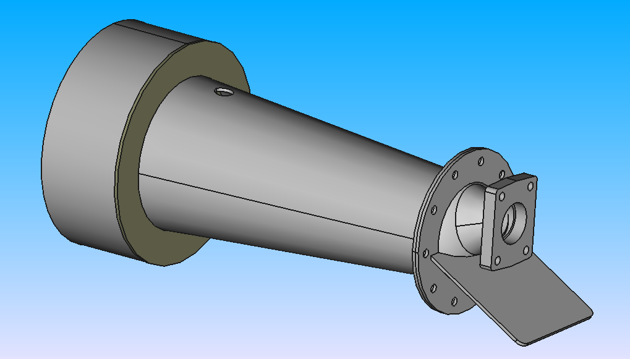
Hole radius Rh = 1.1 cm
Inner radius Ri = 8.1 cm
Outer radius Ro = 12.9 cm
Thickness t = 0.4 cm

Slide 3
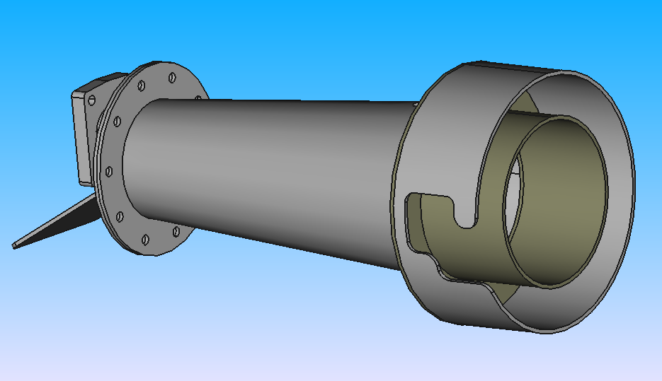
Tube
Inner radius Ri = 12.5 cm
Outer radius Ro = 12.9 cm
Height H = 10 cm
Flanges
Inner radius Ri = 5.5 cm
Outer radius Ro = 9.5 cm
Thickness t = 0.4 cm
Hole radius Rh = 0.25 cm
# of holes = 10
Tube
Inner radius Ri = 8.1 cm
Outer radius Ro = 8.5 cm
Height H = 10 cm

Slide 4
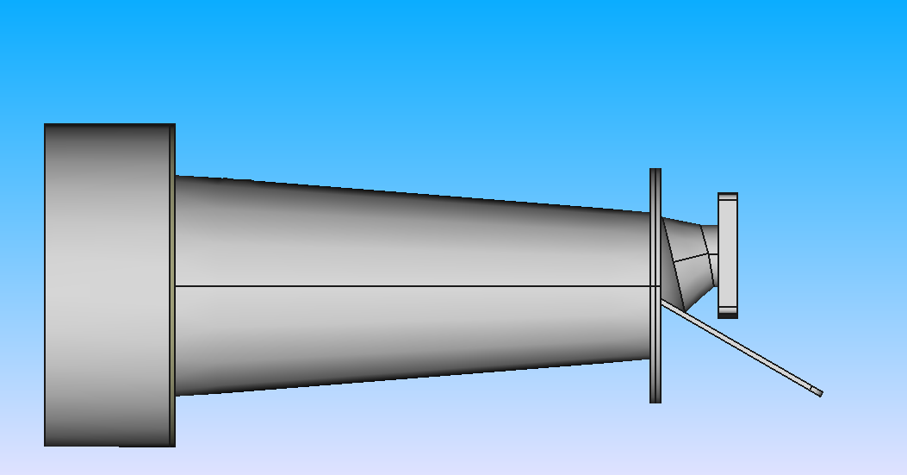
Right view
Cone
Radius R1 = 2.5 cm
Radius R2 = 4 cm
Height H = 3 cm
Cylinder
Inner radius Ri = 2.1 cm
Outer radius Ro = 2.5 cm
Height H = 1.5 cm
Length L = 38 cm
Angle ɑ = 60°

Slide 5
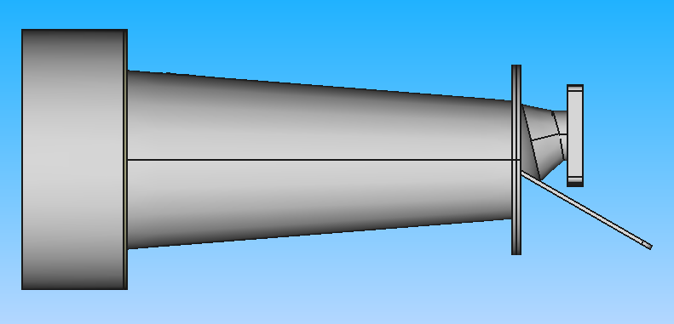
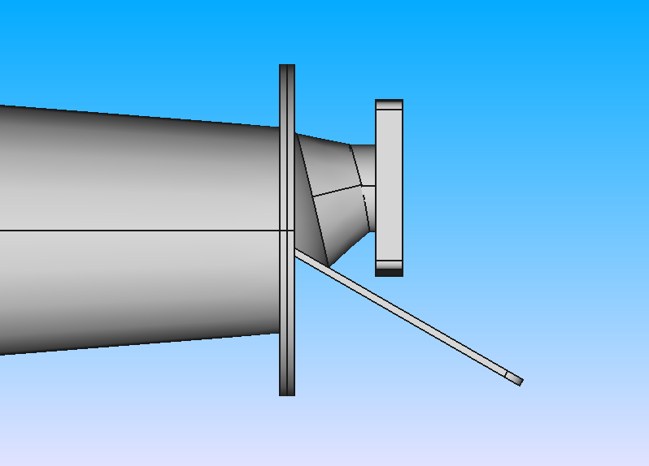
Distance d = 3 cm
Distance D = 1 cm
Length L = 15 cm
Width W = 14 cm
Thickness t = 0.4 cm
Fillet f = 1 cm

Slide 6
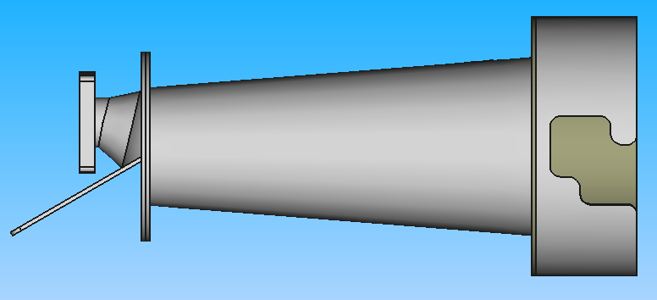
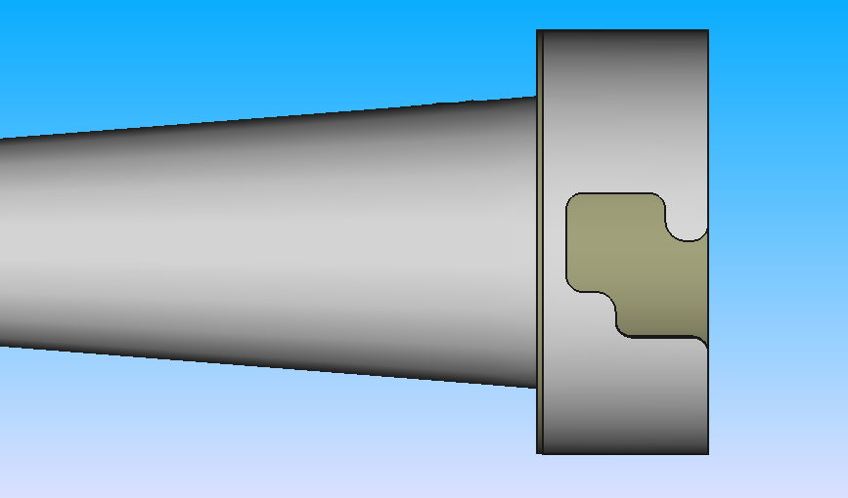
Distance d = 8.7 cm
Length of square L = 4 cm
Width of square W = 6 cm
Fillet f = 1 cm
Distance d = 5.6 cm

Slide 7
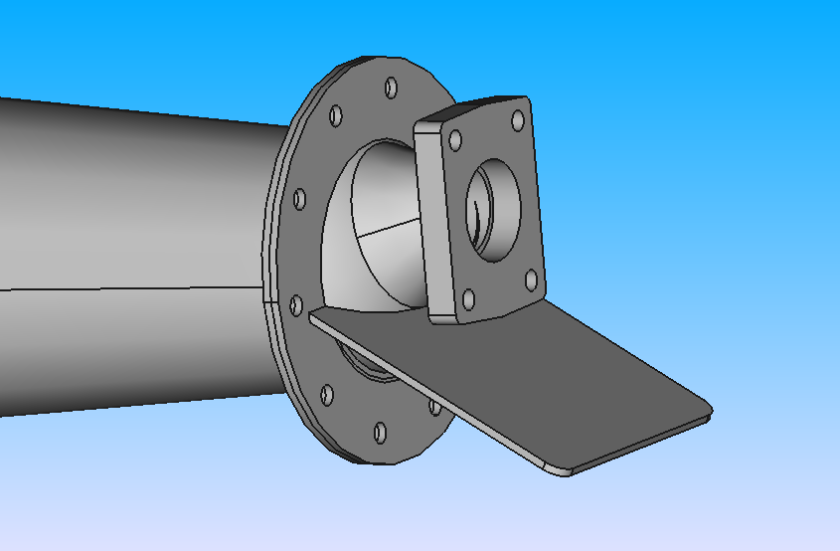
Length L = 9.5 cm
Width W = 7.9 cm
Central hole radius R = 2.4 cm
4 holes radius r = 0.4 cm
Thickness t = 0.4 cm

Slide 8
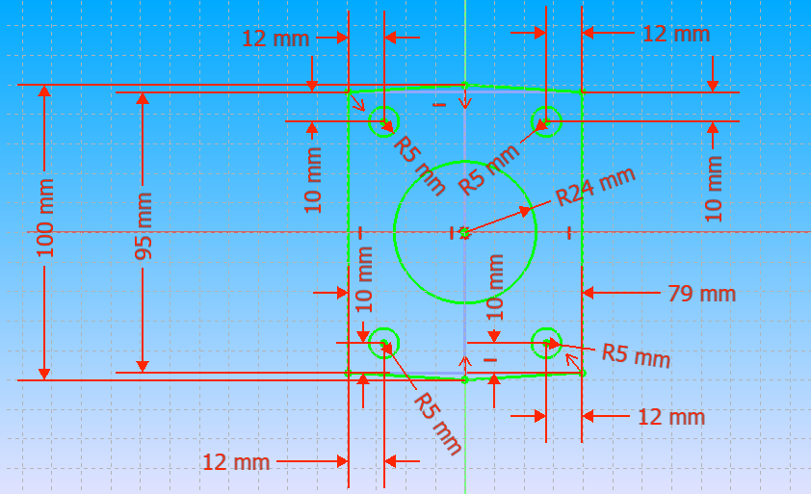

Slide 9
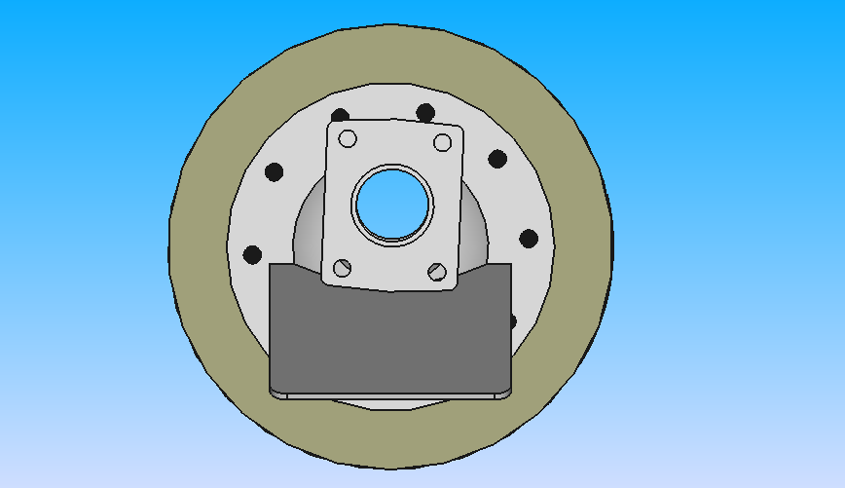
Front view

Slide 10
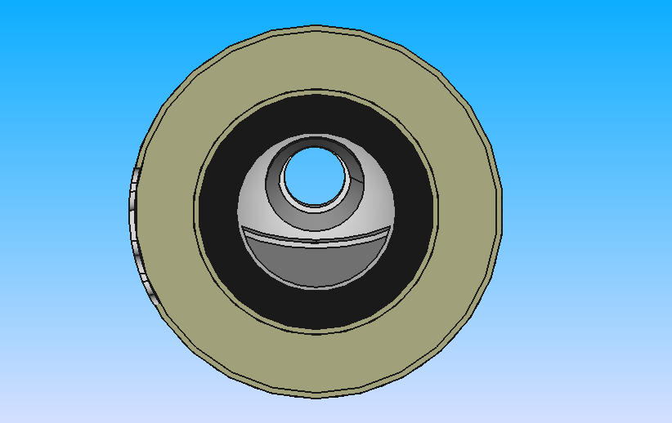
Rear view

Slide 11
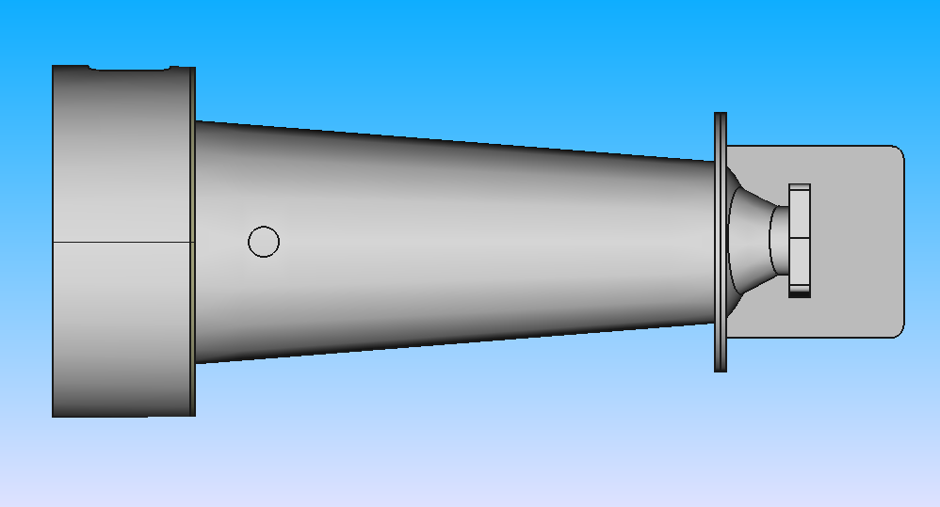
Top view

