Slide 1
Fuel Burner Stand
Design & Size

Slide 2
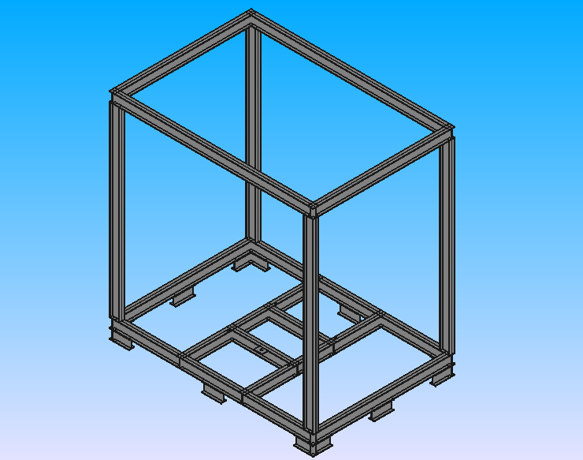
The stand _ Isometric view

Slide 3
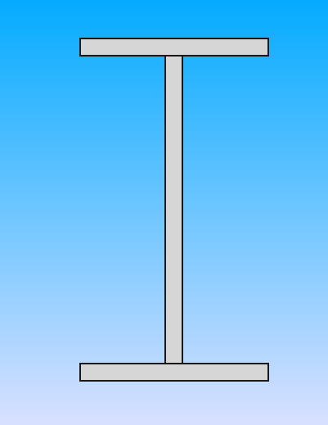
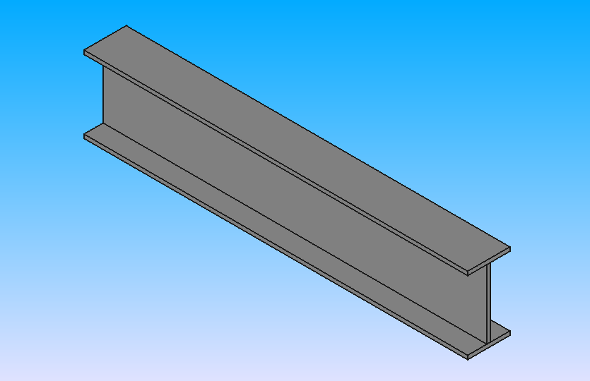

5.5 cm
0.5 cm
9 cm
Used in the stand
0.5 cm
9 cm
2.5 cm
5.5cm

Slide 4
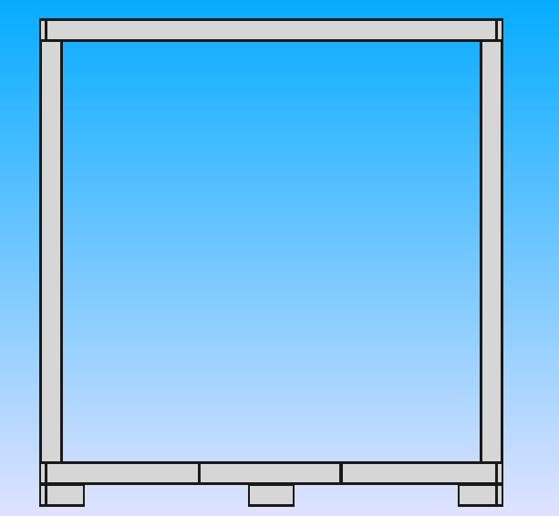
Width W = 210 cm
Length L = 197 cm
The stand _ Front view
Distance
D = 10 cm
d = 20 cm

Slide 5
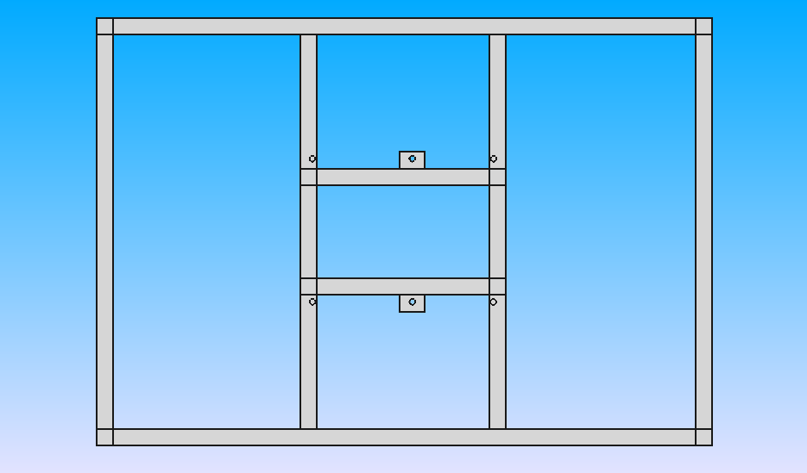
d = 5.5 cm
D = 57 cm
W = 6 cm
Width W = 197 cm
D = 43 cm
The stand _ Top view
L = 8 cm
D = 57 cm

Slide 6
d = 5.5 cm
D = 70 cm
Radius R = 1 cm
D = 64 cm
The stand _ Top view
D = 75 cm
D = 64 cm
Radius R = 1 cm
D = 75 cm
Length L = 210 cm

Slide 7
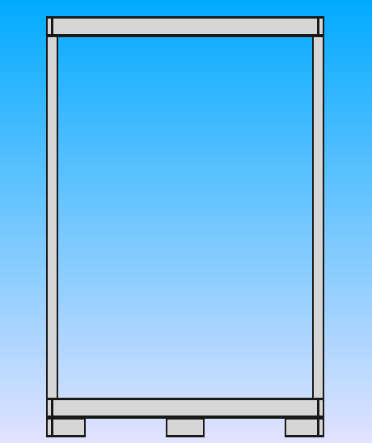
d = 10 cm
d = 5.5 cm
D = 197 cm
The stand _ Right view
Length L = 146 cm
d = 20 cm

Slide 8
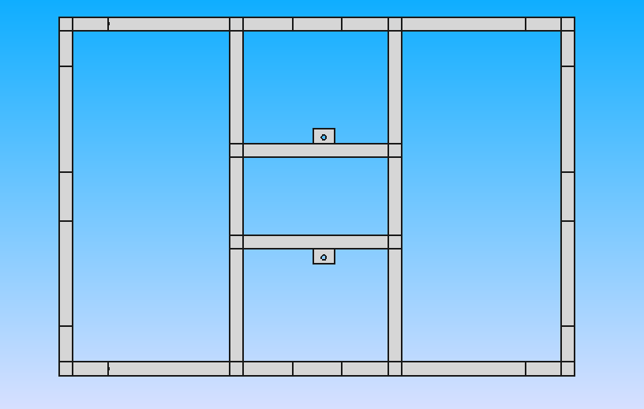
d = 20 cm
d = 20 cm
d = 20 cm
D = 64 cm
D = 75 cm
d = 20 cm
D = 37 cm
D = 43 cm
The stand _ Bottom view
Width W = 197 cm
D = 64 cm
D = 75 cm
d = 20 cm
Length L = 210 cm

Slide 9
Fuel Burner with Stand
Design & Size

Slide 10
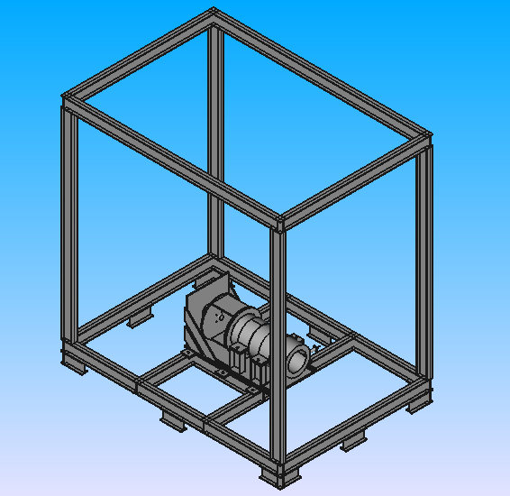
Fuel burner with stand _ Isometric view

