Slide 1
Helical coil heat exchanger
Sizing details

Slide 2
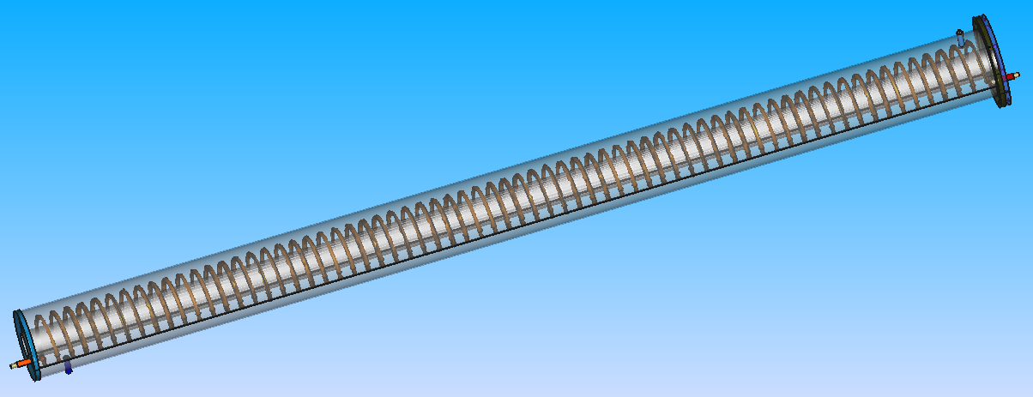
Outlet cold fluid
Length of HX : L = 2.6 m
Inlet warm fluid
Inlet cold fluid
Outlet warm fluid

Slide 3
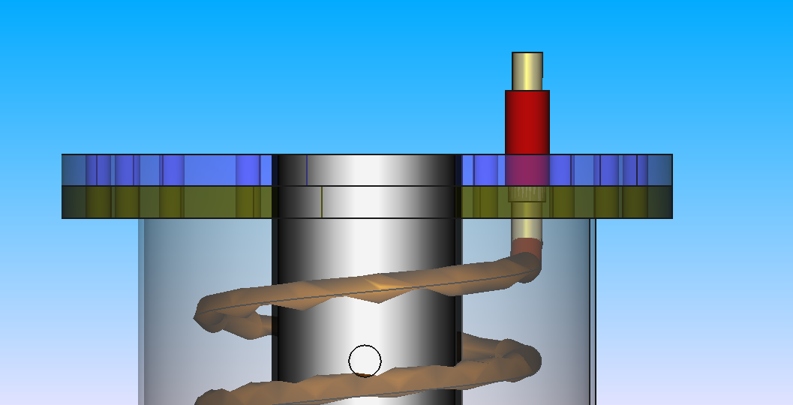
Diameter d = 1 cm
Diameter d = 1.4 cm
Diameter D = 20 cm
Thickness t = 10 mm
Pitch P = 3 cm
Outlet shell
Material : Stainless
Hole diameter 1.24 cm

Slide 4

Outside diameter O.D. = 14 cm
Inside shell
Material : Stainless
Inner diameter di = 5.4 cm
Outer diameter do = 6 cm
Coil (warm fluid)
Material : Copper
Nominal pipe sizing : 3/8”
Pitch P = 3 cm
Diameter of helical coil D = 10 cm
Length of helix/spiral L = 22.8 m
Number of turns n = 73 turns
Angle between in – out : ɑ =180°
Direction of fluid : From top to bottom
Pipe (Cold fluid)
Material : stainless
Nominal pipe size (NPS) : 1/2”
Outside diameter O.D.: 5/8”
Length of pipe L = 40 cm
Angle between in – out : ɑ =180°
Direction of fluid : From bottom to the top

Slide 5
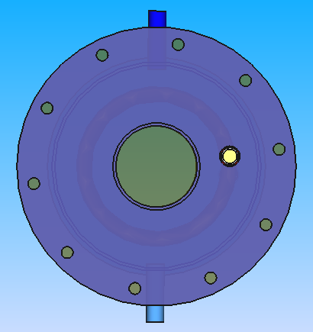
Inlet Cold fluid (on the bottom of shell)
Material : Stainless
Length of pipe L = 40 cm
Outside flange
Material : Stainless
Outside diameter : d = 20 cm
Copper coil
Material : Copper
Nominal pipe diameter : DN = 10 mm
Screw holes
Number of holes n = 10
Diameter of hole d = 8 mm
Diameter of holes array : Da = 17 cm
Thickness t = 10 mm
Outside shell
Material : Stainless
Outside diameter : d = 14 cm
Outlet Cold fluid (on the top of shell)
Material : Stainless
NPS = 1/2”
Outside diameter O.D.: 5/8”
Length of pipe L = 40 cm
Angle between in – out : ɑ =180°
Direction of fluid : From bottom to the top
Inside shell
Material : Stainless
Outside diameter : d = 6 cm

Slide 6
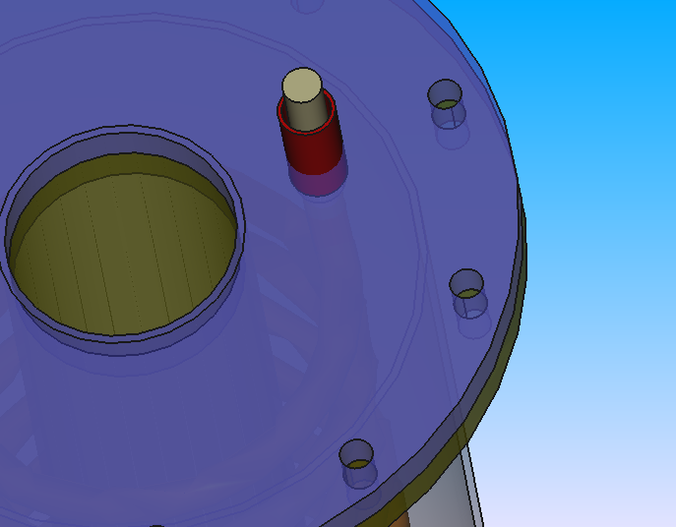
Coil
Material : Copper
Nominal diameter : DN = 3/8
Length L = 50 cm
Upper pipe
Material : Stainless
Inside diameter di = 1 cm
Outside diameter do = 1.4 cm
Length L = 25 mm
Upper flange
Material : Stainless
Inside diameter di = 6 cm
Outside diameter do = 20 cm
Thickness T = 10 mm
Screw holes
Number of holes n = 10
Diameter of hole d = 8 mm
Diameter of holes array : Da = 17 cm
Thickness t = 10 mm
Lower flange
Material : Stainless
Inside diameter di = 14 cm
Outside diameter do = 20 cm
Thickness T = 10 mm

Slide 7
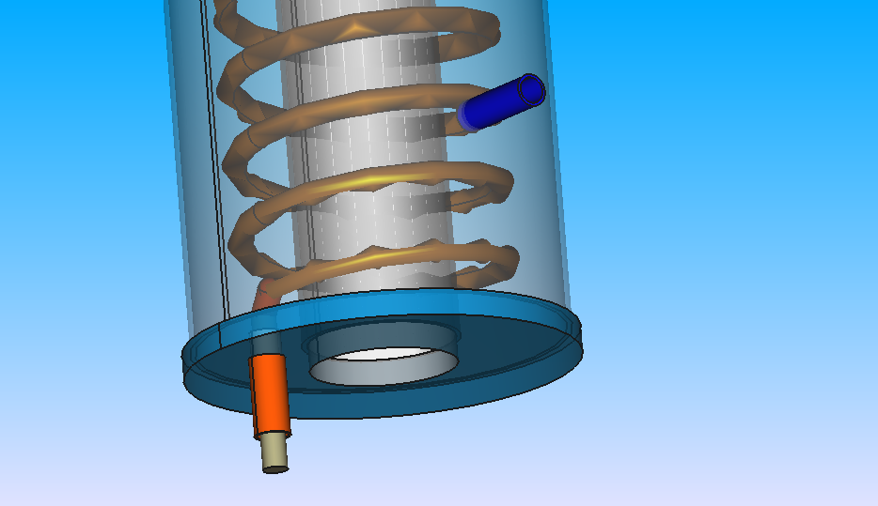
Coil (warm fluid)
Material : Copper
Nominal pipe sizing : 3/8
Pitch P = 3 cm
Diameter of helical coil D = 10 cm
Length of helix/spiral L = 22.8 m
Number of turns n = 73 turns
Angle between in – out : ɑ =180°
Direction of fluid : From top to bottom
Outside shell
Material : Stainless
Diameter d = 14 cm
Thickness T = 3 mm
Length L = 2.5 m
Lower pipe(Inlet cold fluid)
Material : Stainless
Inside diameter di = 1 cm
Outside diameter do = 1.4 cm
Length L = 40 cm
Inside shell
Material : Stainless
Diameter d = 6 cm
Thickness T = 3 mm
Length L = 2.4 m
Bottom flange
Material : Stainless
Inside diameter di = 6 cm
Outside diameter do = 18 cm
Thickness T = 10 mm
Bottom pipe (outlet warm fluid)
Diameter d = 1.24 m
Length L = 25 cm
Flange hole
Diameter d = 1.24 m
Thickness T = 10 mm

