Slide 1



CO spectroscopy gas analysis
Siham Aisha
Maryam abdel-karim

Slide 2
Spectroscopic techniques
A number of spectroscopic techniques have been developed for trace gas measurements:
Non-dispersive infrared (NDIR)
Fourier transform infrared (FTIR),
Differential optical absorption spectroscopy (DOAS),
Laser-induced fluorescence (LIF)
Tuneable diode laser absorption spectroscopy (TDLAS)
Cavity enhanced absorption spectroscopy (CEAS)
Open Path Gas Detector (OPGD) is specific to Hydrogen Chloride (HCl).
Notes:
Stability of frequency is important that why we choose the laser that have a low drift and stable

Slide 3
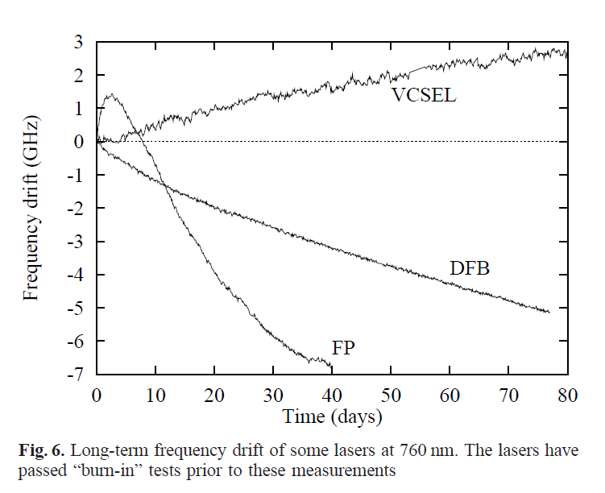
Type of laser
Fabry–Perot (FP)
Distributed feedback (DFB),
Distributed Bragg reflector (DBR) and
Vertical cavity surface emitting lasers (VCSEL)

Slide 4
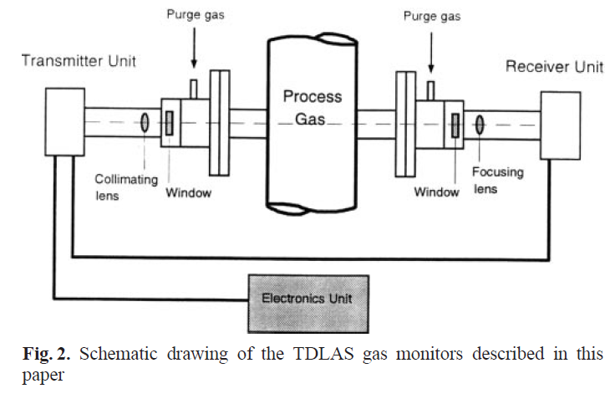
Schematic
Notes:
The mechanical layout of a monitor installed on a stack is shown in Fig. 2. The laser and detector are located in the transmitter and receiver units, respectively. Both units are mounted on the stack by using standard flanges purged with dry air to keep the optical windows clean. The detected signal is transmitted through a cable to the electronics unit, which contains signal-processing electronics. The measured concentration is displayed on an LCD display, and for data recording and logging it is sent through an RS232 digital output and a standard 4–20mA analogue output. An alternative to this design would be to place the laser and possibly detector in the electronics unit and use optical fibres to the point of measurement. However, it has been difficult to obtain similar detection sensitivities without sacrificing the simplicity of the above solution.

Slide 5
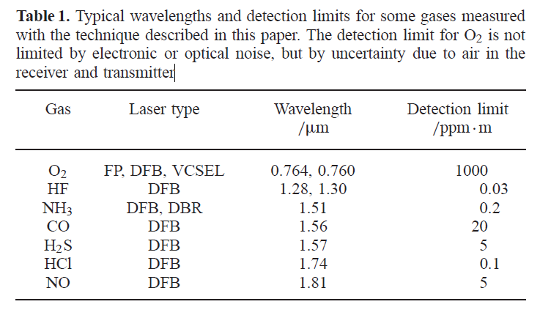
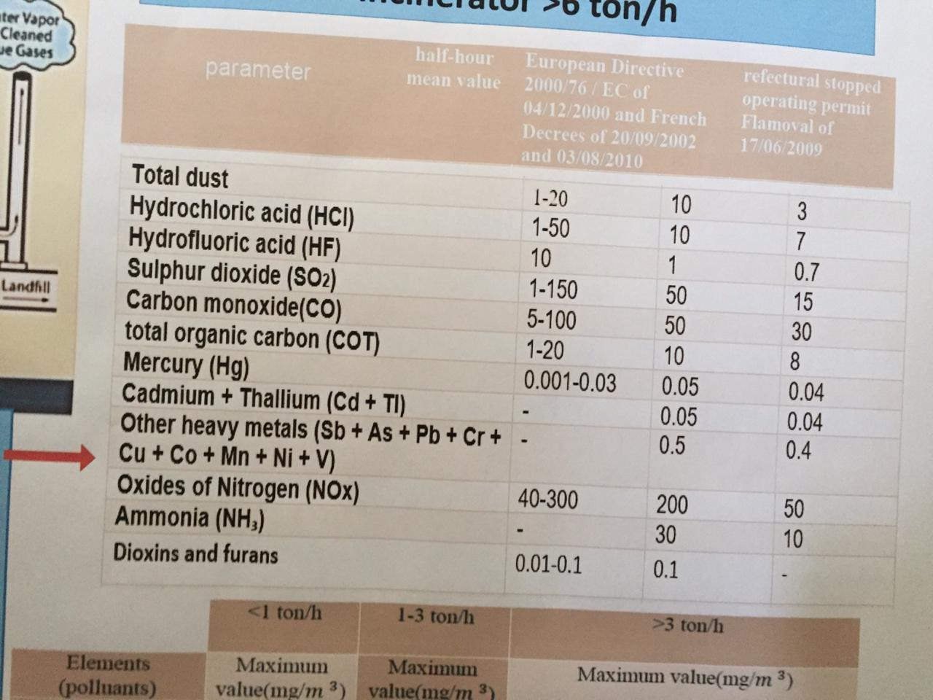
Gases wavelength
Standard wavelengths for hydrogen chloride detection HCl
nanoplus offers various wavelengths to target the vibrational-rotational bands of hydrogen chloride. Literature recommends the following wavelengths for hydrogen chloride detection:
1742 nm
3395 nm

Slide 6
Standard wavelengths for sulfur dioxide detection (SO2)
nanoplus offers various wavelengths to target the vibrational-rotational bands of sulfur dioxide. Literature recommends the following wavelengths for sulfur dioxide detection:
2460 nm
4020 nm
Standard wavelengths for carbon monoxide detection (CO)
nanoplus offers various wavelengths to target the vibrational-rotational bands of carbon monoxide. Literature recommends the following wavelengths for carbon monoxide detection:
1568 nm
2330 nm
4610 nm
Standard wavelengths for nitrogen oxide detection (NOx)
nanoplus offers various wavelengths to target the vibrational-rotational bands of nitrogen oxides. Literature recommends the following wavelengths for nitrogen oxides detection:
1814 nm
2270 nm
2670 nm
2860 nm
3420 nm
4470 nm
5255 nm

Slide 7
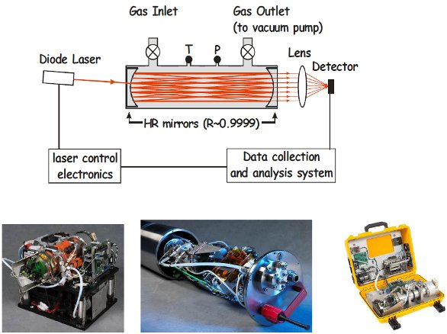
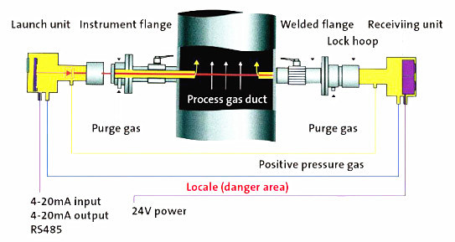
Standard wavelengths for ammonium detection
nanoplus offers various wavelengths to target the vibrational-rotational bands of ammonium. Literature recommends the following wavelengths for ammonium detection:
1512 nm
3000 nm
CEAS (Cavity Enhanced absorption spectroscopy)
TDLAS (Tunable diode laser absorption spectroscopy)

Slide 8
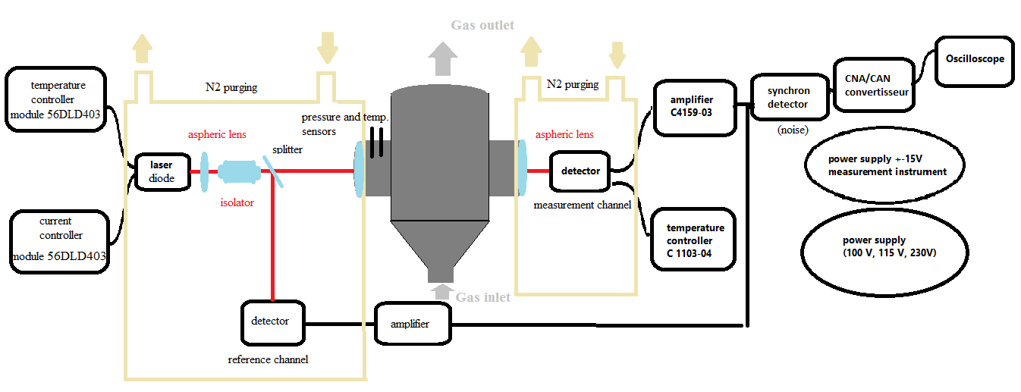
Design of the instrument

Slide 9
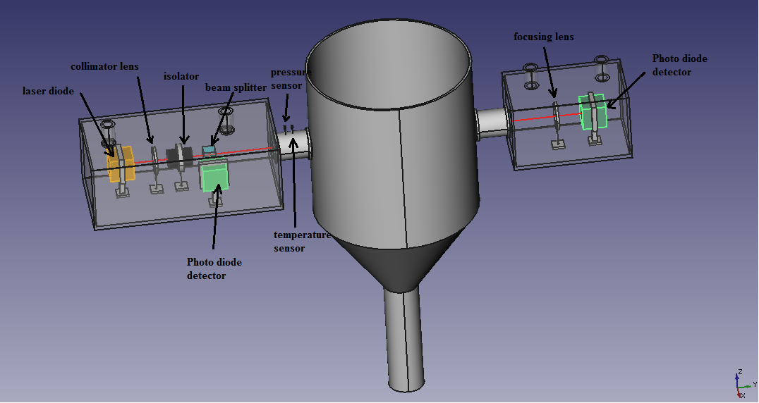
FreeCAD Design

Slide 10
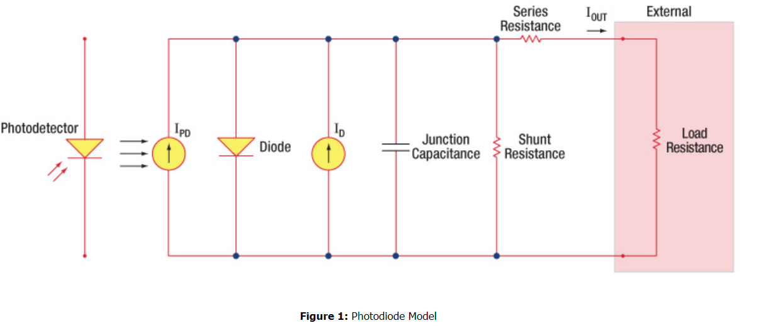
Block diagram

Slide 11
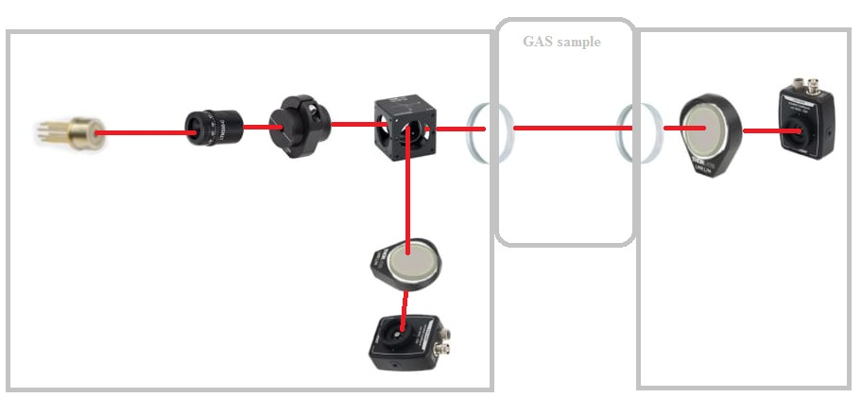
Spectroscopy for CO

Slide 12
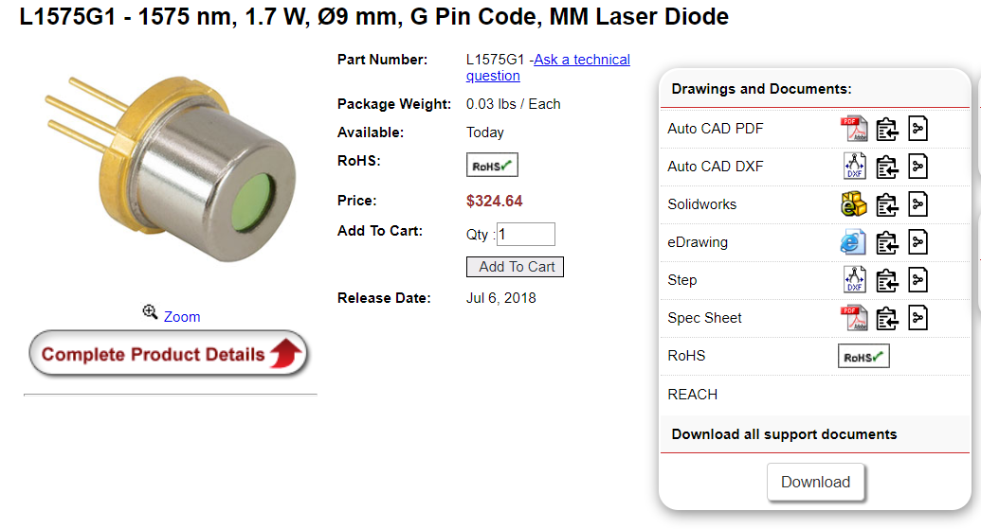
Diode laser
https://www.thorlabs.com/thorproduct.cfm?partnumber=L1575G1

Slide 13
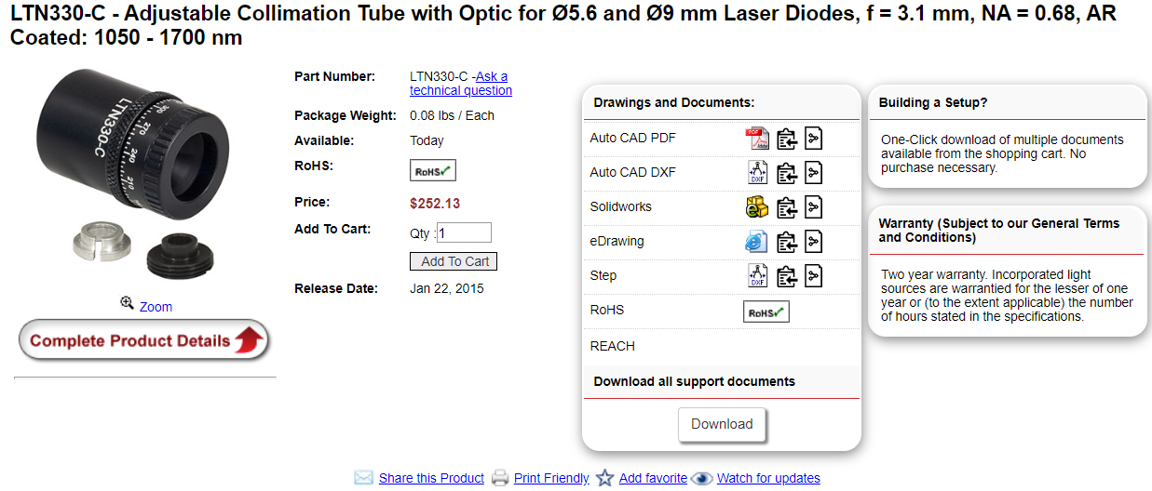
Collimator for CO
https://www.thorlabs.com/thorproduct.cfm?partnumber=LTN330-C

Slide 14
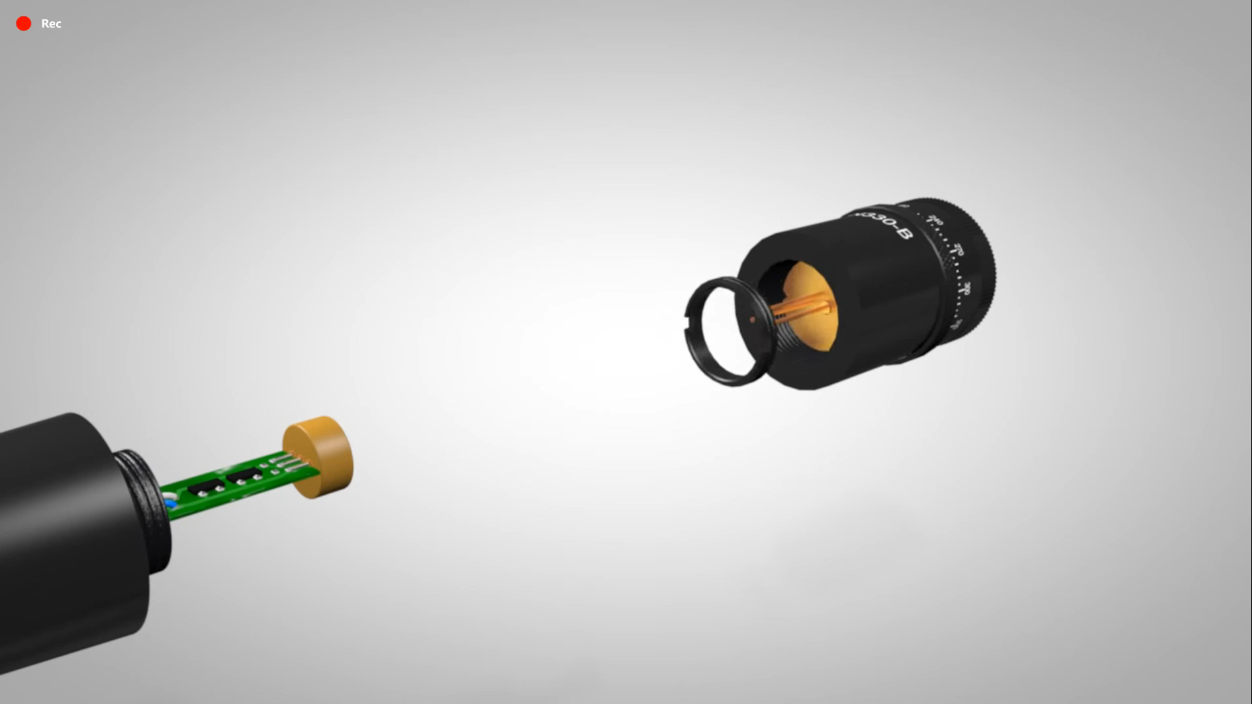

Slide 15
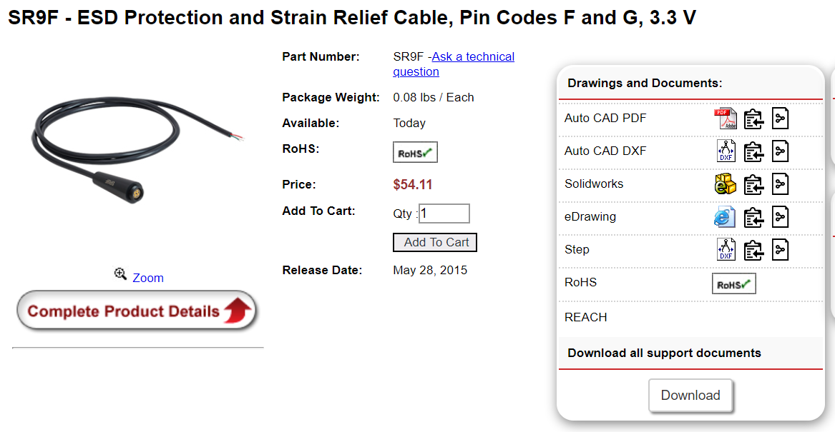
Cable for diode laser
https://www.thorlabs.com/thorproduct.cfm?partnumber=SR9F

Slide 16
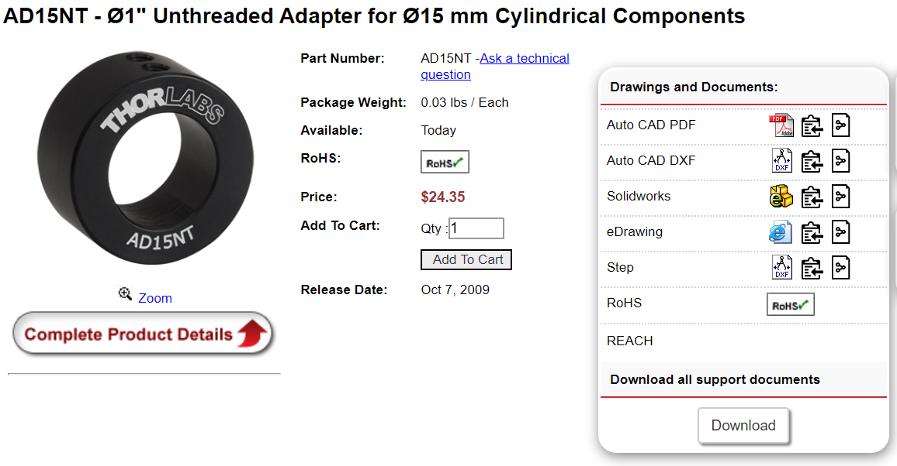
Collimator holder
https://www.thorlabs.com/thorproduct.cfm?partnumber=AD15NT

Slide 17
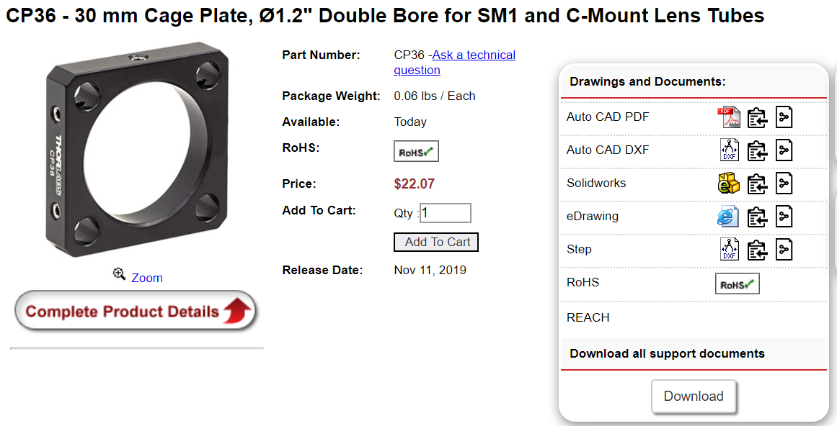
Collimator holder
https://www.thorlabs.com/thorproduct.cfm?partnumber=CP36

Slide 18
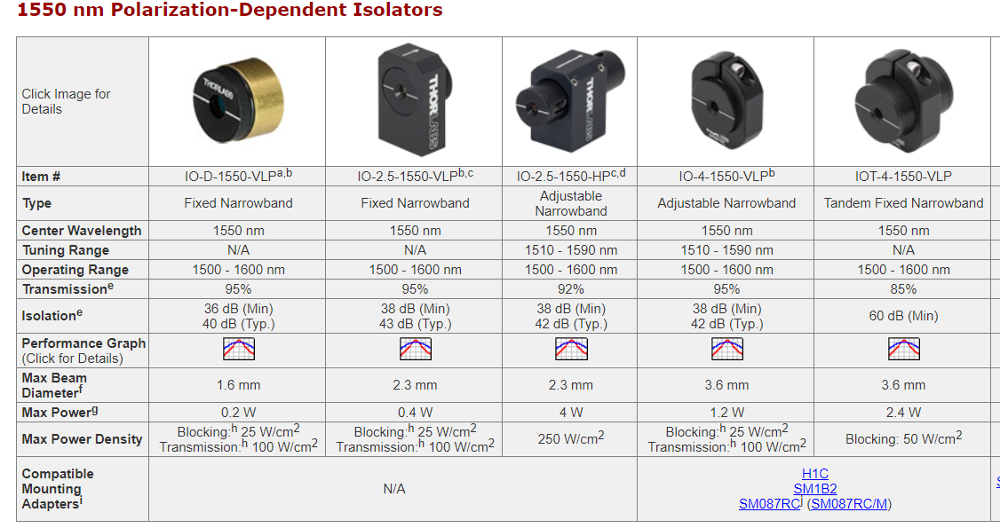
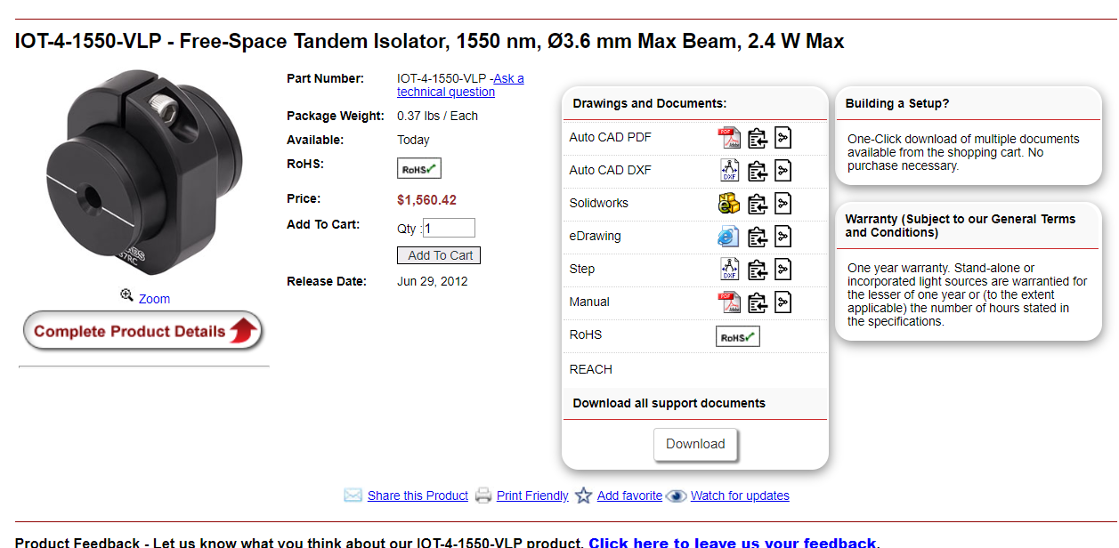
Isolator
https://www.thorlabs.com/thorproduct.cfm?partnumber=IOT-4-1550-VLP

Slide 19
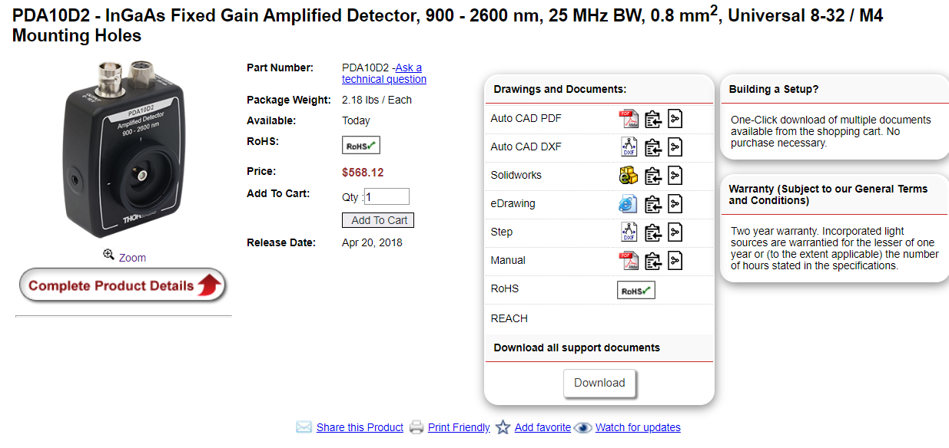
Photodiode
https://www.thorlabs.com/thorproduct.cfm?partnumber=PDA10D2

Slide 20
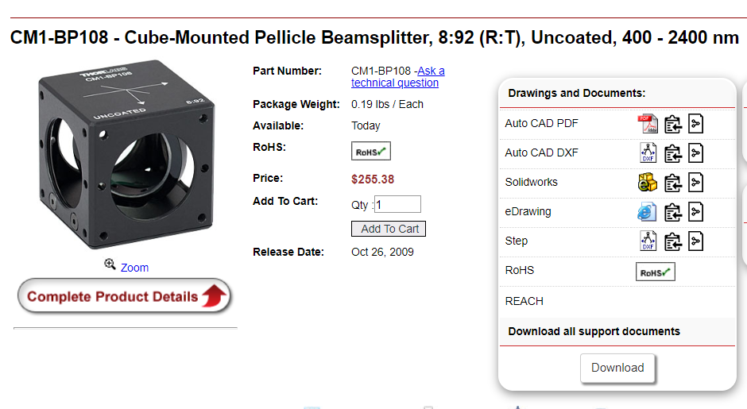
Beam splitter (for HF, NH3, NO, CO)
https://www.thorlabs.com/thorproduct.cfm?partnumber=CM1-BP108

Slide 21
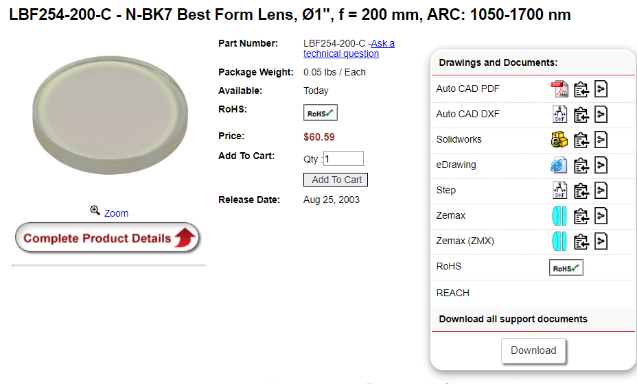
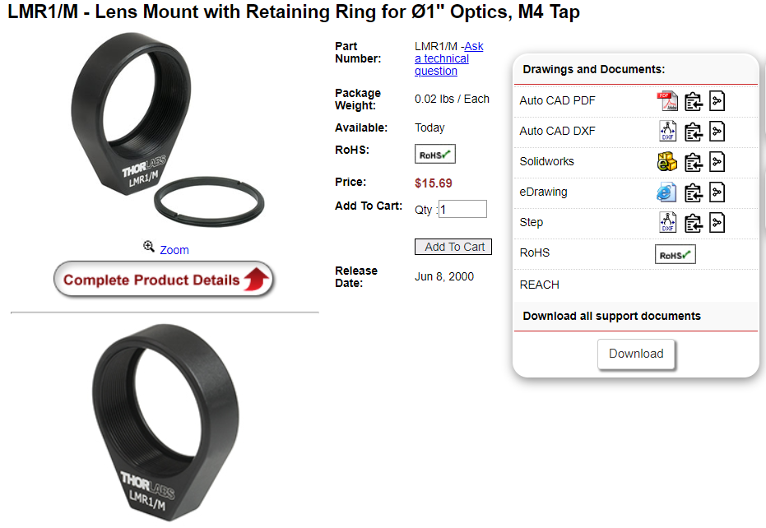
Focusing lens (NH3, HF, CO)
https://www.thorlabs.com/thorproduct.cfm?partnumber=LBF254-200-C
https://www.thorlabs.com/thorproduct.cfm?partnumber=LMR1/M#ad-image-0

Slide 22
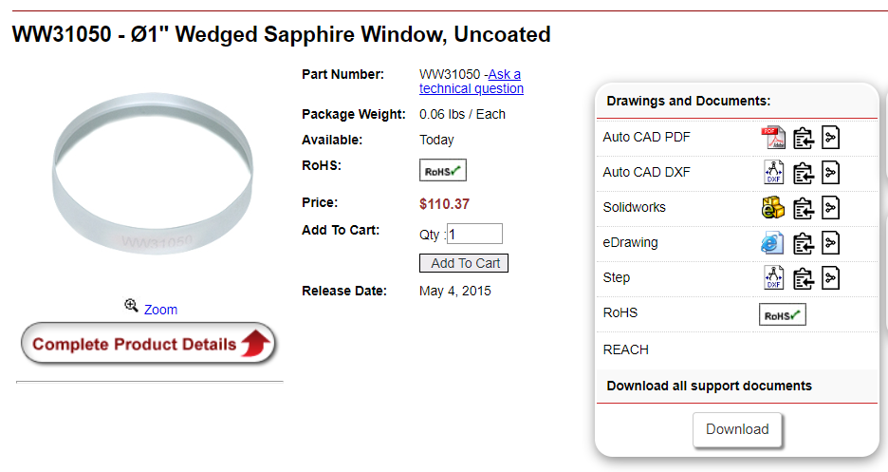
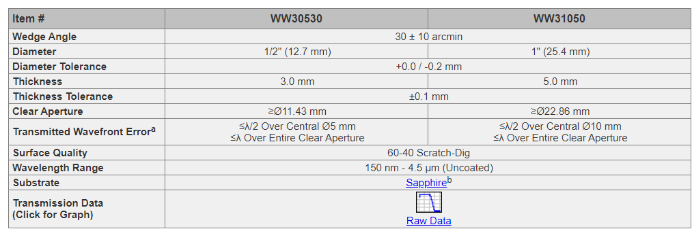
Wedge window
https://www.thorlabs.com/newgrouppage9.cfm?objectgroup_id=8764
https://www.thorlabs.com/thorproduct.cfm?partnumber=WW31050

Slide 23
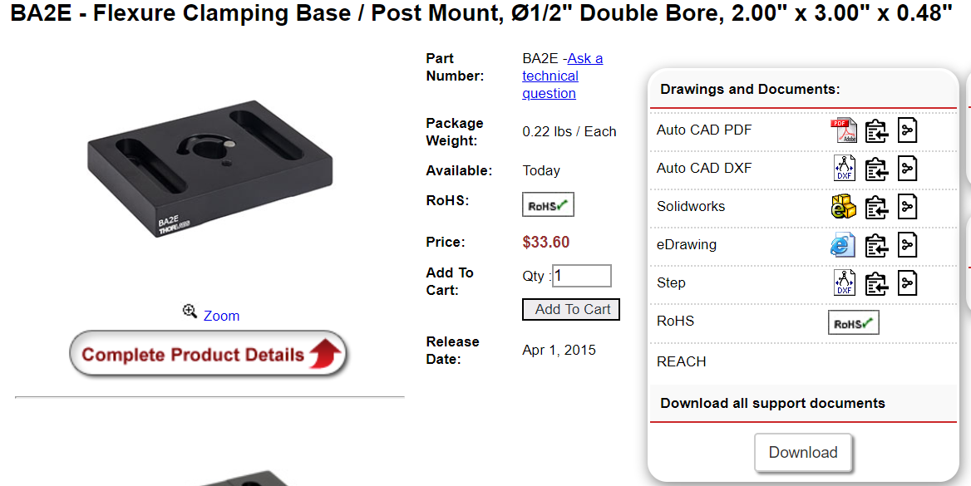
Base
https://www.thorlabs.com/thorproduct.cfm?partnumber=BA2E#ad-image-0

Slide 24
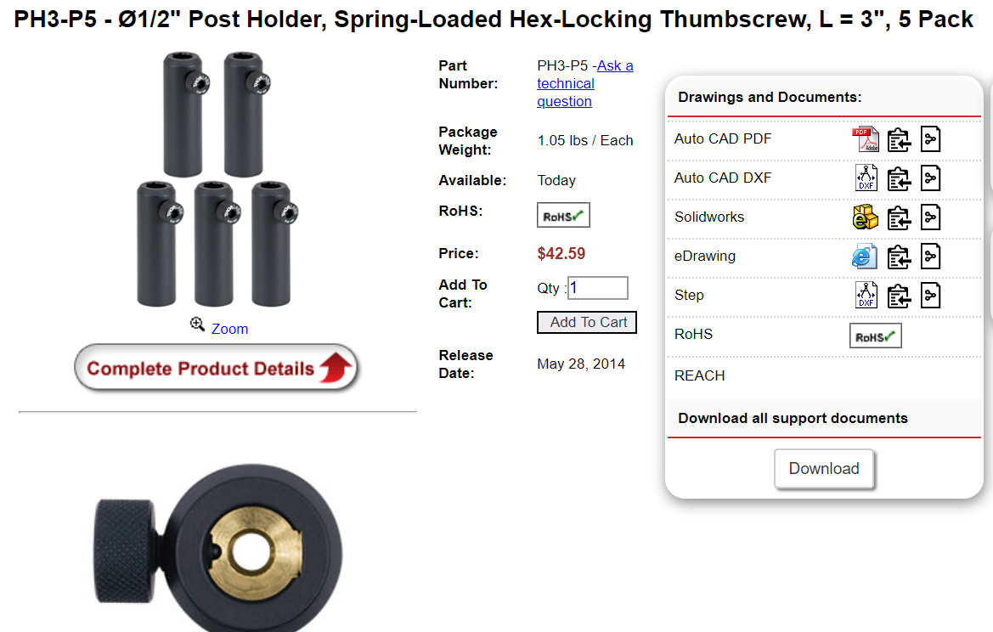
Post holder
https://www.thorlabs.com/thorproduct.cfm?partnumber=PH3-P5#ad-image-0
https://www.thorlabs.com/thorproduct.cfm?partnumber=PH3#ad-image-0 (PIECE)

Slide 25
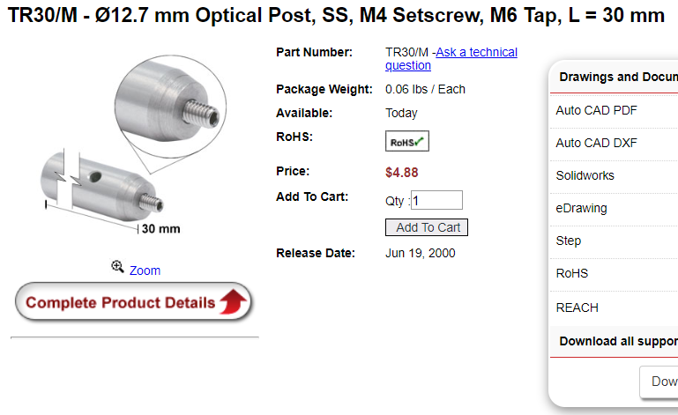
Holder
https://www.thorlabs.com/thorproduct.cfm?partnumber=TR30/M
https://www.thorlabs.com/thorproduct.cfm?partnumber=TR30/M-P5 (PACKAGE)

Slide 26
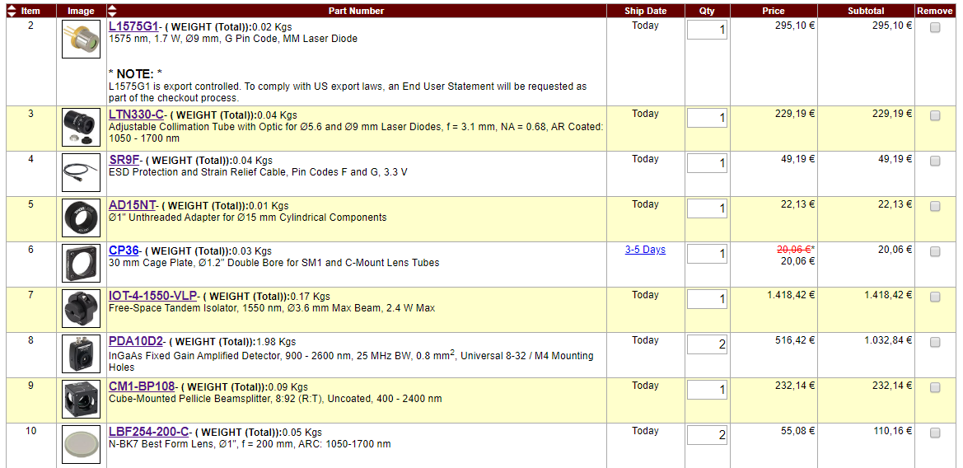
List of material and prices

Slide 27
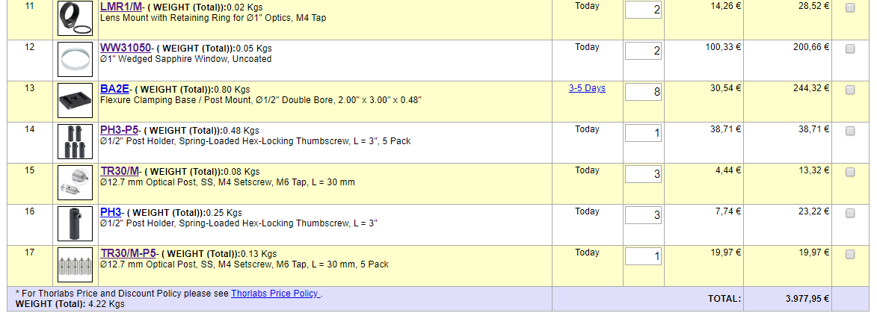
List of material and prices

Slide 28
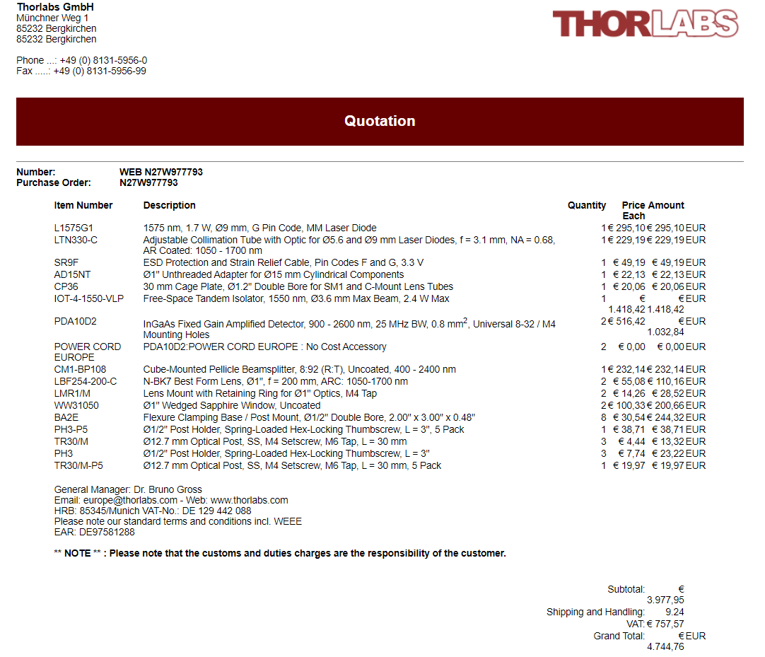
Quotation Thorlabs

