Slide 1



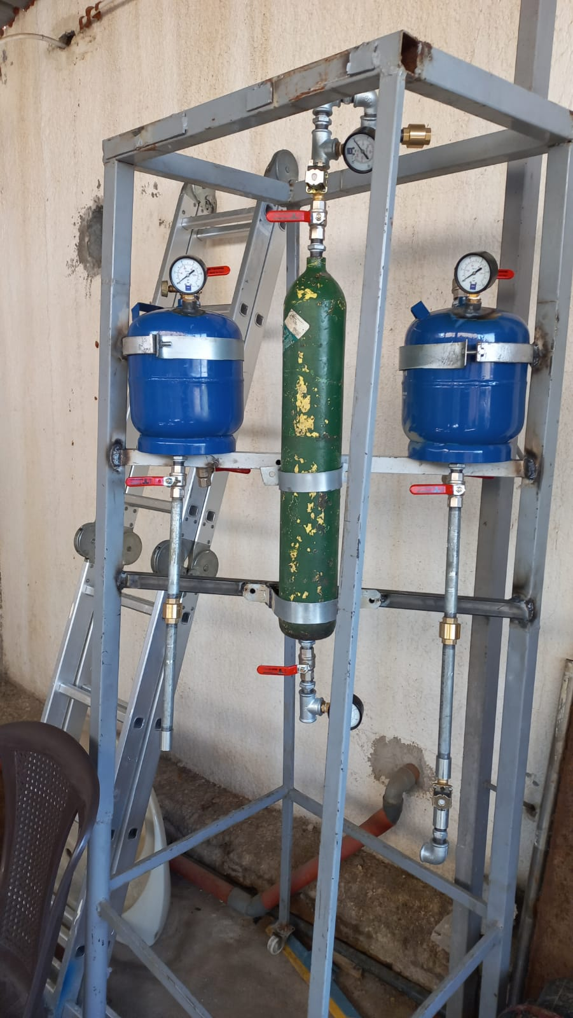
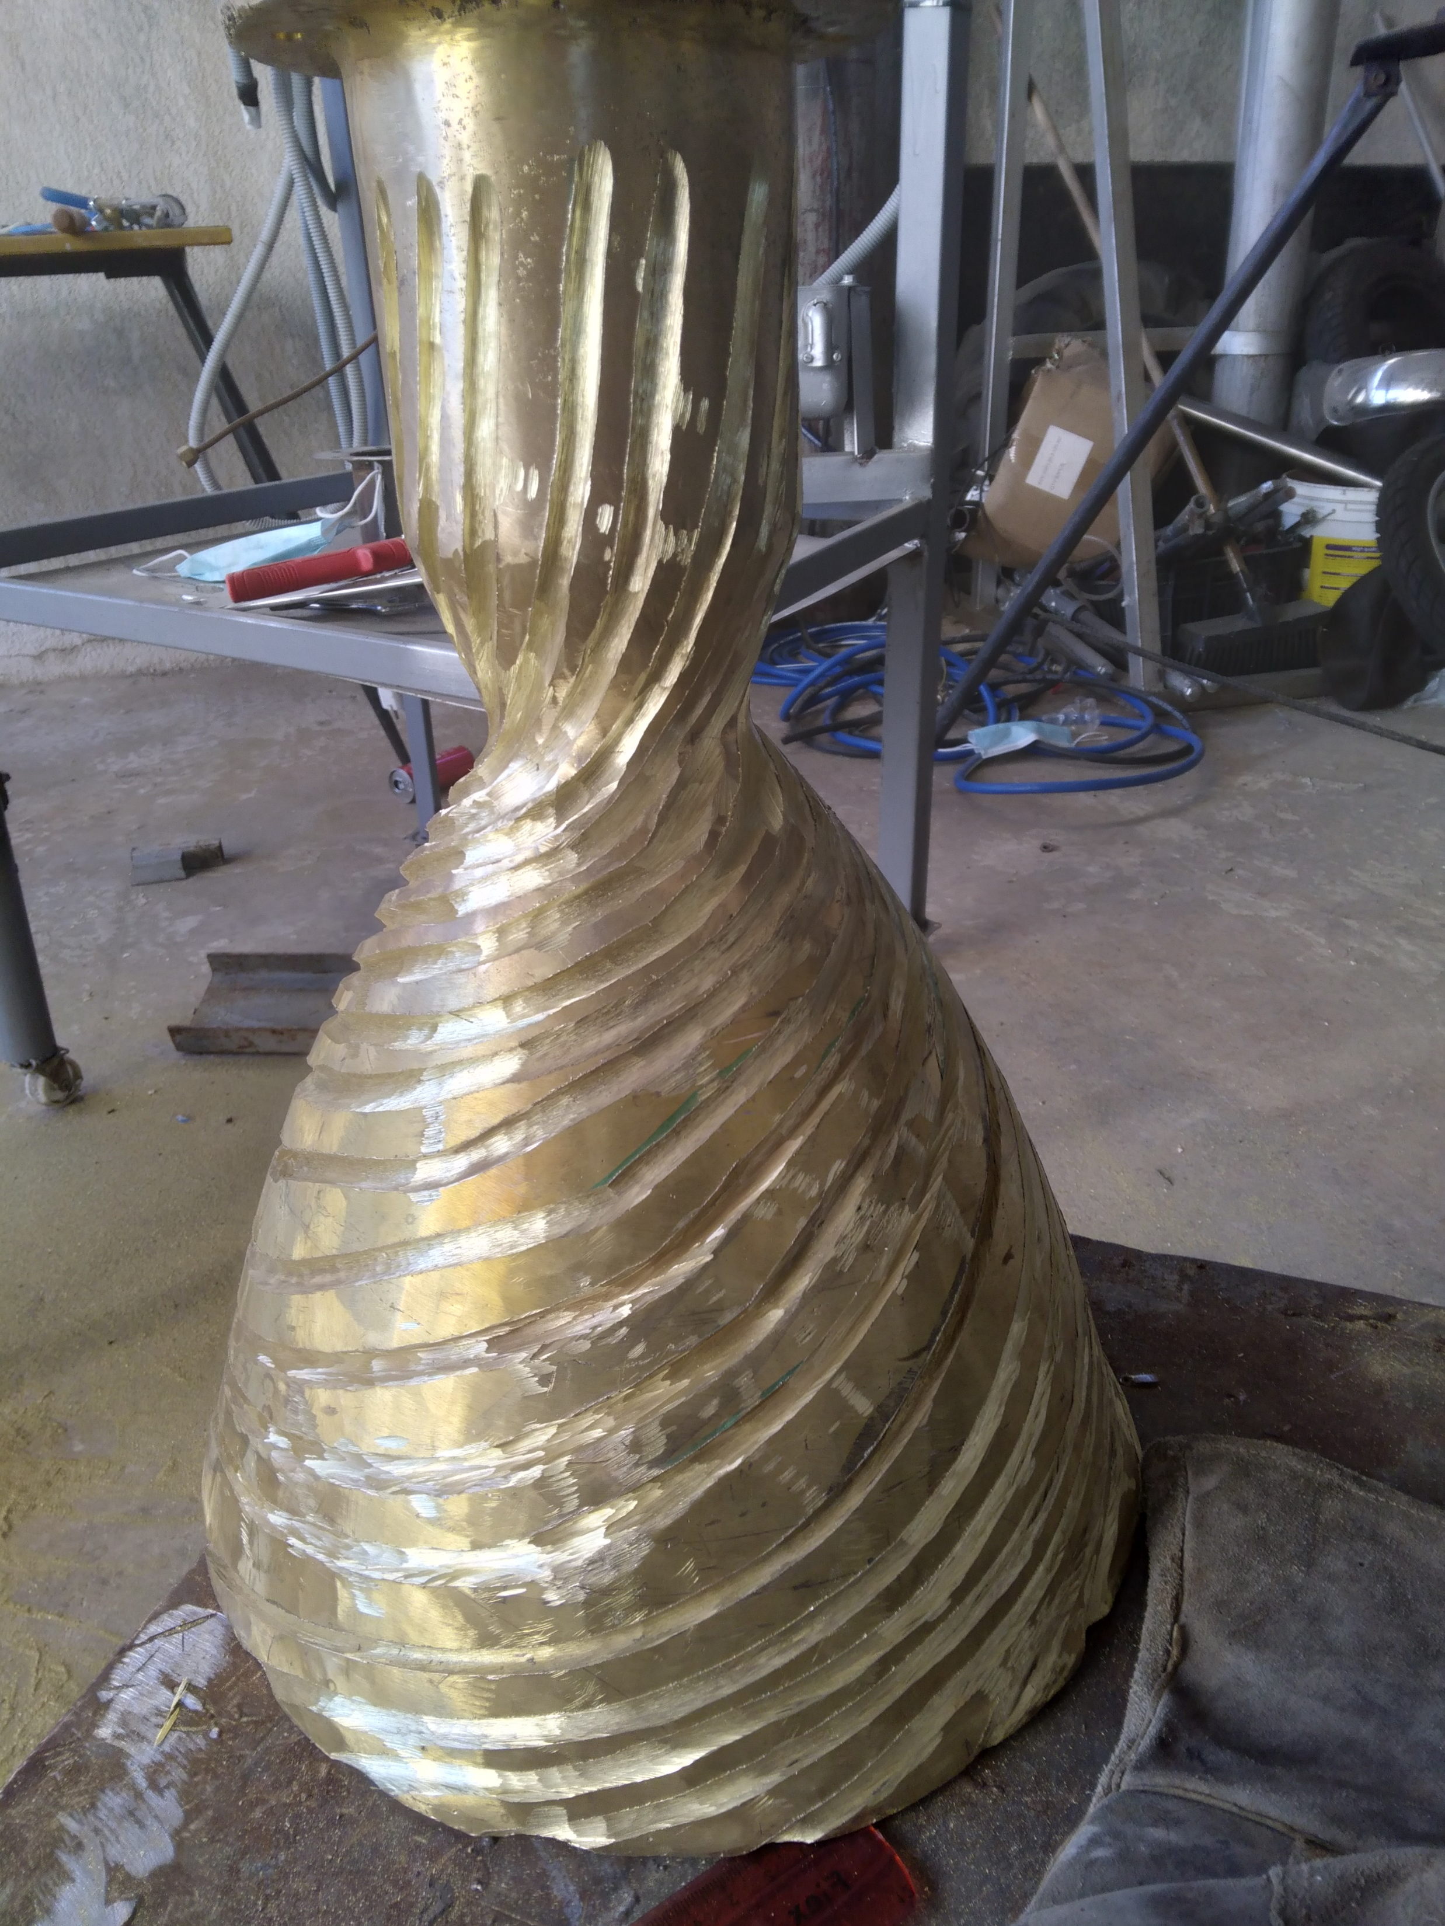
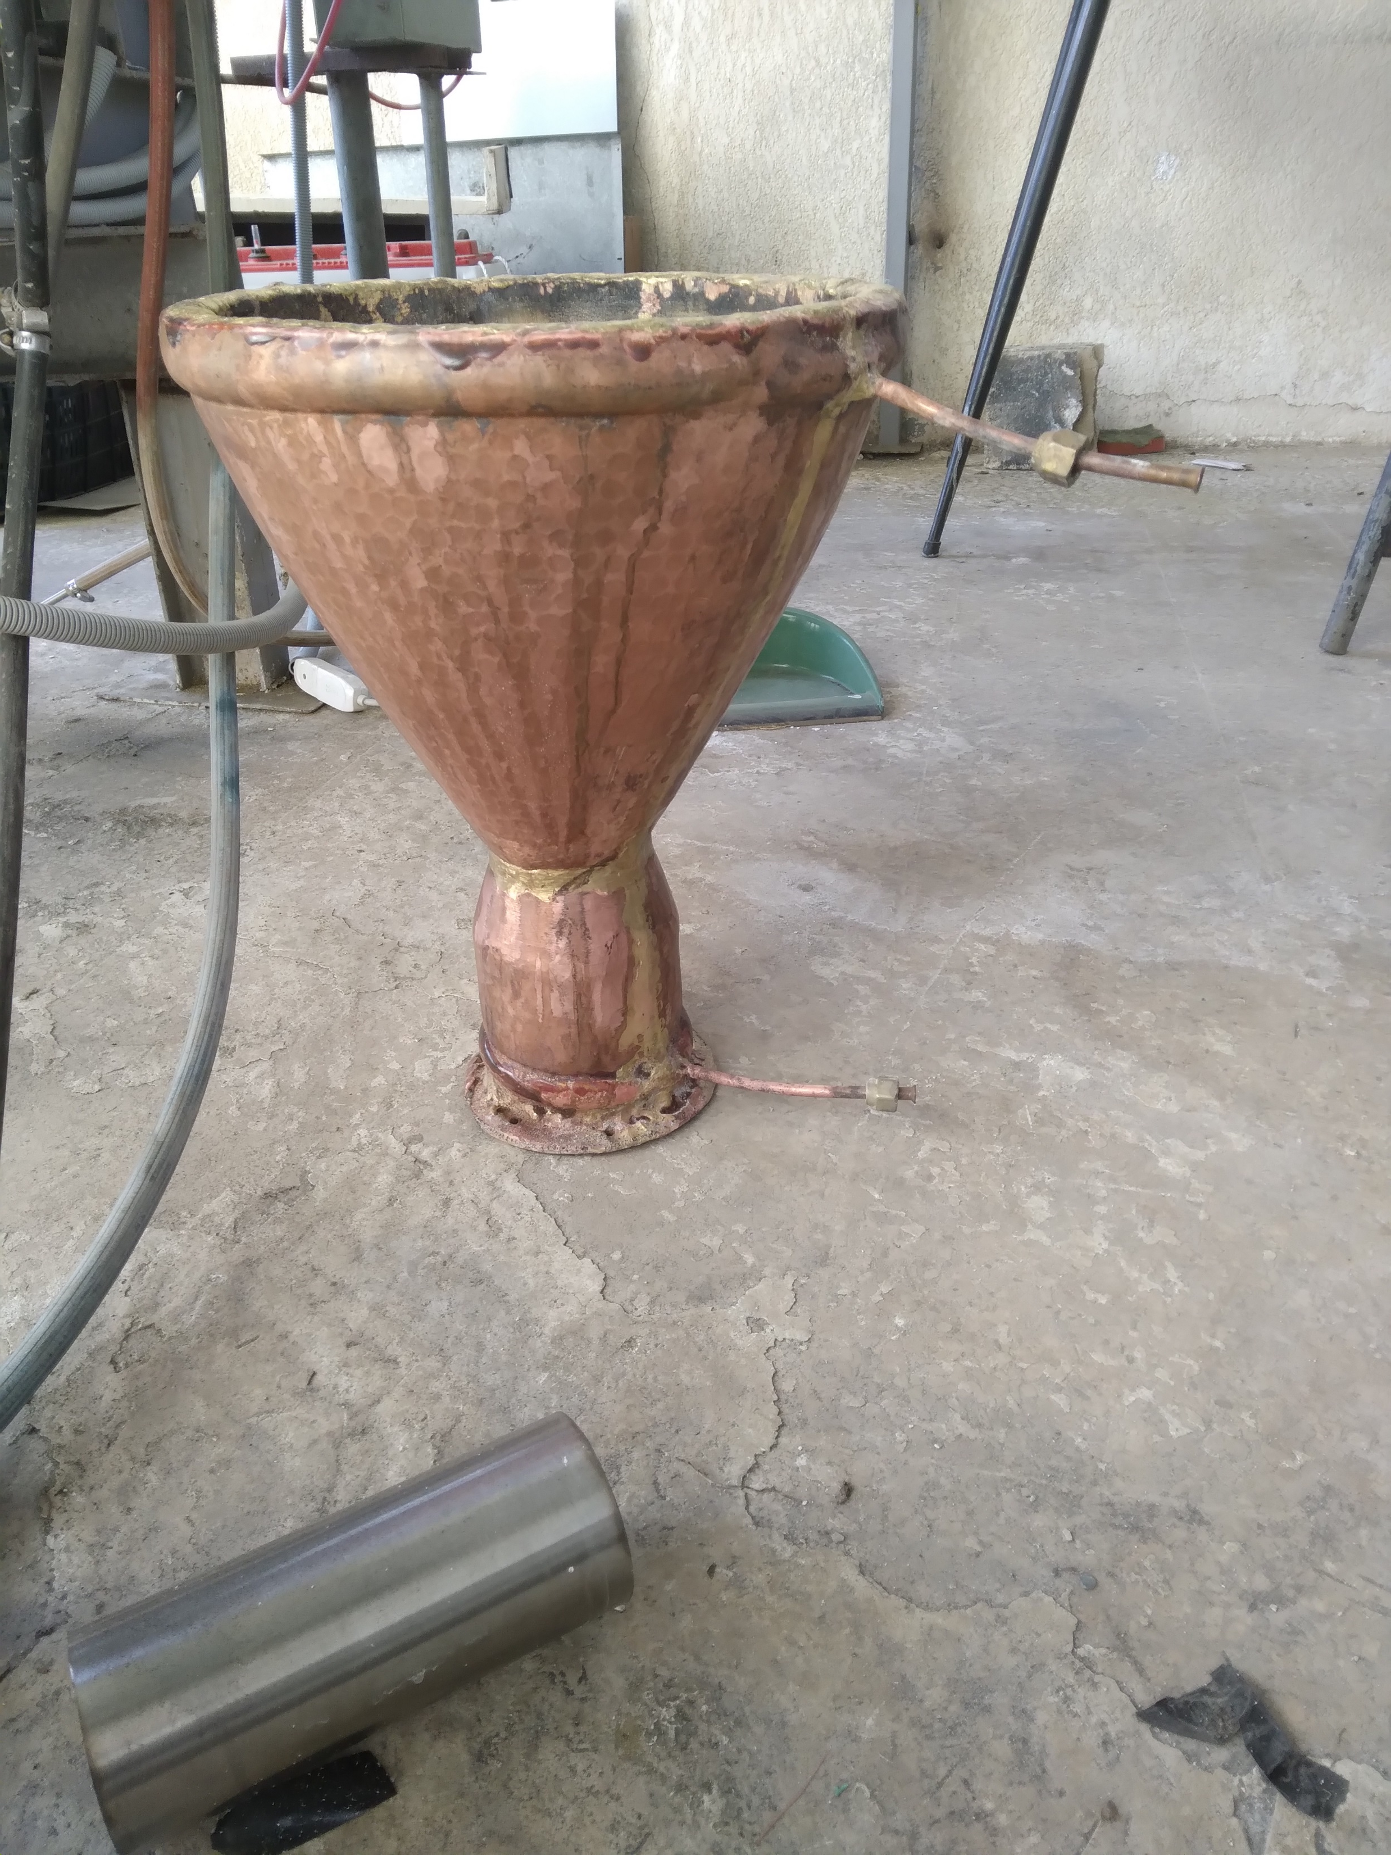
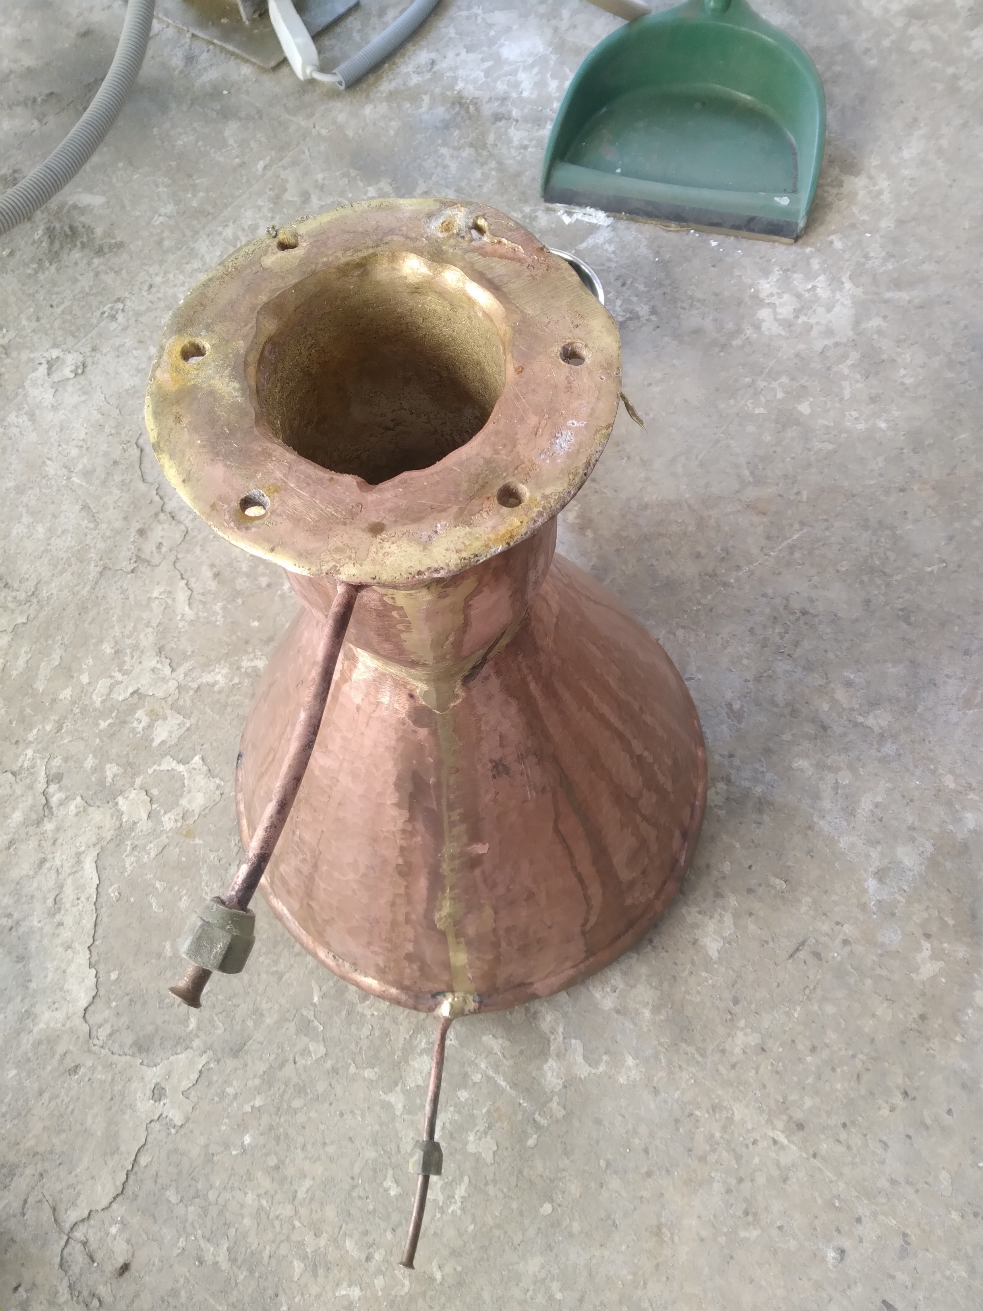
AS-COMSAT_1 OrbitChange Module Hardware-in-the-loop (HIL) teststand
System Design of HIL
Valve_fuel
PLC of Testrig
-Mixture Ratio Control
-Chamber Pressure Control
Valve_oxidizer
Pressure
GUI:
Guidance commands
Mass Flow_fuel
Mass Flow_oxidizer
Orbit Change
Propulsion Testrig
Fig.2 from: https://ntrs.nasa.gov/archive/nasa/casi.ntrs.nasa.gov/19920004056.pdf
GUI:
Animation of
Space Vehicle in Flight (C#)
Position of satellite (x,y,z,teta,psi, phi)
Realtime simulation:
Dynamic Model
Thrust (in N) at exit
Hardware: Pressure fed liquid propulsion unit (tanks, piping, sensors, valves,
combustion chamber, injector, nozzle
Realtime Simulation of Satellite changing orbit from LEO to GEO (Dynamic Model)
Regenerative Cooling
Samir Mourad, Jana Hammoud, Roukayya Samad@AECENAR_AS-COMSAT/November2024

