Slide 1



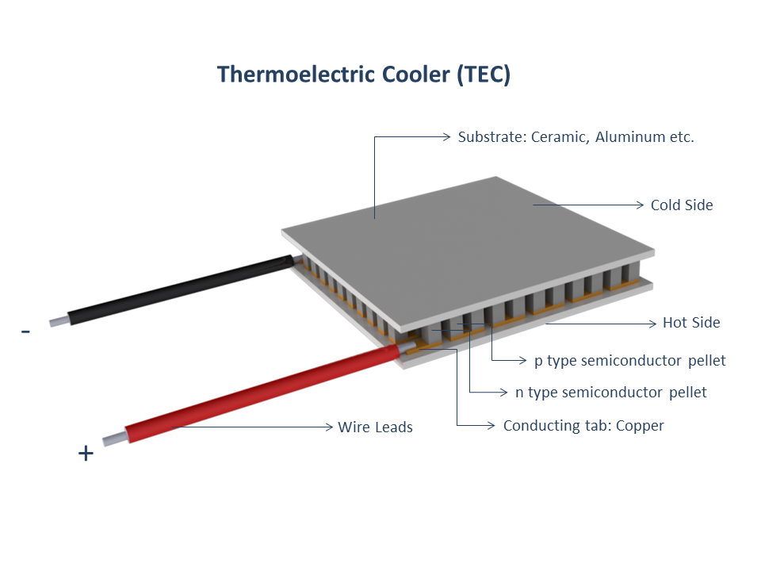
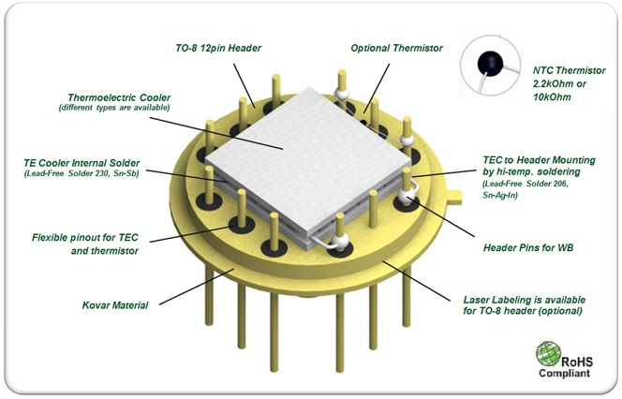
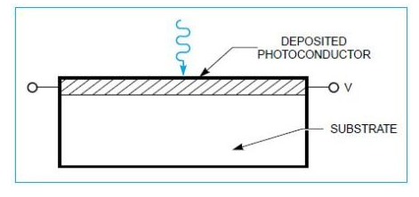
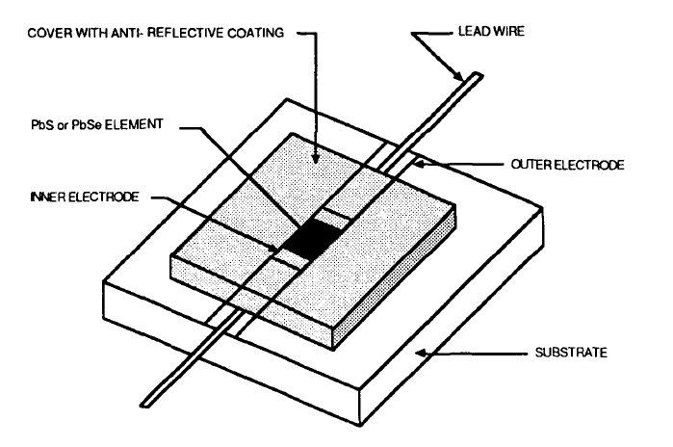
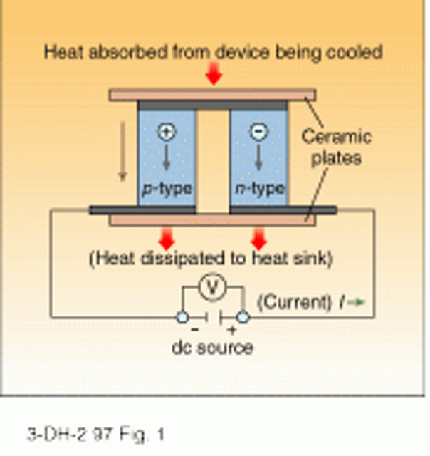
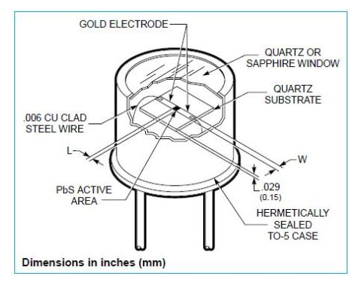

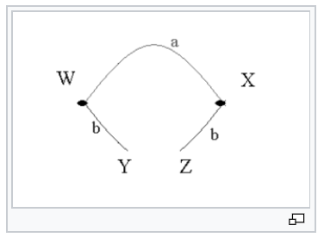
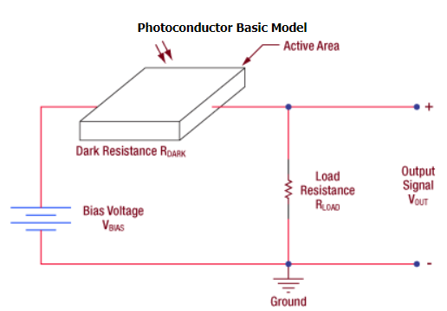


PbS cooled infrared detector
Introduction
Material
Thin film of PbS
Electrical leads
Substrate
Thermoelectric cooler
The electrical conductivity of photoconductive detectors is changed by the free-charge carriers generated by absorbed incident photons. A current starts flowing due to an applied voltage or bias. The current flow varies in proportion to the photon irradiance. Lead selenide and lead sulfide detectors fall into this category of detectors. This concept is shown in Figure .
PbS and PbSe detectors are constructed through chemical deposition of polycrystalline film on a quartz substrate. Gold electrodes are plated to the film edges to provide electrical contact, and the entire assembly is sealed within a package with a suitable window, quartz or sapphire. A typical lead salt detector is depicted in Figure.
Thermoelectric cooling uses the Peltier effect to create a heat flux at the junction of two different types of materials. The Peltier effect is a thermoelectric effect consisting of a phenomenon of heat displacement in the presence of an electric current. The effect is made in conductive materials1 of different types by contacts (contacts). One of junctions then, while the other was warming up. The figure shows the basic thermoelectric circuit.
Two conductive materials of different natures a and b are connected by two junctions in X and W. In the case of the Peltier effect, an electric current I is imposed on the circuit, by placing for example a source of electric current between Y and Z resulting in heat release Q at one junction and heat absorption at the other junction2. The Peltier coefficient relative to the material pair a and b is defined as the thermal power P released or absorbed per unit of intensity of current I. It is expressed in volts.
Π_{ab} is then defined by:
  Theory of Operation
For photoconductive materials, incident light will cause the number of charge carriers in the active area to increase, thus decreasing the resistance of the detector. This change in resistance leads to a change in measured voltage, and hence, photosensitivity is expressed in units of V/W. An example operating circuit is shown.
If a current imposed in the direction Y → W → X → Z causes a heat release in W and an absorption in X, then Π_{ab} is positive.
Sapphire window
Heat sink
Header is made of Kovar material
Supplier material
The detection mechanism is based upon the conductivity of the thin film of the active area. The output signal of the detector with no incident light is defined by the following equation:
A change ΔV_{OUT} then occurs due to a change ΔR_{Dark} in the resistance of the detector when light strikes the active area:
Siham Aisha August/2019

