Slide 1




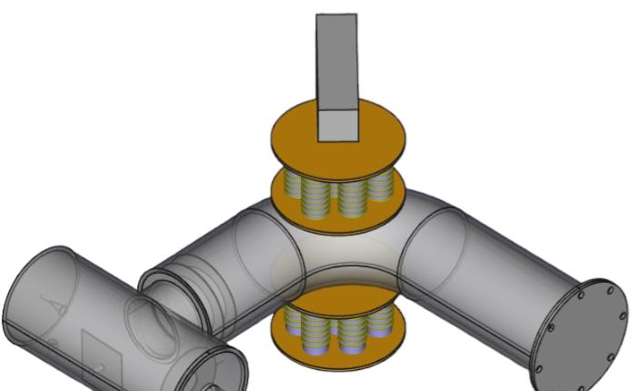
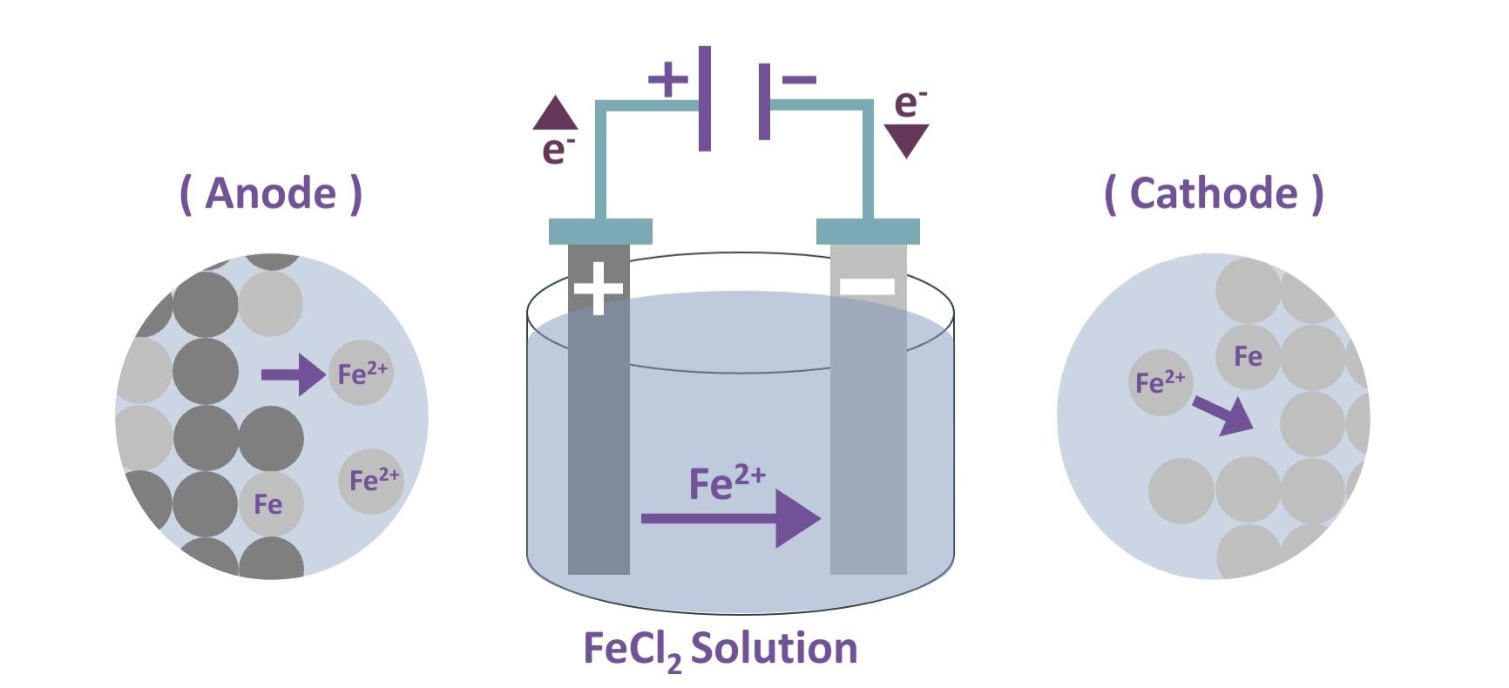
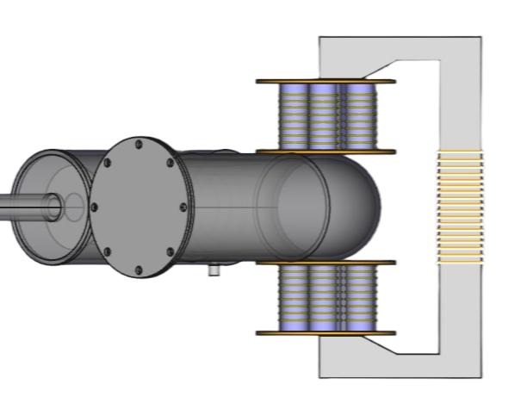
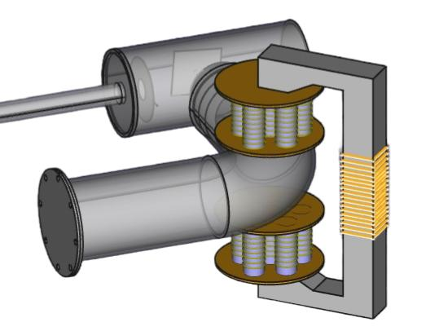
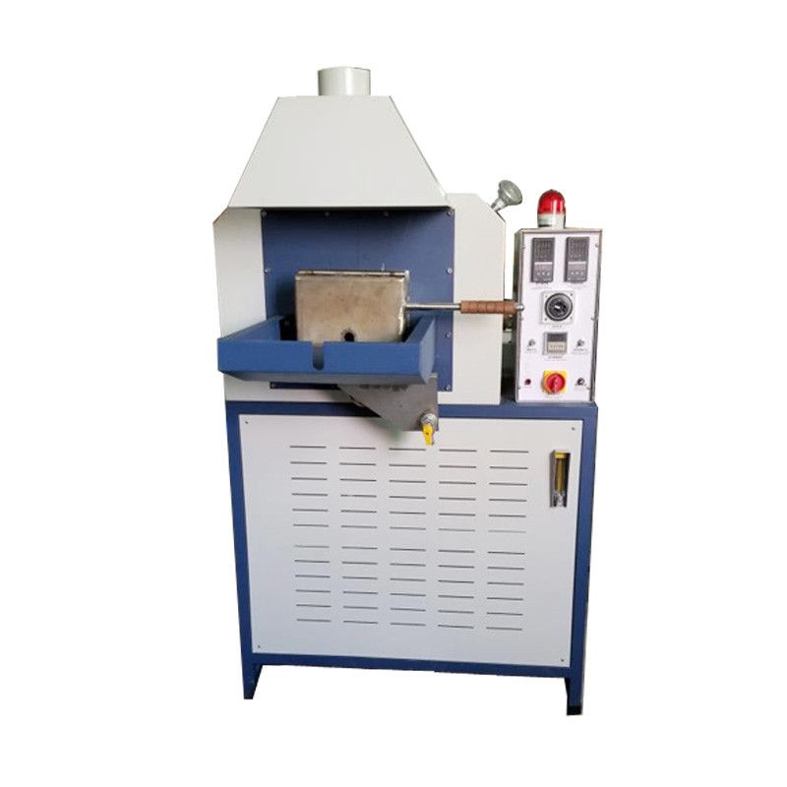
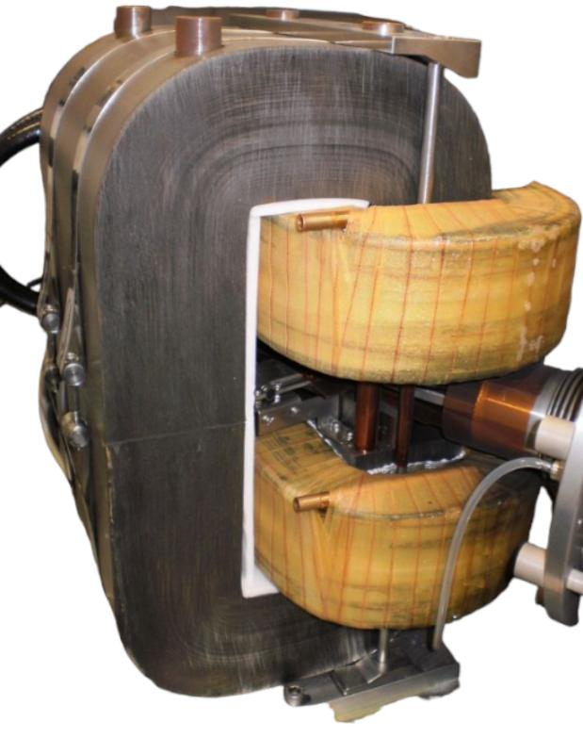
Creating an electromagnetic coil for conducting tests on heavy ions (toxic metals)
System Requirements
Coil Design
For Purification:
We have 2 identical units up and down to perform a uniform strong magnetic field
Each unit contains
7 solenoids with a purified iron core (cylinderical shape 20×100mm) and 70 turns of copper (2mm)
Electrolysis Cell: Container made of acrylic
Power Source: DC power supply
Anode: Impure Iron rod
Electrolyte Solution: FeCl₂ Solution
5. Cathode: Thin sheet of pure iron
Magnetic field intensity is given by Biot Savart’s Law as:
In order to remove impurities from the iron, we use an electrolysis cell.
The impure iron serves as the anode,
while on the cathode side, we use another iron that will be purified.
μNI
B=
2L
(Cosθ₁ + Cosθ₂)
B: magnetic field intensity in Tesla (T)
μ: permeability of the core in Henry per meter (H/m)
N: number of turns of the solenoid
I: electrical current in Ampere (A)
L: length of the coil in meter (m)
The process known as
Electrolytic Refining Method
θ₂
θ₁
L
Biot-Savart Law
For Annealing:
The magnetic field intensity required for the analyzer in our mass spectrometer
is ~ 0.2 T along 14 cm
We inspired the design idea from this model below
Iron bar
Ethanol
Nitrogen gas
Muffle furnace
Temperature
Controlling
For the process, purge the nitrogen gas in the furnace and set it between 800 and 850°C,
then put the iron inside it until reaches the target temperature,
and let it there for 1 hour,
finally turn off the furnace and let the iron cooled slowly and normally.
Image Source: WIKIMEDIA COMMONS
Omar Zreika & Majd El Moussa @AECENAR/ June 2024

