Slide 1

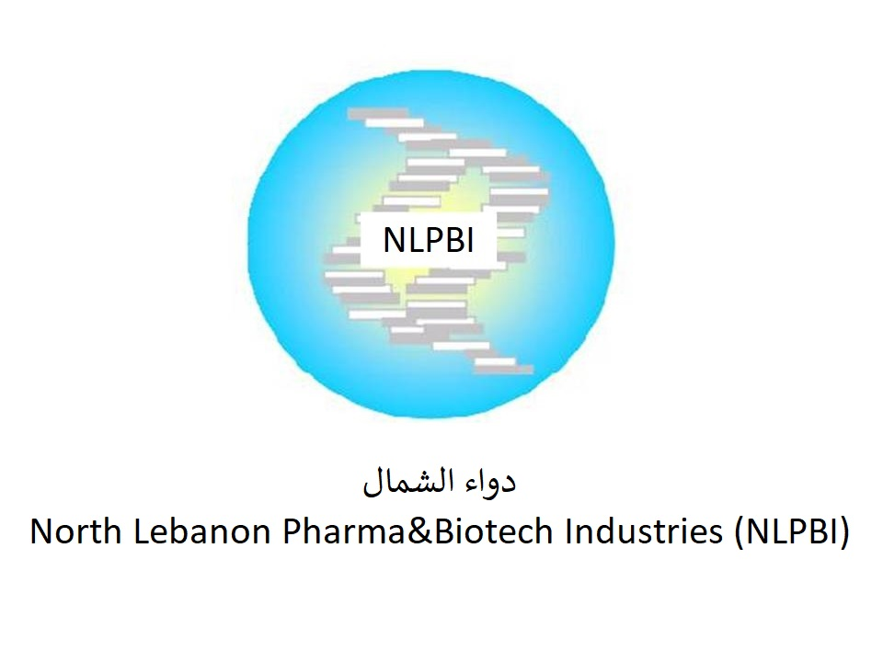
Tripoli/Lebanon
Aspirin Production
Penicillin / Ampicillin Production
Chemicals Materials Production
Addresses
German Branch: Im Klingenbühl 2/1, 69123 Heidelberg, Germany
Lebanese Branch: Bahsas, Haykalieh Str., Harba Bld., Ground Flr., Tripoli, Lebanon
Contact
Dr. Samir Mourad, CEO
Mobile +49 178 72 855 78 (WhatsApp) / +961 76 341 526
Email: samir.mourad@temo-group.com
Mohammad Qalawun
Mobile +961 70 834 012 (WhatsApp)

Slide 2

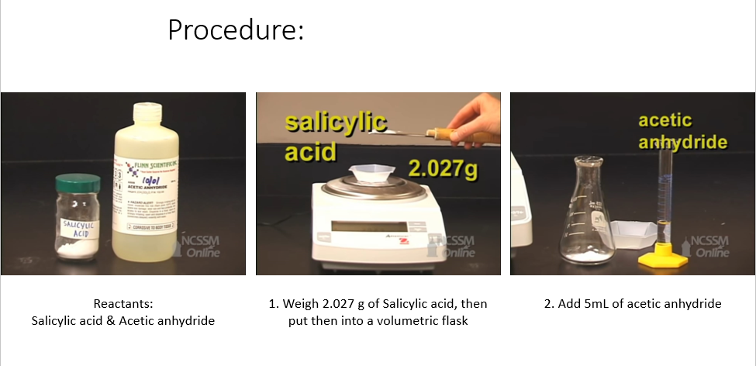
Aspirin Production

Slide 3
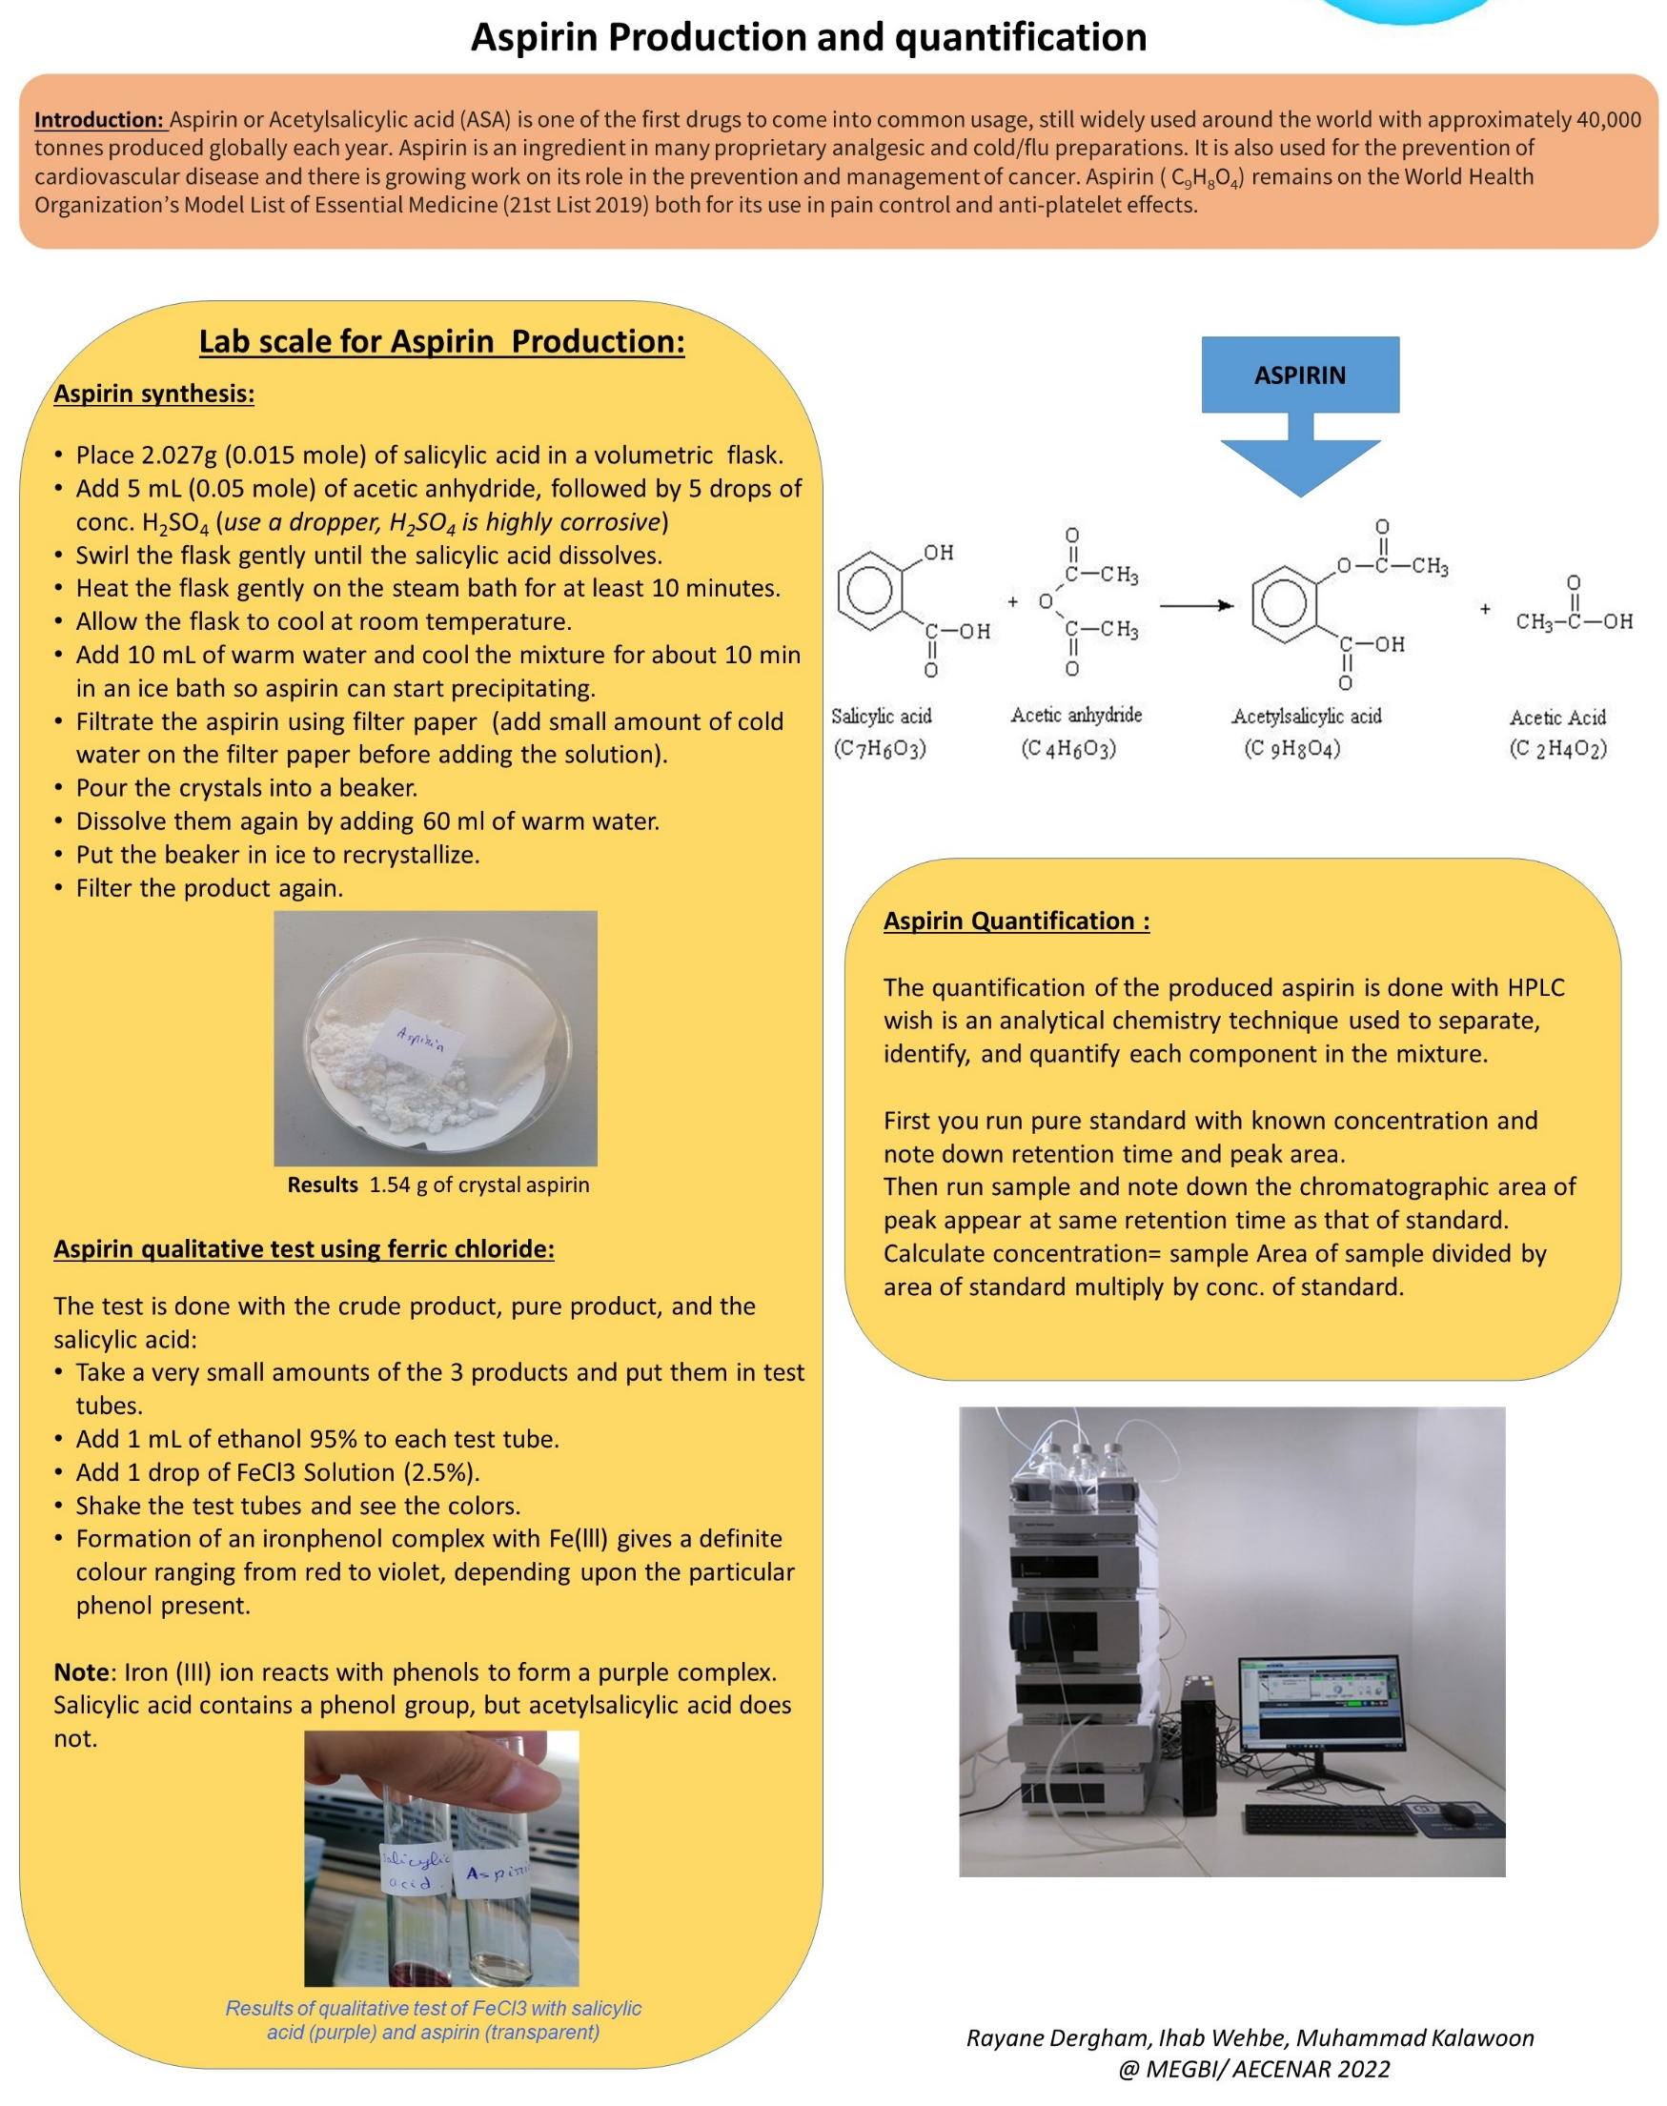
Aspirin Production

Slide 4
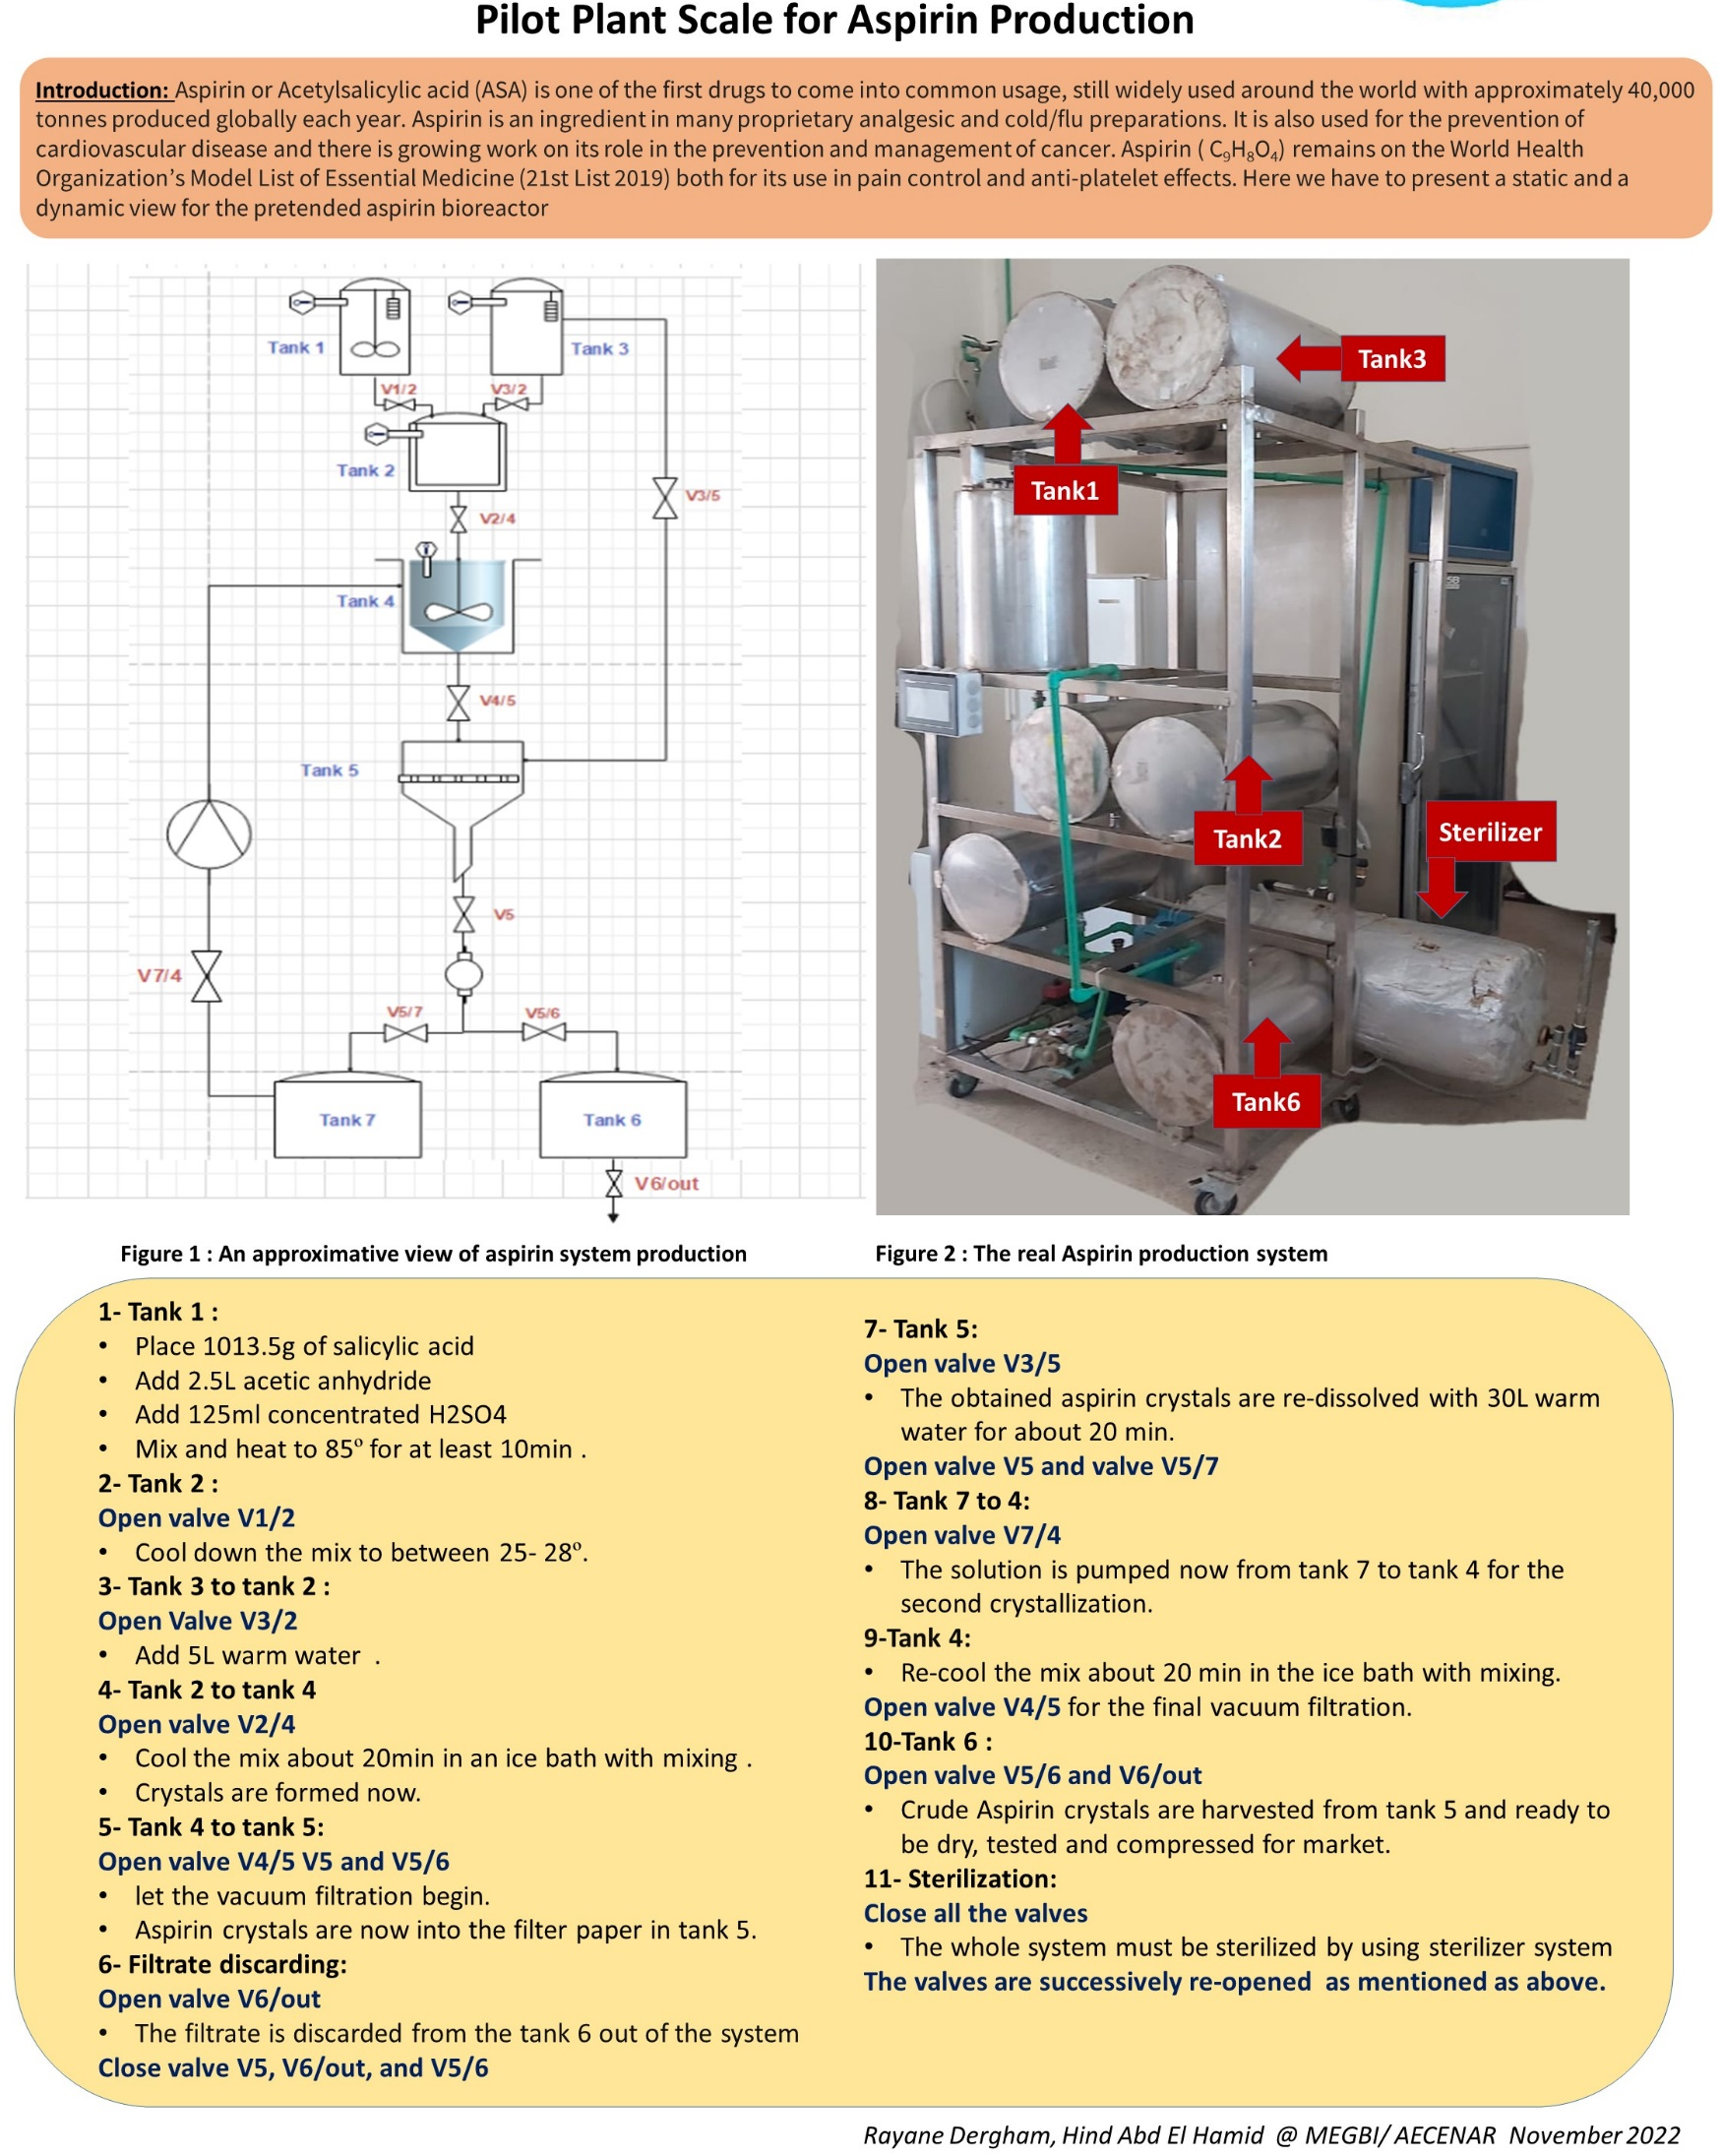
Aspirin Production

Slide 5
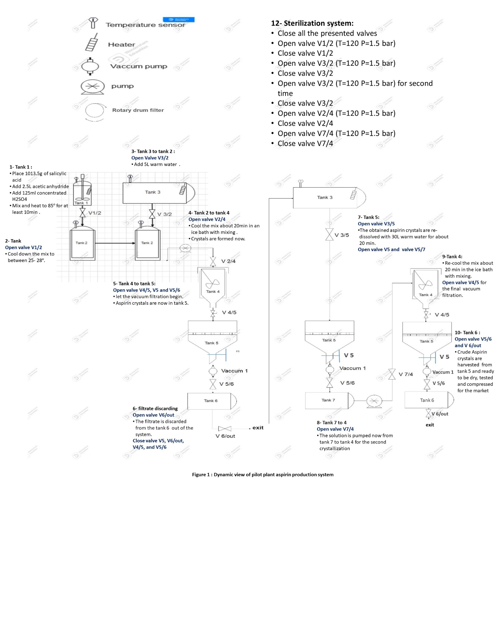
Aspirin Production
28-12-2022_Dynamic view of pilot plant scale aspirin production.pptx

Slide 6
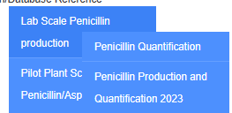
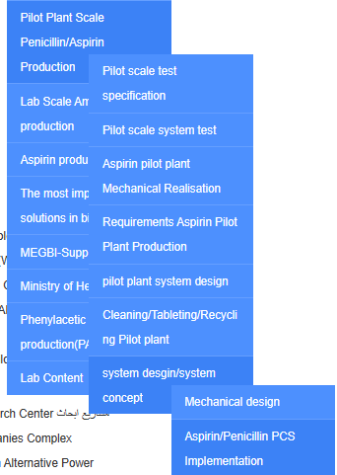
Penicillin Production
Lab Scale Production
Pilot Plant Scale Production

Slide 7
Ampicillin Production

Slide 8
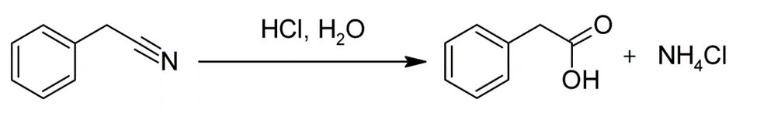

Chemicals Materials Production
Phenylacetic acid production (PAA-precursor):
Phenylacetic acid (PAA) is the precursor needed for a high yield of penicillin G production according to the latest studies, so as per its importance, we are working on its local production.
Phenylacetic acid production(PAA-precursor) (aecenar.com)
Different methods of production:
Method 1 – Benzyl cyanide
*Reagents and Apparatus:
Benzyl cyanide
Hydrochloric acid
Vacuum distillation apparatusSuction filtration apparatus
Four necked flask (1000 mL)
Reflux condenser
Thermometer
Dropping funnel
Method 2 - Mandelic Acid (A)
Reagents and Apparatus:
Mandelic acid
Potassium iodide (KI)
Red phosphorous
Phosphoric acid
Reflux apparatus
Ether (for extraction)
Separatory funnel
Dilute NaHSO₃
Na₂SO₄
Vacuum distillation apparatus
Method 3 - Mandelic Acid (B)
Method 4 - Acetophenone
Method 5 - Styrene
In cooperation with
Green Chemistry

Slide 9
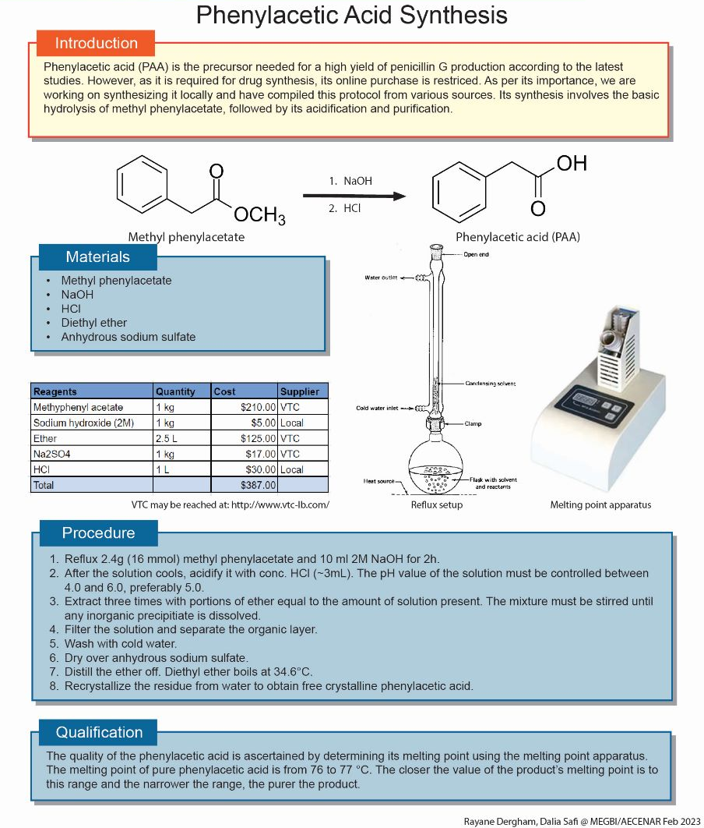
Chemicals Materials Production
In cooperation with
Green Chemistry

Slide 10
Chemicals Materials Production
Basic materials for Aspirin production:
Salicylic acid
Acetic anhydride
Aspirin production:
In cooperation with
Green Chemistry

